Slide 1

Voice in a Digital Broadband World
Kevin Werbach
Supernova Group LLC
kevin@werbach.com
FCC VOIP Forum
December 1, 2003

Slide 2
A Change of Perspective
Cable
Traditional View
Broadcast
Telephony
Data
Wireless

Slide 3
A Change of Perspective
Cable
Current View
Data
Broadcast
Telephony
Wireless

Slide 4
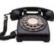
A Change of Perspective
Reality
Data
Content
Web
Devices
Voice
Apps
Users
Video
Email
File
Transfer
Cable
Wireless
Satellite
Fiber

Slide 5
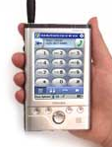


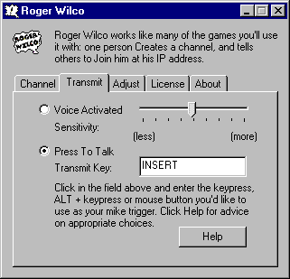
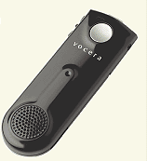
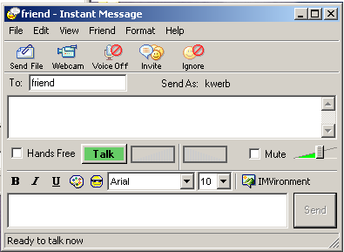
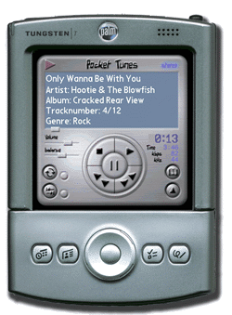
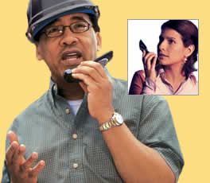
These Count as Phones?

Slide 6
Lessons to Keep in Mind
Voice ≠ POTS telephony
In an end-to-end world, applications are
defined at the edges
Packets are packets
Innovation happens

