Slide 1

Supernova Conference
Jeff Weiner
Senior Vice President
Yahoo! Search and Marketplace
June 21, 2005

Slide 2
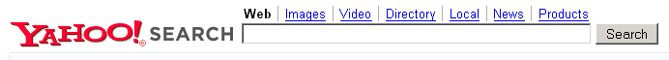
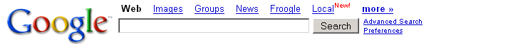

An Exercise in Sizing Knowledge…
QUERY:
“real estate”
Number of Results
real estate
299,000,000
real estate
109,000,000
real estate
105,455,502

Slide 3
An Exercise in Sizing Knowledge…
QUERY:
“Everything I have learned in the past 26 years selling real estate in Larchmont, NY that can be used to create value for first time home buyers”
Number of Results
“Everything I have learned in the past 26…
0
“Everything I have learned in…
0
“Everything I have learned in the…
0

Slide 4
An Exercise in Sizing Knowledge…
10 pages per subject
5,000 subjects per person
50,000 pages per person
7,000,000,000 people
350,000,000,000,000 pages
8 billion pages indexed / 350 trillion pages = .0023%

Slide 5
Sensitivity Analysis
Number of Pages per Person
50
500
5,000
50,000
500
25,000
250,000
2.5 Million
25 Million
290,000,000
14.5 Billion
145 Billion
1.45 Trillion
14.5 Trillion
Number of People
7,000,000,000
350 Billion
3.5 Trillion
35 Trillion
350 Trillion

Slide 6
Sensitivity Analysis
Number of Pages per Person
50
500
5,000
50,000
500
25,000
250,000
2.5 Million
25 Million
290,000,000
14.5 Billion
145 Billion
1.45 Trillion
14.5 Trillion
Number of People
7,000,000,000
350 Billion
3.5 Trillion
35 Trillion
350 Trillion

Slide 7
The Challenge
Today’s Search Is a
Representative Democracy
Without a Fair Election Process

Slide 8
How Do We Enable More People to Participate?
Provide easy to use technology that enables people to publish and “vote”
Provide the right incentives
  Personal, i.e., utility
  Social, i.e., authority
  Economic, i.e., $$$

Slide 9
Yahoo! Search Vision
Enable people to find, use, share and expand all human knowledge
Find: Enable people to find what they are looking for
Find: Enable people to find what they are looking for
Use: Search not for sake of searching, but to achieve a purpose
Use: Search not for sake of searching, but to achieve a purpose
Share: Sharing knowledge with people you connect with and
connecting to people who you share knowledge with
Share: Sharing knowledge with people you connect with and
connecting to people who you share knowledge with
Expand

Slide 10
Yahoo! Search Vision
Enable people to find, use, share and expand all human knowledge

Slide 11
FUSE
fuse (fy^{oo}z)
verb fused, also fus•ing, fus•es
To become mixed or united by melting together
fusion (fy^{oo} zh^{ų}n)
noun
A reaction in which nuclei combine to form massive nuclei with the simultaneous release of energy
Knowledge Fusion:
Enable people to find, use, share and expand all human knowledge

Slide 12
Yahoo! Search Mission
Provide the world’s most valued and trusted search experience for
users, publishers, and advertisers

Slide 13
The Web: A Play in Three Acts
Public
ACT I
e.g., Web search
Personal
ACT II
e.g., Desktop search
Shared
ACT III
e.g., Search communities

Slide 14
FUSE: My Web

Slide 15
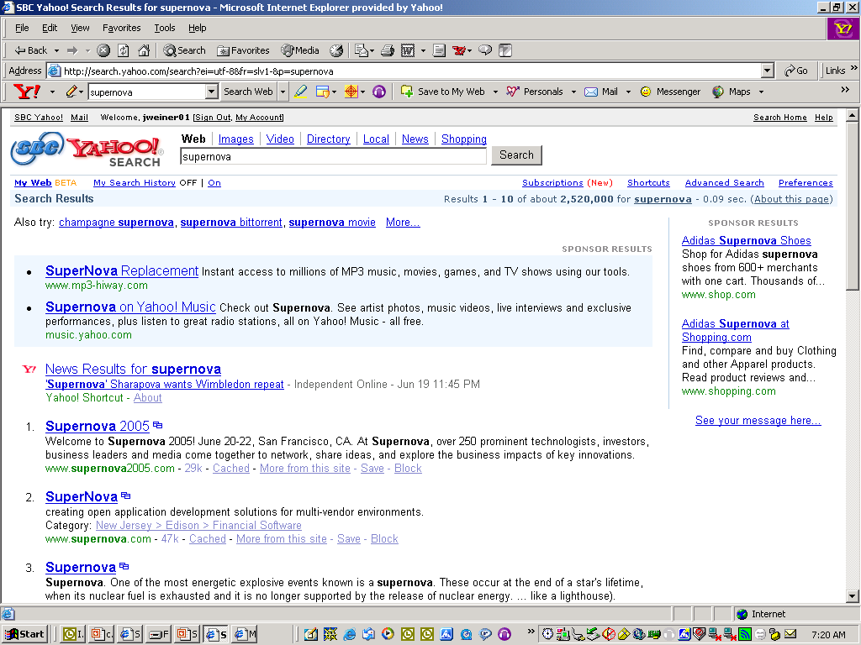

Slide 16
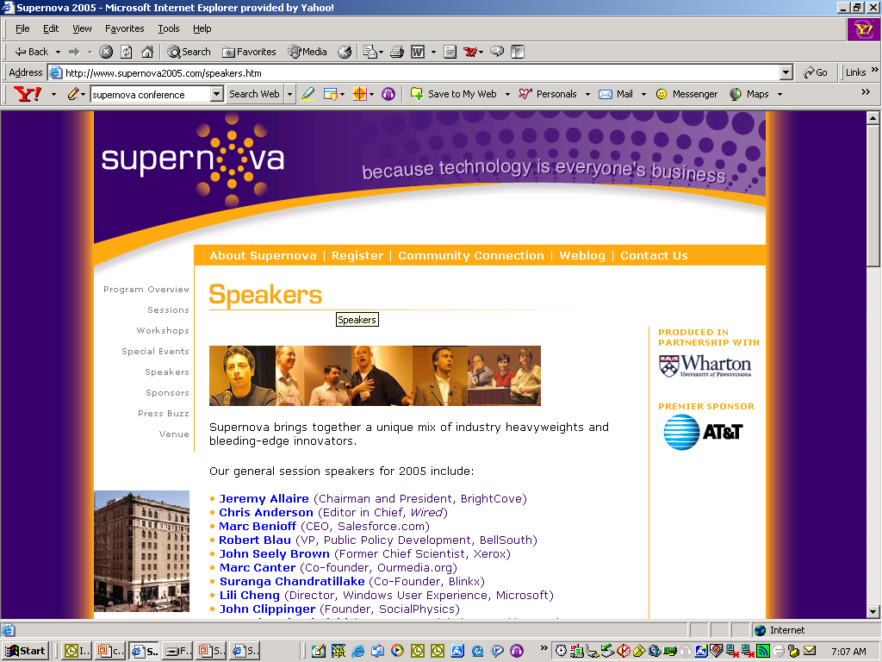

Slide 17
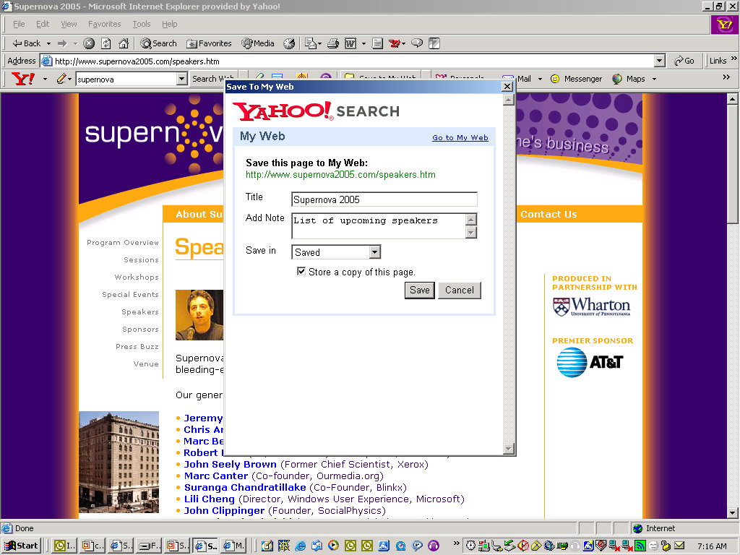

Slide 18
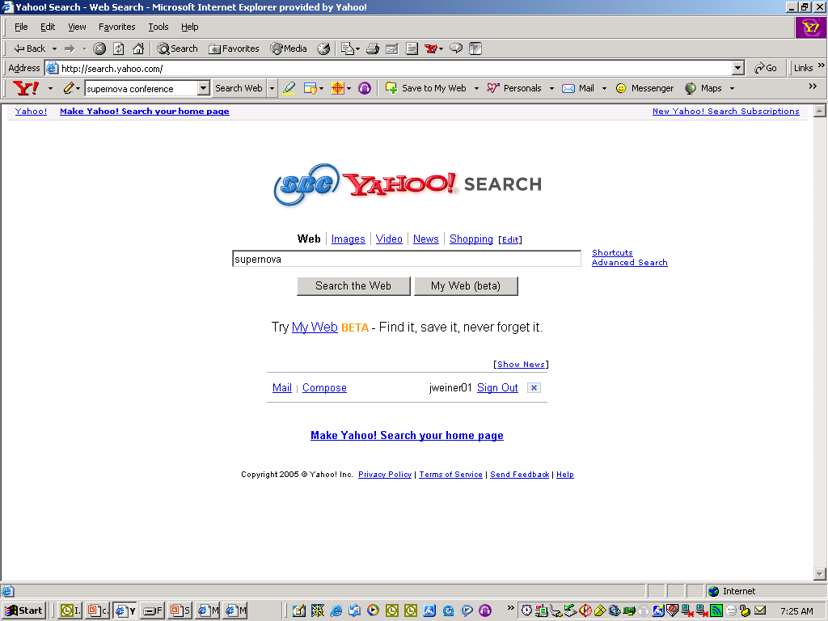

Slide 19
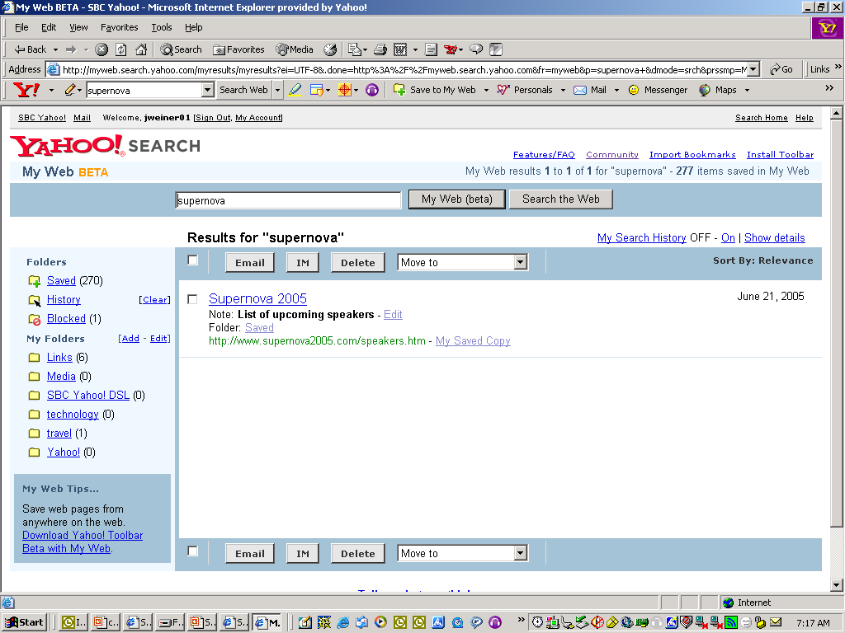

Slide 20
FUSE: Local / 360

Slide 21
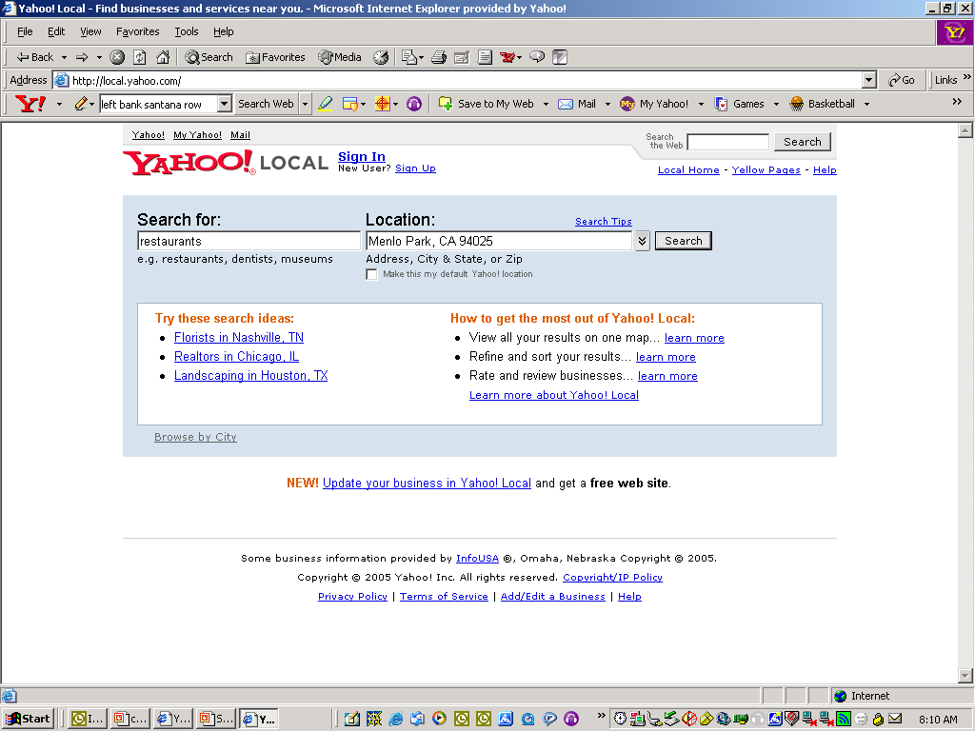

Slide 22
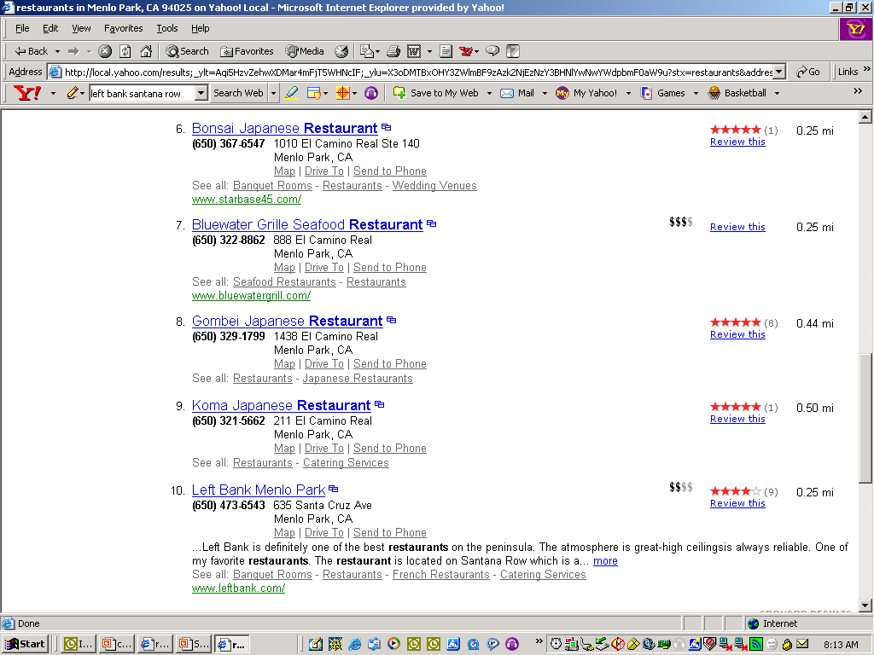

Slide 23
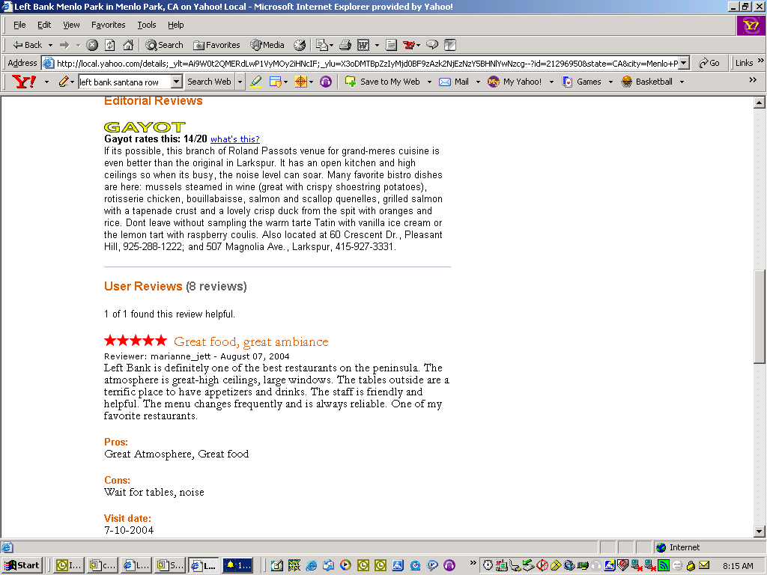

Slide 24
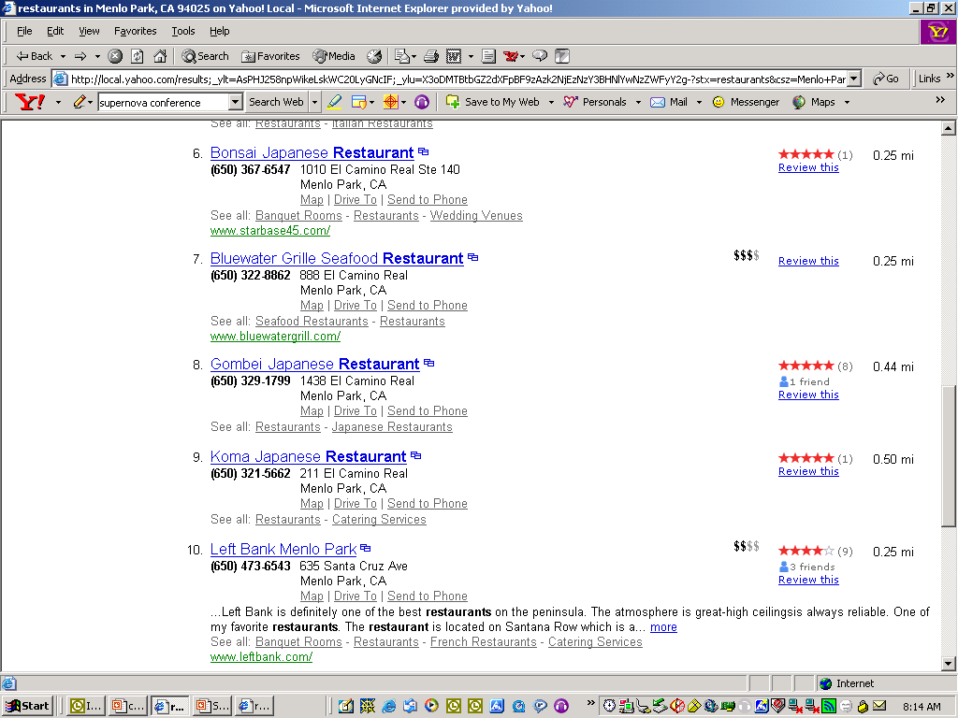

Slide 25
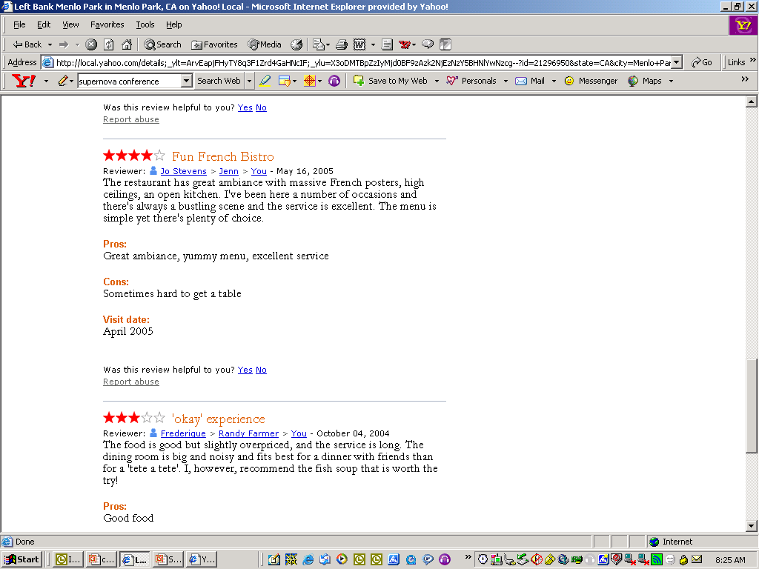

Slide 26


Slide 27
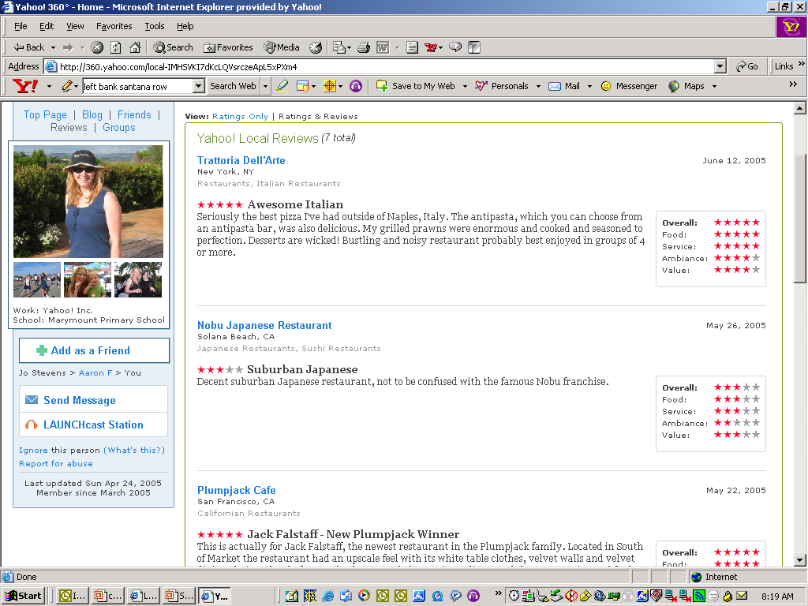

Slide 28
FUSE: Flickr

Slide 29


Slide 30
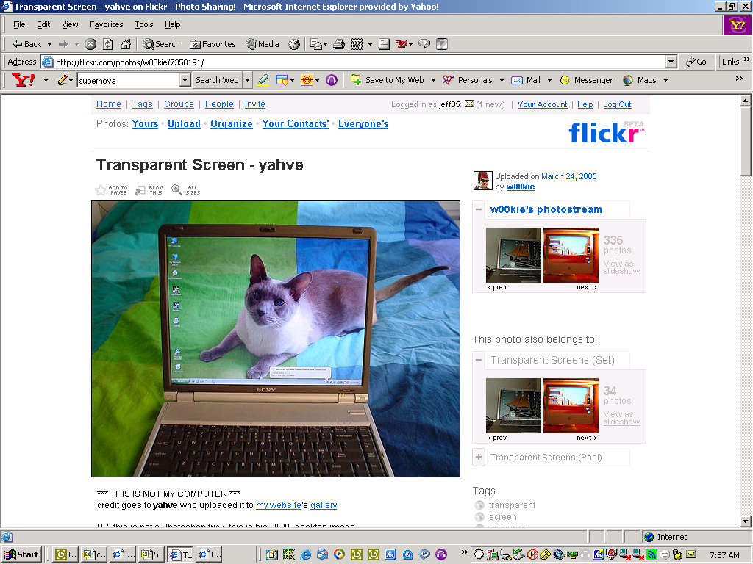

Slide 31
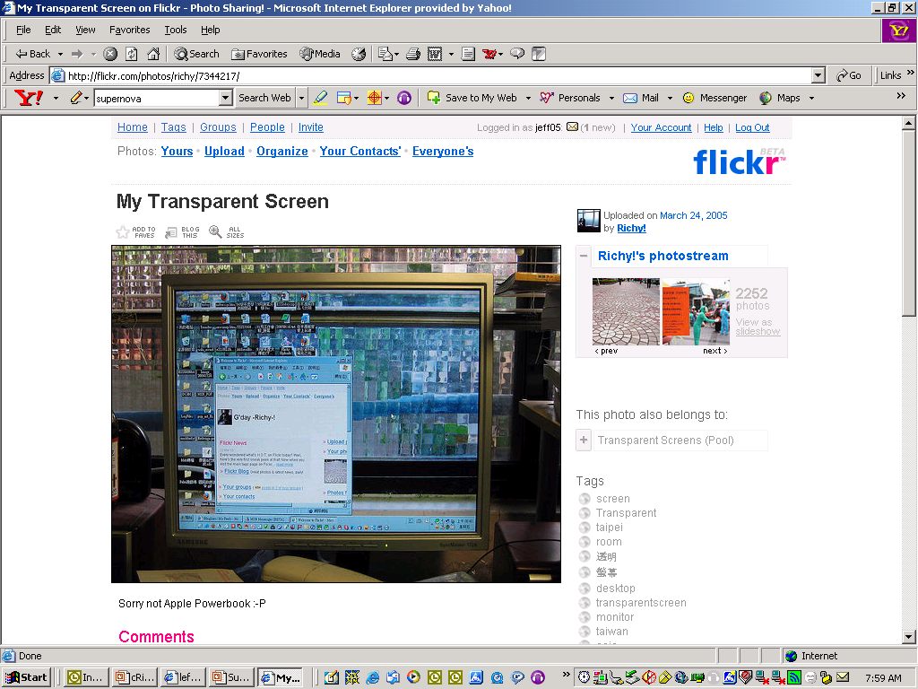

Slide 32
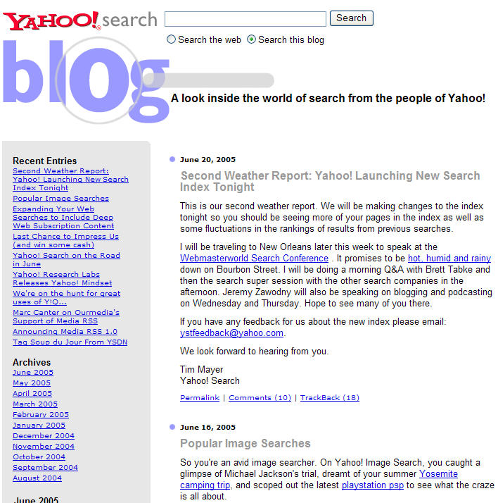
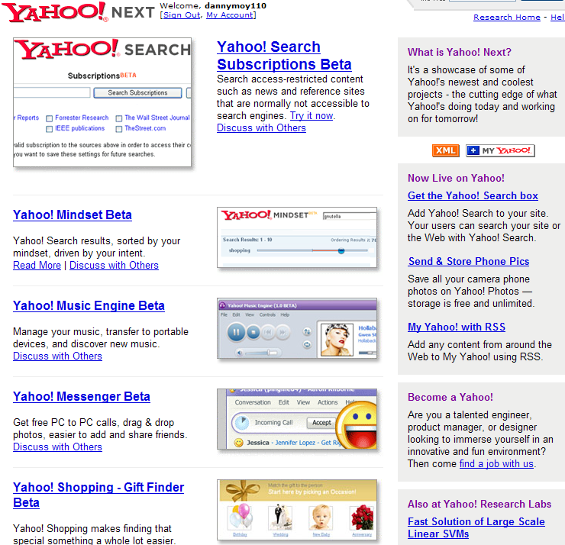
The Best is Yet To Come…
ysearchblog.com
next.yahoo.com

