Slide 1


Slide 2
No functional perspective
Little or no dynamics
No human behavior

Slide 3
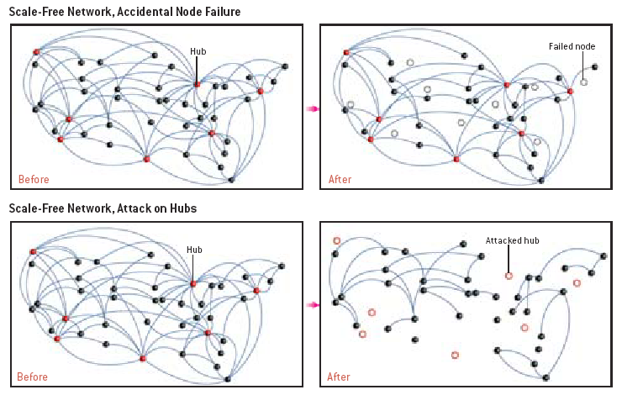
From Barabasi & Bonabeau, Scientific American, May 2003

Slide 4
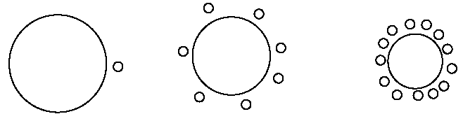
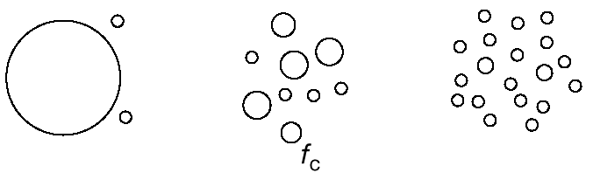
Failures
Attacks

Slide 5
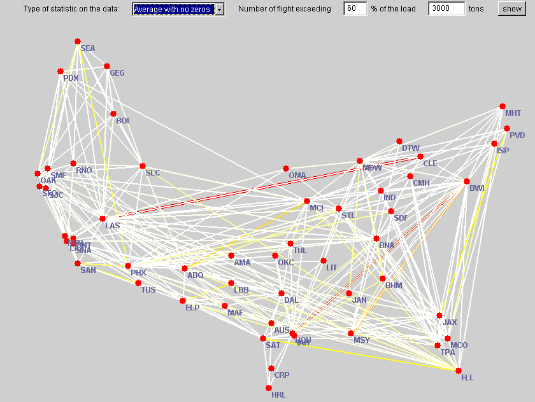
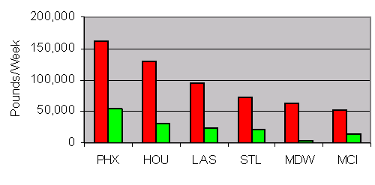
Southwest Airlines Cargo routing
Problem: scale-free network affected by congestion and delays/cancellations at hubs. Can one make the network more robust to unexpected events –weather-related in particular?
Network topology is a given… Routing rules can be changed. Client wants simple and efficient rules which will be followed by ramp personnel.
Yes: 75% improvement!

Slide 6
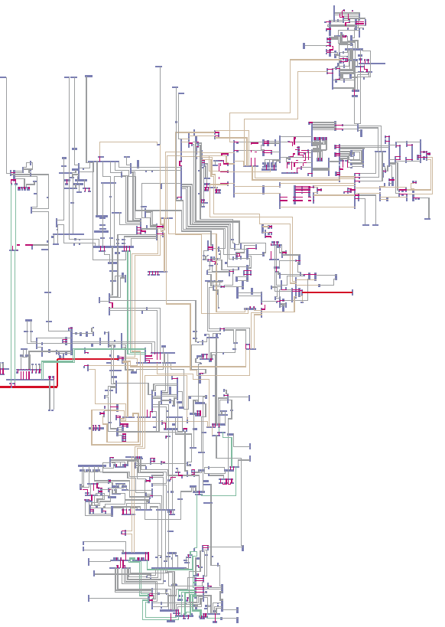
(US) power grids are not scale free: removing any node from the network does not destroy connectivity.
But their function emerges from a highly complex set of interdependent algorithms, sometimes resulting in cascading events leading to catastrophic failure.
New York State power grid, From Strogatz, Nature, 2001

Slide 7
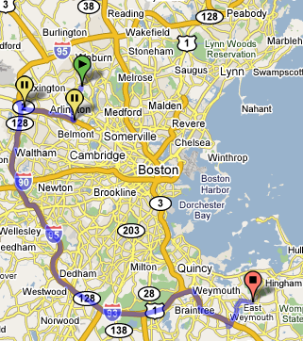
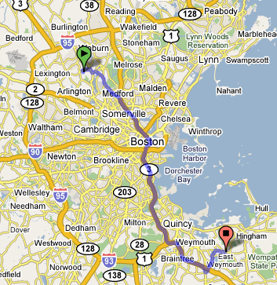
<t>=58 min
Std=10 min
<t>=49 min
Std=45 min (skewed to right)

Slide 8
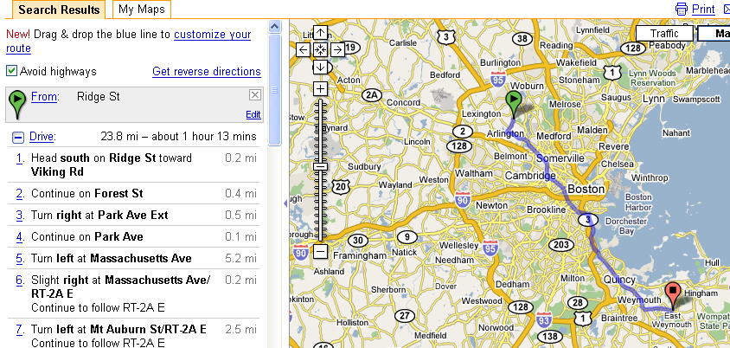
Avoid highways not very helpful
Avoid “hubs” or congestion nodes would be better

Slide 9

The practitioner
The network scientist

Slide 10

http://www.flickr.com/photos/cobalt/34248855/

Slide 11
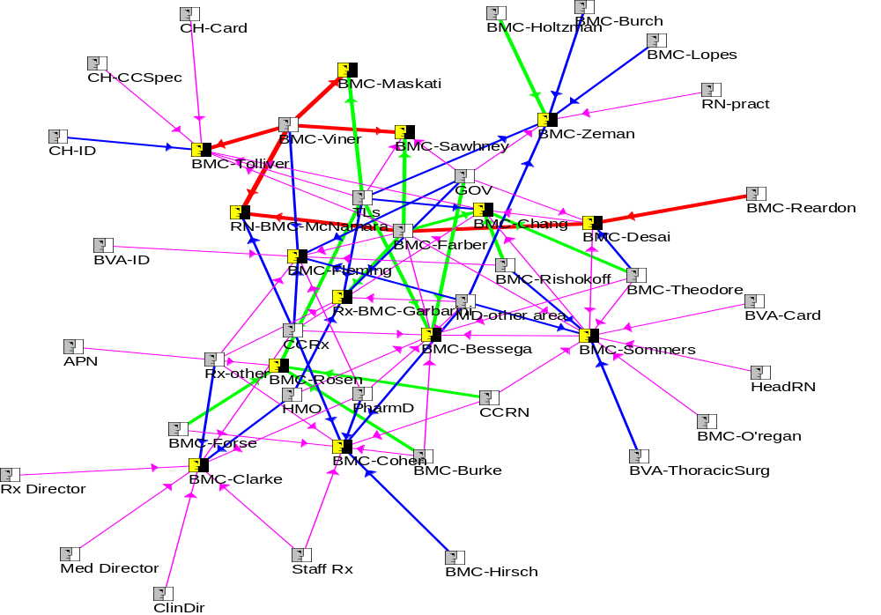
Influence network map for BMC
Strongest influence
Strong influence
Moderate influence
Weak influence
Very weak paths not shown
Study participants

Slide 12
Conclusions
Local is where it is at
Influence communities exist within a market
Relatively small number of key local influencers
Local influencers are Accessible, Approachable, Experienced,
Well Thought Of within the Influence Community
Interactions with the Local influencer tend to be within business
settings in either 1 on 1 or small group settings
Informal consultations and conversations are a key type of a
interaction
Recommended Action
Identify Key Local Influencers
Create interventions that support informal interaction
within the “community of influence”
Implement interventions in partnership with key local influencers

Slide 13
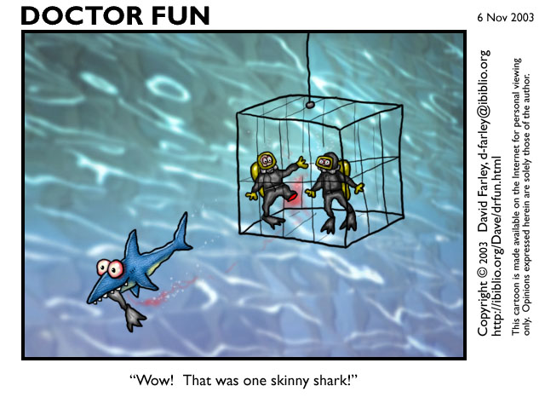

Slide 14
Drivers of prescription
Shift structures for staff.
Patient volume.
Observability of patient benefit.
Numbers of attending physicians
Socializing opportunities.
Physical layout of building.
VERY STRONG ++++
STRONG +++
STRONG +++
MODERATE ++
MODERATE ++
WEAK +

Slide 15
Ranked by Quota | Ranked by Sales Velocity | Ranked by Model
Northwestern | U Chicago | U Chicago
Christ | MGH | MGH
MGH | BMC | BMC
Stroger | Christ | Christ
B&W | B&W | B&W
U Chicago | Northwestern | Northwestern
IMH | Stroger | IMH
BMC | IMH | Stroger

Slide 16
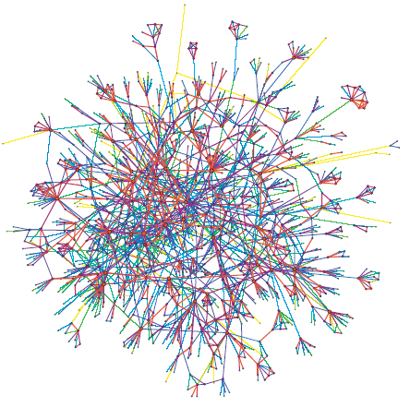
Adoption of mobile services
3.9 million individuals, connected by edges that represent wireless calls.
Weight of an edge: mix of total call duration and number of calls between two individuals over a period of 18 weeks.
3 epidemic parameters: probability of contact with infected individual, probability of infection (if contact with infected), virulence (does infection trigger strong response?)
Network sample where link colors represent weights, from yellow (weak link) to red (strong link)

Slide 17
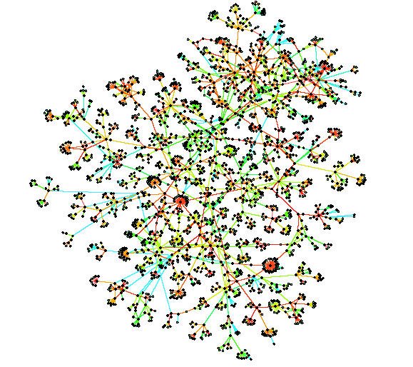
Adoption of mobile services
3 services tested, with a marketing campaign reduced to the description of the service in the monthly newsletter sent to subscribers.
A. Individual-based service: for example, stock quotes
B. Service with a social component: for example, SMS broadcast
C. Service that requires a social network: for example, a friend tracker
 | 1 week | 1 month | 3 months
A | 43000 | 53000 | 57000
B | 31000 | 85000 | 92000
C | 19000 | 77000 | 385000
Example of the diffusion of a service with social component (B) starting from one individual (represented by a square in the middle of the network)

Slide 18
Adoption of mobile services
By controlling for marketing, it is possible to measure the probability of transmission of a service from person to person rather than via marketing.
The level of satisfaction of the 3 services was the same –similar virulence.
The adoption dynamics of services B and C clearly suggest an epidemic effect with a significantly higher probability of infection for service C. Service C combines high virulence and high contact probability, while in service B the probability of contact is lower because contact is not absolutely necessary. Furthermore, the value of service C tends to increase with the number of friend users, thereby creating a virtuous circle for the epidemic.
The adoption dynamics of service A suggest very little epidemic effect, even though virulence is high (that is, individual users like the service). Service A is purely individual and does not contain any invitation (such as Hotmail) to contact friends.
In conclusion, the presence of a strong social component with positive network externality produces not only an acceleration of the adoption curve but also expands the adopter population: the market is bigger, faster.

Slide 19
non viral basket of services
+
inactive viral vector (disconnected from the services)
=
active viral vector
viral basket of services

Slide 20

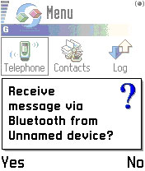
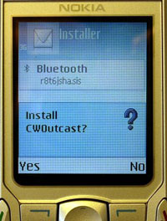
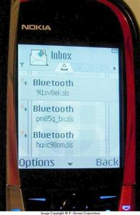

Slide 21
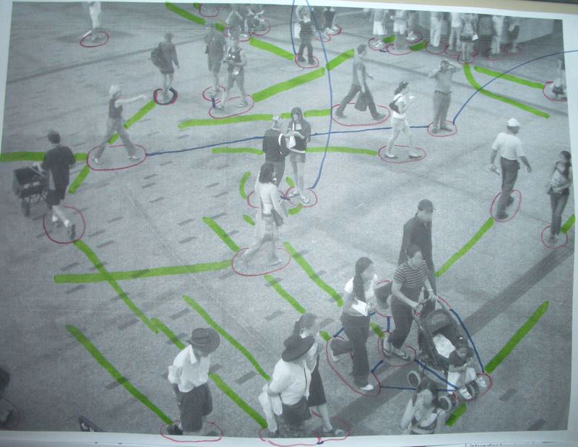

Slide 22
Subscriber Contact Network
One node per Symbian 60 user.
Links represent customers who might come within Bluetooth range of each other at some point during the simulation period.
Notes:
Power law network (scale-free network)
Probability is of an interaction occurring between these two people on any given day.
Most of the people in the network have relatively few contacts, a few of them have most of the contacts
this is a characteristic of most human networks

Slide 23
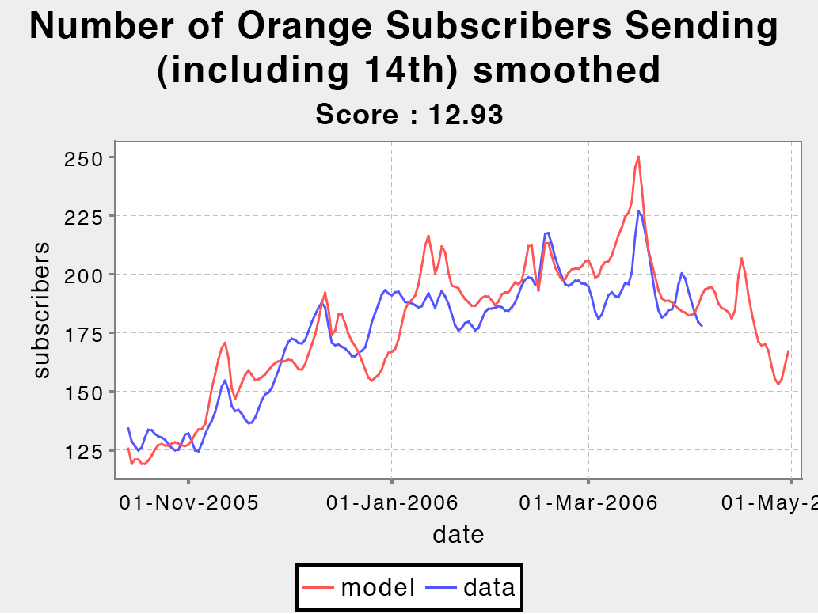

Slide 24
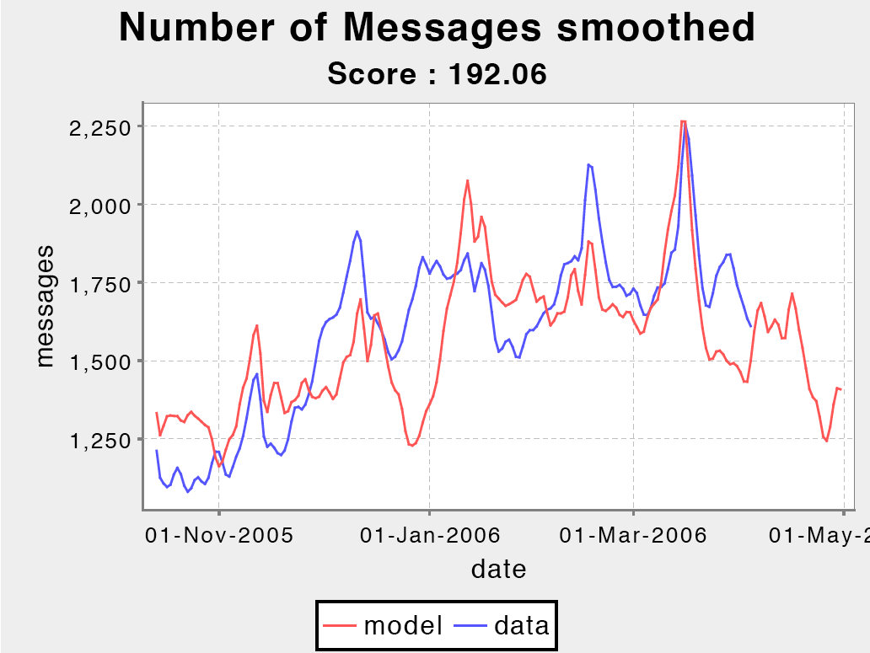

Slide 25
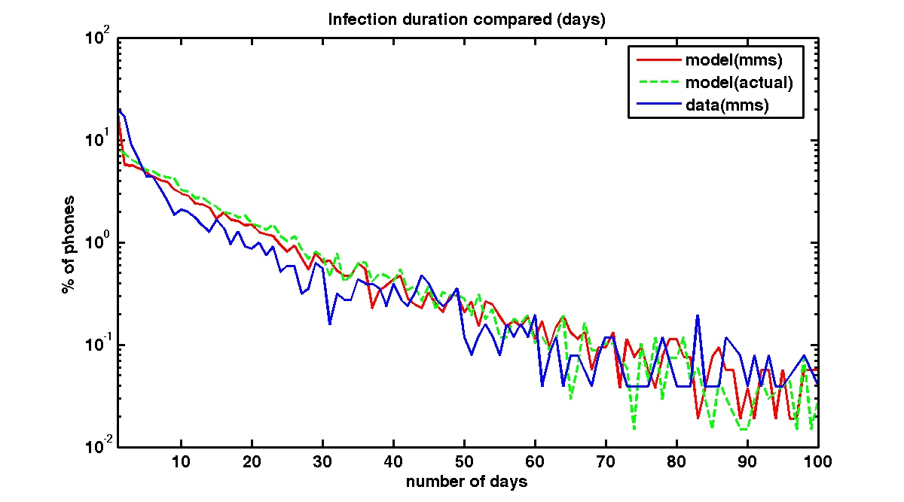

Slide 26
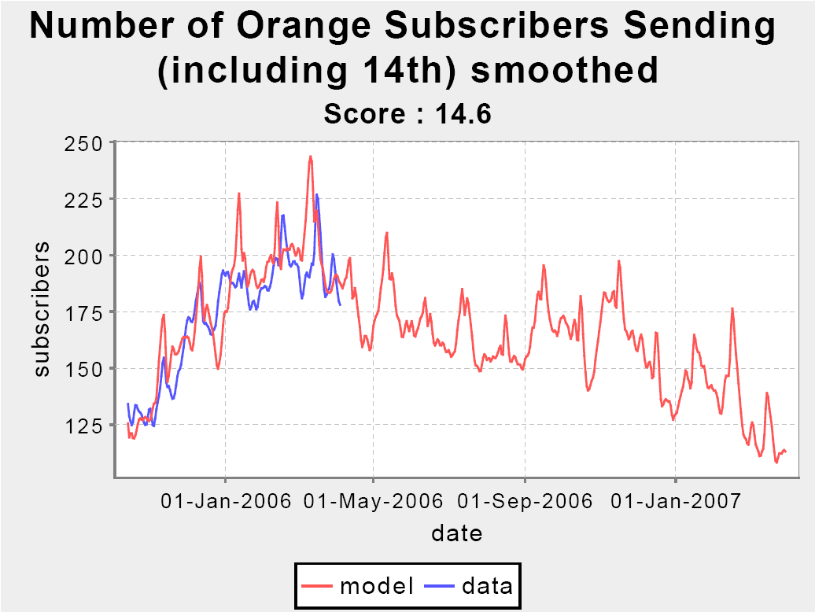
Actionable insight #1

Slide 27
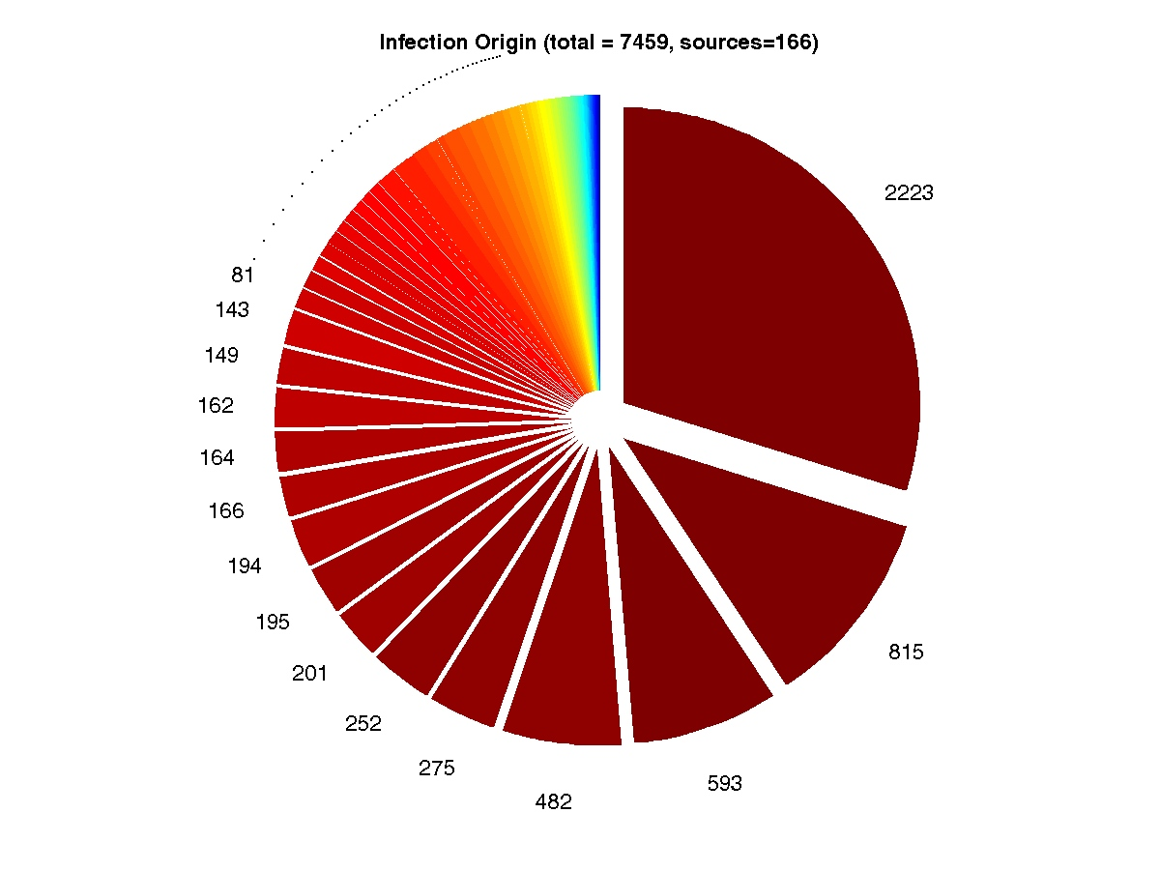
Actionable insight #2

Slide 28
Take Away
      Need to understand, model and measure network and user behavior better.
      Topology is a small piece of the puzzle
      Need to have a theory of Function and structure-function
      Dynamics happens: fluid structure
      Human behavior sucks (but is unavoidable in a human world)

