Slide 1
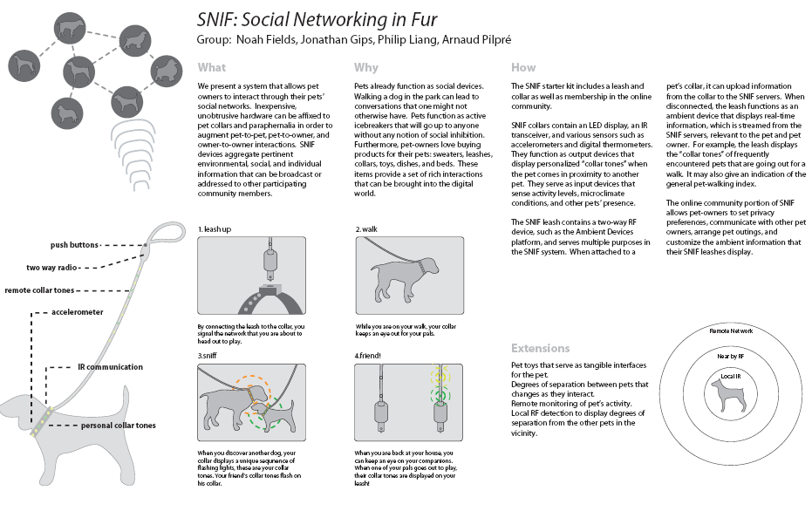


Understanding & Enabling the Network Age
Noshir Contractor
Jane S. & William J. White Professor of Behavioral Sciences
Professor of Ind. Engg & Mgmt Sciences, McCormick School of Engineering
Professor of Communication Studies, School of Communication &
Professor of Management & Organizations, Kellogg School of Management,
Director, Science of Networks in Communities (SONIC) Research Laboratory
nosh@northwestern.edu
SONIC
Advancing the Science of Networks in Communities

Slide 2
Aphorisms about Networks
Social Networks:
  Its not what you know, its who you know
Cognitive Social Networks:
  Its not who you know, its who they think you know.
Knowledge Networks:
  Its not who you know, its what they think you know.
SONIC
Advancing the Science of Networks in Communities

Slide 3
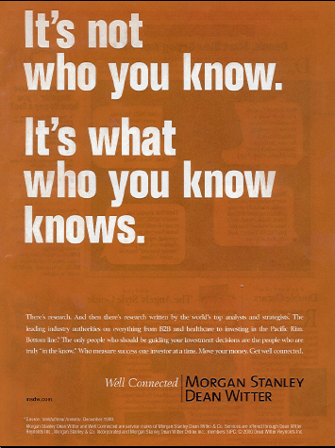
Cognitive Knowledge Networks
SONIC
Advancing the Science of Networks in Communities

Slide 4


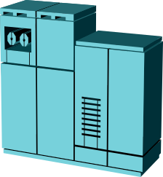




INTERACTION NETWORKS
Non Human Agent to
Non Human Agent
Communication
Non Human Agent
(webbots, avatars, databases,
“push” technologies)
To Human Agent
Publishing to
knowledge repository
Retrieving from
knowledge repository
Human Agent to Human Agent
Communication
SONIC
Advancing the Science of Networks in Communities

Slide 5
COGNITIVE KNOWLEDGE NETWORKS
Non Human Agent’s
Perception of Resources
in a Non Human Agent
Human Agent’s Perception of
Provision of Resources in a
Non Human Agent
*
Non Human Agent’s Perception of what a Human Agent knows
Human Agent’s Perception of
What Another Human Agent
Knows
* … Why Amazon thinks I am pregnant & Tivo thinks I am gay ….

Slide 6
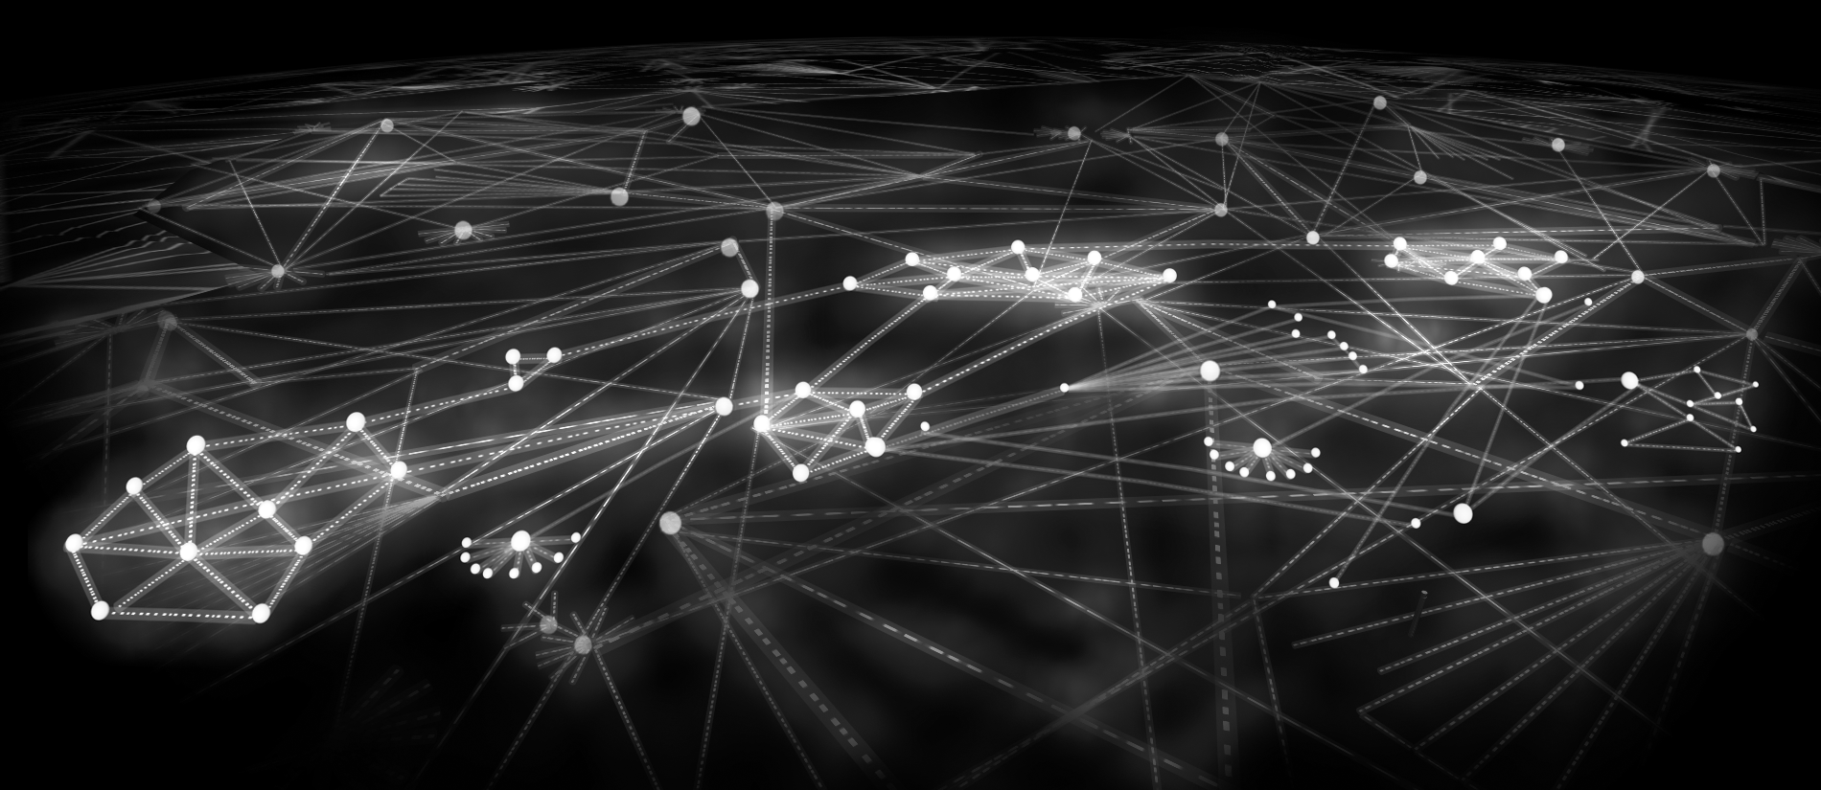
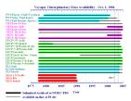
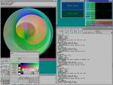







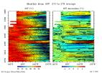





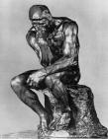

















Multidimensional Networks in Web 2.0
Multiple Types of Nodes and Multiple Types of Relationships
Multidimensional Networks
Multiple Types of Nodes and Multiple Types of Relationships

Slide 7
WHY DO WE
CREATE,
MAINTAIN,
DISSOLVE, AND RECONSTITUTE OUR COMMUNICATION AND KNOWLEDGE NETWORKS?
SONIC
Advancing the Science of Networks in Communities

Slide 8
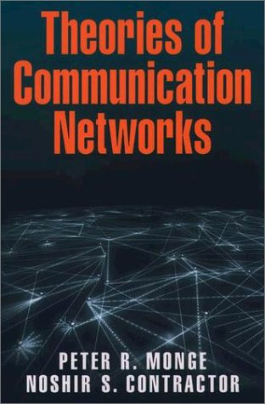
Monge, P. R. & Contractor, N. S. (2003). Theories of Communication Networks. New York: Oxford University Press.
SONIC
Advancing the Science of Networks in Communities

Slide 9
Social Drivers:
Why do we create and sustain networks?
Theories of self-interest
Theories of social and resource exchange
Theories of mutual interest and collective action
Theories of contagion
Theories of balance
Theories of homophily
Theories of proximity
Theories of co-evolution
Sources:
Contractor, N. S., Wasserman, S. & Faust, K. (2006). Testing multi-theoretical multilevel hypotheses about organizational networks: An analytic framework and empirical example. Academy of Management Review.
Monge, P. R. & Contractor, N. S. (2003). Theories of Communication Networks. New York: Oxford University Press.
SONIC
Advancing the Science of Networks in Communities

Slide 10
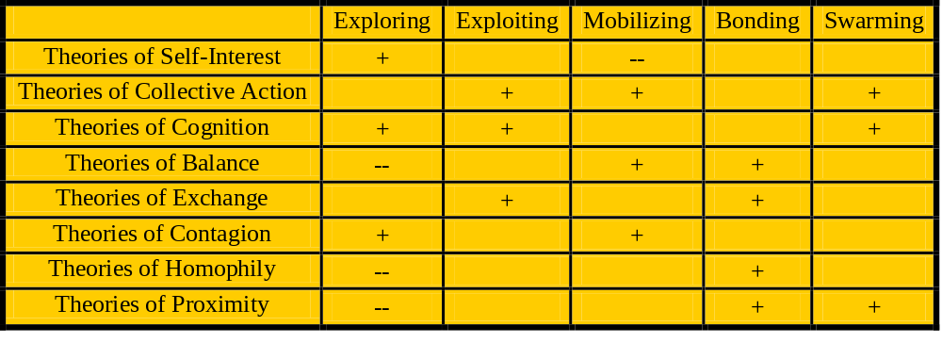
A contextual “meta-theory” of
social drivers for creating and sustaining communities
SONIC
Advancing the Science of Networks in Communities

Slide 11
Projects Investigating Social Drivers for Communities
Science Applications
Nano-IKNOW: Enabling and Evaluating the Network for Computational Nanotechnology (NSF)
CP2R: Collaboration for Preparedness,
Response & Recovery (NSF)
TSEEN: Tobacco Surveillance
Evaluation & Epidemiology
Network (NSF, NIH, CDC)
Business Applications
PackEdge Community of
Practice (P&G)
Vodafone-Ericsson “Club” for virtual supply chain management (Vodafone)
Core Research
Social Drivers for
Creating & Sustaining
Communities
Societal Justice Applications
Cultural & Networks Assets
In Immigrant Communities
(Rockefeller Program on
Culture & Creativity)
Mapping the Digital Media and
Learning Environment
(MacArthur Foundation)
Entertainment Applications
Second Life (Linden Labs)
Everquest 2 (NSF, Sony Online
Entertainment)
SONIC
Advancing the Science of Networks in Communities

Slide 12
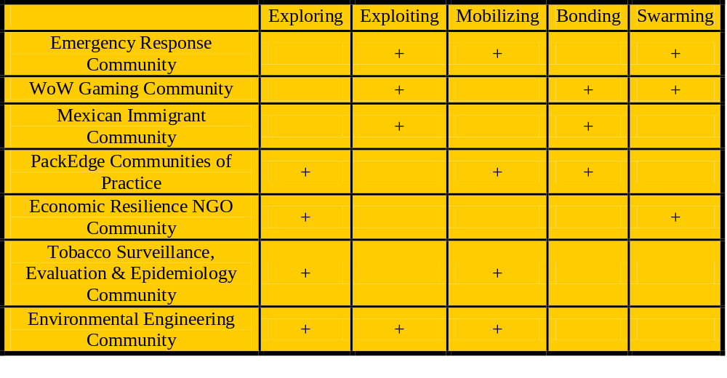
Contextualizing Goals of Communities
Challenges of empirically testing, extending, and exploring theories about networks … until now
SONIC
Advancing the Science of Networks in Communities

Slide 13
Its all about “Relational Metadata”
Technologies that “capture” communities’ relational meta-data (Pingback and trackback in interblog networks, blogrolls, data provenance)
Technologies to “tag” communities’ relational metadata (from Dublin Core taxonomies to folksonomies (‘wisdom of crowds’) like
  Tagging pictures (Flickr)
  Social bookmarking (del.icio.us, LookupThis, BlinkList)
  Social citations (CiteULike.org)
  Social libraries (discogs.com, LibraryThing.com)
  Social shopping (SwagRoll, Kaboodle, thethingsiwant.com)
  Social networks (FOAF, XFN, MySpace, Facebook)
Technologies to “manifest” communities’ relational metadata (Tagclouds, Recommender systems, Rating/Reputation systems, ISI’s HistCite, Network Visualization systems)
SONIC
Advancing the Science of Networks in Communities
Notes:
Social bookmark managers such as Del.icio.ous (http://del.icio.us), unalog (http://unalog.com),
BlinkList (http://www.blinklist.com), Connectedy (http://www.connectedy.com) or GiveALink
(http://givealink.org) support the collection, categorization and sharing of web linkages. Flickr
(http://www.flickr.com) supports the collection, sharing, and tagging of photos. Common to all of them is
the importance of tags to create folksonomies. Folksonomy is a portmanteau word combining ‘folk’ and
‘taxonomy’. It refers to the organization of knowledge based on tags attached by thousands of users to
millions of records. It is a rather decentralized form of classification that uses the ‘wisdom of crowds’ to
classify records. Folksonomies are typically displayed as list of most commonly used tags.
Tagclouds The text font type, color, and size are frequently used to indicate the number of records that have this tag, the novelty of a tag, activity bursts for the usage of a tag, etc.

Slide 14
Tobacco Research: TobIG Demo
Computational Nanotechnology: nanoHUB Demo
Cyberinfrastructure: CI-Scope Demo
Oncofertility: Onco-IKNOW
Design Examples:
Mapping & Enabling Networks in …
SONIC
Advancing the Science of Networks in Communities

Slide 15
Tobacco Informatics Grid (TobIG)
Network Referral System
Low-tar cigarettes cause more cancer than regular cigarettes …
A pressing need for systems that will help the TSEEN members effectively connect with other individuals, data sets, analytic tools, instruments, sensors, documents, related to key concepts and issues
SONIC
Advancing the Science of Networks in Communities

Slide 16
Summary
Research and application on the dynamics of networks is well poised to make a quantum leap by leveraging recent advances in:
  Theories about the social and organizational incentives for creating, maintaining, dissolving and re-creating social and knowledge network ties
  Exponential random graph modeling techniques to statistically model and make theoretically grounded network recommendations
  Development of cyberinfrastructure/Web 2.0 provide the technological capability that go beyond SNIF
SONIC
Advancing the Science of Networks in Communities

Slide 17









Acknowledgements
SONIC
Advancing the Science of Networks in Communities

