Slide 1



Users – A Reality Check
Eszter Hargittai
Department of Communication Studies
Northwestern University
http://www.eszter.com

Slide 2
Internet skills
Knowledge about what is available online
Ability to find content efficiently
Ability to assess source and message credibility
Knowledge of “netiquette”
Knowledge of how to contribute
Knowledge about online tools
Understanding privacy and security issues

Slide 3
Differences in skill

Slide 4
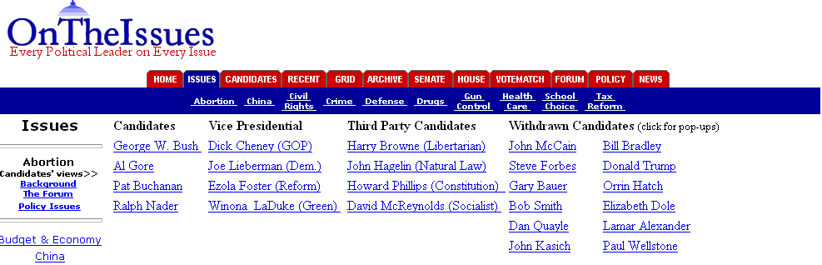
Differences in skill
43% failed on political task
survey measures of skill

Slide 5

Paper-and-pencil survey
Differences in skill among young people

Slide 6
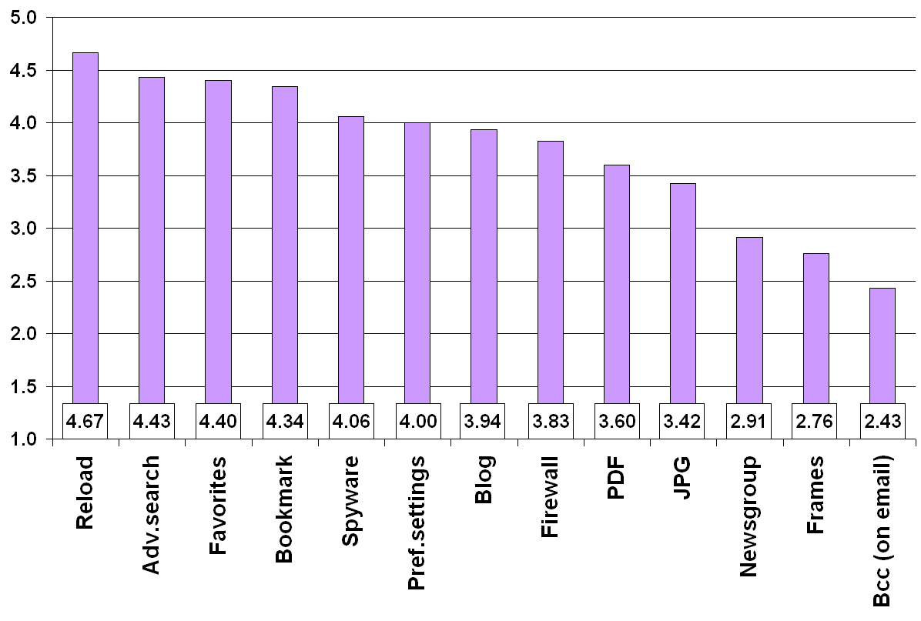
Basic Internet-related terms
Range: 15-65
Mean: 46
St.dev.: 11
Notes:
We base our analyses on original data we collected for the purposes of studying digital inequality among young adults in the US.

Slide 7
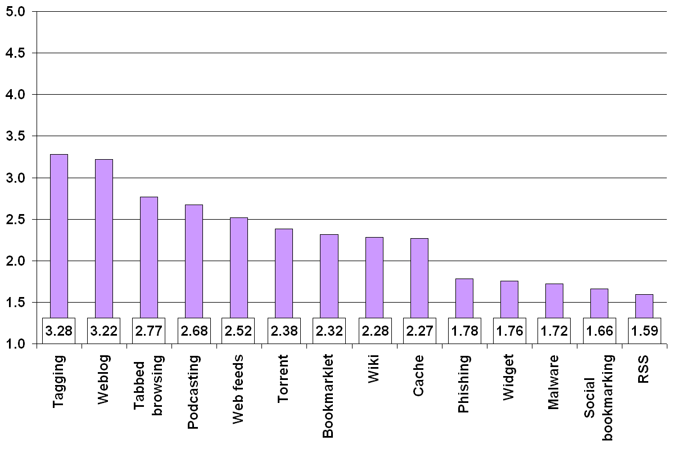
Web 2.0-related terms
Range: 13-70
Mean: 35
St.dev.: 13
Notes:
We base our analyses on original data we collected for the purposes of studying digital inequality among young adults in the US.

Slide 8
Skill and user background
Lower levels of self-reported know-how:
Women
Hispanic origin
African American
Have parents with lower levels of education
[especially
advanced skill]
Higher levels of self-reported know-how:
Asian American [basic skill]
More autonomy (# of access locations)
More experience (# of use years, weekly Web hours)
Notes:
We base our analyses on original data we collected for the purposes of studying digital inequality among young adults in the US.

Slide 9











Use of specific Web sites
(sometimes or often)
2008 (2007)
85% (75%)
47% (54%)
93% (79%)
8% (4%)
93% (83%)
0
1%
10% (7%)
36% (15%)
0 (<1%)
4% (4%)
0
Notes:
We base our analyses on original data we collected for the purposes of studying digital inequality among young adults in the US.

Slide 10

Is there a participation gap?
What explains variation in
creative output and sharing?
Notes:
The main variable of interest in our study is skill or people’s ability to use the Web effectively and efficiently. In addition to looking at the “usual suspects” such as income and education, we also consider the conditions of people’s use and their experiences with using the medium. By “autonomy of use” we refer to the level of freedom people have to use the medium when and where they want to. [Don’t have to say this, but so you know: it’s different to access the Internet at a library that is far away from one’s home, has limited hours, requires standing in line and is under surveillance than using the medium in one’s home. Yet two such access points are sometimes counted as equal in statistics about Internet access and use.]

Slide 11
Online Sharing by Gender
(among creators)
 | Among those who create | Men | Women
Video** | 50 | 55 | 42
Poetry/fiction | 51 | 54 | 49
Artistic photo | 35 | 39 | 33
Music*** | 29 | 40 | 15
** p=<.01 ***p=<.001

Slide 12
Explaining differences in sharing
(controlling for content creation)
Lower levels of online sharing:
Women
Higher levels of online sharing:
Skill (both basic and Web 2.0 terms)

Slide 13
Cell phone usage

Slide 14
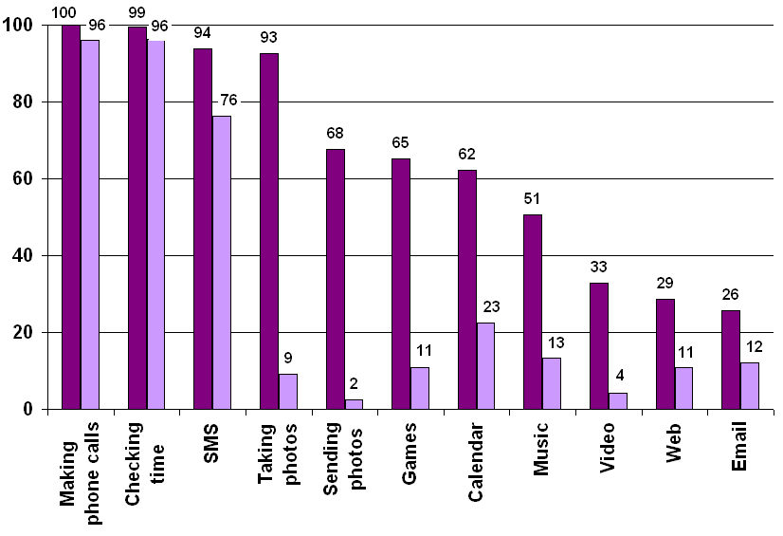
Cell phone usage
Ever
Daily

Slide 15
Concluding remarks
People differ considerably in their level of
familiarity with various online services
Online know-how is not randomly distributed
among the population, user background is
related to digital media savvy
Skill differences are related to differentiated
Web use suggesting different online activities
(and therefore opportunities) based on user
background

Slide 16
http://www.webuse.org

