Slide 1
People: What we know and what it means
….to us and to them
Elizabeth F. Churchill, Yahoo! Research
Supernova June 2008

Slide 2
Three points (1): People
People are endlessly creative
Few tools are good at complex knowledge sharing

Slide 3
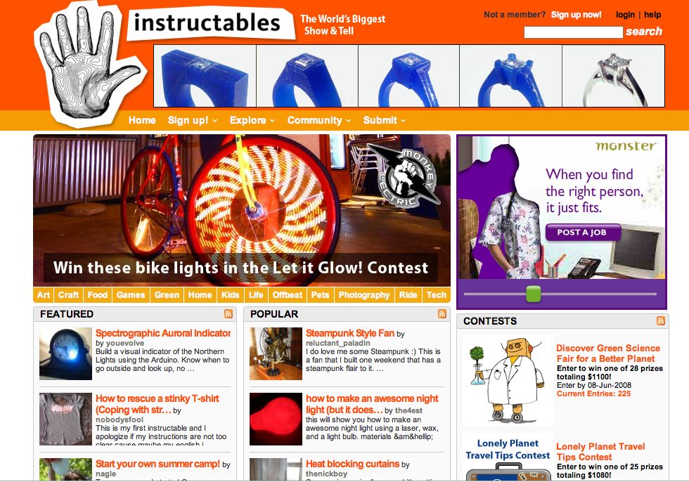
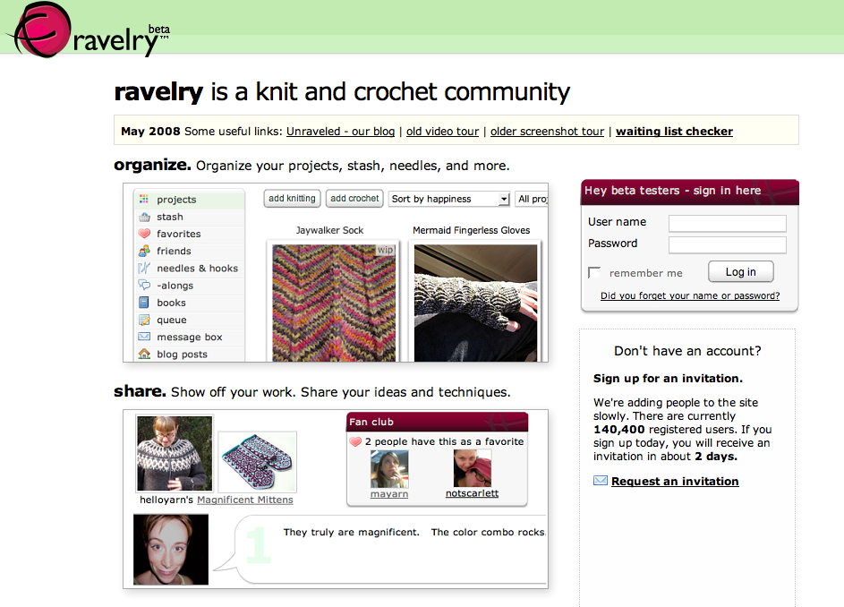
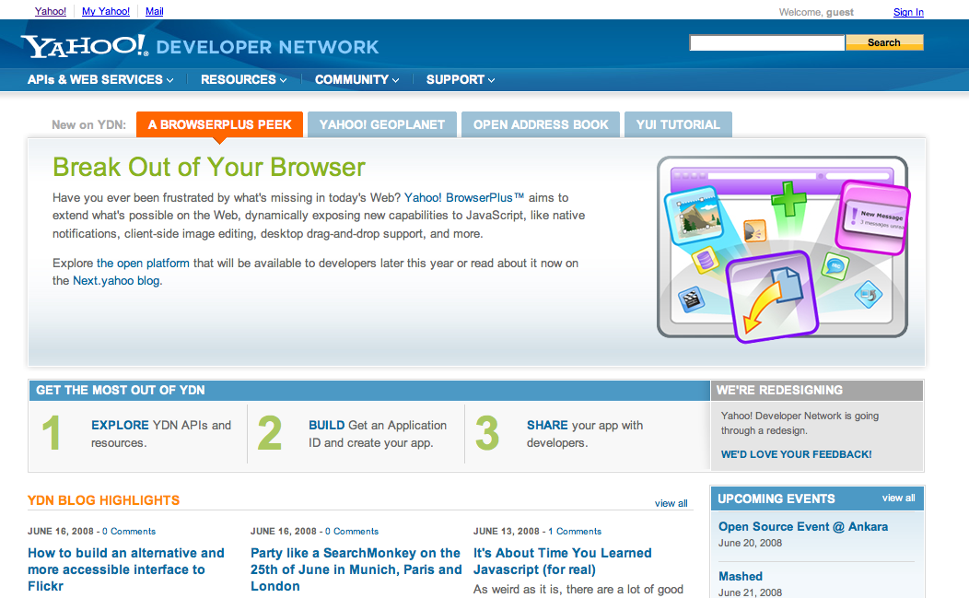
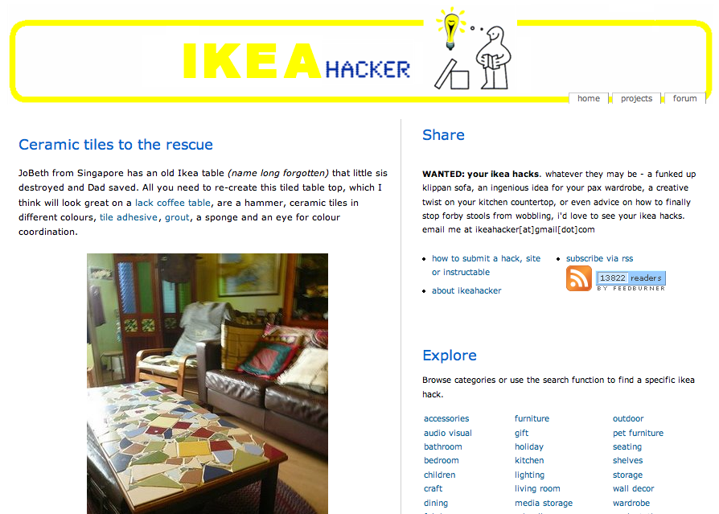

Slide 4
Three points (2) : Technology and people
Most of most people’s time is spent offline
Applications and services are only part the picture; information finding is emotional as well as practical, it has meaning for people

Slide 5
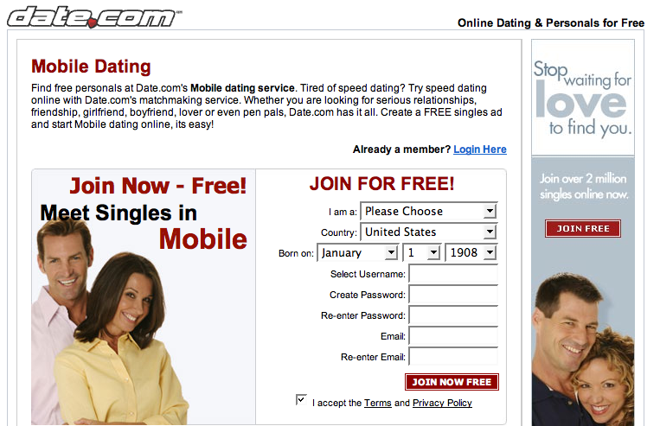
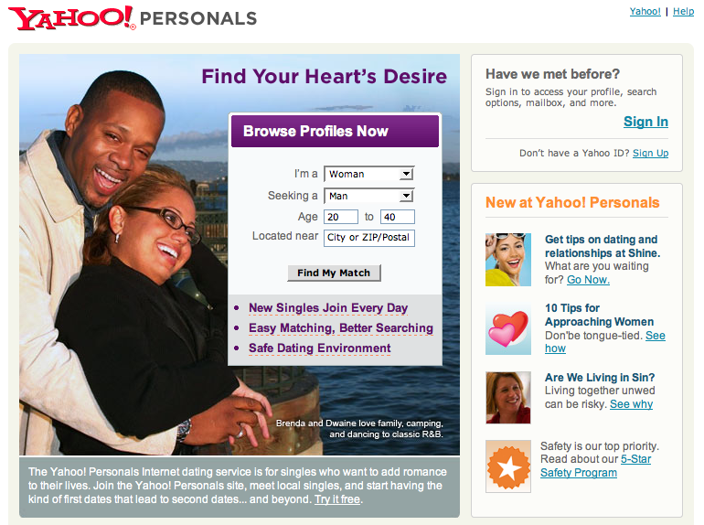
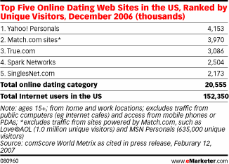
16 million Americans
$1 billion per year
Ads, subscriptions and services

Slide 6
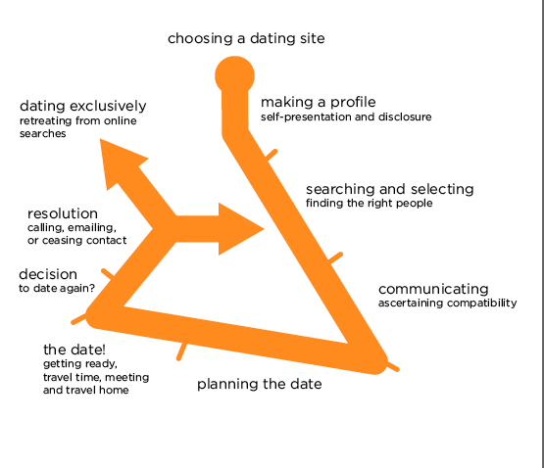
Breaking down the dating cycle

Slide 7
Breaking down the dating cycle

Slide 8
Breaking down the dating cycle

Slide 9
Three points (3) - Data about people
Get data in the large and in the small
Quantitative data over large groups tells you what, where, perhaps how and who (but note privacy issues)
Qualitative data can tell you why

Slide 10
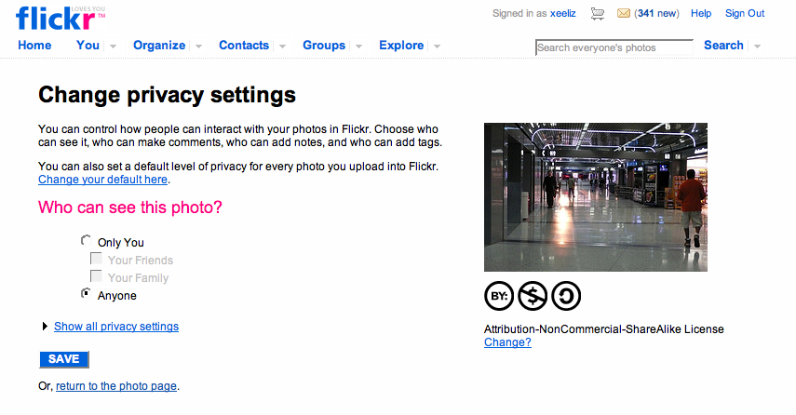
Example 2

Slide 11
Flickr – Photo sharing distribution

Slide 12
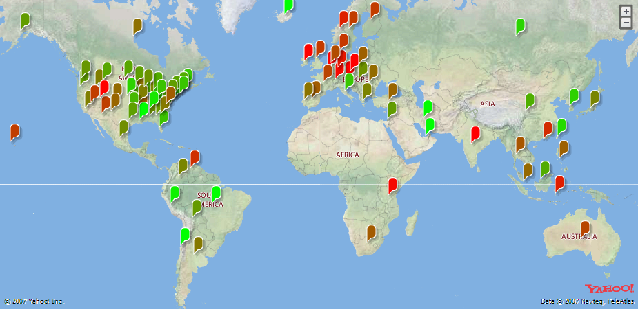
Flickr – Photo sharing by user location

Slide 13
Thanks!
For more information please email
Elizabeth Churchill at echu@yahoo-inc.com

