Slide 1





Deriving Value from Consumer Networks
Shawndra Hill
University of Pennsylvania
Supernova 2008
June 17, 2008
Joint work with: Bob Bell, Deepak Agarwal, Foster Provost, Chris Volinsky
Notes:
Success with predictive modeling using network attributes

Slide 2

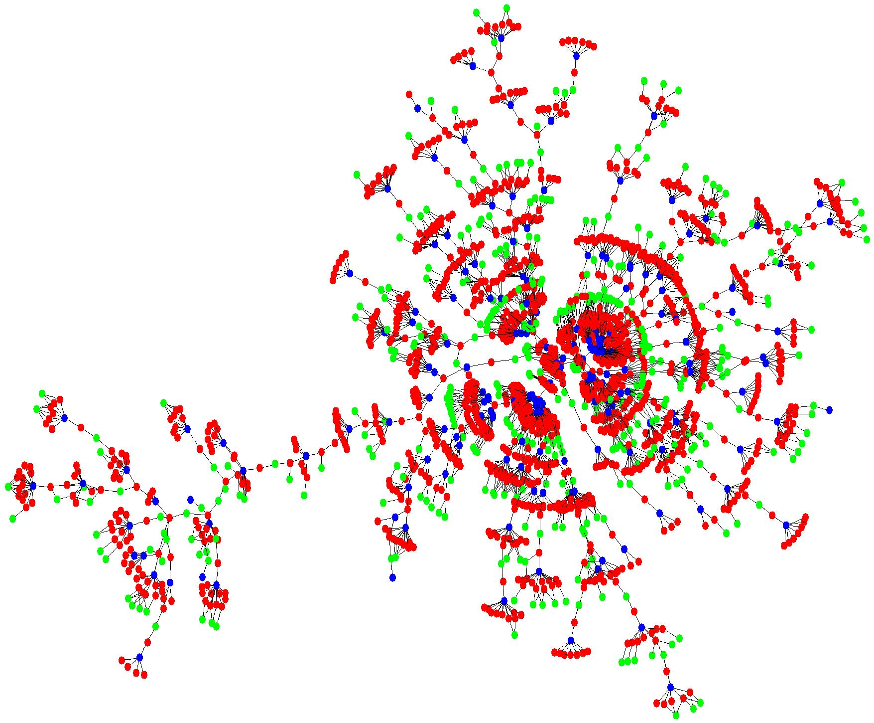
Communication Networks
  Nodes represent transactors
  Edges are explicit transactions
Notes:
Well consumer networks for the purpose of my research are networks where the nodes represent transactors and
edges represent explicit transactions between the nodes.
On the network presented in this picture, the nodes are telecommunications consumers and the links between them are phone calls.
Now, I’ll explain what I mean by value …
---------------------------------------------------------------------------

Slide 3
How can firms use data on explicit consumer networks to improve consumer rankings?
For example, in order to rank customers by likelihood of …
Response to a target marketing offer
Fraud
Donating to a cause
Spreading information about a product
…
Notes:
Generally, my research address the following overarching question. How can firms use data on explicit consumer networks to improve X. The value is derived from improvements in X.
For my research, X can be instantiated with the values classification and class probability estimates.
So, in general, I want to know How can firms use data on explicit consumer networks to improve classification, specifically class probability estimates.
If we are able to improve class probability estimates, then we can rank customers better. Ranking customers is beneficial in at leas two business applications.
The first is ranking customers by the likelihood of product adoption.
The second is ranking customer by the likelihood of fraud.
In the first case, if successful, the firm would get value from increased profits and the latter would get value from decreased costs.
Both impact the bottom line and both are important for at least one large industry, the telecommunications industry.
Not just telecom firms may profit, These data are all around now …
-----
------
Instead of target marketing … fraud detection, advertisement delivery, customer attrition, retrition, etc.
Want to pause here because adopt can be replaced with … leave, commit fraud …
Instantate x …
If I can rank them it will help me increase profit … increase profit educing cost … for ranking customers of exhibiting characteristic … responding offer or repetitive defaulter … if a firm could do this then their bottom line would surely be effected

Slide 4
Consumer Networks
Dependencies
  Nodes are interdependent
Scale
  Tens or hundreds of millions of nodes and edges
Dynamic
  Large numbers of nodes coming and going continuously
Email
Web purchases
Call detail logs
Blogs
Discussion forums
Online auctions
Recommender sites
Networking portals
Notes:
The consumer network that is represented by for example for example by call detail has hundreds of millions of nodes and edges. We have to deal with this scale. You can always fall back and say this is part of the graph that has millions and we are dealing with …
For example, consumer networks can be derived from email data, recommender sites, blogs and so on …
Something that ties these data together is that they are difficult to analyze.
Data analysis is difficult for at least 3 reasons.
Dependencies – most methods do not inherently exploit interdependencies in the data. In fact, traditional machine learning and statistical methods assume independence.
Scale – operating on billions of nodes in main memory or by repeatedly reading from disk is a challenge so we need approximations of the graph in order to do analysis in real time
Dynamics – links and nodes are coming and going ..
These three challenges are what drive my dissertation research.
---------------------
----
First, let me discuss what I mean by consumer networks. We all participate in them. We belong to many. Typically the way people classify you … but can’t observe the reality.
It involves the links between consumers. There is a wealth of information in consumer networks. These data are potentially huge. They are interesting because they are dynamic, they are large, and they are noisy (missing , and people trying to hide information). Here are some examples of non proprietary consumer .networks. Here are some examples of proprietary. These links may be explicit or implicit. Firms can mine these data for a number of interesting problems. I will discuss one area of research
Need some quotes here.
Show some pictures.
Enron Offers an Unlikely Boost to E-Mail Surveillance
New York Times
By Gina Kolata
May 22, 2005
As an object of modern surveillance, e-mail is both reassuring and troubling. It is a potential treasure trove for investigators monitoring suspected terrorists and other criminals, but it also creates the potential for abuse, by giving businesses and government agencies an efficient means of monitoring the attitudes and activities of employees and citizens.
Now the science of e-mail tracking and analysis has been given a unlikely boost by a bitter chapter in the history of corporate malfeasance - the Enron scandal. In 2003, the Federal Energy Regulatory Commission posted the company's e-mail on its Web site, about 1.5 million messages. After duplicates were weeded out, a half-million e-mails were left from about 150 accounts, including those of the company's top executives. Most were sent from 1999 to 2001, a period when Enron executives were manipulating financial data, making false public statements, engaging in insider trading, and the company was coming under scrutiny by regulators. Because of privacy concerns, large e-mail collections had not previously been made publicly available, so this marked the first time scientists had a sizable e-mail network to experiment with. "While it's sad for the people at Enron that this happened, it's a gold mine for researchers," said Dr. David Skillicorn, a computer scientist at Queen's University in Canada. Scientists had long theorized that tracking the e-mailing and word usage patterns within a group over time - without ever actually reading a single e-mail - could reveal a lot about what that group was up to. The Enron material gave Mr. Skillicorn's group and a handful of others a chance to test that theory, by seeing, first of all, if they could spot sudden changes. For example, would they be able to find the moment when someone's memos, which were routinely read by a long list of people who never responded, suddenly began generating private responses from some recipients? Could they spot when a new person entered a communications chain, or if old ones were suddenly shut out, and correlate it with something significant? There may be commercial uses for the same techniques. For example, they may enable advertisers to do word searches on individual e-mail accounts and direct pitches based on word frequency. "Will you let your e-mail be mined so some car dealer can send information to you on car deals because you are talking to your friends about cars?" asks Dr. Michael Berry, a computer scientist at the University of Tennessee who has been analyzing the data. Working with the Enron e-mail messages, about a half-dozen research groups can report that after just a few months of study they have already learned that they can glean telling information and are refining their ability to sort and analyze it. Dr. Kathleen Carley, a professor of computer science at Carnegie Mellon University, has been trying to figure out who were the important people at Enron by the patterns of who e-mailed whom, and when and whether these people began changing their e-mail communications when the company was being investigated. Companies have organizational charts, but they reveal little about how things really work, Dr. Carley said. Companies actually operate through informal networks, which can be revealed by analyzing "who spends time talking to whom, who are the power brokers, who are the hidden individuals who have to know what's going on," she said. With the Enron data, Dr. Carley continued, "what you see is that prior to the investigation there is this surge in activity among the people at the top of the corporate ladder." But she adds, "as soon as the investigation starts, they stop communicating with each other and start communicating with lawyers." It showed, she says, "that they were becoming very nervous." The analyses also found someone so junior she did not show up on organization charts but who, whichever way the e-mail data was mined, "shows up as a person of interest," Dr. Skillicorn said, in the language of intelligence analysts. In the investigation of a terror network, pinpointing such a person could be of enormous significance. Dr. Berry said the e-mail traffic patterns tracked major events, like the manipulation of California energy prices. "We could see how things built up right before the bankruptcy," he said. There were e-mail surges with each crisis, pointing to a problem that was consuming Enron employees. And in each crisis, there were features of certain e-mail messages - word choices, routing patterns - that allowed the computer scientists to isolate them from the morass of irrelevant personal or business messages. One thing that didn't show up when the researchers screened for changes in word use was guardedness, said Dr. Skillicorn, a failure that was revealing in itself. Ordinarily, he said, when people are being deceptive they are more self-conscious, and their word use becomes simpler, as though they are trying too hard to sound natural. But that apparently never occurred at Enron because its employees remained unconcerned while they engaged in illegal activity. "It wasn't a case of keeping a low profile," Dr. Skillicorn said. "They didn't worry about the story they were telling." The scientists who are studying the Enron data said they assumed intelligence agencies are doing similar classified analyses on international e-mail traffic. Since World War II, a five-nation consortium of the United States, Canada, Britain, Australia and New Zealand have cooperated in a vast communications collection and analysis program called Echelon, for example, one that has assumed increasing importance since the terror attacks of Sept. 11, 2001. No one in the unclassified world knows precisely what is being done with the Echelon data. But, Dr. Berry said, surveillance in the civilian world could one day have troubling consequences. It could allow companies, without ever actually infringing on e-mail conversations, to track employee attitudes and activities closely and easily. "They can monitor discussions without actually isolating individuals," Dr. Berry said. "They can assess morale. If they make a cut in salaries, how long does the unhappiness go on? You could track topics and get a sense of how people are responding to policies and flag potential hot spots." Or, he said, managers might be able to learn which people have too much time on their hands. And, as Dr. Skillicorn notes, if you try to write bland e-mail messages with hidden communications, chances are the programs will pick those out, too. "It's clearly Orwellian," Dr. Berry said. "And I know that freaks people out."

Slide 5
Business problem:
Target consumers for new product
Large telecommunications company
Product: new telecom service
Large direct marketing campaign
Long experience with targeted marketing
Sophisticated segmentation models based on data and intuition
  e.g., regarding the types of customers known or thought to have affinity for this type of service
Notes:
Read bullets. ….
The firm had access to their current method of doing things.
So they had data on these targets. These data include …

Slide 6
The Data
The firm determined 21 segments by a combination of customer characteristics
SEGMENT ID
1
2
3
4
5
6
7
8
9
10
11
12
13
14
15
16
17
18
19
20
21
Loyalty (L)
Geography (G)
Existing Customer
Prior spending
Current plan
Frequent switch
State
Zip
Urban
Cable Region
Demographics (D)
Other (O)
Type of Mailer
Internet Type
Age
Gender
Children
Head of Household
separately, assessed >150 potential attributes from these categories
Notes:
The data the firm had access to includes loyalty, goegraphy, demographics, other information like the type of mailer.
The firm already had 21 predefined segments based on a combination of attributes.
In total however, 150 potential attributes were available from these categories.
21 segments that the firm identified as being those customers that ought to be targeted. A lot were not included. These are the customers that the firm decided to target. The fact that there are 21 segments are not important. It just happens that they were in 21 segments … the important that those were the ones worth targeting. The likely responders…later on say aha.

Slide 7



What’s new?
Directed Network-based Marketing
Existing customers
“Network Neighbor” targets
Non-customers
Store millions of inbound/outbound communications a day to/from existing customers
Constructed representation of consumer network over prior 6 months
Can this additional data improve customer
ranking significantly?
Notes:
So what is new? Well, There is another type of data that the firm long ignored for targeted marketing. The explicit links between existing customers and targets.
We now look at the list of existing customers, make a list of all those the existing customers and call these guys the network neighbor targets.
The question is can this additional data improve ranking significantly?
Here is the question that we are … all I am going to be telling ou
Turn the target from background to now … this is the question!!!!!!!!!!!!!!!!!!!!!!!!!!!!!!!!!!!!!!! This is important … this is the essence of this first essay.
Make sure to say this is a network neighbor attribute.
The important thing narrows down to this attribute. A lot of great things were simple in retrospect that they may seem trivial … can be distilled down to this one relationship

Slide 8
What’s new?
Directed Network-based Marketing
SEGMENT ID
1
2
3
4
Store millions of inbound/outbound communications a day to/from existing customers
Constructed representation of consumer network over prior 6 months
5
6
7
8
9
10
11
12
13
14
15
16
17
18
19
20
important
21
22
Notes:
There are two lists that help us to compare the two types of targets. The network neighbors, those that had prior
communication with existing customers and the non-network neighbors.
There is some overlap
Where the lists didn’t overlap, the firm created a new segment
So these are the firms’ data. Now I will talk about the experiments.
We collected segment 22 based on analysis

Slide 9
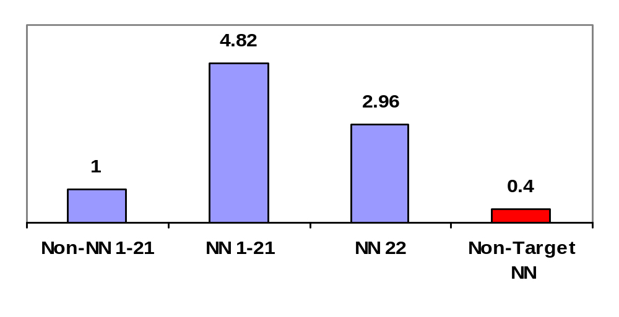
Results
Relative Take Rates for Marketing Segments
(1.35%)
(0.83%)
(0.28%)
(0.11%)
Notes:
If we use the non-nn 1-21 as a baseline, then we see that on average nn 1-21 do adopt 4.82 x the rate
If we use the NN 22 … those guys that were not going to be targeted, we find that they adopt 3 X the rate of the non-nn 1-21
This is particularly interesting because segment 22 were considered undesirable by the firm using only traditional consumer attributes.

Slide 10
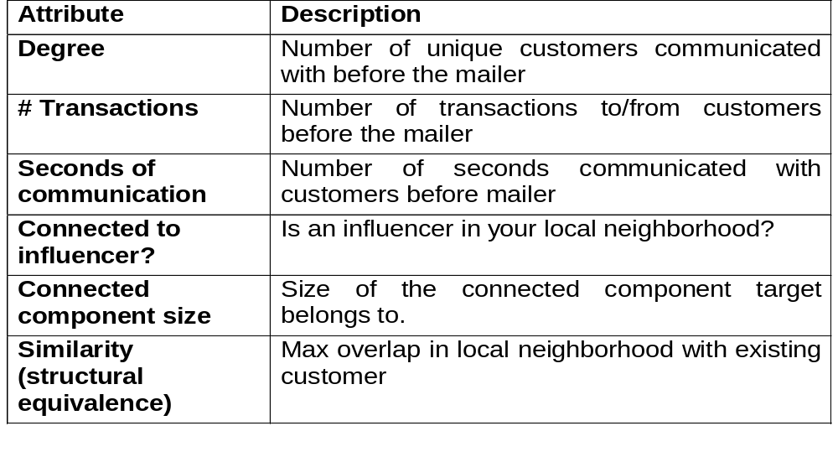
More Sophisticated Local Network-based Attributes?

Slide 11

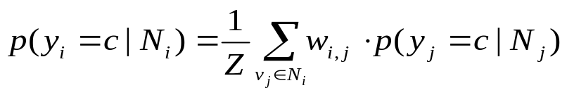

More sophisticated Network attributes? For example collective inference
Relational classifier
  WvRN
Notes:
Now We take the union of all these little graphs and do collective inference.
We assume this graph is a gaussian random field
We use the collective inference score in a logistic regression model.
So we show how we can combine network information with traditional attributes.
Explain the equation
Log odds of prob of response …
If you want to present it … build it up as you go along … ties the essay together. Here is our version of what marketing is doing initially. B0 – b4 .. When you talk about the different variables put up the logistic regression … have in one color … then add in NB … distilling everything into the logistic regression. Essentially what we are doing. That becomes very clear. In the second part, then we add in NL…then we add in a brace that goes to NL and that’s essay 1 and NC comes from the GRF model. Let it be a them that goes through. Ties the two essays together nicely.
Don’t mention the collective inference … a very local
Logistic reqression can be used to predict a dependent variable on the basis of continuous and/or categorical independents and to determine the percent of variance in the dependent variable explained by the independents; to rank the relative importance of independents; to assess interaction effects; and to understand the impact of covariate control variables.
Logistic regression applies maximum likelihood estimation after transforming the dependent into a logit variable (the natural log of the odds of the dependent occurring or not). In this way, logistic regression estimates the probability of a certain event occurring. Note that logistic regression calculates changes in the log odds of the dependent, not changes in the dependent itself as OLS regression does.
Logistic regression has many analogies to OLS regression: logit coefficients correspond to b coefficients in the logistic regression equation, the standardized logit coefficients correspond to beta weights, and a pseudo R2 statistic is available to summarize the strength of the relationship. Unlike OLS regression, however, logistic regression does not assume linearity of relationship between the independent variables and the dependent, does not require normally distributed variables, does not assume homoscedasticity, and in general has less stringent requirements. It does, however, require that observations are independent and that the independent variables be linearly related to the logit of the dependent. The success of the logistic regression can be assessed by looking at the classification table, showing correct and incorrect classifications of the dichotomous, ordinal, or polytomous dependent. Also, goodness-of-fit tests such as model chi-square are available as indicators of model appropriateness as is the Wald statistic to test the significance of individual independent variables. .

Slide 12
More sophisticated Network attributes? For example collective inference
Relational classifier
  WvRN
Notes:
Now We take the union of all these little graphs and do collective inference.
We assume this graph is a gaussian random field
We use the collective inference score in a logistic regression model.
So we show how we can combine network information with traditional attributes.
Explain the equation
Log odds of prob of response …
If you want to present it … build it up as you go along … ties the essay together. Here is our version of what marketing is doing initially. B0 – b4 .. When you talk about the different variables put up the logistic regression … have in one color … then add in NB … distilling everything into the logistic regression. Essentially what we are doing. That becomes very clear. In the second part, then we add in NL…then we add in a brace that goes to NL and that’s essay 1 and NC comes from the GRF model. Let it be a them that goes through. Ties the two essays together nicely.
Don’t mention the collective inference … a very local
Logistic reqression can be used to predict a dependent variable on the basis of continuous and/or categorical independents and to determine the percent of variance in the dependent variable explained by the independents; to rank the relative importance of independents; to assess interaction effects; and to understand the impact of covariate control variables.
Logistic regression applies maximum likelihood estimation after transforming the dependent into a logit variable (the natural log of the odds of the dependent occurring or not). In this way, logistic regression estimates the probability of a certain event occurring. Note that logistic regression calculates changes in the log odds of the dependent, not changes in the dependent itself as OLS regression does.
Logistic regression has many analogies to OLS regression: logit coefficients correspond to b coefficients in the logistic regression equation, the standardized logit coefficients correspond to beta weights, and a pseudo R2 statistic is available to summarize the strength of the relationship. Unlike OLS regression, however, logistic regression does not assume linearity of relationship between the independent variables and the dependent, does not require normally distributed variables, does not assume homoscedasticity, and in general has less stringent requirements. It does, however, require that observations are independent and that the independent variables be linearly related to the logit of the dependent. The success of the logistic regression can be assessed by looking at the classification table, showing correct and incorrect classifications of the dichotomous, ordinal, or polytomous dependent. Also, goodness-of-fit tests such as model chi-square are available as indicators of model appropriateness as is the Wald statistic to test the significance of individual independent variables. .

Slide 13
More sophisticated Network attributes? For example collective inference
Relational classifier
  WvRN
Notes:
Now We take the union of all these little graphs and do collective inference.
We assume this graph is a gaussian random field
We use the collective inference score in a logistic regression model.
So we show how we can combine network information with traditional attributes.
Explain the equation
Log odds of prob of response …
If you want to present it … build it up as you go along … ties the essay together. Here is our version of what marketing is doing initially. B0 – b4 .. When you talk about the different variables put up the logistic regression … have in one color … then add in NB … distilling everything into the logistic regression. Essentially what we are doing. That becomes very clear. In the second part, then we add in NL…then we add in a brace that goes to NL and that’s essay 1 and NC comes from the GRF model. Let it be a them that goes through. Ties the two essays together nicely.
Don’t mention the collective inference … a very local
Logistic reqression can be used to predict a dependent variable on the basis of continuous and/or categorical independents and to determine the percent of variance in the dependent variable explained by the independents; to rank the relative importance of independents; to assess interaction effects; and to understand the impact of covariate control variables.
Logistic regression applies maximum likelihood estimation after transforming the dependent into a logit variable (the natural log of the odds of the dependent occurring or not). In this way, logistic regression estimates the probability of a certain event occurring. Note that logistic regression calculates changes in the log odds of the dependent, not changes in the dependent itself as OLS regression does.
Logistic regression has many analogies to OLS regression: logit coefficients correspond to b coefficients in the logistic regression equation, the standardized logit coefficients correspond to beta weights, and a pseudo R2 statistic is available to summarize the strength of the relationship. Unlike OLS regression, however, logistic regression does not assume linearity of relationship between the independent variables and the dependent, does not require normally distributed variables, does not assume homoscedasticity, and in general has less stringent requirements. It does, however, require that observations are independent and that the independent variables be linearly related to the logit of the dependent. The success of the logistic regression can be assessed by looking at the classification table, showing correct and incorrect classifications of the dichotomous, ordinal, or polytomous dependent. Also, goodness-of-fit tests such as model chi-square are available as indicators of model appropriateness as is the Wald statistic to test the significance of individual independent variables. .

Slide 14
Contributions
  Consumers that have already interacted with an existing customer adopt a product (eg., respond to a direct mailer) at a higher rate than those that have not.
  Variables constructed from the consumer’s immediate network enable the firm to (classify/rank targets, generate profit) better.
  Global network attributes can be used to help rank consumers two hops away from existing customers
  Our ability to improve consumer ranking translated into significant profit to the firm
Notes:
In summary, this is the first work that provides evidence that linked consumers lead to increased profits.
The results show that consumers that have already interacted with an existing customer adopt a product at a higher rate than those that have not.
Variables constructed from the consumer’s immediate network enable to firm to rank targets better.
Now the question is can we do more sophisticated analysis

Slide 15
Overview: Our Objective
Design a generic definition, representation, and approximation for dynamic graphs that can be used for problems where looking at entities through time is of interest.
  What is the graph at time t: G_{t}
  How does one account for addition and attrition of nodes
….that is useful for problems of local representation
  Local representation – learning about individual nodes in the graph, instead of global graph properties

Slide 16
Business problem:
Repetitive Subscription Fraud
Large telecommunications company
telecom service
Long experience with fraud detection
Sophisticated models based on record linkage
Notes:
Read bullets. ….
The firm had access to their current method of doing things.
So they had data on these targets. These data include …

Slide 17
Motivating Example: Repetitive Fraud
Lots of people cant pay their bill, but they want phone service anyway:
Name | Ted Hanley
Address | 14 Pearl Dr St Peters, MN
Balance | $208.00
Disconnected | 2/19/04 (nonpayment)
Name | Debra Handley
Address | 14 Pearl Dr St Peters, MN
Balance | $142.00
Connected | 2/22/04
Name | Elizabeth Harmon
Address | APT 1045 4301 ST JOHN RD SCOTTSDALE, AZ
Balance | $149.00
Disconnected | 2/19/04 (nonpayment)
Name | Elizabeth Harmon
Address | 180 N 40TH PL APT 40 PHOENIX, AZ
Balance | $72.00
Connected | 1/31/04

Slide 18
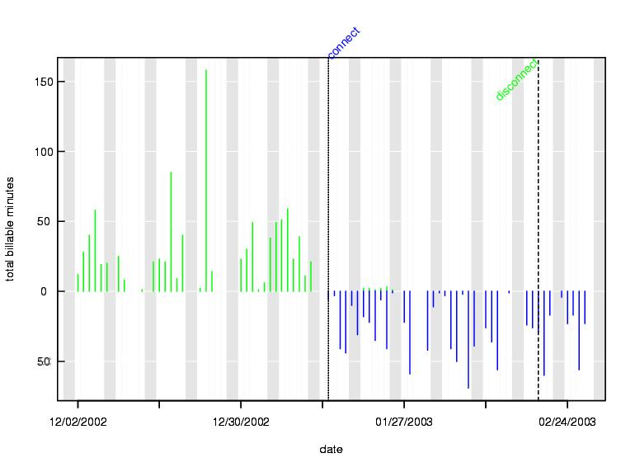
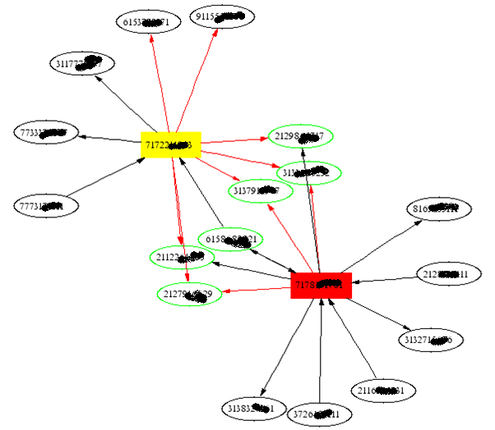
Motivating Example: Repetitive Fraud
How can we identify that it is the same person behind both accounts?
Old Account: | 67855232344 | New Account: | 4215554597
Old Date: | 2003-02-25 | New Date: | 2003-02-13
Old Name: | DAVID ATKINS | New Name: | DAVID WATKINS
Old Address: | 10 NIGHT WAY APT 114 | New Address: | 10 HATSWORTH DR
Old City: | FAYVILLE | New City: | BONDALE
Old State: | AL | New State: | AL
Old Zip: | 302141798 | New Zip: | 300021530
Old II Code: | 5512127609901 | New II Code: | 5312074639501
Old Balance: | 284.62 | New Balance: | 5.83

Slide 19
Motivating Example: Challenges
This is a problem of record linkage and graph matching, but because of obfuscation, we can only count on entity matching.
But the number of potential matches
is huge…
If we have an efficient representation of entities, we might be able to make a dent….
Now, lets talk about our representation
10 K/day
300K/month
Connect pool
T
Restrict pool
5 K/day
150 K/month
45 billion comparisons

Slide 20
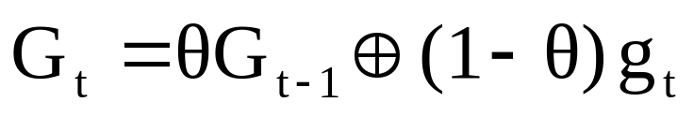

Our Approach: Defining Dynamic Graphs
We adopt an Exponentially Weighted Moving Average (EWMA):
i.e. today’s graph is defined recursively as a convex combination of yesterday’s graph and today’s data
Advantages:
  recent data has most influence
  only one most recent graph need be stored
We also use two types of approximation of the graph, by pruning:
Global pruning of edges – overall threshold below which edges are
removed from the graph
Local pruning of edges – designate a maximal in and out degree (k) for
each entity, and assign an overflow bin

Slide 21
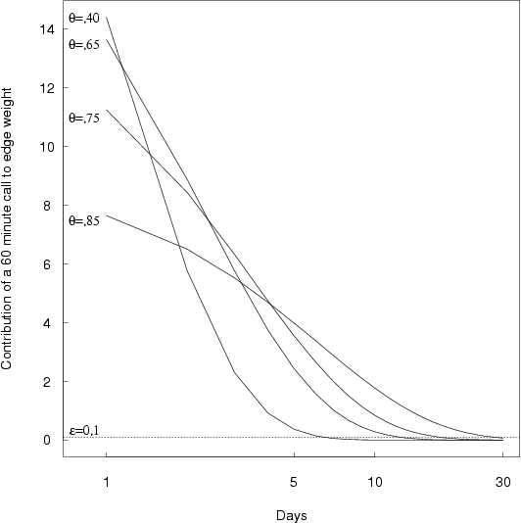
Our Approach: Defining Dynamic Graphs
Selecting θ
closer to 1
calls decay slower
more historical data included
smoother
closer to 0
faster decay
recent calls count more
more power to detect changes
less smooth

Slide 22
Applying our Method
Results:
  We identify 50-100 of these cases per day
  95% match rate
  85% block rate
  ollars
  Credited with saving telecom millions if dollars
  By far the most reliable matching criteria is the entity based matching
  Optimized parameter set outperforms both current process and current theta and optimized k
  *We also demonstrate our method on email and clickstream data

Slide 23
Other applications, conclusions…
Our three parameter representation of a dynamic graph is a powerful, flexible, and efficient way of analyzing problems where looking at entities through time are of interest.
Can be applied to any problem where entity modeling over time is of interest
    Other fraud: Guilt by association
    Email
    Web pages
    Social Networks
    Terrorism
    Viral Marketing
What class of problems is this good for? After all, there is no model!!!
Further work
  More complex entities
  Distance Functions
  More flexible, adaptive parameter setting

Slide 24
Want more? Deriving Value from Consumer Networks
Network-based Marketing: Identifying Likely Adopters via Consumer Networks Shawndra Hill, F. Provost, C. Volinsky, Network-based Marketing: Identifying Likely Adopters via Consumer Networks, Statistical Science, Vol. 21, No. 2, pp. 256-276 2. Collective Inference in Consumer Networks Shawndra Hill, F. Provost, C. Volinsky, Collective Inference in Consumer Networks, to be submitted to Marketing Science March 2007. 3. Building an Effective Representation for Dynamic Networks Shawndra Hill, D. Agarwal, R. Bell, C. Volinsky , Building an Effective Representation for Dynamic Networks, Journal of Computational & Graphical Statistics, Vol. 15, No. 3, pp. 584-608(25)
Notes:
First, let me discuss what I mean by consumer networks. We all participate in them. We belong to many. Typically the way people classify you … but can’t observe the reality.
It involves the links between consumers. There is a wealth of information in consumer networks. These data are potentially huge. They are interesting because they are dynamic, they are large, and they are noisy (missing , and people trying to hide information). Here are some examples of non proprietary consumer .networks. Here are some examples of proprietary. These links may be explicit or implicit. Firms can mine these data for a number of interesting problems. I will discuss one area of research
Need some quotes here.
Show some pictures.

Slide 25
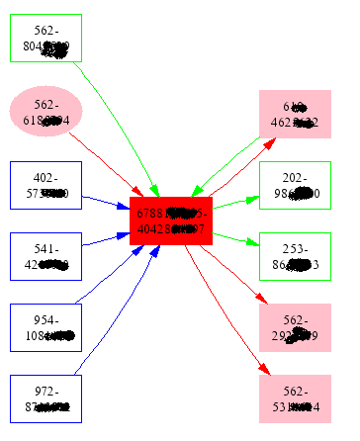
Fraud Revisited: Applying our methods
Results:
  We identify 50-100 of these cases per day
  95% match rate
  85% block rate
  Credited with saving large telecom $5 million / year
  By far the most reliable matching criteria is the entity based matching
  Could we benefit from a more sophisticated model on entities?

Slide 26
Other applications, conclusions…
Our three parameter representation of a dynamic graph is a powerful, flexible, and efficient way of analyzing problems where looking at entities through time are of interest.
Can be applied to any problem where entity modeling over time is of interest
    Other fraud: Guilt by association
    Language models
    Email
    Web pages
    Social Networks
    Terrorism
    Viral Marketing
What class of problems is this good for? After all, there is no model!!!
Further work
  More complex entities
  Distance Functions
  More flexible, adaptive parameter setting

Slide 27
Matching Algorithm
What cases will we present to the reps?
A combination of:
  COI Overlap measures
    At least two, and strength determined by uniqueness of overlap TNs
  Name/address overlap
    Edit distance no more than 50% of the longest name or address
  $$ owed
    Most interested in the ones that will generate the most $$
500-1000 cases a day become 100-150 that we present to the reps

Slide 28
Motivating Example: Repetitive Fraud
When we catch a fraudster, we rarely catch the person, we simply shut down the line
They will likely move on to another attempt at defrauding us, from a different network location
Idea: record linkage - network identity has changed, but network behavior is the same
We can use network behavior to indicate that the new line has the same “owner” as an old line

Slide 29
COI Signatures to COI
To construct a COI from a COI signature:
  Often the signature contains things we don’t want:
    Businesses
    High weight nodes
  Often the signature doesn’t contain things we do want:
    Local calls
    Other carrier calls
To combat this, create a COI by:
  Recursively expanding the COI signature
  Adding edges
  Pruning edges
here’s an example…

Slide 30
COI signature
other
me
other

Slide 31
Extended COI
other
me
other

Slide 32
Enhanced COI
other
me
other

Slide 33
Pruned COI
other
me
other

Slide 34
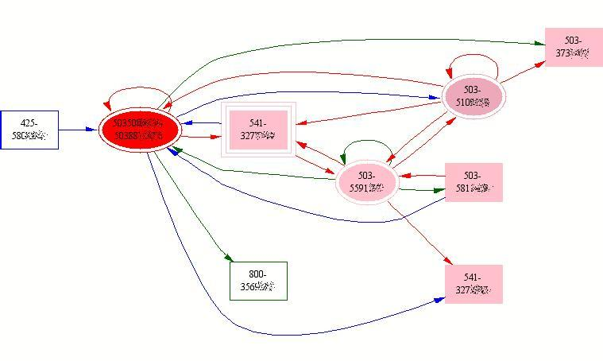
A likely case of the same fraudster showing up as a new number
Pink nodes exist in both COI

Slide 35
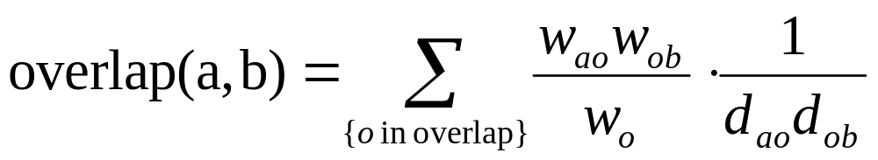
Fraud Revisited: Applying our methods
Calculate the “informative overlap” score:
Where:
w_{ao} = weight of edge from a to o
w_{ob} = weight of edge from o to b
w_{o} = sum weight of edges to o
d_{ao}, d_{ob} are the graph distances from a and b to o
Z
w_{ob}
B
w_{ao}
A
O
w_{o}

Slide 36
Outline
Defining a dynamic graph, and our objectives
A motivating example: Repetitive fraud in telecommunications
Our approach: representation and approximation of dynamic graphs
Parameter setting and applications to other domains
Fraud revisited – applying our methods
Other applications, conclusions

Slide 37
Defining a Dynamic Graph, and Our Objectives

Slide 38
Defining Dynamic Graphs
Dynamic Graphs represent transactional data –
  Telecommunications network traffic
  Web connectivity data
  Web logs
  Credit card data
  Online auction data
  Transactional data can be represented as a directed graph…
Corinna
Chris
Daryl
Anne
Debby
Jen
Kathleen
Fred
Zach
John

Slide 39
Defining Dynamic Graphs
Dynamic Graphs
  Nodes represent transactors
  Edges are directed transactions
  All edges have a time stamp
  All edges have a weight (?)
  May contain
    Other attributes on nodes (avg bill, calling plan)
    Other attributes on edges (wireless, intl)
Corinna
Chris
Daryl
Anne
Debby
Jen
Kathleen
Fred
Zach
John

Slide 40
Analysis of dynamic graphs
Why is it hard?
What do we want to know?
  Clusters, social and behavioral patterns, fraud…
Two main challenges:
  Large Scale
    Often tens or hundreds of millions of nodes and edges
  Dynamic Nodes and Edges
    Large numbers of nodes coming and going continuously

Slide 41
A motivating example: Repetitive fraud in telecommunications

Slide 42
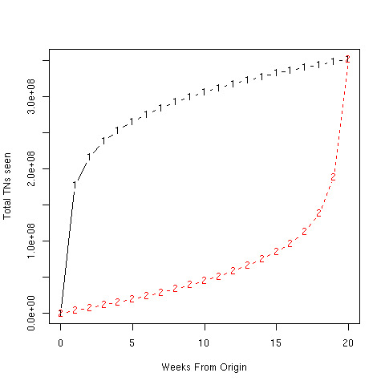
Motivating Example: Our data
4 Million TNs appear per week
Our graph is large….
    350M Telephone numbers (TNs) currently active on our Long Distance network, 300M calls/day
….dynamic….
4 Million TNs disappear per week

Slide 43
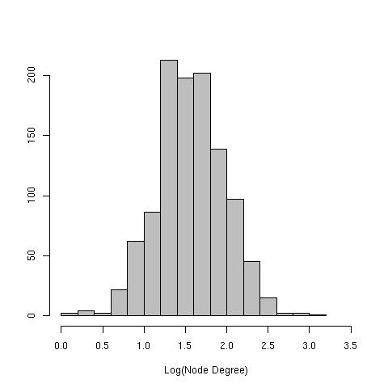
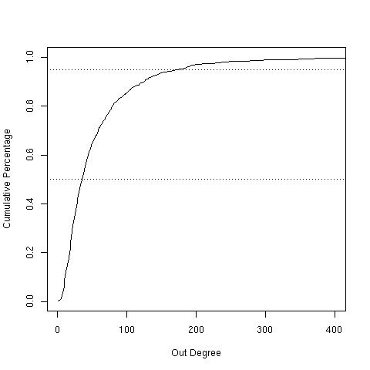
Motivating Example: Our data
…and sparse:
For one year of long distance data:
95% = 171
Median = 34

Slide 44
Our Approach to Dynamic Graphs
  Definition of the graph
  Representation as atomic units
  Approximation by pruning

Slide 45
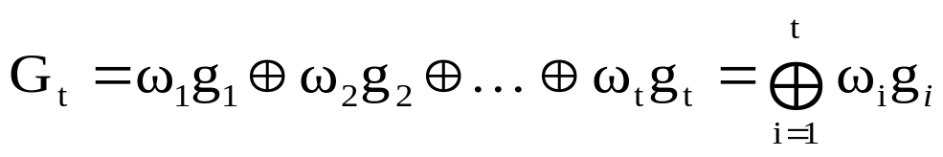

Our Approach: Defining dynamic graphs
We adopt an Exponentially Weighted Moving Average (EWMA):
i.e. today’s graph is defined recursively as a convex combination of yesterday’s graph and today’s data
Alternatively, this is:
Through time, edge weights decay with decay rate θ
Advantages:
  recent data has most influence
  only one most recent graph need be stored

Slide 46

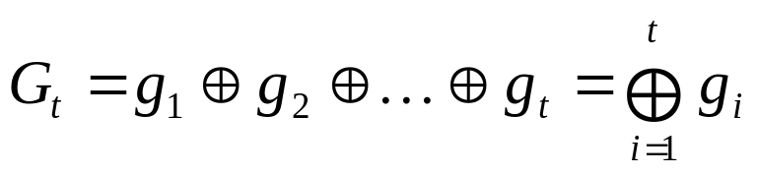
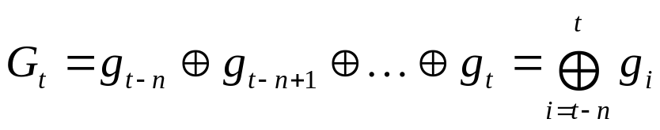
Our Approach: Defining dynamic graphs
Q: for transactional data, what does the graph at time t (G_{t})mean?
- let g_{t} be the collection of nodes and edges during the time period t
We could use:
Too narrow!
We could use the union of all time periods:
Too broad!
We could use a moving average of the most recent time periods:
Too many!

Slide 47
Our Approach: Defining dynamic graphs
Selecting θ
closer to 1
calls decay slower
more historical data included
smoother
θ closer to 0
faster decay
recent calls count more
more power to detect changes
less smooth
θ = 1/(1-n) means weight reduces to 1/e times its original weight in n days

Slide 48
Our Approach: Representation
Because we are interested in entities, and to facilitate efficient storage, we represent the entire graph as a union of entity graphs.
These are our atomic units of analysis, a signature of the node’s behavior.
Storing hundreds of millions of small graphs is much more efficient than storing one massive graph, especially in an indexed database.
Pros: efficiency, recursion Cons: redundancy
2222222222 100.3
1111111111 90.1
3213232423 27.0
9098765453 11.3
8876457326 5.4
2122121212 3.0
9908989898 0.9
8887878787 0.1

Slide 49
Our Approach: Representation
Update the graph by updating all of the atomic units daily – so any time we access the data we have the most recent representation.
Yesterday’s graph
Today’s data
Today’s graph
2222222222 100.3
1111111111 90.1
3213232423 27.0
9098765453 11.3
8876457326 5.4
2122121212 3.0
9908989898 0.9
8887878787 0.1
+
1111111111 20.0
2122121212 10.0
9991119999 5.0
=
1111111111 92.1
2222222222 90.3
3213232423 24.3
9098765453 10.1
8876457326 4.9
2122121212 3.7
9991119999 0.5 3990898989 0.8
8887878787 0.09

Slide 50
Our Approach: Approximation
We also use two types of approximation of the graph, by pruning.
  Global pruning of edges – overall threshold (ε) below which edges are removed from the graph
  Local pruning of edges – designate a maximal degree (k) for each entity

Slide 51
Our Approach: Approximation
Removes stale edges
Reduces effect of supernodes
Increases efficiency
Preserves entity weight
1111111111 92.1
2222222222 90.3
3213232423 24.3
9098765453 10.1
8876457326 4.9
2122121212 3.7
9991119999 0.5 3990898989 0.8
8887878787 0.09
1111111111 92.1
2222222222 90.3
3213232423 24.3
9098765453 10.1
8876457326 4.9
2122121212 3.7
Other 1.4
=

Slide 52
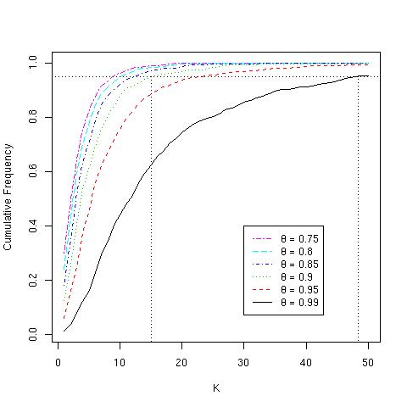
Our Approach: Approximation
Defending k
  Most entities have the vast majority of their weight in a fraction of their nodes

Slide 53
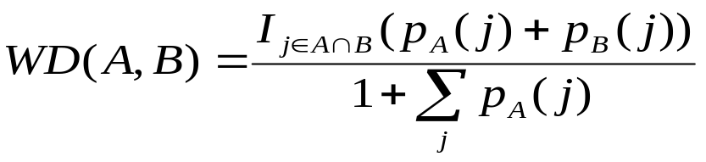
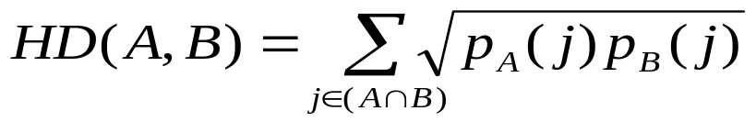
Our Approach: Parameter Setting
Let A and B be two entities.
Weighted Dice:
Hellinger Distance:
For each value
  Set ε to be a low tolerance value
  For a range of k, optimize θ
  Look at the plot to select parameters

Slide 55






Viral Marketing
“Word-of-Mouth”?
Notes:
We are probably familiar with viral marketing, word of mouth marketing, buzz marketing….
Data
.samp1.dat almost half and half
Title:
Start with a seed and he tells two friends and they tell two friends and so on. Some purchase the product and others do not.
This can be represented by a graph with attributes. We can use calls.
Looks more like this – go to cluster. Explain the purchase. Show a cluster of customers that is not viral.
Quantifying the difference -- Picture
This picture is not the main point of the study so don’t get stuck here. Just serves to illustrate what we mean by viral. We can take questions on this after.
Viral nodes will be blue (takers will be dary blue and non takers will be light blue)
Other studies do not measure communication – go to next slide with related work.

Slide 56
Research Questions
How could a firm use the consumer network to (network targeting) improve target marketing?
Do consumers who have already interacted with someone on the existing customer network respond to a direct mailer at a higher rate than those that do not?
Can variables constructed from the network enable the firm to better classify targets?
Does collective inference help us to improve target marketing?
Notes:
Research questions driven by the application. The talk is organized …. In part 1 I address the question … part 2 …
I am going to tell you ….
Before moving on to next step make clear that we will only be looking at data on the viral targets. We started off trying to ask the question….is this viral marketing?

Slide 57


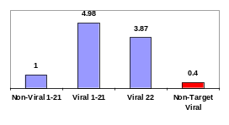
Outline of Talk
Experimental Setup
Directed network marketing
Local Network
Collective Network
Notes:
Research questions driven by the application. The talk is organized …. In part 1 I address the question … part 2 …
I am going to tell you ….
Before moving on to next step make clear that we will only be looking at data on the viral targets. We started off trying to ask the question….is this viral marketing?

Slide 58
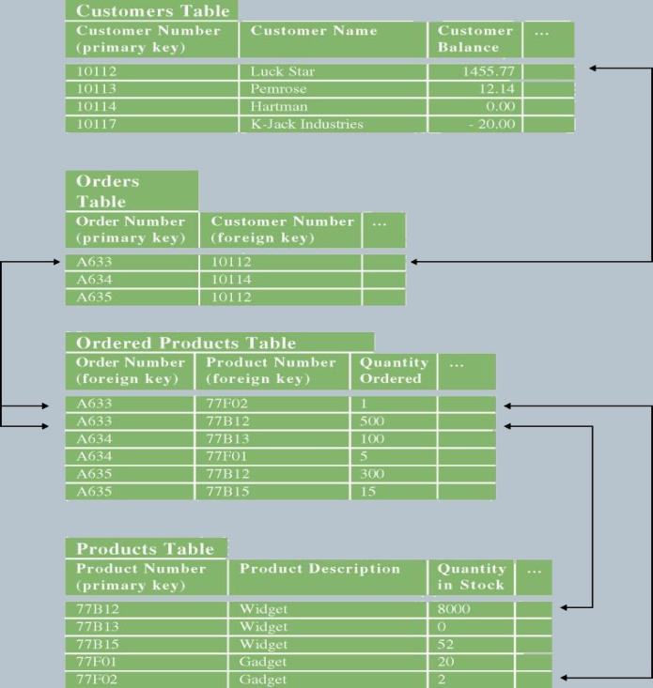
Motivation
Consumer vs. Consumer “Network”
Consumer
  No link structure
Consumer “Network”
  Link structure
  Additional consumer information
  Proxy for homophily

Slide 59
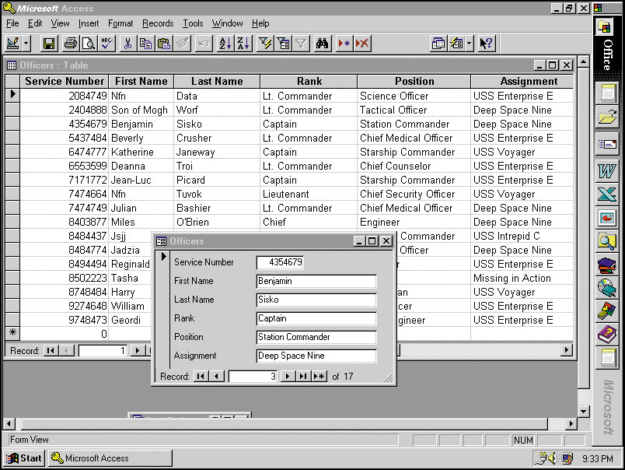
Motivation
Consumer vs. Consumer “Network”
2
3
1
1
1
1
0
0
1
1
0
1
1
4
6
5
7
8
9
Relational
Database
10
Weighted
Directed
Graph
Relational
Vectors
1
1
1
1
1
0
1
1
0
1
Consumer
  No link structure
Consumer “Network”
  Link structure
  Additional Information
  Proxy for homophily

Slide 60
Analyzing Consumer Networks
Why is it hard?
Scale
  Tens or hundreds of millions of nodes and edges
  Entire network can’t fit in main memory
Dynamic
  Large numbers of nodes coming and going continuously
  Accounting for temporal component of changing graphs is a challenge
Dependencies
  Nodes are heterogeneous
  Nodes are interdependent

Slide 61
What is Viral Marketing?
Explicit advocacy
  Word-of-Mouth
Implicit advocacy
  Hotmail
Network targeting
  My study
Notes:
The propogation of information from consumer to consumer
Explicit advocacy: Individuals become vocal advocates for the product or service, recommending them to their friends or acquaintances. Particular individuals such as Oprah, with her monthly book club reading list, or Francis McInerney with the Da Vinci Code may represent “hubs” of advocacy in the consumer relationship network. The success of “The Da Vinci Code,” by Dan Brown, may be due to its initial marketing (Paumgarten 2005). The best seller was marketed in the following way: ten thousand free books were initially delivered to readers whose opinions supposedly matter, (eg., readers, booksellers) enough to stimulate the traffic in editions that are not free.
Implicit advocacy: Even if individuals do no speak about a product, they may advocate implicitly through their actions—especially through their own adoption of the product. Designer labeling has a long tradition of using consumers as implicit advocates. Firms commonly capitalize on influential individuals (such as athletes) to advocate products simply by conspicuous adoption. More recently, firms have tried to induce the same effect by convincing particularly “cool” members of smaller social groups to adopt products (Gladwell 1997; Baker 2005).
Network targeting: The third mode of achieving viral marketing is for the firm to market to prior purchasers’ social-network neighbors, possibly without any advocacy at all by customers. For network targeting, the firm must have some means of identifying these social neighbors.
These modes may be used in combination. The most well-known example of viral marketing combines network targeting and implicit advocacy. The Hotmail free email service appended to the bottom of every outgoing e-mail message the hyperlinked advertisement, “Get your free e-mail at Hotmail,” thereby targeting the social neighbors of every current user (Montgomery 2001). This strategy simultaneously took advantage of the user’s implicit advocacy. Hotmail saw an exponentially increasing customer base. Started in July 1996, in the first month alone, Hotmail acquired 20,000 customers. By September 1996 the firm had acquired over 100,000 accounts, and by early 1997 it had over one-million subscribers. Today Hotmail has found that hotmail sales followed the well-known model of diffusion proposed by Bass (Bass 1969)

Slide 62
Viral Marketing Research
Economics
Marketing
Info Sys
Statistics
Sociology
Epidemiology
CS
Notes:
Crosses many streams
Discuss the studies that people have done

Slide 63
Viral Marketing Research
Diffusion
Customer Value
Consumer Preferences
Economics
Marketing
Info Sys
Statistics
Sociology
Epidemiology
CS
Notes:
Crosses many streams
Discuss the studies that people have done
Literature Review
Viral marketing, takes advantage of the relationship network among consumers—awareness or adoption spreads from consumer to consumer. Therefore, interdependency among consumer preferences is a necessary condition for viral marketing to exist. In this section, we will review the wide range of research topics that have had impact on viral marketing research. The research topics fall into three categories: 1) consumer preference, where the focus is on the consumer attributes that influence one’s choice of product; 2) consumer value, where the focus is on consumer attributes that influence one’s lifetime value to the firm; and 3) product diffusion, where the focus is on describing the process that describes product adoption at the aggregate level. Not only is the focus of the questions that fall within each of the three categories of research different but so is the data and analysis needed to answer the associated research questions.
Although the related work discussed in this section spans the fields of sociology, computer science, statistics, marketing and economics, the related work all meet at the intersection of consumer behavior models that consider interdependent preferences. Before we introduce interdependent preferences, we will first place our work in the broader field of consumer behavior. In general, the purpose of the study of consumer behavior is to enable firms to design and improve their marketing strategies by understanding individuals, groups, or organizations and the processes they use to select, secure, use, and dispose of products, services, experiences, or ideas to satisfy needs and the impacts that these processes have on the consumer and society (Hawkins, Best et al. 2004). Within the broader discipline of consumer behavior our work fits with consumer decision making. Consumer decision making comes about as an attempt to solve consumer problems (Hawkins, Best et al. 2004). Consumers often note problems when by comparing their current situation to some desired situation discrepancies arise. Once a discrepancy is found a search for solutions may be initiated.
The choice of solution (or product) has been found to be influenced by a number of factors. At some level, consumer choice research investigates the effects of various consumer attributes, intrinsic and extrinsic, on the consumer’s propensity to consume a particular product or group of products. Among the factors that are studied are: 1) how consumers think, feel, reason (eg., habits, loyalty, bias); 2) limitations in consumer knowledge or information processing abilities (eg., awareness, experience, education); 3) consumer motivation (eg., importance of product, switching costs, search costs); 4) the consumer’s environment (e.g., signs, media, geographic location ); and 5) the consumer’s interdependent preferences (e.g., culture, family, friends). Consumer preference models seek to find and explain the consumer attributes or dimensions along which consumers are similar in order to explain their choices. The same factors may influence a consumer’s propensity to spread the word about a product. In this study, we add to the body of literature that explores the impact of interdependent preferences on consumer preferences. However, based on prior studies, we acknowledge we must control (to the extent possible) for additional factors known to influence consumer choice.
The term interdependent preference, preferences which depend on other people’s preferences, has been used to describe a number of interactions, both inferred and assumed, between consumers. To our knowledge, the first work on interdependent preferences describes several examples of interdependence in consumer consumption (Duesenberry 1949). Duesenberry uses data on consumer purchases made in 1935 and 1936. He finds that the percentage of income spent on consumption is highly correlated with the person’s rank order in the local income distribution. The finding suggests that individuals are arrayed in a hierarchy in which each individual’s preferences are influenced by the consumption behavior to those directly above him in the hierarchy. Using this finding as an assumption, the role of expenditure distribution as a determinant of per capita consumption patterns was formalized to consider consumer patterns over time (Pollak 1976), introducing the concept of lagged interdependent consumer preferences. Pollak presents a theoretical model of demand analysis that incorporates interdependent preference and its influence on the distributions of overall consumption. In both of these ground-breaking studies, and some that follow (Darrough, Pollak et al. 1983; Alessie and Kapteyn 1991), the link between consumers is defined by their relative income and the dependent variable is the consumer’s overall expenditure allocation.
Since the pioneering studies that relied on a rather crude dataset, firms and researchers have gained access to a wide range of consumer data including not only income and overall expenditures but transaction, demographic, habits, and more recently data on consumer networks. This has made the study of different types of interdependencies, or links between customers, possible. All of the work below studies the impact of interdependent preferences on customer adoption (both individual and at the aggregate level) and value.
The following review is organized by the types of targets (eg, preference, value, model) studied and to some degree the types of interdependencies that are assumed or inferred between the individual consumers. The goal of the review is to provide a useful guide for researchers studying interdependent preferences within explicit consumer networks. The review is organized by types of targets in reverse order of relevance: 3) consumer preference; 2) consumer value; and 1) product diffusion,
Diffusion
The speed of product diffusion depends to some extent on the speed of product adoption. Like individual preferences and group preferences, product sales/adoption/diffusion,/etc, are impacted by many factors. These factors are both endogenous and exogenous to the firm. Despite the fact that some of these factors are uncontrollable, it is very important that firms have an idea of the sales trajectory prior to launching a new product. Therefore, understanding process adoption in general is very important to the firm. There are many theories of product adoption, the most notable and most influential has been the Bass (Bass 1969; Dodds 1973; Ueda 1990; Bass, Krishnan et al. 1994; Evans 1995; Satoh 2001; Niu 2002) model of product adoption. This model is so popular there is so widely accepted that software (Lilien 2000) available for use in real world applications.
The Bass model of product diffusion predicts the number of users that will adopt an innovation. It assumes that the total population has m individuals that will eventually adopt the product and defines the number of individuals who have adopted at time t as n(t). In addition to word-of-mouth instigated product diffusion, the model assumes a constant proportion adopt because of advertising. The model has three parameters m: market potential, α: the effect of advertising and β: the effect of word of mouth. There have been many extensions that fit the parameters to various data sets. In fact, there have been over 250 papers including applications, refinements and extensions. A review of can be found here (Mahajan, Muller et al. 1990).
Another popular model familiar to many practitioners can be found in Geoffry Moore’s crossing the chasm (Moore 1999). Moore discusses the market for new products in terms of a product life cycle. The area of each segment corresponds roughly to the number of people who fit its profile. His thesis for product adoption, specifically technology product adoption, is more of a schematic that includes the following 5 types of consumers about product adoption, 1) technology enthusiasts; 2) visionaries; 3) pragmatists; 4) conservatives; and 5) skeptics. His thesis relates to viral marketing in that he suggests the technology adoption happens in the following two ways, technology enthusiasts tell visionaries who in turn tell the pragmatists. The most recent work on product diffusion explore the extent to which internet (Fildes 2003) in addition to globalization (Kumar and Krishnan 2002) have played a role in product diffusion. In general, the empirical studies which test and extend accepted theories of product diffusion rely on aggregate level data for both the customers and overall consumption of the product in order to fit parameters in order to predict future sales.
Recall our research question “do viral-marketed consumers, those who have previously communicated with a person who subscribes to the service, respond to direct mailers at a much higher rate than non-viral marketed consumers?” Diffusion models do not focus on the same target. However, these models assume (and firm’s hope) that viral marketing is effective. The understanding of when it occurs and to what extent is important for the firm. In the next section, we will discuss studies that consider when viral marketing occurs.
Customer Value
Models for the processes by which product adoption propagates through a customer network have been studied for the diffusion of technological innovations as described above. However, these models rely on the assumption that viral marketing exists. One way for firms to influence the diffusion rate of a product is to convince a subset of individuals to adopt the new product or innovation, so they may in turn influence additional customers.
Therefore, in addition to figuring out the right customers to target based on whether or not they will adopt a product. Firms also care about the lifetime value of the customer. If a firm knows the lifetime customer value for individual customers, they can decide how much effort they should spend on targeted individuals. In fact, for large projects, for which the cost to acquire customers is very large (and the opportunity costs of not acquiring customers is large) both in dollars and resources, this is a very important number for firms to estimate. In the past this numbers has been based in terms of spending over time. Recently, the idea of targeting individual customers based on network value was proposed (Domingos 2005). In this case the value is not only based on how much income the customer themselves will generate but also the amount of income the network of customers they influence will generate.
BEST SUBSET
In (Domingos and Richarson 2001), the social network of customers is modeled as a Markov random field. They test their model on a collabarative filtering database of movie reviews from the EachMovie database. The customers are assumed to be linked when a customer reads a review of a movie by another customer and then sees the movie as evidenced by their own review in turn. The authors show that they can offer value to a firm by selecting a good subset of customers to target. The authors find the model outperforms naïve methods for estimating customer value.
Since the pioneering work of Domingos and Richardson, new strategies for selecting the best subset of customers based on their network value has been proposed. For example, Kleinberg treats the same problem of selecting the best subset of customers as an optimization problem and provide the first provable approximation guarantees for efficient algorithms. Using an analysis framework based on submodular functions, the authors show that a natural greedy strategy for selecting customers based on network attributes obtains a solution that is provably within 63% of optimal for several classes of models; The authors provide computational experiments on large collaboration networks, showing that in addition to their provable guarantees, our approximation algorithms significantly out-perform nodeselection heuristics based on the well-studied notions of degreecentrality and distance centrality from the field of social networks.
In both of these cases, the authors make an assumption about the links. They don’t have a true idea of whether or not a customer will respond because they used proxies. They do not answer the same questions and their methods would benefit from knowing the actual links. There methods assume that customers that communicate with each other will adopt at a higher rate and therefore the customers that are central are most influential. There models depend on the assumption that we provide evidence for. That customer choice is interdependent. A discussion of interdependence is described in the next section.
WHO WILL SPREAD PRODUCT INFORMATION BY WORD-OF-MOUTH
Word-of-Mouth studies are probably the most prevalent in viral marketing studies. There are two sides however to the word-of-mouth coin. In [godes and mazylin 2004], the authors identify word of mouth as a driver of consumer behavior and word-of-mouth as an outcome of consumer behavior. In this section we discuss the related work related to word-of-mouth as an outcome. In many of these studies, the authors ask the question who are the people that are most likely to spread the word and under what conditions. It is important to identify those influential people because it has been shown that consumers sometimes place more weight on their friend’s and acquaintance’s preferences than their own leading to irrational outcomes. The models of diffusion discussed above depend assume that consumer-to-consumer interaction occur both as an outcome and precursor of sales.
As an outcome, authors have studied when people pass along product information, both good and bad. For example, Richins (1983) studies word-of-mouth communication by the dissatisfied customers. This work investigates the moderating factors that determined whether and when one passes along the information associated with their negative experience. The result is that people spread information at rate correlated with the severity of dissatisfaction. Furthermore, if the customer feels the firm is guilty (as opposed to having the result be partially their own fault), they are even more likely to spread negative information about the product or service. Similarity, Anderson (1998) looks at both positive and negative word-of-mouth communication. He finds that very dissatisfied customers and very satisfied customers are most likely to engage in word of mouth. Those “in the middle” do not do so.
Most word-of-mouth studies rely on survey data. This is the strength of these studies because they actually ask people who and how many people they told about the product. For example, Bowman and Narayandas (2001) specify a model that identify product attributes that influence word-of-mouth. The authors survey customers of 60 brands of consumer products manufactured in the US. By using survey data, they were able to capture both whether the customer told someone else of their experience and how many people they told. Furthermore, they find that self reported loyal customers were more likely to participate in word-of-mouth when they are dissatisfied but interestingly not more likely when they are satisfied.
Although these studies have information on the surveyed consumer’s word of mouth behavior, they do not know which of the customers purchased the product and therefore can’t answer our research question to know if word-of-mouth actually impacts individual sales.
CONSUMER PREFERENCES
SPATIAL
Additional empirical work on interdependent preferences include the impact of consumer interdependence on rice consumption (Case 1991) , automobile purchases (Yang and Allenby 2003), and elections (Smith and LeSage 2004). Each of these approaches measures the impact of geographic region on aggregate consumption. Yang and Allenby, however, develop a spatial autoregressive mixture model that incorporates additional explanatory variables for each consumer such as age, annual income, and education level. These variables allow for the alternative explanation that their result is capturing explicit similarity. The authors show that the geographically defined network (customers that are close geographically), is more important than the demographic network in explaining consumer behavior as it relates to purchasing japenese cars. The authors only have data on 857 customers living in 122 different zip codes and don’t report about other characteristics that may be influencing the result such as location of dealerships, etc.
Due to the lack of real-world data to test the impact of actual interdependent preferences (both implicit and explicit) on consumption (individual and aggregate), simulation based estimations of parameters have been proposed for the identification of geographic target markets (Ter Hofstede, Wedel et al. 2002) and to forecast brand sales (Bronnenberg and Mahajan 2001) . In the former, the authors suggest that segments of consumers are likely to demonstrate spatial patterns. And to forecast brand sales (Bronnenberg and Mahajan 2001), the authors use simulated data to extrapolate the market response effect from the reverse retailer effect by computing responses to price and promotion net of any spatial-and therefore retailer-influence. The propoosed model allows to test for endogeneity of prices and promotion variables in the cross-sectional dimension of the data. In both cases, the authors are able to test theories of complex data, fit parameters and apply them to empirical data. However, the authors still only take as the response aggregate level data.
The related work presented in this section study the impact of interdependent consumer preferences on consumption. However, the authors wanted to get at whether or not interdependence of the explicit interaction type influenced product consumption. However, they did not have the appropriate data to do so. Because of the fact that prior studies do not have feedback from a direct marketing campaign for a specific product, they cannot directly answer our research question. Recall our research question “do viral-marketed consumers, those who have previously communicated with a person who subscribes to the service, respond to direct mailers at a much higher rate than non-viral marketed consumers?” In some prior work the authors ask similar questions for example, does a particular type of interdependence (like relative income (Duesenberry 1949; Darrough, Pollak et al. 1983; Alessie and Kapteyn 1991) or geography(Case 1991; Yang and Allenby 2003; Smith and LeSage 2004)) influence overall consumption (demand distributions (Duesenberry 1949; Pollak 1976) and aggregate level consumption (Alessie and Kapteyn 1991; Case 1991; Yang and Allenby 2003)). Yang and Allenby are the only authors that look at individual level consumption on real data.
In general, the nature of the data used in the aforementioned research on the impact of interdependent preferences on consumption is different. First, the authors do not have information on explicit links. Second, the authors do not have the results of a direct marketing campaign. The questions are similar but because the nature of the data used is different, it is not possible for the authors to get the same result presented in this paper. They are not able to compare non-viral and viral targets (eg., the impact of the interdependent attribute on consumption). Because the actual links were not available, studies rely on linear and logistic regression models, autoregressive models, and economic theory. The data sets are relatively small and attributes derived from the explicit consumer-to-consumer network are not used. Therefore methods to address networked data are not necessary for the aforementioned studies. The first work we know of the accounts for links between customers (implicit or explict) is in work on collaborative filtering.
COLLABORATIVE FILTERING
The purpose of collaborative filtering systems is to automate the process of "word-of-mouth" by which people recommend products or services to one another. Collaborative filtering systems make personal recommendations to individual consumers via the internet based on the purchase preferences of the most similar consumers. Collaborative filtering marketing techniques involve associating customers primarily based on descriptive data, for example demographics-based data mining or content-based recommendation, and/or transaction data. To our knowledge current collaborative filtering systems do not add to these a third type of data: direct interaction between consumers, for example explicit communication.
Unlike most of the literature in consumer choice that relies on traditional statistical methods, work in collaborative filtering has proposed techniques that enable the exploitation of information in the links between customers (Huang, Chung et al. 2004). Establish the connection between the recommendation problem and the relational learning framework through the application of a recently developed statistical relational learning method called PRMs. The authors use purchase data from a large internet company, which has individual level response data but no explicit interaction between customers. Likewise, (Newton and Greiner 2004 ) applied Probabilistic Relational Models (PRMs) to the Collaborative Filtering task. The authors also define hierarchical PRMs, which extend standard PRMs by dynamically refining classes into hierarchies. This representation is more expressive that standard PRMs, and allows greater context sensitivity. Finally, we show that hierarchical PRMs achieve stateof- the-art results on the focussing on the EachMovie dataset, which is a dataset of movie recommendations. The authors use recommendations for links between customers and whether or not the customer sees the recommended movie as the target. Another example of links used to assess similarity for better product recommendations is location as identified by a mobil device. For example, The system uses physical proximity between mobile devices to help users filter incoming information and determine its relevance(Huang, Terry et al. 2002).
Collaborative filtering methods have a suite of products and the goal is to offer the most suited one. Furthermore, the user interface may also influence consumption. The differs from ours in that we are interested the consumption of one product. In addition, collaborative filtering focus on how do we automate word of mouth (assuming word of mouth is not there) and we focus on how to we measure the extent to which viral marketing is effective on take rates. These data however on the whole are the closest to ours as well as the techniques used in business. Also, internet firms have to mine a lot of data on a lot of customers. We suspect firms that use recommendation systems could benefit from the additional link of explicit consumer interaction. This customer link would allow the firm to combine one additional, if not the most important, aspect of customer similarity.
WHO WILL BE INFLUENCED BY PRODUCT INFORMATION BY WORD-OF-MOUTH
The theoretical models of diffusion all incorporate to some degree the impact of viral marketing on product sales. In the Bass model, the attribute is imitation, another study by Banerjee (1992, 1993) suggests that in some cases people may place significant weight on the opinions of others. In these models, social phenomena such as herding where actors take similar actions even if they each have information that favors a different outcome take place.
These theoretical studies rely on the fact that people tell or influence other people in some way. However, these studies do not have individual response. Recent studies have had the ability to get explicit links between customers via web data. For example, (Godes and Mayzlin 2004) {other ref] use discussion boards to establish links between people. The compare the frequency of mention of new tv shows within and across different tv discussion groups. The find that both the frequency and dispersion of mention are related to take rates. In another study they look at customer reviews of books. The compare consumer choice of two books across two different book sellers and they show that the number of reviews and quality of reviews influences the overall relative book sales. In both of their studies, they use aggregate level data for the response variable.
The web has made it easier to establish links between customers. For example, in the discussion groups and review sites above. Yet another type of word-of-mouth proxy has been established in reputation response sites. Dellerocus (Dellarocas 2004) shows that customer reputation greatly influences trust which greatly influences custumer purchases.
The Gap in the Literature
A number of firms increasingly utilize advanced information tracking and surveillance technologies that incessantly log consumer behavior. In addition, e-commerce firms are also able to monitor the results of data on refer a friend programs. The data gathered using such technologies can used to derive explicit networks of consumer interactions. Firms whose business involves providing telecommunication and Internet infrastructure have had access to such data sets for many years. More recently, a variety of other firms are able to gather such networked data, by offering their own email and IM services (recent examples being Gmail and GoogleTalk), or by mining the “blogosphere”, which represents an immense network of interconnected consumers. However, because these data is often proprietary and unavailable for research studies rely on proxies for direct interaction. The different types of proxies discussed above make it impossible for prior research to answer our research question.
As should be evident from above, C2C data are widely inferred in many target viral marketing studies. Sometimes, proxies are used when links cannot be explicitly observed. C2C models for product adoption often do not rely that people have personal contact however sometimes it is required for people to have experience with the product.
Often viral marketing studies take as input different types of data such as demographics, geographics, product, and interactions between consumers and products (such as purchases and ratings). In addition, these data vary in their reliability and availability. The links between the consumers and attributes such as geography and product attributes have been used as proxies for explicit links. It is a challenge to determine to what extent and which links are important for predicting individual take rates. We argue that firms should be able to use these dynamic networked data to improve their real-time targeted marketing and personalization.
In addition, individual purchasing behavior is not available in most studies therefore studies rely on aggregate level behavior in most cases. Therefore, the strength of relationship between different customers and the impact that relationship on sales cannot be directly modeled. In order to provide evidence that viral marketing exists, we need both explicit customer to customer interaction and individual response.
In this section we provide a fair summary of prior work showing that no one has had data on both explicit consumer interaction and individual sales rate. We see that in the case where explicit interaction can be measured as is the case in Online Discussion groups, the individual sales rates and/or adoption have not been observed. Furthermore in the cases where individual sales can be observed as is the case in some recommendation studies, the explicit links between consumers was not observed.

Slide 64
Viral Marketing Research
The Ideal Dataset?
in
dep
Diffusion
Customer Value
Consumer Preferences
Economics
Marketing
Info Sys
Statistics
Sociology
Epidemiology
CS
Notes:
Crosses many streams
Discuss the studies that people have done
Literature Review
Viral marketing, takes advantage of the relationship network among consumers—awareness or adoption spreads from consumer to consumer. Therefore, interdependency among consumer preferences is a necessary condition for viral marketing to exist. In this section, we will review the wide range of research topics that have had impact on viral marketing research. The research topics fall into three categories: 1) consumer preference, where the focus is on the consumer attributes that influence one’s choice of product; 2) consumer value, where the focus is on consumer attributes that influence one’s lifetime value to the firm; and 3) product diffusion, where the focus is on describing the process that describes product adoption at the aggregate level. Not only is the focus of the questions that fall within each of the three categories of research different but so is the data and analysis needed to answer the associated research questions.
Although the related work discussed in this section spans the fields of sociology, computer science, statistics, marketing and economics, the related work all meet at the intersection of consumer behavior models that consider interdependent preferences. Before we introduce interdependent preferences, we will first place our work in the broader field of consumer behavior. In general, the purpose of the study of consumer behavior is to enable firms to design and improve their marketing strategies by understanding individuals, groups, or organizations and the processes they use to select, secure, use, and dispose of products, services, experiences, or ideas to satisfy needs and the impacts that these processes have on the consumer and society (Hawkins, Best et al. 2004). Within the broader discipline of consumer behavior our work fits with consumer decision making. Consumer decision making comes about as an attempt to solve consumer problems (Hawkins, Best et al. 2004). Consumers often note problems when by comparing their current situation to some desired situation discrepancies arise. Once a discrepancy is found a search for solutions may be initiated.
The choice of solution (or product) has been found to be influenced by a number of factors. At some level, consumer choice research investigates the effects of various consumer attributes, intrinsic and extrinsic, on the consumer’s propensity to consume a particular product or group of products. Among the factors that are studied are: 1) how consumers think, feel, reason (eg., habits, loyalty, bias); 2) limitations in consumer knowledge or information processing abilities (eg., awareness, experience, education); 3) consumer motivation (eg., importance of product, switching costs, search costs); 4) the consumer’s environment (e.g., signs, media, geographic location ); and 5) the consumer’s interdependent preferences (e.g., culture, family, friends). Consumer preference models seek to find and explain the consumer attributes or dimensions along which consumers are similar in order to explain their choices. The same factors may influence a consumer’s propensity to spread the word about a product. In this study, we add to the body of literature that explores the impact of interdependent preferences on consumer preferences. However, based on prior studies, we acknowledge we must control (to the extent possible) for additional factors known to influence consumer choice.
The term interdependent preference, preferences which depend on other people’s preferences, has been used to describe a number of interactions, both inferred and assumed, between consumers. To our knowledge, the first work on interdependent preferences describes several examples of interdependence in consumer consumption (Duesenberry 1949). Duesenberry uses data on consumer purchases made in 1935 and 1936. He finds that the percentage of income spent on consumption is highly correlated with the person’s rank order in the local income distribution. The finding suggests that individuals are arrayed in a hierarchy in which each individual’s preferences are influenced by the consumption behavior to those directly above him in the hierarchy. Using this finding as an assumption, the role of expenditure distribution as a determinant of per capita consumption patterns was formalized to consider consumer patterns over time (Pollak 1976), introducing the concept of lagged interdependent consumer preferences. Pollak presents a theoretical model of demand analysis that incorporates interdependent preference and its influence on the distributions of overall consumption. In both of these ground-breaking studies, and some that follow (Darrough, Pollak et al. 1983; Alessie and Kapteyn 1991), the link between consumers is defined by their relative income and the dependent variable is the consumer’s overall expenditure allocation.
Since the pioneering studies that relied on a rather crude dataset, firms and researchers have gained access to a wide range of consumer data including not only income and overall expenditures but transaction, demographic, habits, and more recently data on consumer networks. This has made the study of different types of interdependencies, or links between customers, possible. All of the work below studies the impact of interdependent preferences on customer adoption (both individual and at the aggregate level) and value.
The following review is organized by the types of targets (eg, preference, value, model) studied and to some degree the types of interdependencies that are assumed or inferred between the individual consumers. The goal of the review is to provide a useful guide for researchers studying interdependent preferences within explicit consumer networks. The review is organized by types of targets in reverse order of relevance: 3) consumer preference; 2) consumer value; and 1) product diffusion,
Diffusion
The speed of product diffusion depends to some extent on the speed of product adoption. Like individual preferences and group preferences, product sales/adoption/diffusion,/etc, are impacted by many factors. These factors are both endogenous and exogenous to the firm. Despite the fact that some of these factors are uncontrollable, it is very important that firms have an idea of the sales trajectory prior to launching a new product. Therefore, understanding process adoption in general is very important to the firm. There are many theories of product adoption, the most notable and most influential has been the Bass (Bass 1969; Dodds 1973; Ueda 1990; Bass, Krishnan et al. 1994; Evans 1995; Satoh 2001; Niu 2002) model of product adoption. This model is so popular there is so widely accepted that software (Lilien 2000) available for use in real world applications.
The Bass model of product diffusion predicts the number of users that will adopt an innovation. It assumes that the total population has m individuals that will eventually adopt the product and defines the number of individuals who have adopted at time t as n(t). In addition to word-of-mouth instigated product diffusion, the model assumes a constant proportion adopt because of advertising. The model has three parameters m: market potential, α: the effect of advertising and β: the effect of word of mouth. There have been many extensions that fit the parameters to various data sets. In fact, there have been over 250 papers including applications, refinements and extensions. A review of can be found here (Mahajan, Muller et al. 1990).
Another popular model familiar to many practitioners can be found in Geoffry Moore’s crossing the chasm (Moore 1999). Moore discusses the market for new products in terms of a product life cycle. The area of each segment corresponds roughly to the number of people who fit its profile. His thesis for product adoption, specifically technology product adoption, is more of a schematic that includes the following 5 types of consumers about product adoption, 1) technology enthusiasts; 2) visionaries; 3) pragmatists; 4) conservatives; and 5) skeptics. His thesis relates to viral marketing in that he suggests the technology adoption happens in the following two ways, technology enthusiasts tell visionaries who in turn tell the pragmatists. The most recent work on product diffusion explore the extent to which internet (Fildes 2003) in addition to globalization (Kumar and Krishnan 2002) have played a role in product diffusion. In general, the empirical studies which test and extend accepted theories of product diffusion rely on aggregate level data for both the customers and overall consumption of the product in order to fit parameters in order to predict future sales.
Recall our research question “do viral-marketed consumers, those who have previously communicated with a person who subscribes to the service, respond to direct mailers at a much higher rate than non-viral marketed consumers?” Diffusion models do not focus on the same target. However, these models assume (and firm’s hope) that viral marketing is effective. The understanding of when it occurs and to what extent is important for the firm. In the next section, we will discuss studies that consider when viral marketing occurs.
Customer Value
Models for the processes by which product adoption propagates through a customer network have been studied for the diffusion of technological innovations as described above. However, these models rely on the assumption that viral marketing exists. One way for firms to influence the diffusion rate of a product is to convince a subset of individuals to adopt the new product or innovation, so they may in turn influence additional customers.
Therefore, in addition to figuring out the right customers to target based on whether or not they will adopt a product. Firms also care about the lifetime value of the customer. If a firm knows the lifetime customer value for individual customers, they can decide how much effort they should spend on targeted individuals. In fact, for large projects, for which the cost to acquire customers is very large (and the opportunity costs of not acquiring customers is large) both in dollars and resources, this is a very important number for firms to estimate. In the past this numbers has been based in terms of spending over time. Recently, the idea of targeting individual customers based on network value was proposed (Domingos 2005). In this case the value is not only based on how much income the customer themselves will generate but also the amount of income the network of customers they influence will generate.
BEST SUBSET
In (Domingos and Richarson 2001), the social network of customers is modeled as a Markov random field. They test their model on a collabarative filtering database of movie reviews from the EachMovie database. The customers are assumed to be linked when a customer reads a review of a movie by another customer and then sees the movie as evidenced by their own review in turn. The authors show that they can offer value to a firm by selecting a good subset of customers to target. The authors find the model outperforms naïve methods for estimating customer value.
Since the pioneering work of Domingos and Richardson, new strategies for selecting the best subset of customers based on their network value has been proposed. For example, Kleinberg treats the same problem of selecting the best subset of customers as an optimization problem and provide the first provable approximation guarantees for efficient algorithms. Using an analysis framework based on submodular functions, the authors show that a natural greedy strategy for selecting customers based on network attributes obtains a solution that is provably within 63% of optimal for several classes of models; The authors provide computational experiments on large collaboration networks, showing that in addition to their provable guarantees, our approximation algorithms significantly out-perform nodeselection heuristics based on the well-studied notions of degreecentrality and distance centrality from the field of social networks.
In both of these cases, the authors make an assumption about the links. They don’t have a true idea of whether or not a customer will respond because they used proxies. They do not answer the same questions and their methods would benefit from knowing the actual links. There methods assume that customers that communicate with each other will adopt at a higher rate and therefore the customers that are central are most influential. There models depend on the assumption that we provide evidence for. That customer choice is interdependent. A discussion of interdependence is described in the next section.
WHO WILL SPREAD PRODUCT INFORMATION BY WORD-OF-MOUTH
Word-of-Mouth studies are probably the most prevalent in viral marketing studies. There are two sides however to the word-of-mouth coin. In [godes and mazylin 2004], the authors identify word of mouth as a driver of consumer behavior and word-of-mouth as an outcome of consumer behavior. In this section we discuss the related work related to word-of-mouth as an outcome. In many of these studies, the authors ask the question who are the people that are most likely to spread the word and under what conditions. It is important to identify those influential people because it has been shown that consumers sometimes place more weight on their friend’s and acquaintance’s preferences than their own leading to irrational outcomes. The models of diffusion discussed above depend assume that consumer-to-consumer interaction occur both as an outcome and precursor of sales.
As an outcome, authors have studied when people pass along product information, both good and bad. For example, Richins (1983) studies word-of-mouth communication by the dissatisfied customers. This work investigates the moderating factors that determined whether and when one passes along the information associated with their negative experience. The result is that people spread information at rate correlated with the severity of dissatisfaction. Furthermore, if the customer feels the firm is guilty (as opposed to having the result be partially their own fault), they are even more likely to spread negative information about the product or service. Similarity, Anderson (1998) looks at both positive and negative word-of-mouth communication. He finds that very dissatisfied customers and very satisfied customers are most likely to engage in word of mouth. Those “in the middle” do not do so.
Most word-of-mouth studies rely on survey data. This is the strength of these studies because they actually ask people who and how many people they told about the product. For example, Bowman and Narayandas (2001) specify a model that identify product attributes that influence word-of-mouth. The authors survey customers of 60 brands of consumer products manufactured in the US. By using survey data, they were able to capture both whether the customer told someone else of their experience and how many people they told. Furthermore, they find that self reported loyal customers were more likely to participate in word-of-mouth when they are dissatisfied but interestingly not more likely when they are satisfied.
Although these studies have information on the surveyed consumer’s word of mouth behavior, they do not know which of the customers purchased the product and therefore can’t answer our research question to know if word-of-mouth actually impacts individual sales.
CONSUMER PREFERENCES
SPATIAL
Additional empirical work on interdependent preferences include the impact of consumer interdependence on rice consumption (Case 1991) , automobile purchases (Yang and Allenby 2003), and elections (Smith and LeSage 2004). Each of these approaches measures the impact of geographic region on aggregate consumption. Yang and Allenby, however, develop a spatial autoregressive mixture model that incorporates additional explanatory variables for each consumer such as age, annual income, and education level. These variables allow for the alternative explanation that their result is capturing explicit similarity. The authors show that the geographically defined network (customers that are close geographically), is more important than the demographic network in explaining consumer behavior as it relates to purchasing japenese cars. The authors only have data on 857 customers living in 122 different zip codes and don’t report about other characteristics that may be influencing the result such as location of dealerships, etc.
Due to the lack of real-world data to test the impact of actual interdependent preferences (both implicit and explicit) on consumption (individual and aggregate), simulation based estimations of parameters have been proposed for the identification of geographic target markets (Ter Hofstede, Wedel et al. 2002) and to forecast brand sales (Bronnenberg and Mahajan 2001) . In the former, the authors suggest that segments of consumers are likely to demonstrate spatial patterns. And to forecast brand sales (Bronnenberg and Mahajan 2001), the authors use simulated data to extrapolate the market response effect from the reverse retailer effect by computing responses to price and promotion net of any spatial-and therefore retailer-influence. The propoosed model allows to test for endogeneity of prices and promotion variables in the cross-sectional dimension of the data. In both cases, the authors are able to test theories of complex data, fit parameters and apply them to empirical data. However, the authors still only take as the response aggregate level data.
The related work presented in this section study the impact of interdependent consumer preferences on consumption. However, the authors wanted to get at whether or not interdependence of the explicit interaction type influenced product consumption. However, they did not have the appropriate data to do so. Because of the fact that prior studies do not have feedback from a direct marketing campaign for a specific product, they cannot directly answer our research question. Recall our research question “do viral-marketed consumers, those who have previously communicated with a person who subscribes to the service, respond to direct mailers at a much higher rate than non-viral marketed consumers?” In some prior work the authors ask similar questions for example, does a particular type of interdependence (like relative income (Duesenberry 1949; Darrough, Pollak et al. 1983; Alessie and Kapteyn 1991) or geography(Case 1991; Yang and Allenby 2003; Smith and LeSage 2004)) influence overall consumption (demand distributions (Duesenberry 1949; Pollak 1976) and aggregate level consumption (Alessie and Kapteyn 1991; Case 1991; Yang and Allenby 2003)). Yang and Allenby are the only authors that look at individual level consumption on real data.
In general, the nature of the data used in the aforementioned research on the impact of interdependent preferences on consumption is different. First, the authors do not have information on explicit links. Second, the authors do not have the results of a direct marketing campaign. The questions are similar but because the nature of the data used is different, it is not possible for the authors to get the same result presented in this paper. They are not able to compare non-viral and viral targets (eg., the impact of the interdependent attribute on consumption). Because the actual links were not available, studies rely on linear and logistic regression models, autoregressive models, and economic theory. The data sets are relatively small and attributes derived from the explicit consumer-to-consumer network are not used. Therefore methods to address networked data are not necessary for the aforementioned studies. The first work we know of the accounts for links between customers (implicit or explict) is in work on collaborative filtering.
COLLABORATIVE FILTERING
The purpose of collaborative filtering systems is to automate the process of "word-of-mouth" by which people recommend products or services to one another. Collaborative filtering systems make personal recommendations to individual consumers via the internet based on the purchase preferences of the most similar consumers. Collaborative filtering marketing techniques involve associating customers primarily based on descriptive data, for example demographics-based data mining or content-based recommendation, and/or transaction data. To our knowledge current collaborative filtering systems do not add to these a third type of data: direct interaction between consumers, for example explicit communication.
Unlike most of the literature in consumer choice that relies on traditional statistical methods, work in collaborative filtering has proposed techniques that enable the exploitation of information in the links between customers (Huang, Chung et al. 2004). Establish the connection between the recommendation problem and the relational learning framework through the application of a recently developed statistical relational learning method called PRMs. The authors use purchase data from a large internet company, which has individual level response data but no explicit interaction between customers. Likewise, (Newton and Greiner 2004 ) applied Probabilistic Relational Models (PRMs) to the Collaborative Filtering task. The authors also define hierarchical PRMs, which extend standard PRMs by dynamically refining classes into hierarchies. This representation is more expressive that standard PRMs, and allows greater context sensitivity. Finally, we show that hierarchical PRMs achieve stateof- the-art results on the focussing on the EachMovie dataset, which is a dataset of movie recommendations. The authors use recommendations for links between customers and whether or not the customer sees the recommended movie as the target. Another example of links used to assess similarity for better product recommendations is location as identified by a mobil device. For example, The system uses physical proximity between mobile devices to help users filter incoming information and determine its relevance(Huang, Terry et al. 2002).
Collaborative filtering methods have a suite of products and the goal is to offer the most suited one. Furthermore, the user interface may also influence consumption. The differs from ours in that we are interested the consumption of one product. In addition, collaborative filtering focus on how do we automate word of mouth (assuming word of mouth is not there) and we focus on how to we measure the extent to which viral marketing is effective on take rates. These data however on the whole are the closest to ours as well as the techniques used in business. Also, internet firms have to mine a lot of data on a lot of customers. We suspect firms that use recommendation systems could benefit from the additional link of explicit consumer interaction. This customer link would allow the firm to combine one additional, if not the most important, aspect of customer similarity.
WHO WILL BE INFLUENCED BY PRODUCT INFORMATION BY WORD-OF-MOUTH
The theoretical models of diffusion all incorporate to some degree the impact of viral marketing on product sales. In the Bass model, the attribute is imitation, another study by Banerjee (1992, 1993) suggests that in some cases people may place significant weight on the opinions of others. In these models, social phenomena such as herding where actors take similar actions even if they each have information that favors a different outcome take place.
These theoretical studies rely on the fact that people tell or influence other people in some way. However, these studies do not have individual response. Recent studies have had the ability to get explicit links between customers via web data. For example, (Godes and Mayzlin 2004) {other ref] use discussion boards to establish links between people. The compare the frequency of mention of new tv shows within and across different tv discussion groups. The find that both the frequency and dispersion of mention are related to take rates. In another study they look at customer reviews of books. The compare consumer choice of two books across two different book sellers and they show that the number of reviews and quality of reviews influences the overall relative book sales. In both of their studies, they use aggregate level data for the response variable.
The web has made it easier to establish links between customers. For example, in the discussion groups and review sites above. Yet another type of word-of-mouth proxy has been established in reputation response sites. Dellerocus (Dellarocas 2004) shows that customer reputation greatly influences trust which greatly influences custumer purchases.
The Gap in the Literature
A number of firms increasingly utilize advanced information tracking and surveillance technologies that incessantly log consumer behavior. In addition, e-commerce firms are also able to monitor the results of data on refer a friend programs. The data gathered using such technologies can used to derive explicit networks of consumer interactions. Firms whose business involves providing telecommunication and Internet infrastructure have had access to such data sets for many years. More recently, a variety of other firms are able to gather such networked data, by offering their own email and IM services (recent examples being Gmail and GoogleTalk), or by mining the “blogosphere”, which represents an immense network of interconnected consumers. However, because these data is often proprietary and unavailable for research studies rely on proxies for direct interaction. The different types of proxies discussed above make it impossible for prior research to answer our research question.
As should be evident from above, C2C data are widely inferred in many target viral marketing studies. Sometimes, proxies are used when links cannot be explicitly observed. C2C models for product adoption often do not rely that people have personal contact however sometimes it is required for people to have experience with the product.
Often viral marketing studies take as input different types of data such as demographics, geographics, product, and interactions between consumers and products (such as purchases and ratings). In addition, these data vary in their reliability and availability. The links between the consumers and attributes such as geography and product attributes have been used as proxies for explicit links. It is a challenge to determine to what extent and which links are important for predicting individual take rates. We argue that firms should be able to use these dynamic networked data to improve their real-time targeted marketing and personalization.
In addition, individual purchasing behavior is not available in most studies therefore studies rely on aggregate level behavior in most cases. Therefore, the strength of relationship between different customers and the impact that relationship on sales cannot be directly modeled. In order to provide evidence that viral marketing exists, we need both explicit customer to customer interaction and individual response.
In this section we provide a fair summary of prior work showing that no one has had data on both explicit consumer interaction and individual sales rate. We see that in the case where explicit interaction can be measured as is the case in Online Discussion groups, the individual sales rates and/or adoption have not been observed. Furthermore in the cases where individual sales can be observed as is the case in some recommendation studies, the explicit links between consumers was not observed.

Slide 65
Evidence of Viral Marketing?
We need explicit links as inputs and adoption response as the dependent
… Our Testbed is closer to the Ideal than other published study!
Remember wiretapping is illegal!
Notes:
My study is different from all prior work because we are able to observe the links between consumers.

Slide 66



Viral Marketing Data: Call Detail
Internet telephony service
Millions of calls a day
We observe calls to and from existing customers
EXPERIMENT
Existing customers
Viral targets
NET MKTG
LOCAL
COLLECTIVE
Notes:
This is field experiment
Take a break … working on Real experiment …. Large firm … spent time there … large … what is the service …. Real customers …. LARGE SCALE DATA FROM A LARGE SCALE FIELD EXPERIMENT IN A LARGE FONT
Segments, viral targets and viral non targets
Internet telephony service. Be more decriptive about the details here. Reduce confusion.

Slide 67
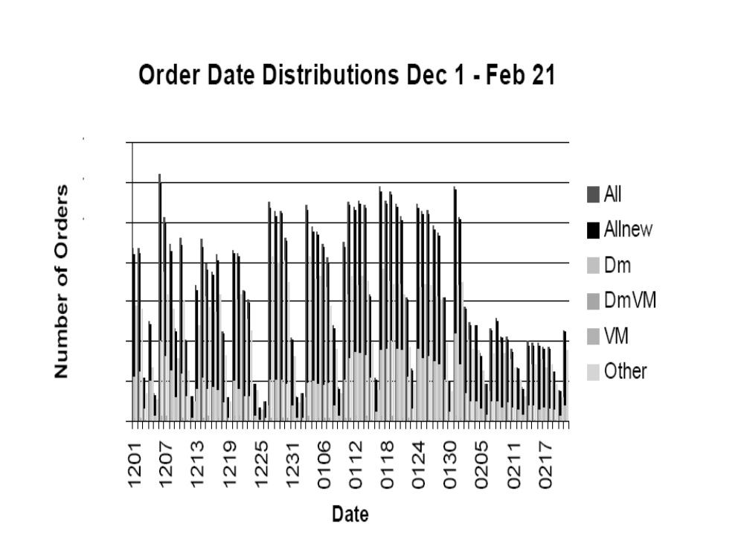
Viral Marketing Data: Response to Mailer
Two months after mailer calculated how many targets responded
EXPERIMENT
NET MKTG
LOCAL
COLLECTIVE
Notes:
This is field experiment
Take a break … working on Real experiment …. Large firm … spent time there … large … what is the service …. Real customers …. LARGE SCALE DATA FROM A LARGE SCALE FIELD EXPERIMENT IN A LARGE FONT
Segments, viral targets and viral non targets
Internet telephony service. Be more decriptive about the details here. Reduce confusion.

Slide 68


Do consumers who have already interacted with someone on the existing customer network respond to a direct mailer at a higher rate than those that do not?
Model Variables
Models
EXPERIMENT
Dependent Variable: Response to direct mailer RES
  If response is positive, RES = 1.
  If negative, RES = 0.
Independent Variables: Segment, traditional marketing attribute, viral attribute
  Segment 1-21
  Loyalty, Demographics, Geographics
  Binary Viral Attribute
Odds Ratio
ANOVA
Analysis of Deviance Table
Classification with Logistic regression evaluated by Area under the ROC curve
NET MKTG
LOCAL
COLLECTIVE
Notes:
Add results of classification

Slide 69
Do consumers who have already interacted with someone on the existing customer network respond to a direct mailer at a higher rate than those that do not?
Model Variables
EXPERIMENT
Dependent Variable: Response to direct mailer RES
  If response is positive, RES = 1.
  If negative, RES = 0.
Independent Variables: Segment, traditional marketing attribute, viral attribute
  Segment 1-21
  Loyalty, Demographics, Geographics
  Binary Viral Attribute
NET MKTG
LOCAL
COLLECTIVE
Notes:
Add results of classification

Slide 70
Do consumers who have already interacted with someone on the existing customer network respond to a direct mailer at a higher rate than those that do not?
EXPERIMENT
Model
Variable | Deviance | DF | Change Deviance | sig
Intercept | 11200
Segment | 10869 | 9 | 63 | **
Segment + Cell | 10733 | 1 | 370 | **
Segment + Cell + Interactions | 10687 | 8 | 41 | **
NET MKTG
Analysis of Deviance: The table confirms the significance of the main effects and of the interactions.
Each level of the nested model is significant when using a chi-squared approximation for the differences of the deviances.
The fact that so many interactions are significant demonstrates that the viral effect is stronger for different segments of the prospect population.
LOCAL
COLLECTIVE
Notes:
Add results of classification

Slide 71


Does collective inference help to improve target marketing?
Experiment Setup
EXPERIMENT
Dependent Variable: Response to direct mailer RES
  If response is positive, RES = 1
  If negative, RES = 0
  RES over two month time period after mailer
Independent Variables: Segment, traditional marketing attributes, viral attribute
  Segment 1-21
  Loyalty, demographics, geographics
  Binary viral attribute
  Local network attributes
  Collective inference prediction
Sample: Subset of viral targets
NET MKTG
LOCAL
COLLECTIVE
Notes:
What are the right baselines? Nearest neighbor with attributes + network attributes.

Slide 72



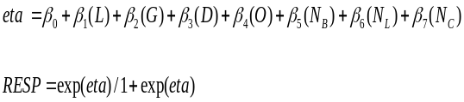

Guilt-by-association weighted-vote RN Classifier (wvRN)
Does collective inference help to improve target marketing?
Model
EXPERIMENT
NET MKTG
?
LOCAL
COLLECTIVE

Slide 73
Relational classifiers
Introduction
Toolkit
Case study
Relational classifiers for case study
  wvRN
  nBC
    Naïve Bayes on neighbor class labels
    Markov Random Field, following Chakrabarti et al. (1998)
      when uncertainty in neighbor labels
      some minor modifications
  nLB
    following Lu & Getoor’s (2003) Link-based Classifier
    for a node i, form its neighbor-class vector CV(i)
    logistic regression based on CV(i)
  cdRN
    for each class cdRN estimates neighbor-class distribution RV(c)
    p(y_{i} = c|N_{i}) is the normalized distance between CV(i) and RV(c)
      we used cosine distance
    compare with wvRN on bipartite class graph

Slide 74
Collective inference
Introduction
Toolkit
Case study
  iterative classification (following Lu & Getoor, 2003)
    initially assign a “prior” to all nodes using local classifier: p⁽⁰⁾(y_{i} = C)
    Select ordering O
    walk down chain, classifying with MAP classification
    Final class labels selected upon convergence or 1000 iterations
  relaxation labeling (following Chakrabarti et al., 1998)
    initially assign a “prior” to all nodes using local classifier: p⁽⁰⁾(y_{i} = C)
    estimate p^{(t)}(y_{i} = C) using relational classifier based on p^{(t-1)}
  Gibbs sampling (following Geman & Geman, 1984)
    Select ordering O on nodes, randomly
    initially sample labels based on priors
    walk down chain, estimating each class anew, sample new value based on estimated distribution
    repeat many times (for these experiments, 200 burnin then 2000)
    estimate class membership probabilities as frequencies y_{i} = c

Slide 75
Overview of Contributions
Question 1 – This is the first evidence that viral marketing exists in explicit cons
Question 2 – Show we can use constructed consumer network attributes to improve over traditional target marketing methods
Question 3 – First time collective inference has been used in a real-world target marketing problem
Notes:
I told you in the beginning ….
Here is a summary of the results …

Slide 76
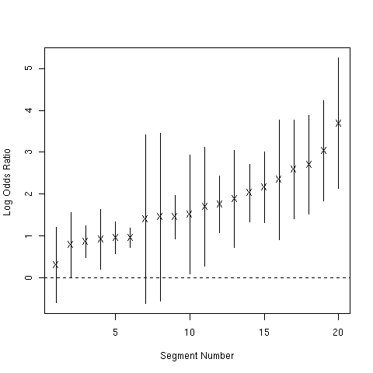
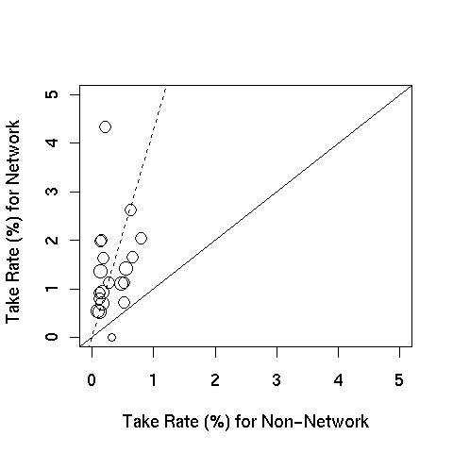
Essay 1: Results
Notes:
In the top plot, segment number on the horizontal axis, and log odds ratio on the vertical axis.
Now, if we look across all of the segments, we find that the log odds ration is greater than one which means greater than base rate in that group.
Another plot in the bottom half of the page has the take rate percent for the non-network neighbors on the horizontal axis and the take rate % for the netowork neighbors on the vertical axis. The dotted line has the slope of the base line, we see that some are greater and some are more .

Slide 77
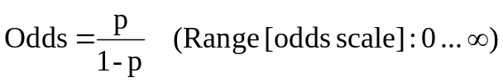
Prior Results
Model
Odds:
Odds Ratio: ratio of odds (focus: risk indicator, covariate) odds of responding to the mailer in network neighbor target group / odds in non-network neighbor target group
The odds ratio measures the ‘belief’ in a given outcome in two different populations or under two different conditions. If the odds ratio is one, the two populations or conditions are similar.
Notes:
In this plot, segment number on the horizontal axis, and log odds ratio on the vertical axis.
Now, if we look across all of the segments, we find that the log odds ratio is greater than “one” which means greater than base rate in that group.
Odds ratio of what to what. Confidence bounds of the odds ratio. Address it before asked. Odds of taking for the network neighbors versus not taking for non-network neighbors taking. Even chance.
Except for two segments that arent shown here --- don’t mention it.
A nice short way to describe this graph. Odds of network neighbor taking are greater than the odds of a non-network neighbor taking. Sometimes a lot … in almost all cases, the entire confidence interval across the line. The entire confidence interval is above the line. Focus in on little issues of stat significance. Forget about mentioning statistical significance. In all cases it is better.
The confidence bands effectively give a measure (statistical) of where the actual line can be expected to lie (within certain probabilities) - like a broad thick line that the actual line must lie within.87.102.33.144 16:19, 28 January 2007 (UTC)

Slide 78
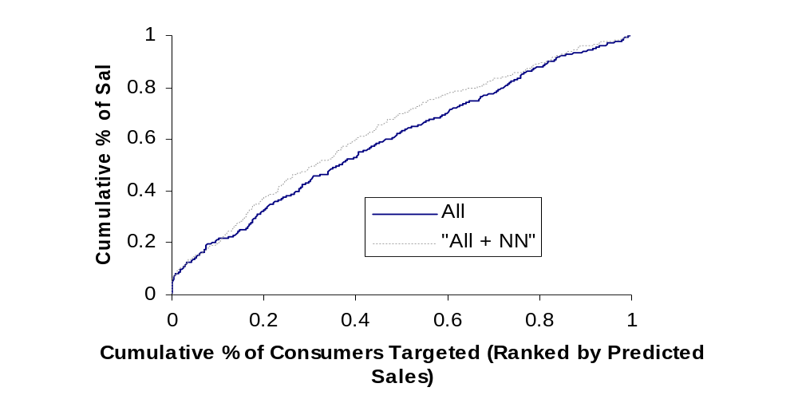
Prior Results
Notes:
We know the take rates are greater across the segments, but how can this help the firm?
Well, we can rank the customers better and this lift curve shows that when the NN attribute is included, we can rank the targets better.
For the same percent of customers targeted, we get a larger number percentage of sales across the board.
The question then becomes, Can we do even better?

Slide 79
Network-based Marketing
Experiment Setup
Dependent Variable: Response to direct mailer RES
  If response is positive, RES = 1
  If negative, RES = 0
  RES over two month time period after mailer
Independent Variables: Segment, traditional marketing attributes, viral attribute
  Segment 1-21
  Loyalty, demographics, geographics
  Binary NN attribute
Sample: All targets
Notes:
First experiment, just want to see if the binary attribute NN will help with ranking the customers.
The dependent variable is the response as a dependent variable
Second, Independent all variables including the binary attribute
The sample includes all of the targets
Say binary network neighbor attribute 3 times. 150 different attributes.

Slide 80
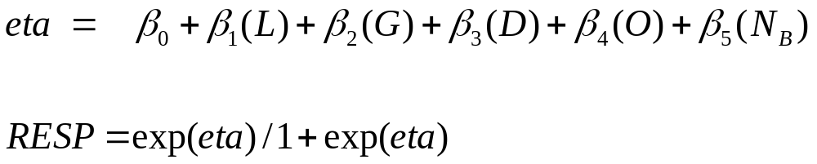
Network-based Marketing
Model
Logistic Regression:Logistic Regression across all segments including viral attributes.
{
}
Notes:
Add results of classification

Slide 81
Prior Results
Notes:
In this plot, segment number on the horizontal axis, and log odds ratio on the vertical axis.
Now, if we look across all of the segments, we find that the log odds ratio is greater than “one” which means greater than base rate in that group.
Odds ratio of what to what. Confidence bounds of the odds ratio. Address it before asked. Odds of taking for the network neighbors versus not taking for non-network neighbors taking. Even chance.
Except for two segments that arent shown here --- don’t mention it.
A nice short way to describe this graph. Odds of network neighbor taking are greater than the odds of a non-network neighbor taking. Sometimes a lot … in almost all cases, the entire confidence interval across the line. The entire confidence interval is above the line. Focus in on little issues of stat significance. Forget about mentioning statistical significance. In all cases it is better.
The confidence bands effectively give a measure (statistical) of where the actual line can be expected to lie (within certain probabilities) - like a broad thick line that the actual line must lie within.87.102.33.144 16:19, 28 January 2007 (UTC)

Slide 82
More Sophisticated Local Network-based Attributes?
Experiment Setup
Dependent Variable: Response to direct mailer RES
  If response is positive, RES = 1
  If negative, RES = 0
  RES over two month time period after mailer
Independent Variables: Segment, traditional marketing attributes, viral attribute
  Segment 1-21
  Loyalty, demographics, geographics
  Binary viral attribute
  Local network attributes
Sample: All NN targets
Notes:
Now for the nn targets, we can add more sophisticated network attributes
Setup .. Dependent variable … the only place you can do better.

Slide 83
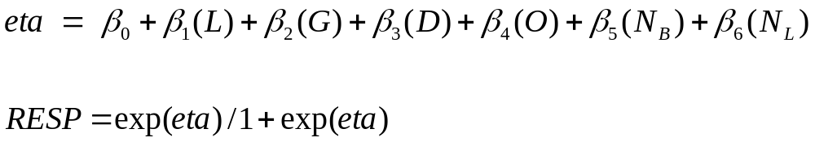
Local: Network Neighbor Attributes
Model
Logistic Regression:Logistic Regression across all segments including viral attribute, local network attributes
{
}
{
}
Notes:
Figure 6: ROC Curve for Network attributes for Loyalty Group 3 resulting from the application of logistic regression models built using all available attributes with (all + net) and without (all) the viral attribute. The associated AUC values are 0.61 and 0.70 respectively.

Slide 84
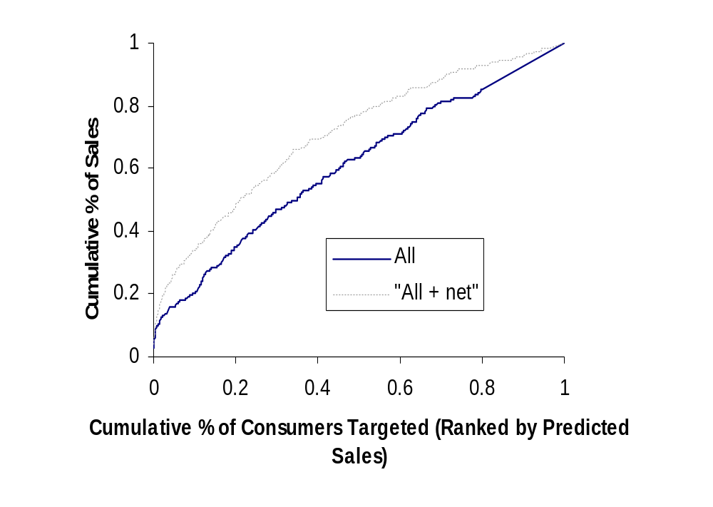
Ranking of “NN” targets
Notes:
For the network neighbor targets that we could already do better, we do even better when we include the more descriptive network attributes into the model.

Slide 85
Results: The bottom line
Hypothetical (future) profit improvement:
Notes:
What are the implications for this for profit.
This slight improvements might not seem significant for improvement in lift curve, but when we take this to a hypothetical profit calculation, it means a lot.
If we targeted 6 million customers, the cost was 20 cents … we compare the different profits for different response rates ..
So one percent better translates into sig profits! Forget about 4% better.
Can get into a big discussion about that . But let’s save it
Added … what are the bayesian thing … justification for doing the way I do.

Slide 86
Contributions
Results
Directed network-based marketing
  Consumers that have already interacted with an existing customer adopt a product (eg., respond to a direct mailer) at a higher rate than those that have not.
  Variables constructed from the consumer’s immediate network enable the firm to (classify/rank targets, generate profit) better.
Notes:
In summary, this is the first work that provides evidence that linked consumers lead to increased profits.
The results show that consumers that have already interacted with an existing customer adopt a product at a higher rate than those that have not.
Variables constructed from the consumer’s immediate network enable to firm to rank targets better.
Now the question is can we do more sophisticated analysis

Slide 87
Even more Sophisticated Network-based Attributes?
Can we use collective inference to make
simultaneous inferences about nodes on the graph?
  what about massive size of network?

Slide 88
Our Approach: Parameter Setting
We have now defined a representation of a dynamic graph by three parameters:
  θ − controls the decay of edges and edge weights
  ε − global pruning parameter
  k – local pruning parameter
For a given application, we choose the parameter values by optimizing predictive performance, selecting the parameters which optimize a distance metric
  Two distance metrics we apply:
    Weighted Dice
    Hellinger Distance
    … But may be domain dependent
For given distance metric
  Set ε to be a low tolerance value
  For a range of k, optimize θ
  Look at the plot to select parameters

Slide 89
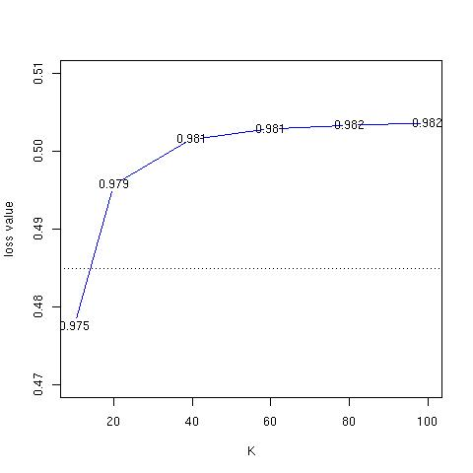
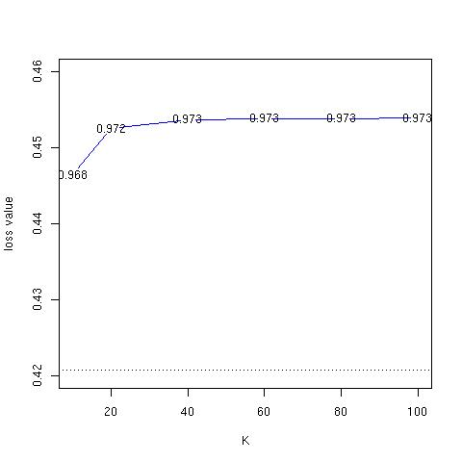
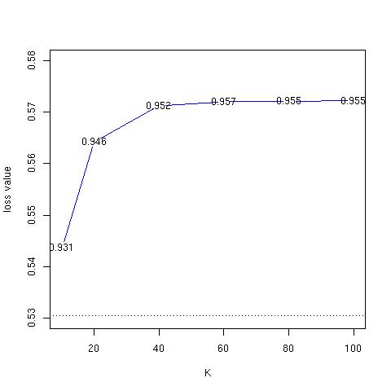
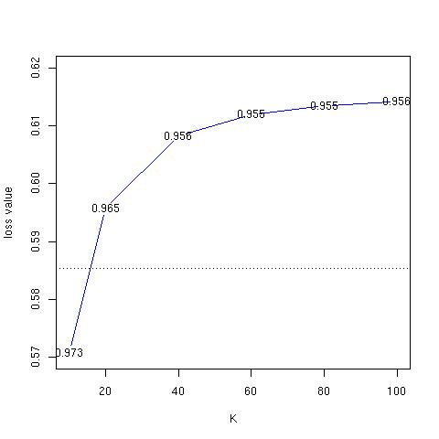
Our Approach: Parameter Setting
Default:
  θ = 1 , controls the decay of edges and edge weights
  ε = 0 , global pruning parameter
  k = ∞ ,local pruning parameter

Slide 90
Our Approach: Summary
Entities are updated daily for all 350 million phone numbers
Up-to-date representation of all entities. These entities are stored in an indexed data base for easy storage and retrieval
Our two main challenges:
  Scale: updates the entities on a daily basis, don’t have to retrieve it. Entities are concise summaries, and are indexed for fast retrieval
  Dynamic nature of data: entities are a summary of behavior over a time period (determined by θ) and can be tracked through time

