Slide 1
Social Attention
Bernardo A. Huberman
HP Labs
Notes:
This is a forward-looking point of view.
The big-picture questions we’re probing here are:
1) Where is the technology industry headed?
2) How is the customer experience going to change over the next five years?
We have five predictions we want to walk thru with you.
But let’s start with some context on where are we are today…what are the big shifts happening right now?

Slide 2
in the age of the web
and with the ubiquity of social networks,
the scarce - and valuable – resource is attention
attention not as an individual psychological mechanism, but as a social phenomenon
measured by the intensity of signals that relate to a particular idea, theory, product, research program, movie, book, etc.
Questions:
how do social networks mediate attention?
how does attention relate to the amount and intensity of information available?
what is the role that novelty and popularity play in eliciting attention?

Slide 3
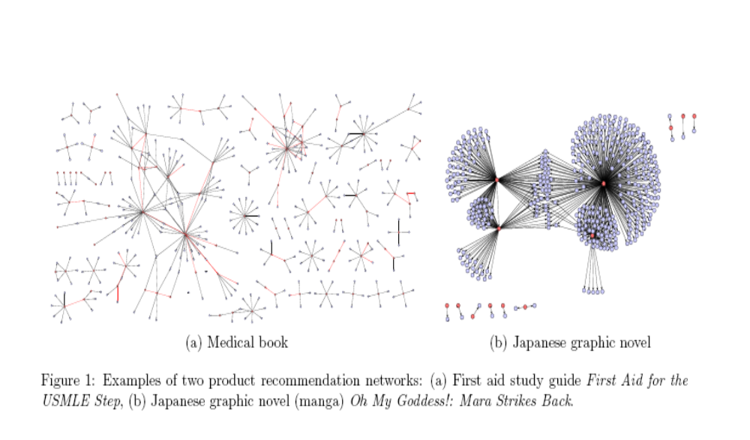
attention – the network dimension
a study of15 million recommendations from amazon.com
prediction: propagation short on average, but every once in a while it goes along way

Slide 4
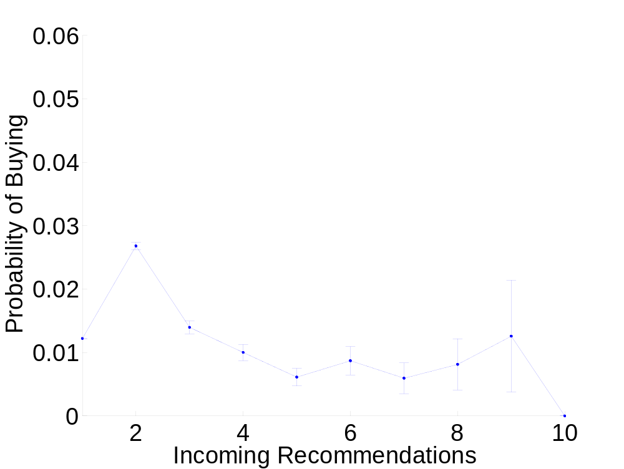
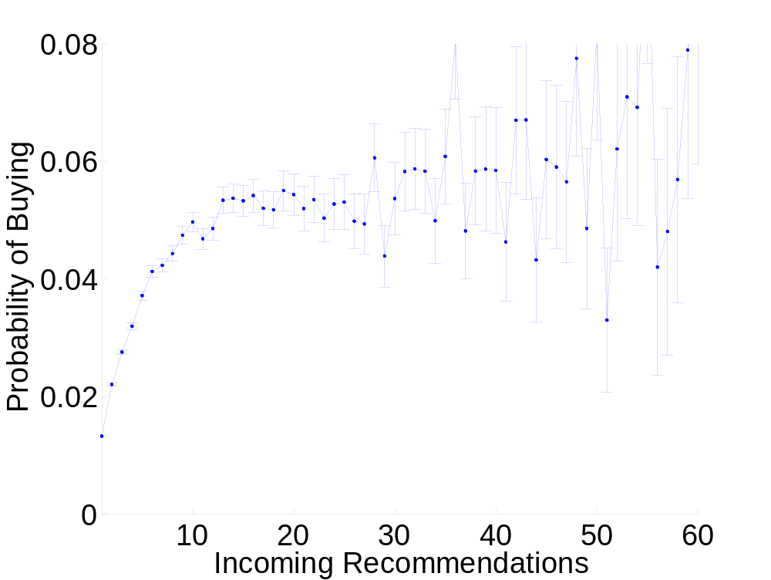
does receiving more recommendations increases the likelihood of buying?
BOOKS
DVDs
J. Lefkovec, L. Adamic and B. A. Huberman, ACM Transactions on the Web, Vol. 1, 5 (2007)

Slide 5


attention - the temporal dimension
we share with others what captures our attention
and when it fades we search for novel experiences

Slide 6

how does novelty interact with collective attention?
in a highly nonlinear but predictable way
prediction 1: attention among many items is distributed in a log-normal way
prediction 2: attention decays in time as a stretched exponential
F. Wu and B. Huberman, “Novelty and collective attention,” Proc. Natl. Acad. USA, Vol.105, 17599 (2007)

Slide 7
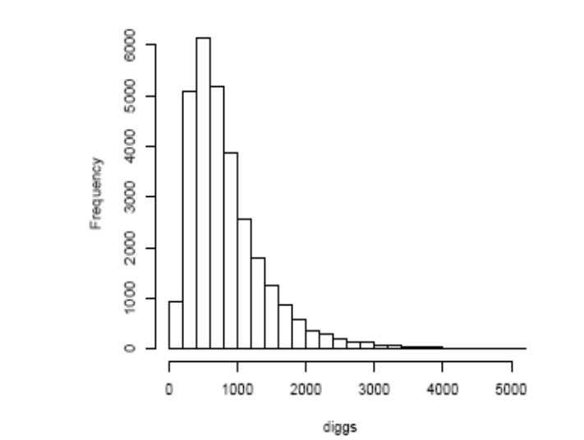
we studied 1 million users of digg.com
the allocation of attention among items is universal
distribution of digg numbers of 29684 stories
lognormal, as predicted

Slide 8
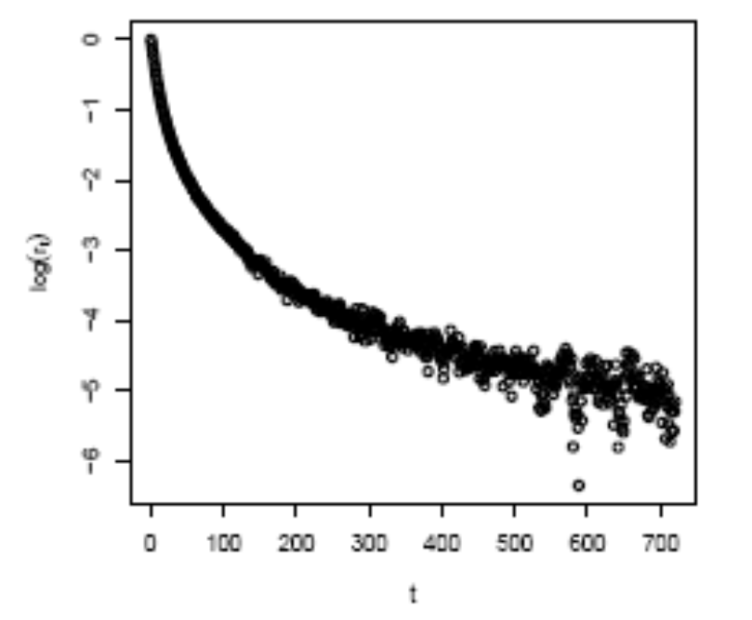
novelty decays in predictable ways:
as predicted: in stretched exponential fashion
story “half life”: 69 minutes

Slide 9
another problem
what is the interplay between popularity and novelty at eliciting attention?
it depends on the rate at which novelty decays
thus, measuring the decay rate allows to predict which (popularity or novelty) to prioritize in order to maximize attention

Slide 10
there is plenty more
e.g. other attention structures (like public opinions)
http://www.hpl.hp.com/research/scl

