Slide 1
Figma

Slide 2

Projekt nr 1

Slide 3
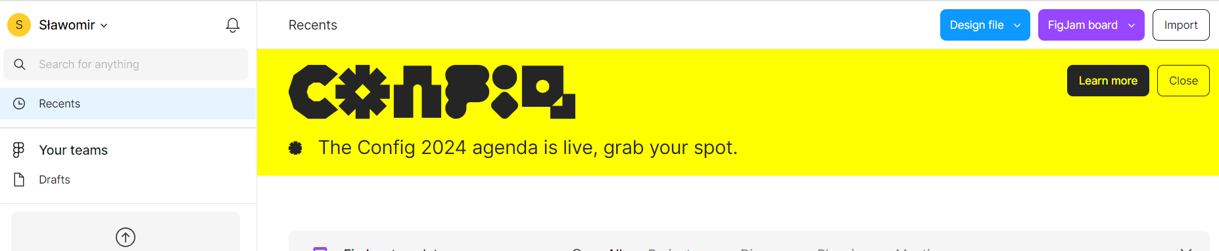
Importowanie projektu

Slide 4

Badanie elementów

Slide 5
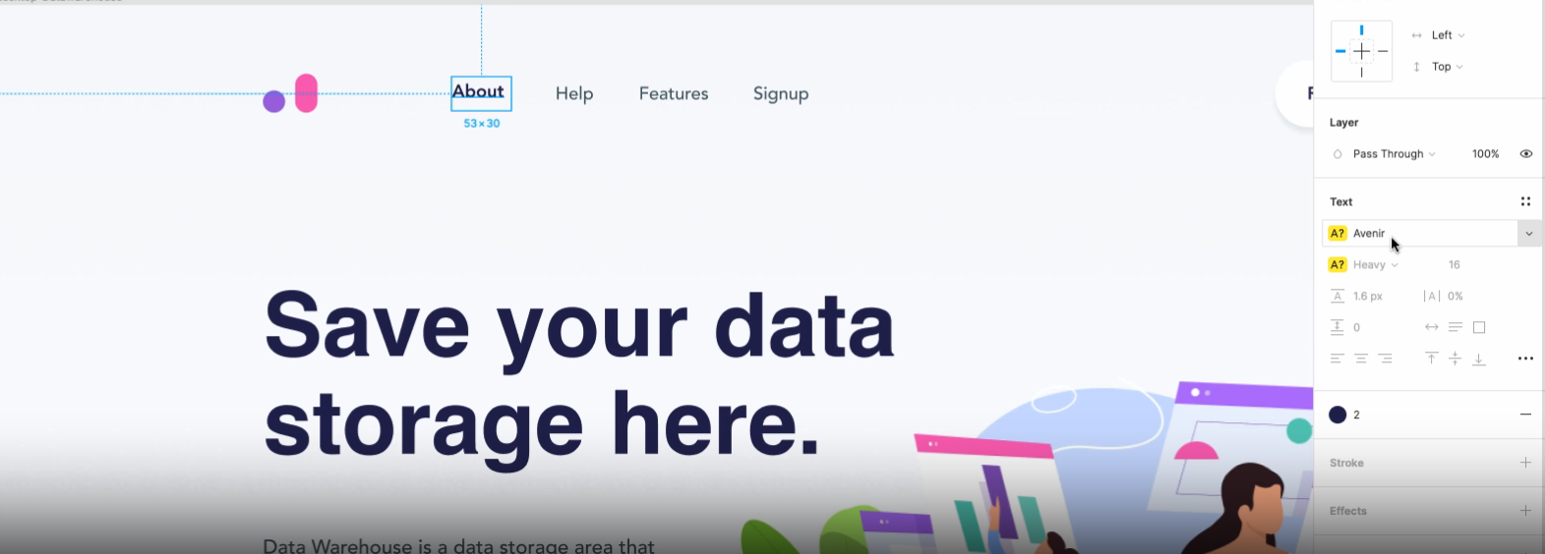

Slide 6

Badanie marginesów - alt

Slide 7
reset.css –paddingi, marginesy- wyrzuca oddzielne
/* http://meyerweb.com/eric/tools/css/reset/
v2.0 | 20110126
License: none (public domain)
*/
html, body, div, span, applet, object, iframe,
h1, h2, h3, h4, h5, h6, p, blockquote, pre,
a, abbr, acronym, address, big, cite, code,
del, dfn, em, img, ins, kbd, q, s, samp,
small, strike, strong, sub, sup, tt, var,
b, u, i, center,
dl, dt, dd, ol, ul, li,
fieldset, form, label, legend,
table, caption, tbody, tfoot, thead, tr, th, td,
article, aside, canvas, details, embed,
figure, figcaption, footer, header, hgroup,
menu, nav, output, ruby, section, summary,
time, mark, audio, video {
margin: 0;
padding: 0;
border: 0;
font-size: 100%;
font: inherit;
vertical-align: baseline;
}

Slide 8
/* HTML5 display-role reset for older browsers */
article, aside, details, figcaption, figure,
footer, header, hgroup, menu, nav, section {
display: block;
}
body {
line-height: 1;
}
ol, ul {
list-style: none;
}
blockquote, q {
quotes: none;
}
blockquote:before, blockquote:after,
q:before, q:after {
content: '';
content: none;
}
table {
border-collapse: collapse;
border-spacing: 0;
}

Slide 9
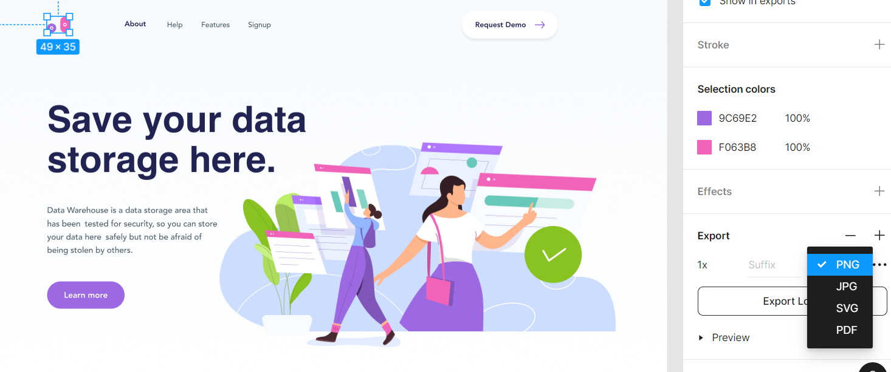
Eksport grafiki

Slide 10
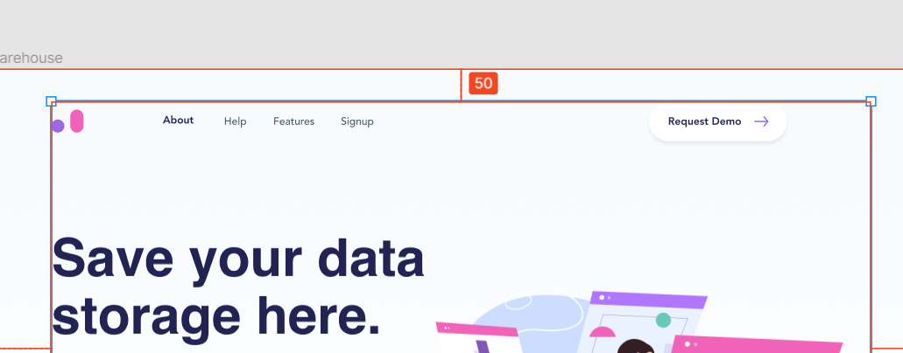
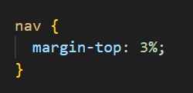
Marginesy

Slide 11
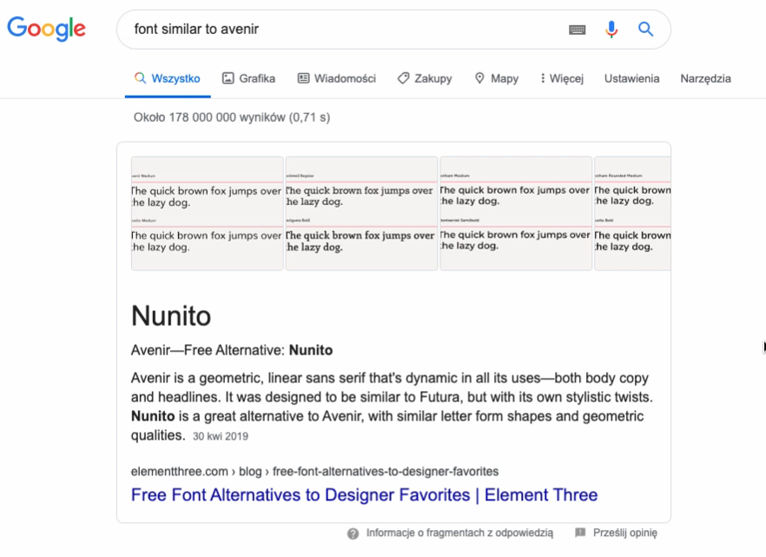
Czcionka podobna

Slide 12
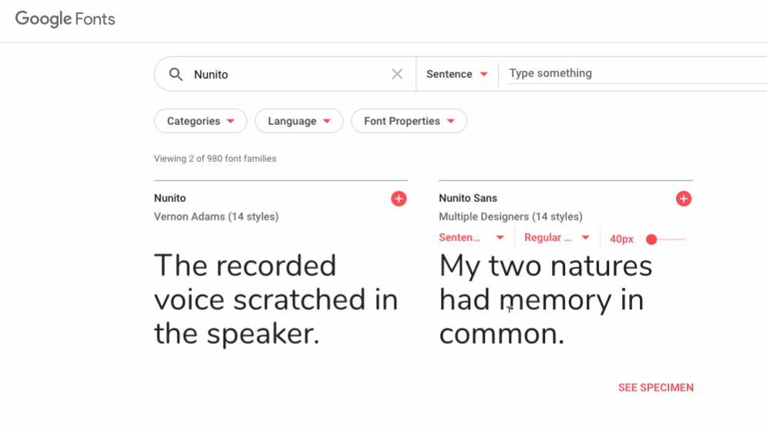
Google fonts

Slide 13
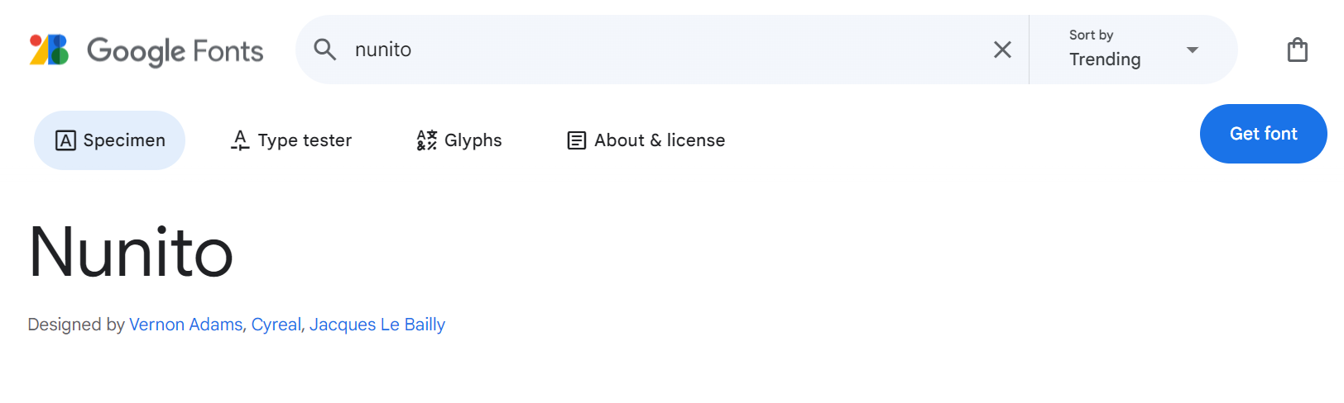
Nowsza wersja

Slide 14
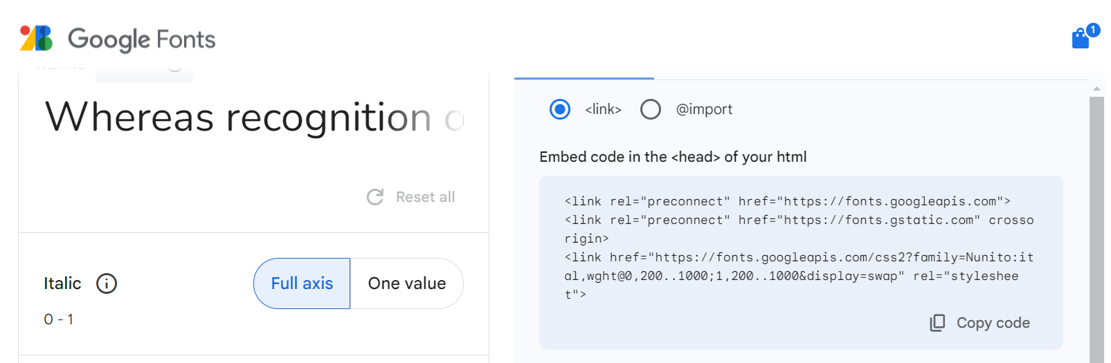
Import jako link

Slide 15
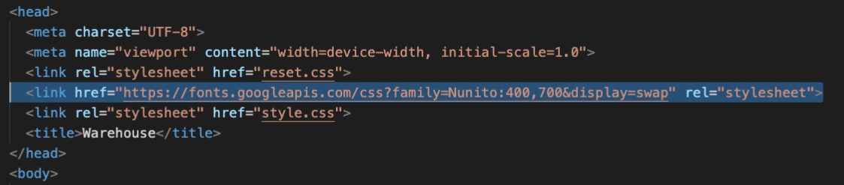
Gdzie ta czcionka

Slide 16
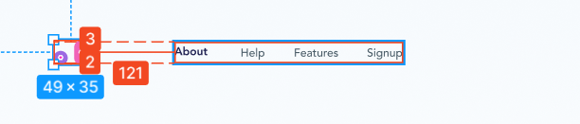
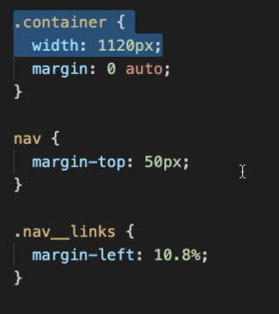
Odległości
121/1120=10,8%

Slide 17

Pobieranie kolorów

Slide 18


Zmienne do kolorów
Lub scss

Slide 19
Import w css

Slide 20
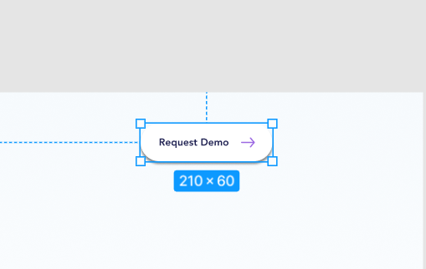
Button – eksport strzałki

Slide 21

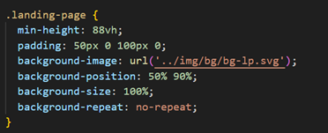
landing page

Slide 22

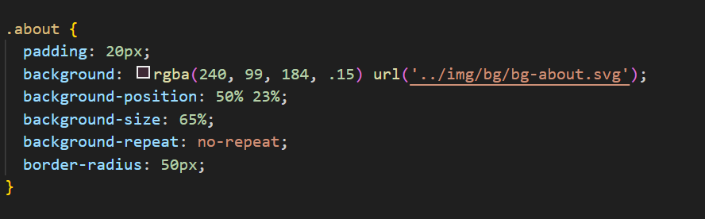
Abaut

Slide 23

Features
Pobranie tła i obrazka jako bacground

