Slide 1
REVIEW OF “COMMANDO: WINNING THE GREEN BERET” BY HUGH McMANNERS
PRESENTATION BY (RANK & NAME)

Slide 2
INTRODUCTION

Slide 3
INTRODUCTION (CONT)
Few emblems in the profession of arms command the prestige and mystique of the Green Beret of the British Commando.
Born in the Second World War, the Commandos became so feared that Hitler declared captured Commandos outside the protection of the Geneva Conventions.
Today the soldiers, sailors, airmen and Royal Marines of 3 Commando Brigade must pass the gruelling Commando Course to wear the beret.
Notes:
The distinction of the Commando lies not merely in physical toughness, but in a carefully engineered process of selection that tests determination, discipline, judgement and character under extreme fatigue. Understanding that process offers enduring insight into how elite forces are built and sustained.

Slide 4
INTRODUCTION (CONT)
“Commando: Winning the Green Beret” by Hugh McManners follows 638 Recruit Troop and All Arms Commando Course 4/92 through the winter of 1992.
It reveals that the essence of commando selection is mental: determination, discipline and character under extreme fatigue.
Described by Publishers Weekly as a “brief and arresting” account of why the Royal Marine Commandos are so highly regarded.
Notes:
The book grew out of a five-part television documentary which McManners devised with the producer-director Charles Thompson. It follows recruits and volunteers from the Army, Royal Navy and Royal Air Force as they battle the Final Exercise and the four Commando Tests for the right to wear the Green Beret.

Slide 5
AIM
To review the book “Commando: Winning the Green Beret” by Hugh McManners with the goal of assessing its scope and relevance and drawing lessons.

Slide 6
SCOPE
Biography of the Author.
Overview of the Book.
Summary of the Book.
Evaluation of the Book.
Lessons Learnt.
Conclusion.

Slide 7
BIOGRAPHY OF THE AUTHOR
HUGH McMANNERS

Slide 8
BIOGRAPHY OF HUGH McMANNERS (CONT)
Birth and Military Career
Born in Oxford in 1952 and raised largely in Australia.
Read Geography at St Edmund Hall, Oxford.
Commissioned into the Royal Artillery in 1973.
Passed the All Arms Commando Course and served five years with 148 (Meiktila) Commando Forward Observation Battery.
Qualified as a commando, military parachutist and army diving supervisor; ran the Army’s jungle warfare school in Belize.
Falklands War 1982: led a naval gunfire forward observation team with the Special Boat Service; Mentioned in Despatches.
Left the Army as a Major in 1989 after some 13 years with 3 Commando Brigade.
Notes:
Joseph Hugh McManners is a former British Army officer with first-hand experience of commando soldiering. He commanded a Naval Gunfire Forward Observation Party operating with the Special Boat Service in the Falklands and was Mentioned in Despatches for service between 21 May and 15 June 1982 (Commando Veterans Archive).

Slide 9
BIOGRAPHY OF HUGH McMANNERS (CONT)
Career after the Army
Defence Correspondent of The Sunday Times; also wrote for The Observer and The Daily Telegraph.
Television documentary producer; co-devised the series “Commando” on which this book is based.
Editor of Command magazine.
Author of some fifteen books, including “Falklands Commando” (1984), “The Scars of War” (1993), “The Commando Survival Manual”, “Ultimate Special Forces” and “Forgotten Voices of the Falklands” (2007).
Notes:
His blend of combat experience, insider knowledge of the Commando Brigade and journalistic skill makes him exceptionally qualified to write on the making of a commando. Falklands Commando was one of the first eye-witness accounts of combat in the Falklands War.

Slide 10
OVERVIEW OF THE BOOK

Slide 11
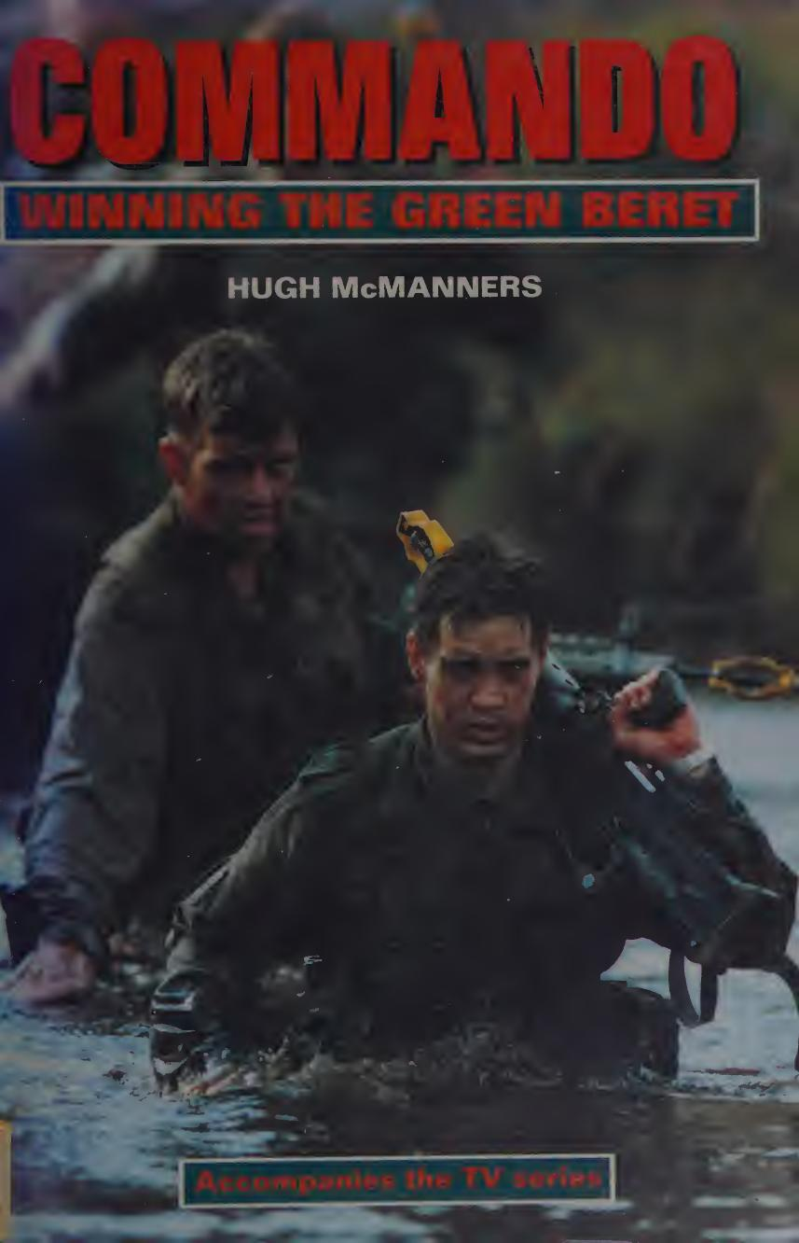
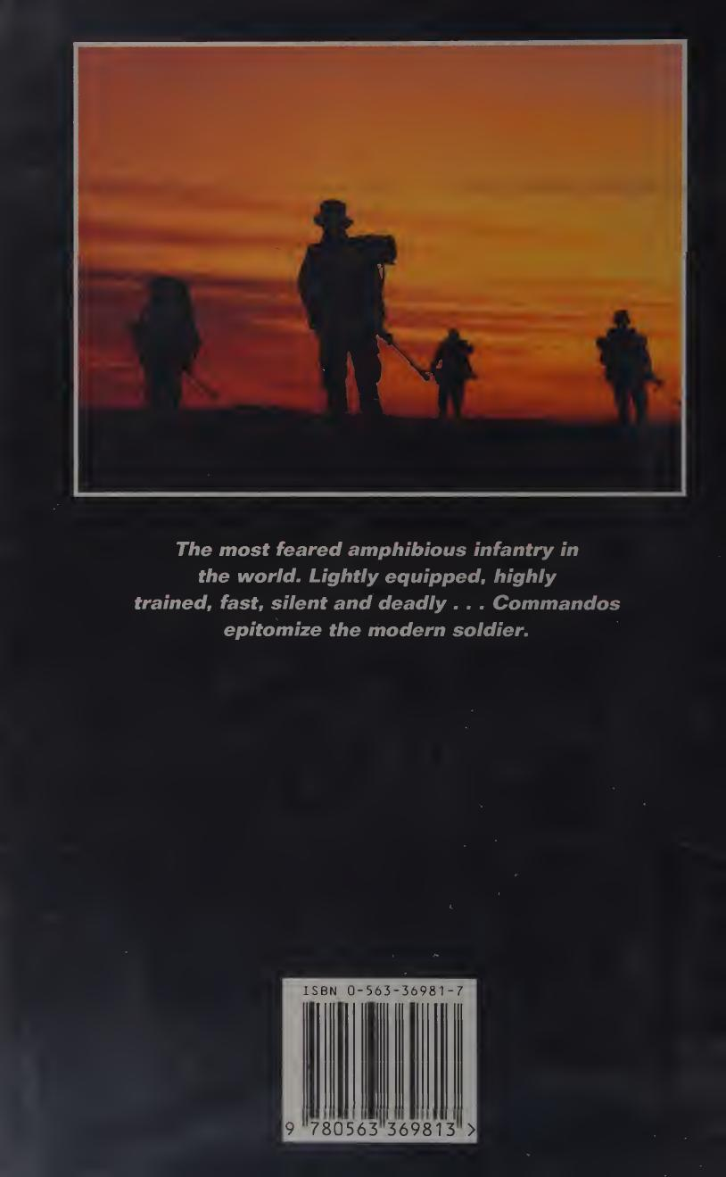
OVERVIEW OF THE BOOK (CONT)
Pictures showing the front and back covers of the book “Commando: Winning the Green Beret”
Source: McManners, H. (1994). Commando: Winning the Green Beret
Notes:
The hardcover features a striking dust jacket with a colour photograph of two mud-soaked recruits wading through water, the title in bold red, and a banner announcing that it accompanies the television series. The back cover carries a silhouette of commandos at sunset with the tagline: The most feared amphibious infantry in the world.

Slide 12
OVERVIEW OF THE BOOK (CONT)
Author: Hugh McManners
Year Published: 1994
Publisher: Network Books (BBC Books)
Place of Publishing: London, Great Britain
ISBN: 0-563-36981-7
Format: Hardcover
Number of pages: 192
Release Language: English
Price: from £2.75 (Amazon, used)
Notes:
The book contains an Introduction, seven chapters and an Epilogue, with an index. It is illustrated with black-and-white photographs taken during filming, an organisation chart of Commando Forces, a diagram of the endurance course and captioned group photographs. A Penguin paperback followed in 1995 and a revised Kindle edition in 2014.

Slide 13
SUMMARY OF THE BOOK

Slide 14
SUMMARY OF THE BOOK (CONT)
Introduction
Chapter 1: All Arms, Volunteer Commandos
Chapter 2: Dawn Assault
Chapter 3: Ambush
Chapter 4: 638 Troop – Dartmoor
Notes:
Introduction: history of the Commandos and the four Commando Tests; the essence of the tests is mental. Chapter 1: All Arms Course 4/92 - dunker trainer, cliff-climbing and the death dive; only 15 of 34 remain. Chapter 2: 638 Troop learn amphibious raiding at Poole and raid the Portland breakwater fort. Chapter 3: ambushed in their lorries, then their own dawn ambush; lessons in alertness and integrity. Chapter 4: advance to contact and night yomps on Dartmoor in relentless rain, ending with a dawn assault on a Napoleonic fort.

Slide 15
SUMMARY OF THE BOOK (CONT)
Chapter 5: The Reckoning
Chapter 6: 638 Troop – Commando Tests
Chapter 7: The End of the Road
Epilogue
Notes:
Chapter 5: the training team judge each recruit by asking, "Would I be prepared to go to war with this man?"; Recruit Jaftha battles his fear of the Tarzan course chasm. Chapter 6: the endurance course, 9-mile speed march, Tarzan assault course and 30-mile march. Chapter 7: Recruit Spink wins the King’s Badge; the All Arms volunteers receive their Green Berets and the King’s Squad pass out before the First Sea Lord. Epilogue: the new commandos in Norway, Belize and Bosnia; Jaftha finally earns his Green Beret in February 1993.

Slide 16
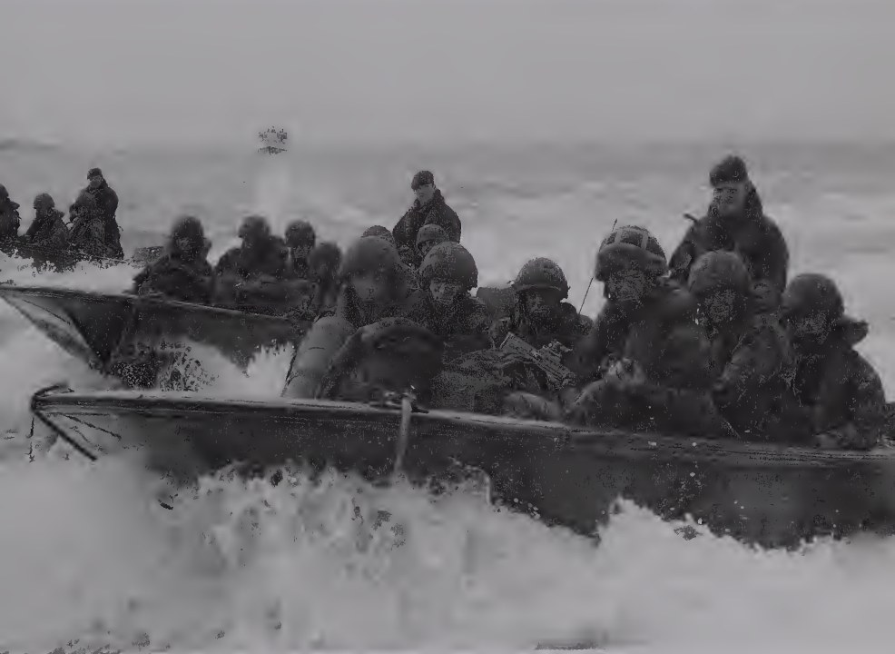
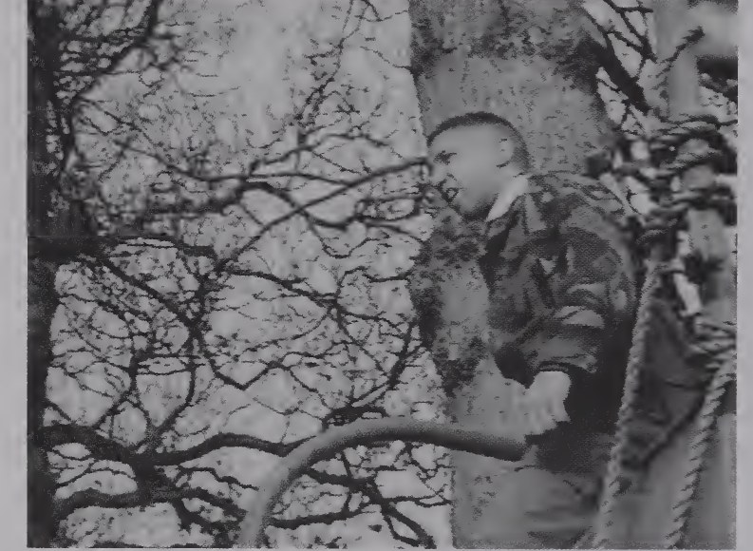
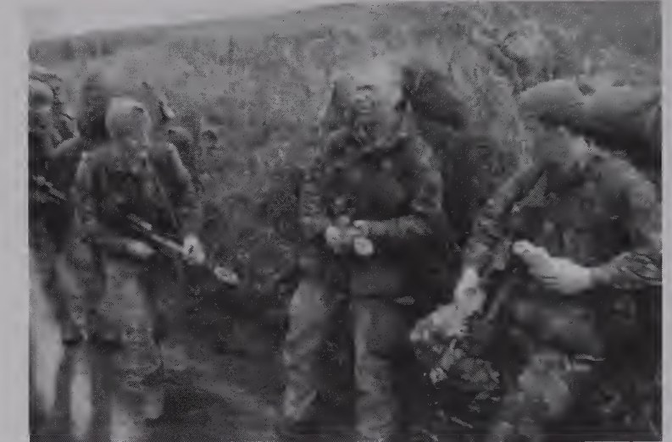
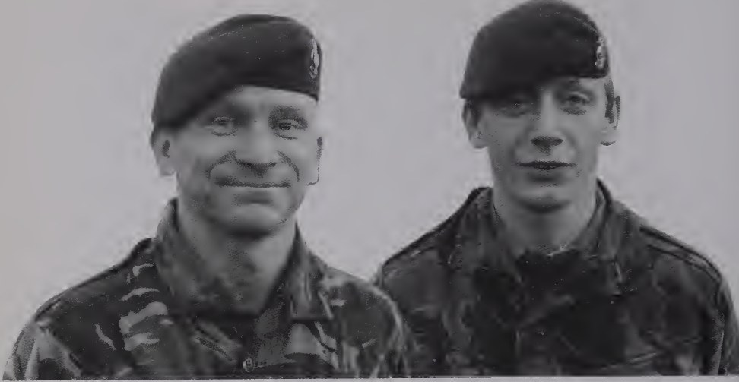
SUMMARY OF THE BOOK (CONT)
Scenes from the book: assault landing at Poole, Recruit Jaftha at the chasm, All Arms 4/92 on Dartmoor and new Green Berets
Source: McManners, H. (1994). Commando: Winning the Green Beret

Slide 17
EVALUATION OF THE BOOK

Slide 18
EVALUATION OF THE BOOK (CONT)
Significance of the Book.
Materials Used.
Facts Presented.
Clarity.
Readability.
Mental Stimulation.
Broad-mindedness.
Inspiration.
Notes:
Significance: one of the most authoritative insider accounts of commando selection; shows how a respected institution turns ordinary young men into elite amphibious soldiers. Materials: entirely original, drawn from first-hand observation and the recorded words of recruits and instructors; opens doors normally closed to outsiders. Facts: test standards, numbers and dates recorded with precision; the Commandant and training teams read the chapters before publication. Clarity: logical sequence building to the Commando Tests; terms explained as they arise; organisation chart, endurance course diagram and captioned photographs. Readability: present-tense, documentary immediacy; vivid scenes and lively dialogue make it a page-turner. Mental stimulation: real dilemmas of selection, standards and integrity invite the reader to ask what he would have done. Broad-mindedness: every voice is heard, from recruit to Commandant; failures are treated with dignity. Inspiration: Jaftha’s perseverance, and leaders such as Colonel Taffinder, Major Lear and Captain Williams who take hard decisions with fairness.

Slide 19
LESSONS LEARNT

Slide 20
LESSONS LEARNT (CONT)
Demonstrates that mental resilience, not physical strength alone, decides success under cold, fatigue and stress.
Underscores that personal administration and attention to detail are combat skills on which operational effectiveness depends.
Shows that common standards build trust and interoperability in joint and multinational operations, as in GAF peace support missions.
Notes:
For military officers, these lessons underline the need to build mental toughness deliberately into training and to enforce standards of personal discipline. Soldiers, sailors and airmen who pass the same tests as the Royal Marines earn the trust of the formation they join.

Slide 21
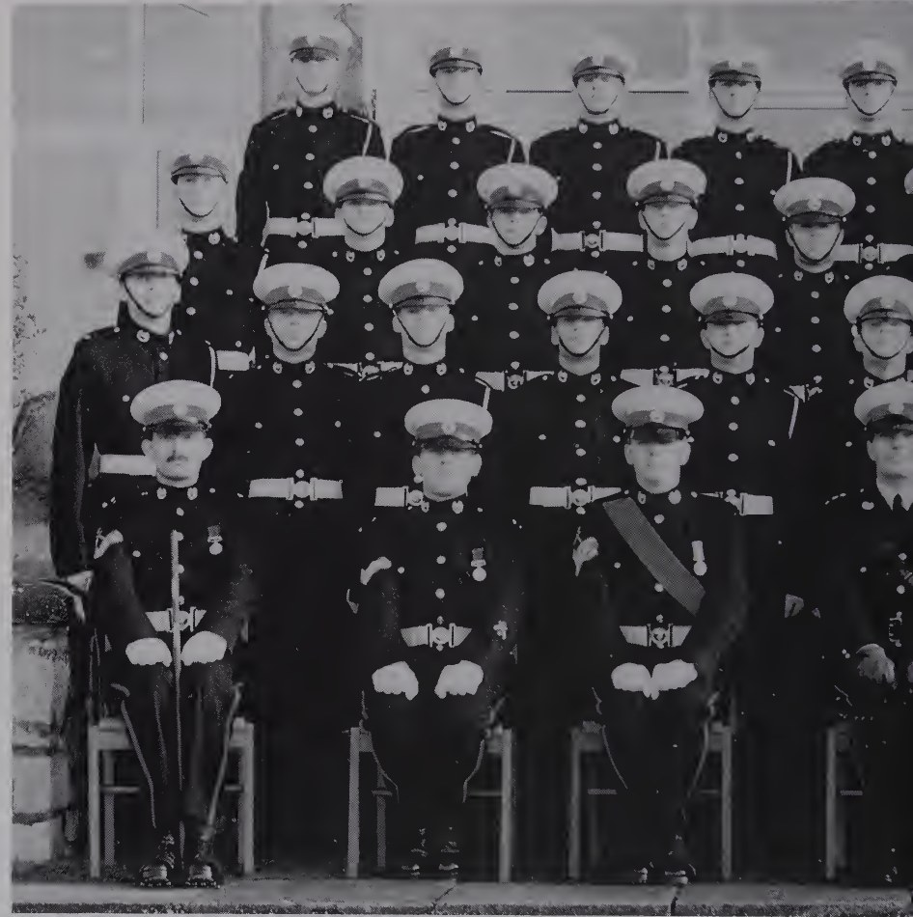
LESSONS LEARNT (CONT)
Highlights the value of leadership that combines firmness with fairness and assesses each soldier as a whole.
Reveals that thorough orders, rehearsals and brief-backs sustain operations when communications fail.
Illustrates that integrity is the bedrock of trust within a unit.
638 Troop, the King’s Squad, with their training team
Source: McManners, H. (1994). Commando: Winning the Green Beret
Notes:
The instructors and commanders portrayed in the book know their men and take difficult decisions with both rigour and compassion. Detailed orders and rehearsals kept the Portland raid on track when the radios failed, while lapses of honesty were dealt with severely.

Slide 22
CONCLUSION
Notes:
"Commando: Winning the Green Beret" by Hugh McManners vividly captures the journey of young recruits and seasoned volunteers through one of the most demanding military courses in the world. Its clear narrative, authentic dialogue and rich illustrations make the realities of commando training accessible to all readers. The book offers valuable lessons in resilience, discipline, leadership and integrity, and is highly recommended to all officers, particularly those engaged in training and the selection of soldiers for specialist units.

Slide 23
THANK YOU

Slide 24
REFERENCES
Commando Veterans Archive. (n.d.). Falklands Campaign – Mention in Despatches. Retrieved from: https://www.commandoveterans.org/node/5568
Commando Veterans Archive. (2013). The Four Commando Tests. Retrieved from: https://www.commandoveterans.org/node/5093
McManners, H. (1994). Commando: Winning the Green Beret. London: Network Books (BBC Books).
Melbourne University Publishing. (n.d.). Author profile: Hugh McManners. Retrieved from: https://mup.com.au/authors/hugh-mcmanners
Publishers Weekly. (1995). Review of Commando by Hugh McManners. Retrieved from: https://www.publishersweekly.com/9780563369813
Royal Marines History. (2020). HM King George V, The King’s Squad & King’s Badge. Retrieved from: https://www.royalmarineshistory.com
Wikipedia. (n.d.). Hugh McManners. Retrieved from: https://en.wikipedia.org/wiki/Hugh_McManners

Slide 25
QUESTION AND CONTRIBUTIONS

