Slide 1
Hidden entrepreneurs in card data
Detecting commercial activity on consumer cards
Mastercard Data Quest 2026 · AIESEC in Almaty
14,440 of 80,000 consumer cards (18%) run a business

Slide 2
THE TASK
Find people who run a business through a personal card
Who: sole traders and self-employed people who sell through ordinary consumer cards.
Goal: a predictive ML model that spots this hidden commercial activity reliably and fast.
No label: nothing in the data says a consumer is an entrepreneur.
Why the bank cares
Business tariffs: higher fees and POS acquiring revenue.
Cross-sell: working-capital loans, payroll projects, merchant acquiring, cash registers.

Slide 3
DATA
12.8M transactions, one data-quality fix that matters
Segment | Cards | Transactions
Business | 25,000 | 2,997,593
Consumer | 80,000 | 9,832,487
Merchants (reference) | 2,165
60,851 ad-platform payments coded 7012 (timeshares); merchant master says 7311 (ads). Fixed from the master.
12,831 purchases above 2.26M KZT kept: big tickets are normal for a business. Features use medians and logs.
No duplicates, nulls or non-positive amounts; every merchant found in the reference.
Oct 2025 to Mar 2026, synthetic data.

Slide 4
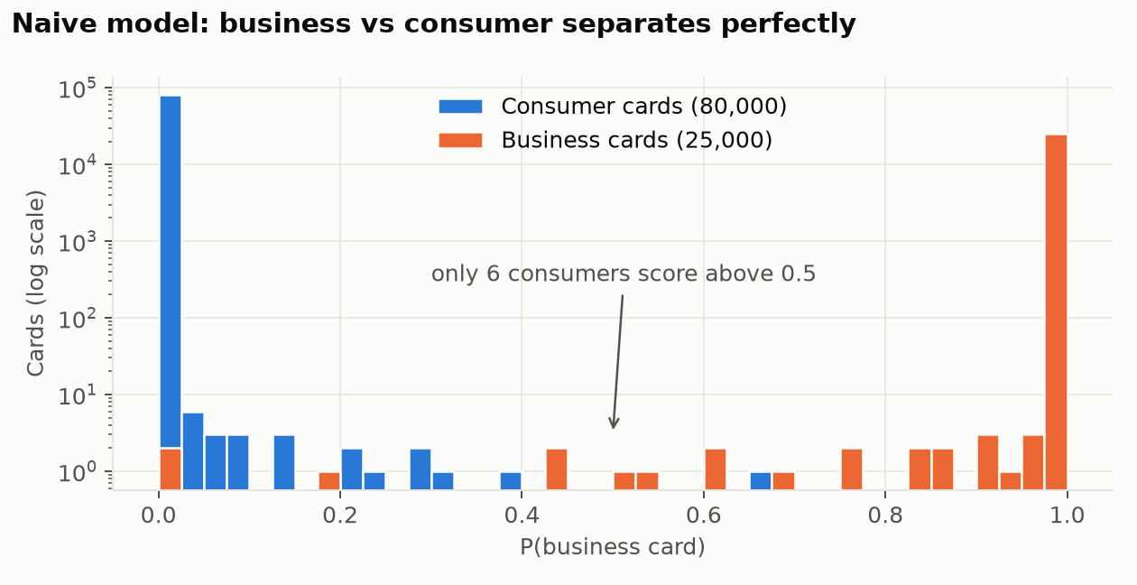
THE TRAP
The obvious model scores AUC ≈ 1.0 and finds 6 people
Business vs consumer is too easy: business cards here never buy groceries.
The model learns the card product, not the behaviour.
A hidden entrepreneur buys groceries on the same card, so this model calls them a consumer.

Slide 5
APPROACH
Weak supervision: label only where two independent views agree
1 Clean
MCC fix, outliers kept
2 Features
49 per card, MCC groups by ISO meaning
3 Personas
K-Means, 10 clusters
4 Silver labels
cluster AND rule agree
5 Models
LR · RF · boosting, 5-fold search
6 Checks
4 tests without our labels
Cluster view: the card sits in a persona whose median card spends ≥ 30% on business inputs.
Rule view: ≥ 25% of spend on business inputs and ≥ 2 commercial merchants used repeatedly; < 10% = clearly personal.
Result: 9,757 positives, 50,912 negatives, 19,331 ambiguous cards left for the model.
Card tier, bank and BIN never enter the model: they describe the product, not the behaviour.

Slide 6
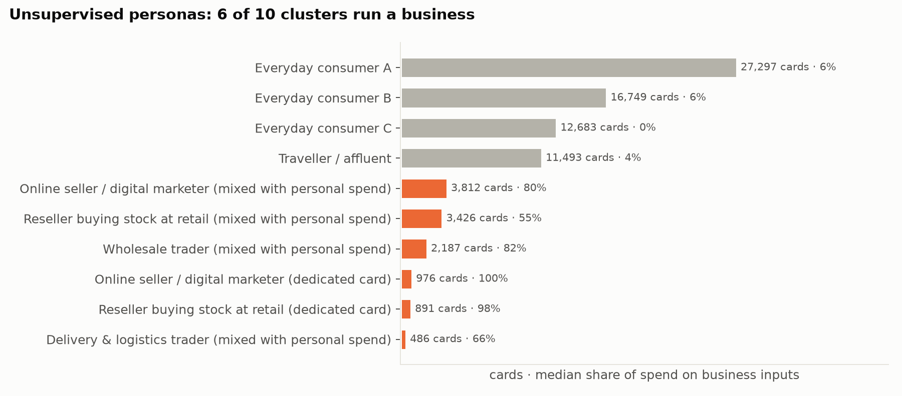
UNSUPERVISED DISCOVERY
Six of ten consumer personas run a business
Stable: 99.8% same commercial split across random seeds.
Resellers buy stock at building and food stores, where business cards never shop.

Slide 7
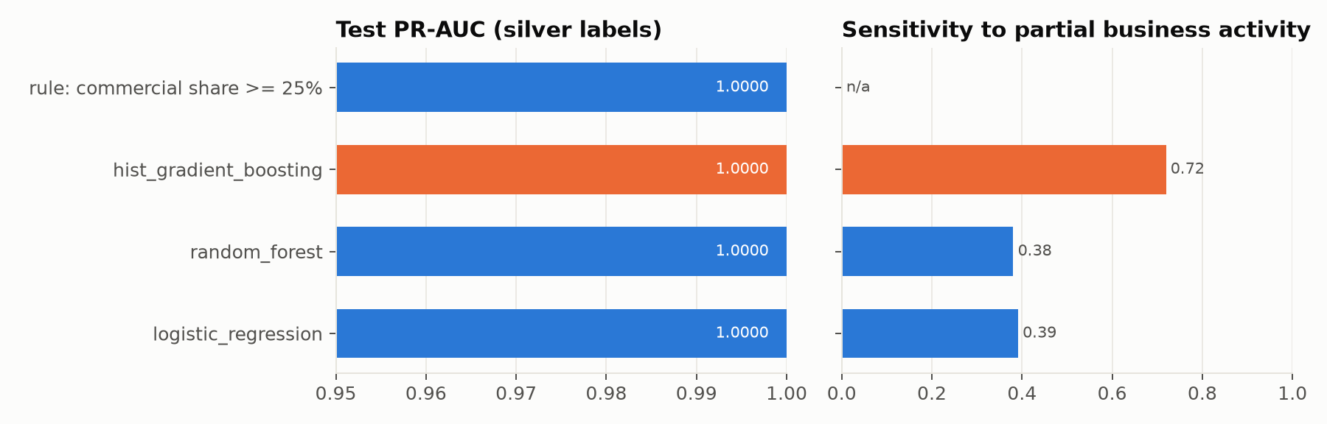
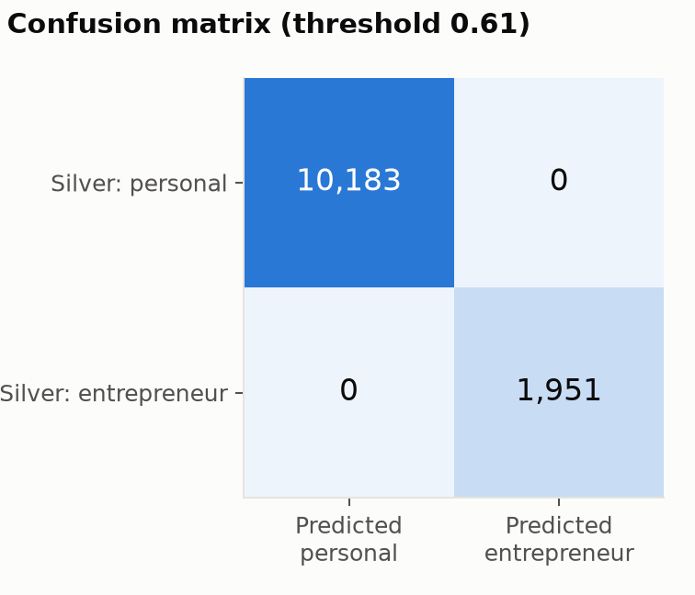
MODEL CHOICE
All models reproduce the labels; boosting handles partial business best
Champion: histogram gradient boosting, threshold 0.61 (max out-of-fold F0.5).
Tie on PR-AUC is expected: silver labels keep clear cases only. The tie-break is sensitivity to cards with 5–30% business activity (0.72 vs 0.38–0.39).
Boosting also scales: 80,000 cards scored in under a second.

Slide 8
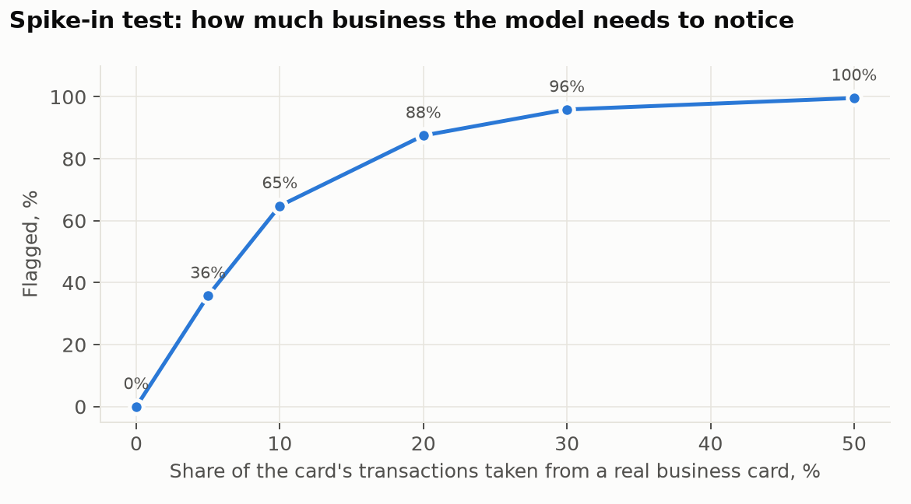
DOES IT WORK?
Four checks that never use our labels
Check | Result
Real business cards (never seen) | 99.99% flagged
MCC-blind model (how, not what) | ROC-AUC 0.9995 · F1 0.995
Spike-in: clean consumer cards | 0% false alarms
Spike-in: 10% / 20% business | 65% / 88% caught
Same decision Oct–Dec vs Jan–Mar | 93.6% of cards
MCC-blind check: labels come from what people buy; a model that sees only tickets, timing and merchant concentration finds the same people. The personas are real behaviour.

Slide 9
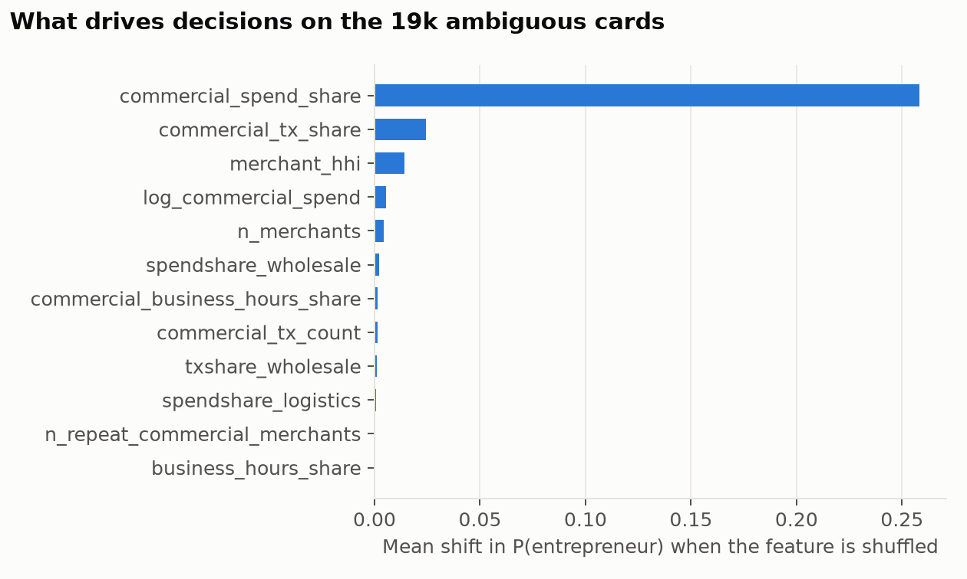
EXPLAINABILITY
Every flag comes with three reasons a banker can read
Examples
533847******4836 · 2-likely: 41% of spend on stock (building materials, food); 54% of purchases in business categories; 18% of spend at wholesalers
533847******4398 · 3-watchlist: 36% of purchases at wholesalers; 35% of spend at wholesalers; 37% of purchases in business categories
522859******6420 · 1-confirmed: 96% of spend goes to business inputs; 64% of purchases in business categories; 30 purchases in business categories

Slide 10
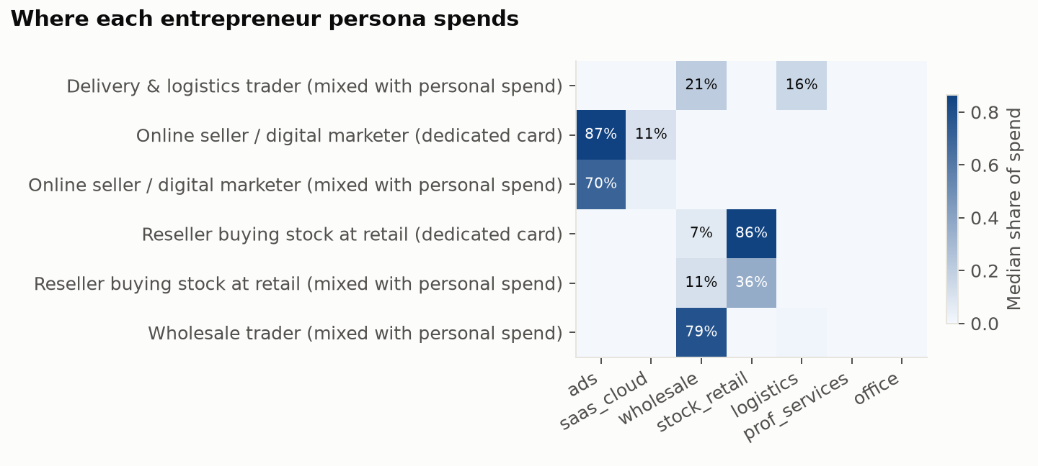
RECOMMENDATIONS
Who they are and what to offer
Persona | Cards | Offer
Online seller / marketer | 4,788 | Card with ad cashback, FX for SaaS, payment links
Reseller (stock at retail) | 4,317 | QR/POS acquiring, inventory loan, IP registration
Wholesale trader | 2,187 | Credit line, corporate card, payroll
Logistics trader | 486 | Fleet/fuel card, acquiring

Slide 11
BUSINESS CASE
Start with 9,757 confirmed leads
Tier | Rule | Cards | Commercial spend / year
1 confirmed | model + cluster + rule | 9,757 | 199.0 bn KZT
2 likely | model + one view | 3,199 | 32.5 bn KZT
3 watchlist | model only | 1,484 | 3.6 bn KZT
≈ 347M KZT a year
Illustrative: tiers 1–2, 15% conversion, +1% revenue on commercial spend after moving to a business tariff. Replace with the bank's own numbers.
4,683 flagged cards came from the ambiguous zone: the model adds leads the rules alone would not send.
Use the score to offer a better product, never to report or reprice clients without consent.

Slide 12
HONEST VIEW
Limitations and next steps
Limitations
Synthetic data with clean personas: real scores will be lower.
Silver labels come from my own cluster model and rule.
Spend side only: the brief mentions incoming payments from many counterparties, which the data does not include.
MCC dictionary is expert-made and needs product-team review.
Next steps
Pilot: managers call a random sample per tier; outcomes become real labels; retrain.
Add inflow features: distinct senders, regular incoming transfers.
Monthly re-scoring with drift monitoring on features and persona sizes.

