Slide 2
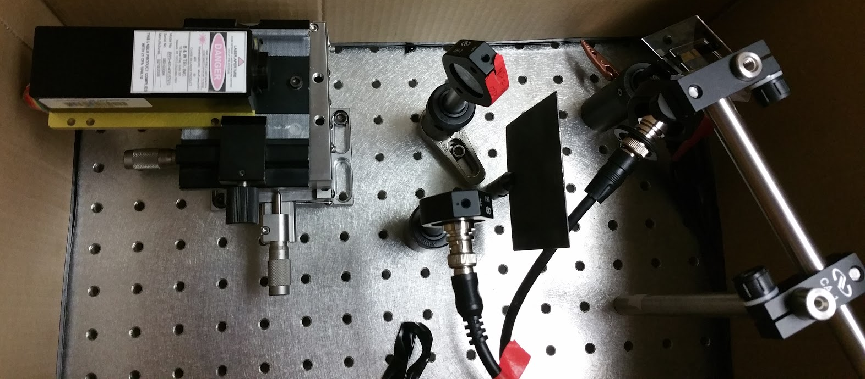
Integrated PL - Origins
Initially, we were working on a setup that could do optical degradation of devices
Would allow single carrier currents under PL excitation to show sensitivity to electron or hole current
ND Filter
“Beam Splitter”
Device
Laser
Device Signal
Laser Signal

Slide 3
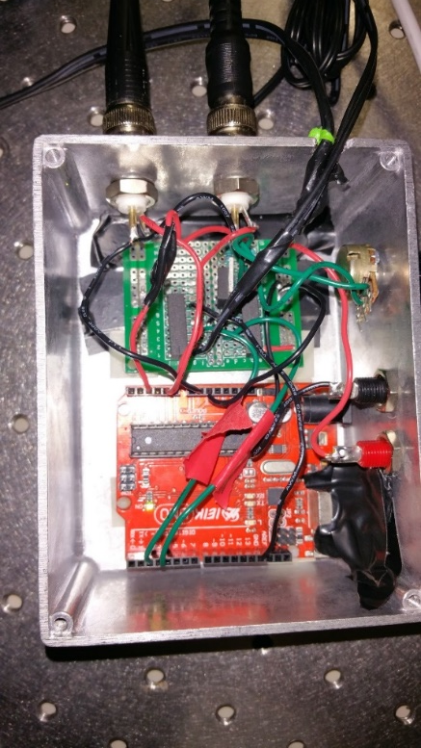
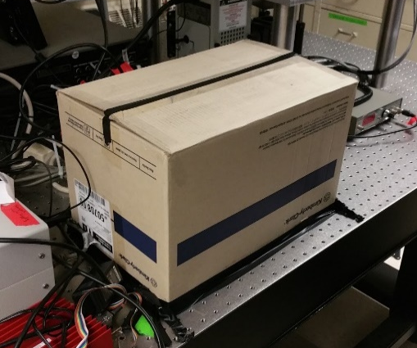
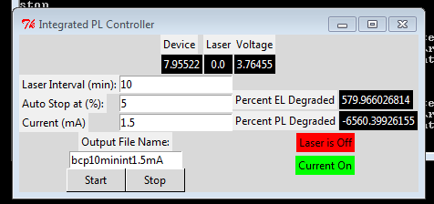
ND Filter
“Beam Splitter”
Device
Laser
Device Signal
Laser Signal
a.
b.
c.
d.

Slide 4
Integrated PL – Gen 1 Development
Microcontroller controls laser and measures power
Source Meter measures device power and sources current
Control software synchronizes both devices and records data
Optics housed in economical dark enclosure

Slide 5


Box Setups
Hardware
Software
Device
Source/Measure
NI VISA
Python
GUI
Detection
$$×N$$
Laser
Laser Detector
Arduino
Serial
Version 1 & 2
Hardware
Software
Device
Source
NI VISA
Python
GUI
Detection
$$×N$$
Laser
Measure
Laser Detector
Arduino
Serial
Version 3

