Slide 1
Mu2e DAQ Data Rate problem of constructing a 120GB/s DAQ.
Developing a load test simulation on commodity cluster hardware for the event building function.
A work in progress, done mostly on free time, not much beauty here.

Slide 2
Questions
What can be learned from existing cluster hardware and software?
  Can MPI be for this study? Can it be used in the construction of DAQ software?
  Can standard high-speed networks be used in event construction? Can the standard PCIe bus be used here?
Can we simulate the data movement actions with existing hardware and software?
What simplifying assumptions can be made to to help with test constructions?
What are the key elements and how are they organized?
How different will the future hardware be?

Slide 3
Fundamental DAQ Components
Detector – the I/O cards that deliver the detector signals to the cluster node. Sits on the PCIe bus. Each card delivered a fraction of the channels.
Source – Reads detector data and helps with the sorting operation by shuffling events out to the processing destination.
Sink – Receives fragments from all sources to assemble a complete event. The filtering will also be controlled from this point.
Builder Node – a node that performs the detector signal reading and the sink function. This means that a fraction of the full events will be collected at each of these. (NOTE: there are lots of cores on a cluster node now and in the future)

Slide 4
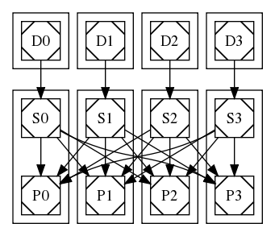
Example Event Builder Config
Sources deliver fragments to sinks based on event ID.
Fragment delivered in a round-robin fashion to sinks.

Slide 5
Possible hardware config
IB NIC
FEB
Signal
Receiver
Source
Sink
FEB
Threaded Filter
Program
Signal
Receiver
IB NIC
Write
IB Network
PCI Express

Slide 6
Configuration Constraints
Detector and source relationship is 1-1.
Source to sink relationship is 1-many.
Detectors sit on their own nodes: their purpose is to take up incoming data bandwidth on the bus of the Sources, to emulate a hardware function, and not be the bottleneck in this problem.
Builder nodes must contain a source function and a detector function.

Slide 7
Study
Given a set of nodes (4, 8, 16, etc.), what is the best organization of components to maximize throughput given the above constraints?
In other words: Given the chosen processing pattern and components, resources, and data, can we find a geometry and data organization that maximizes throughput?
Is this throughput predictable when a different number of nodes are involved? What about when different capacity networks/buses are used?

Slide 8
Parameters
Primary
  Number per node:
    Detectors
    Sources
    Sinks
  Event size (message size)
  Node Count
Secondary
  Outgoing and incoming buffer sizes

Slide 9
Measurements
Receive function
  Start,
  Data ready,
  Receive complete,
  Buffer post complete
Send function:
  Start,
  Acquire buffer complete
  Send complete
Event begin, complete times
Job begin, end times
(detector to send, sources to both, sinks to receive)

Slide 10
Configuration Generator
Parameter ranges
  dets_per 1..3
  srcs_per 1..4
  sinks_per 1..4
  event_sizes [50KB,100KB,200KB,400KB,800KB,2MB]
Full run is ~384 configurations
mpirun -hostfile hostfile_126.txt -n 20
./builder 8 682347 2 4 2 204800 5 126
$ cat hostfile_126.txt
ds0609 slots=2
ds0610 slots=2
ds0611 slots=2
ds0612 slots=2
ds0613 slots=4
ds0614 slots=4
ds0613 slots=2
ds0614 slots=2
682347 = event count
204800 = event size
8 = number of nodes
2 4 2 = dets,srcs,sinks per node
5 = buffers
126 = run number
20 = number of MPI processes (ranks)

Slide 11
Key Program features
Walk through the code

Slide 12
Parameter Options
Why these choices?

Slide 13
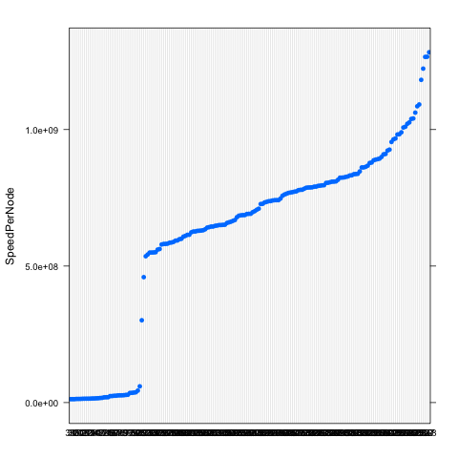
Speed / Node

Slide 14
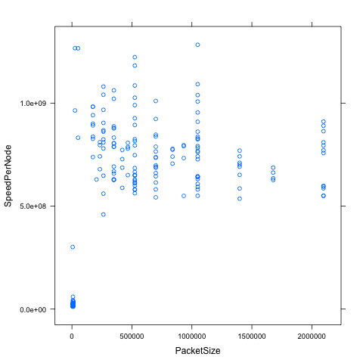
Speed – Packet Size

Slide 15
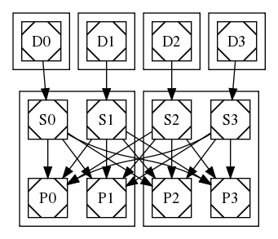
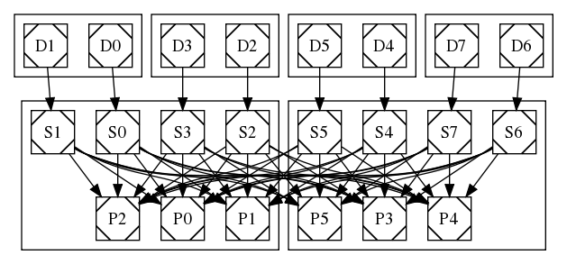
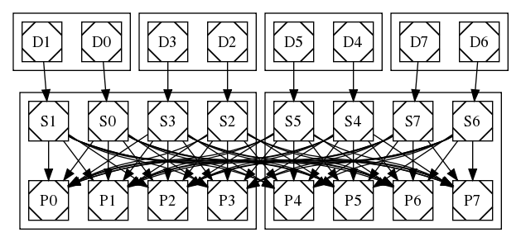
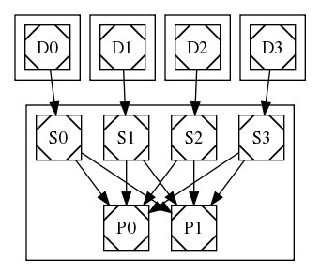
Fastest
Run MaxTicks SpeedPerNode PacketSize
16429 368 21.794135 1283006958 1048576
5509 127 25.983938 1266551463 25600
4516 102 26.105673 1266037479 51200
11295 254 6.858416 1223111604 524288
11313 255 7.096857 1182017323 524288

Slide 16
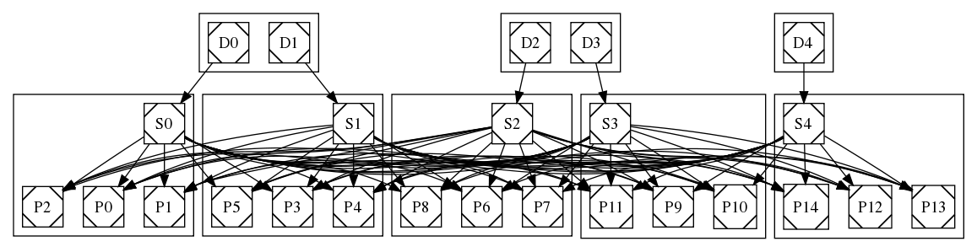
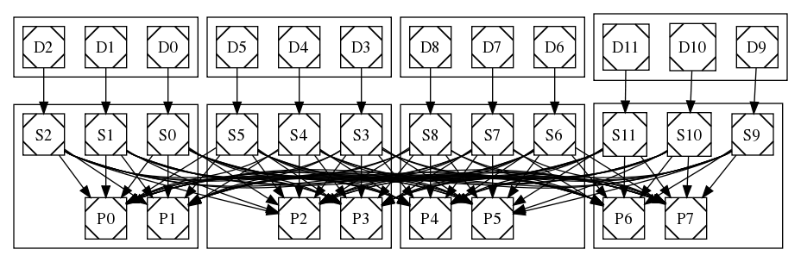
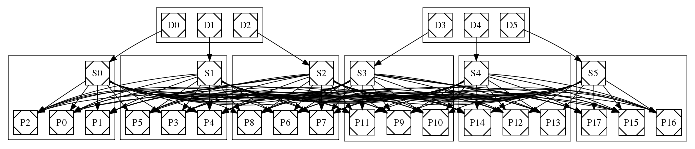
Slowest
Run MaxTicks SpeedPerNode PacketSize
1816 43 24.97084 14510916 4266
1230 33 26.29568 14290093 8533
973 27 25.35372 14262199 5688
533 18 23.50485 14155003 10240
1735 42 28.31244 13886284 4266
355 12 23.22728 13423415 8533
633 20 25.34346 13294826 10240
576 19 25.10087 13253609 10240
1318 35 25.20291 12446328 8533
1279 34 25.09122 12436949 8533
1444 36 25.19648 12430458 8533

Slide 17
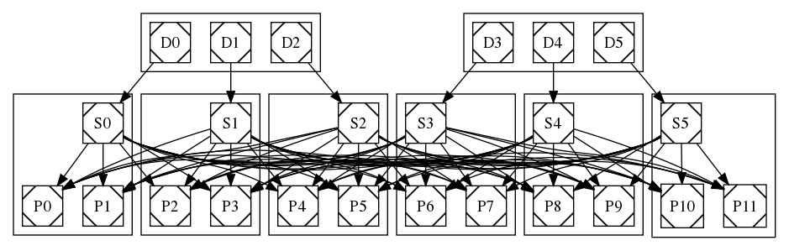
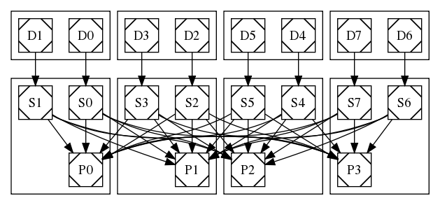
Medium (1/2 performance)
Run MaxTicks SpeedPerNode PacketSize
15889 357 38.13438 549937355 1048576
16097 361 40.70492 549555372 932067
15251 337 38.16873 549442409 2097152
14334 322 19.33478 542325659 699050
16657 372 39.13407 535888904 1398101

Slide 18
Future
Complete runs for 10G, 20G, 40G networks using different numbers of nodes.
See if a model can be constructed that predicts performance given future network and bus speeds.
Put art into the picture to simulation the filtering actions that must occur on the builder nodes.
Put an event logging stage in that moves full events that pass the filter off the builder.
Try to optimize some of the more difficult buffering parameters

Slide 19
MPI
Is MPI a good choice?
What are the advantages and disadvantages?
What needs to be changed?

