Slide 1
A Flask introduction for the absolute beginner

Slide 2
What is Flask

Slide 3
Flask vs Django

Slide 4
Learn Flask
Official Documentation
Stack Exchange
This talk

Slide 5
Install
pip install flask

Slide 6
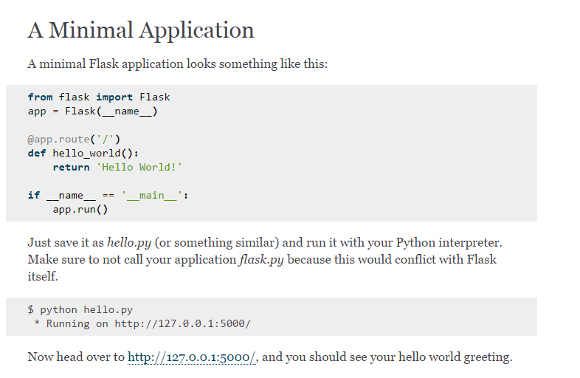

Slide 7
Objective
Stumbleupon ripoff
Sqlite

