Slide 1
Everyday Automations Using Python
Read & Append Multiple Text Files From Multiple Directories Python
Tutorial 7

Slide 2
Use case
A directory contains 81 subdirectories
Each subdirectory contains multiple csv files
Goal is to read all csv files from the sub directory and write (append) all files data to a single file
Prerequisite glob module for search

Slide 3
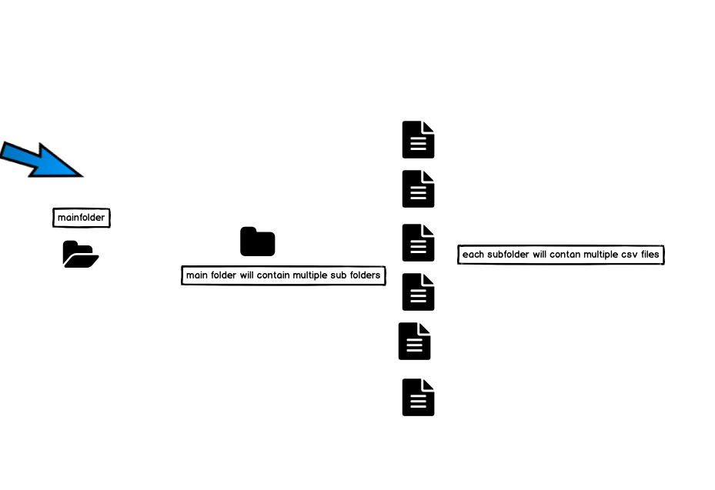
Use case

Slide 4
How to serach and read specific files types from a directory
import glob
import os
import io
import time
Read files with .csv extension

Slide 5
Full Use Case Code:using for loop only
import glob
import os
import io
import time
start=time.perf_counter()
cd=os.getcwd()
dirs=glob.glob(cd+"/*/*/")
def read_file(dir):
files=glob.glob(dir+"*.csv")
for file in files:
with io.open(file,"r",encoding="utf-8")as f1:
data=f1.read()
data=data.split("\n")[1:]
data1="\n".join(row for row in data)
with io.open("output.csv","a",encoding="utf-8") as f2:
f2.write(data1)
f2.close()
f1.close()
for i in range (len(dirs)):
read_file(dirs[i])
end=time.perf_counter()
print(f"time taken {round(end-start,2)} seconds")

Slide 6
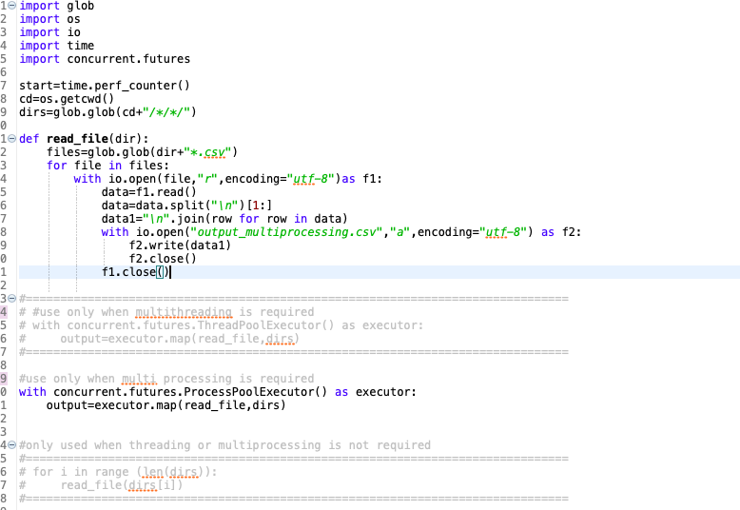
Full Use Case Code:using for loop & multi threading

Slide 7
Full Use Case Code:using for loop and multi processing

