Slide 1
Everyday Automations Using Python
Convert Csv File Into Json Using Python
Tutorial 8

Slide 2
Use case
We have one csv file , we would like convert the csv into json file

Slide 3
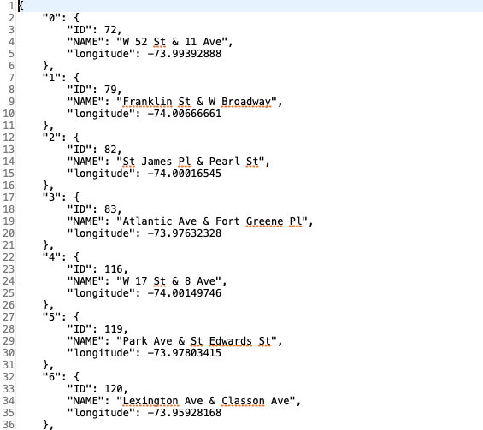
Use case

Slide 4
Convert csv file into json
import io
import pandas as pd
import json
df=pd.read_csv("stationlist.csv")
dc=df.to_dict(orient="index")
with io.open("output.json","w",encoding="utf-8")as f2:
f2.write(json.dumps(dc,indent=4))
f2.close()

