Slide 1
Library Management System
Kevin Wilkosz
INFO-C 451

Slide 2
Brief Summary of the System
This system is meant to easy the use of the library for the users and the employees
Logging in
Login Error
Registration
Closing application

Slide 3


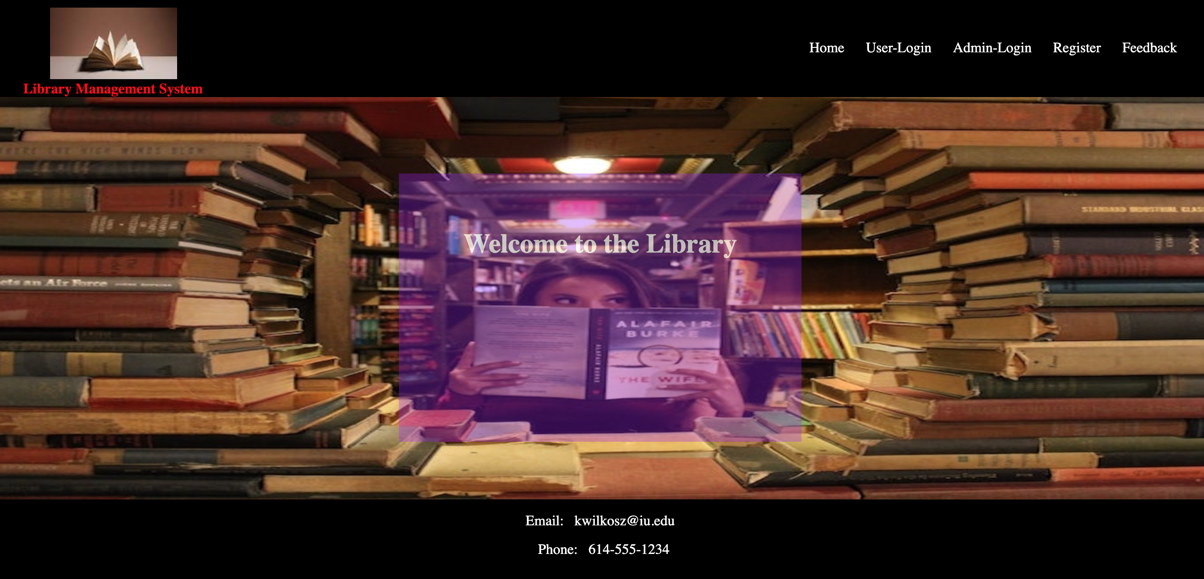

Initial Login Screen
Open screen on startup
Username and password requested
Minimize and close buttons function as expected
Cancel exits the program

Slide 4
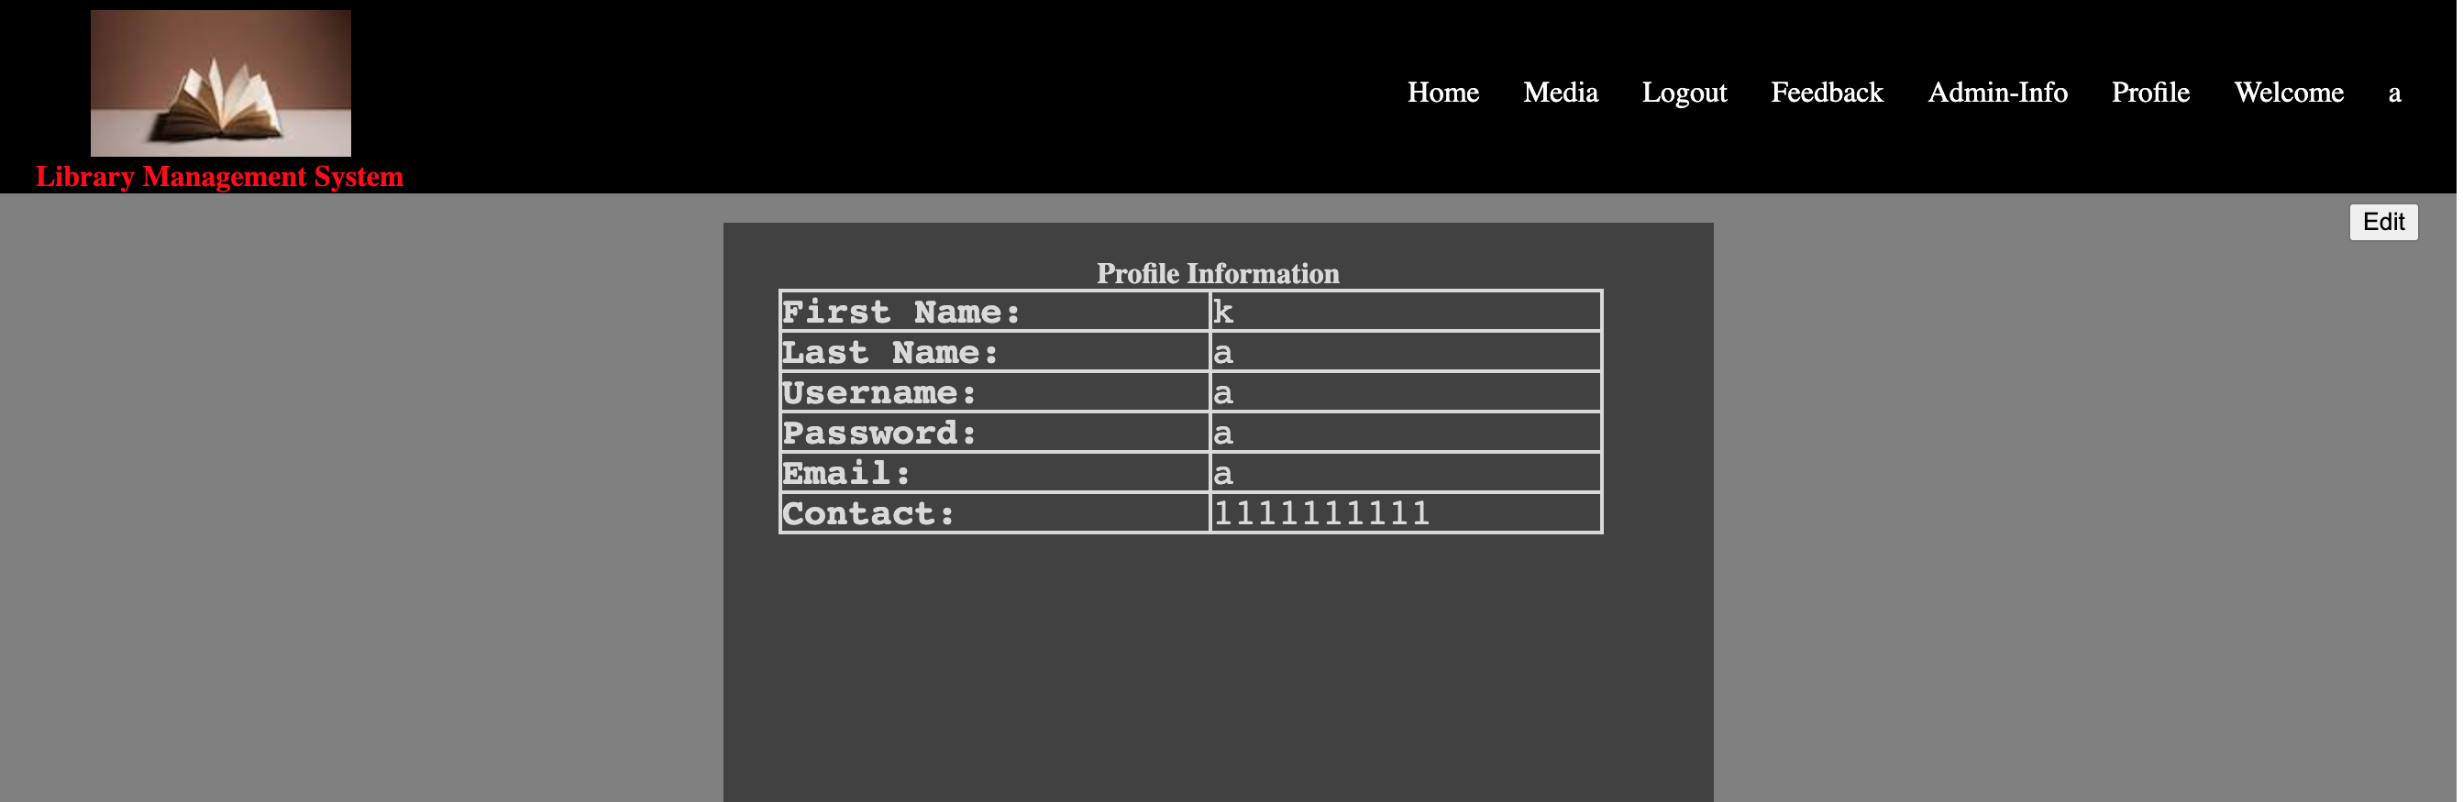
User Profile and Edit Screen
User profile screen
Editable with button top right
After editing, automatically populates with new details
Requires data in all fields

Slide 5
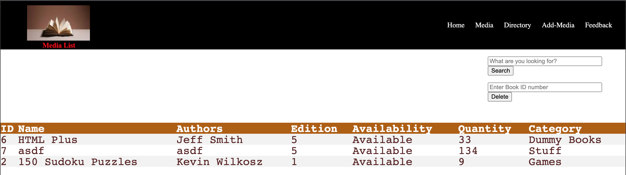
Media Availability, Delete and Add Screens
Show what media is in the library and what is available
Immediately delete media no longer available
Jump to add screen to insert new media directly to database

