Slide 1
Library Management System
Kevin Wilkosz
INFO-C 451

Slide 2
Brief Summary of the System
This system is meant to easy the use of the library for the users and the employees
Logging in
Login Error
Registration
Closing application

Slide 3


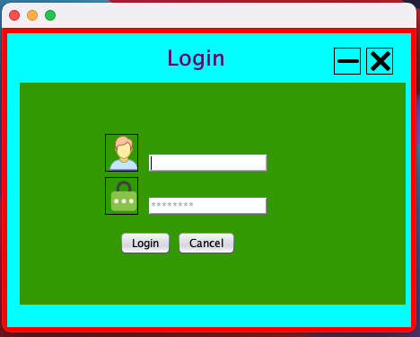

Initial Login Screen
Open screen on startup
Username and password requested
Minimize and close buttons function as expected
Cancel exits the program

Slide 4
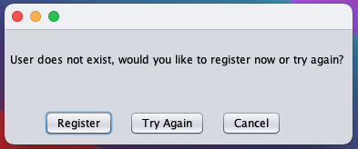
User/Password does not exist or is incorrect
Error screen if credentials do not exist or work
Register sends to registration screen
Try again sends back to login screen
Cancel closes the application

Slide 5
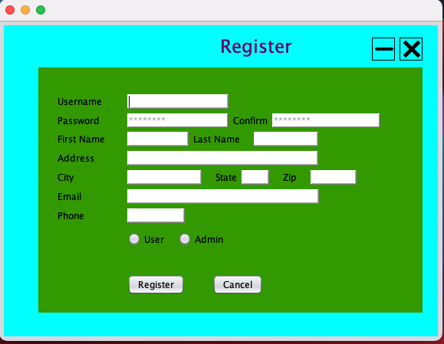
Registration Screen
Information request to create a user
All information must be entered in order for registration to be complete
User and admin radio buttons give different screens after login

