Slide 1

User behavior analysis Visualisation
Chabičovská, Šmíd, Zeman

Slide 2
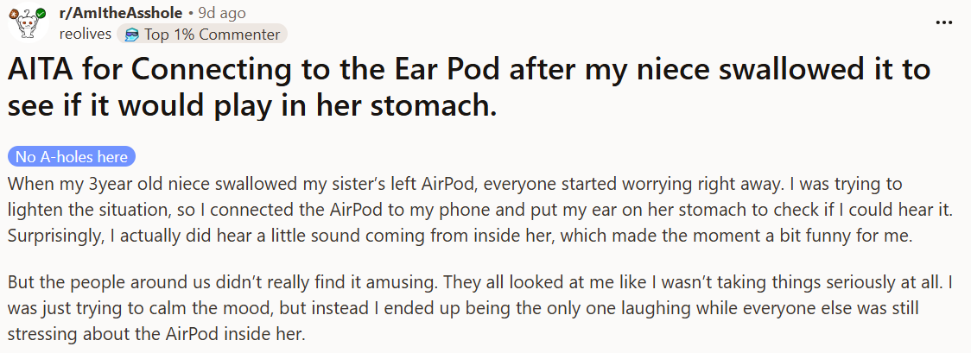
What is Reddit?
Online social media forum
Collection of topic-based communities (subreddits)
Message board, threads
Ranking system - upvotes/downvotes

Slide 3
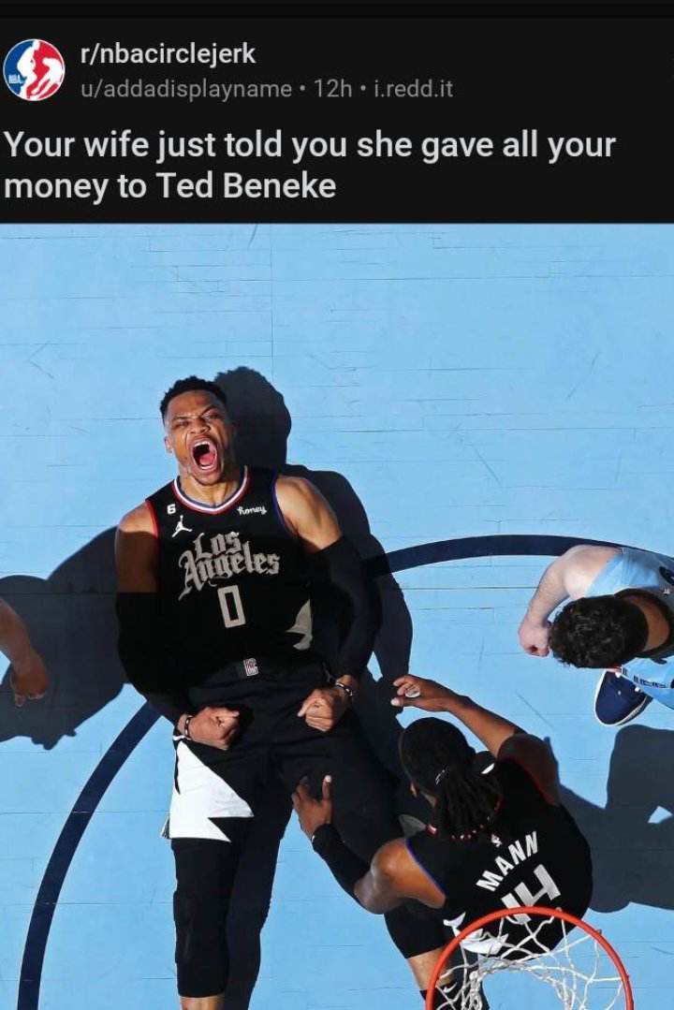
Data
Academic Torrents
Subreddits:
Game of Thrones
FreeFolk
NBA
NBACircleJerk
Aww
Notes:
Top 40 000 subreddits in separate files. Data from june 2005 to december 2024
r/freefolk = game of thrones, but more critical, memes, spoilers, kinda chaotic
r/nbacircvlejerk = mocking nba fans, memes, satire/irony
Aww = wholesome content

Slide 4
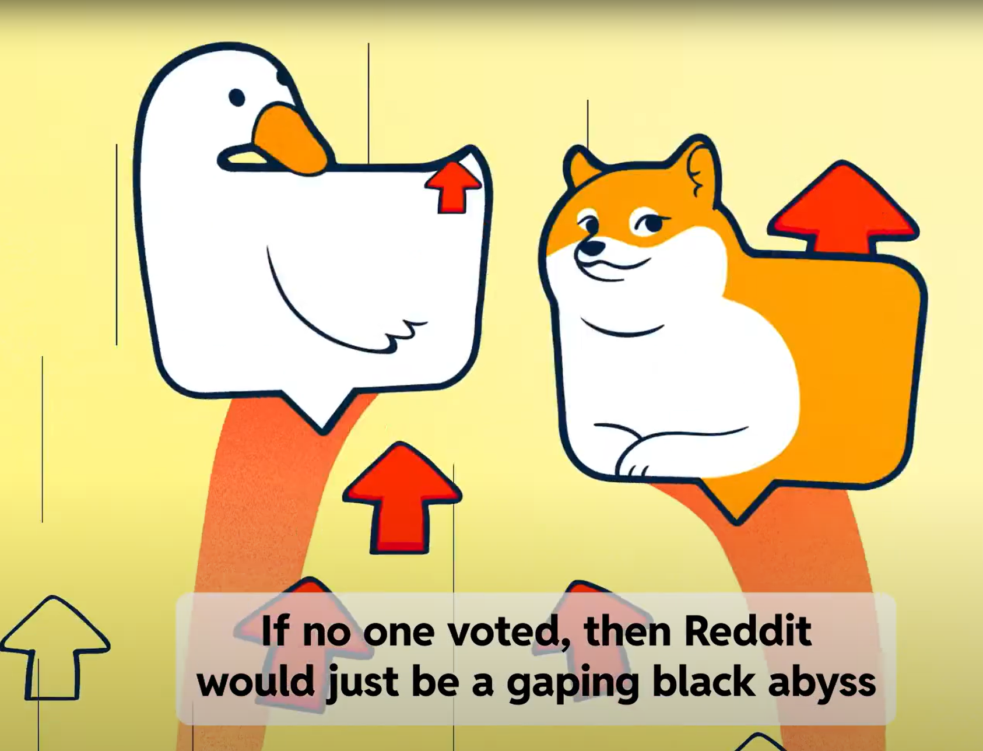
Data
Attributes:
User score = # upvotes - # downvotes
Date of posting
Content of post
Lifespan of a subreddit
User activity
Inter-community conflict

Slide 5
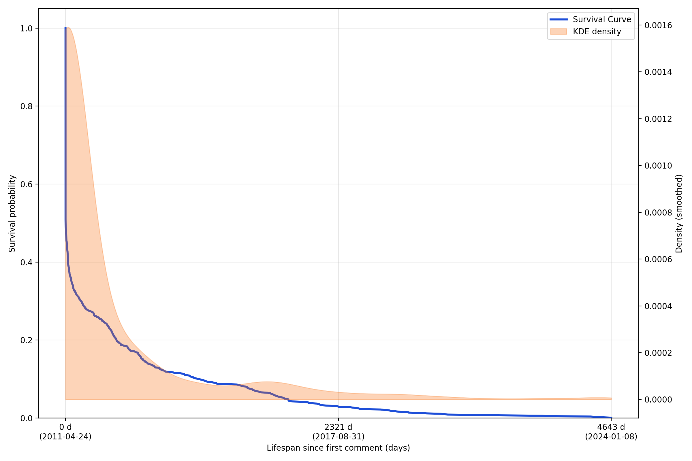
Lifespan (r/GoT)
Notes:
April 2011 – August 2024 -> 4643 days

Slide 6
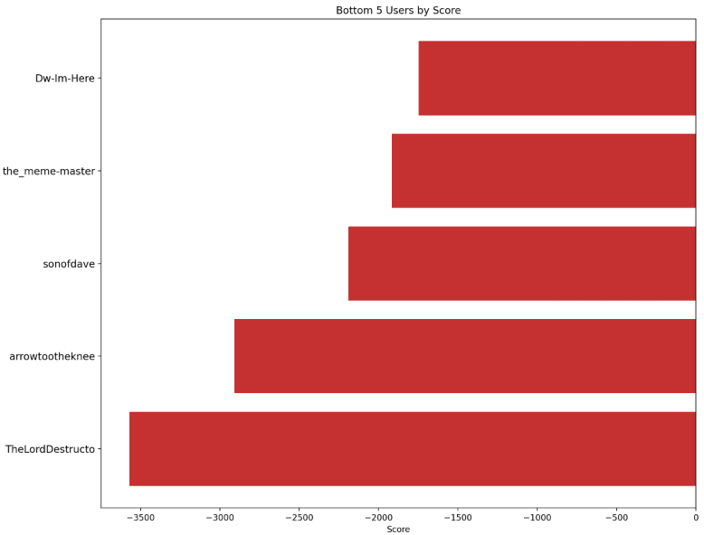
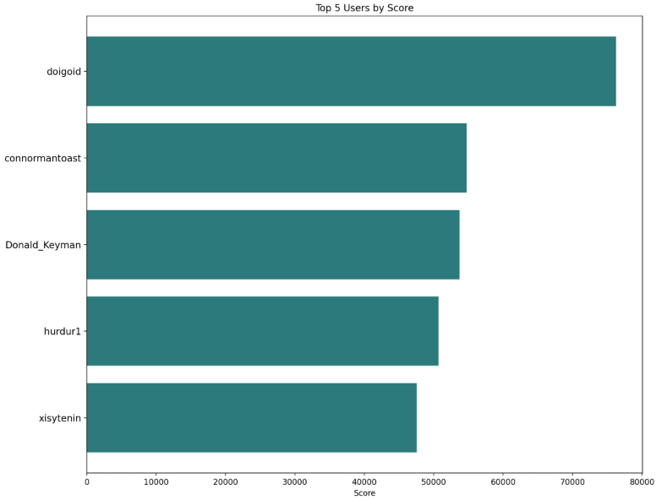
Min/max score (r/NBA)
Notes:
Cumulative scores

Slide 7
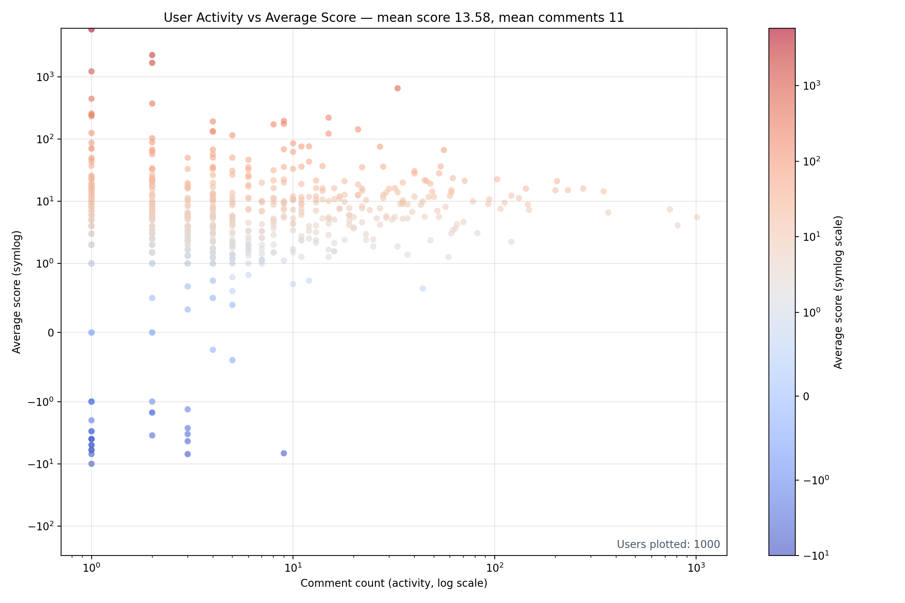
User activity r/GoT

Slide 8
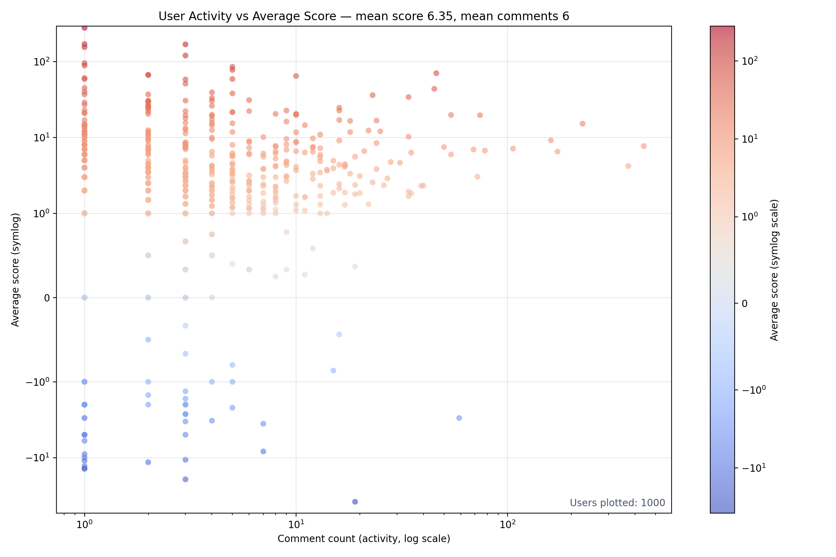
User activity r/Aww
Notes:
Tried to use sth with higher scores – fail apparently

Slide 9
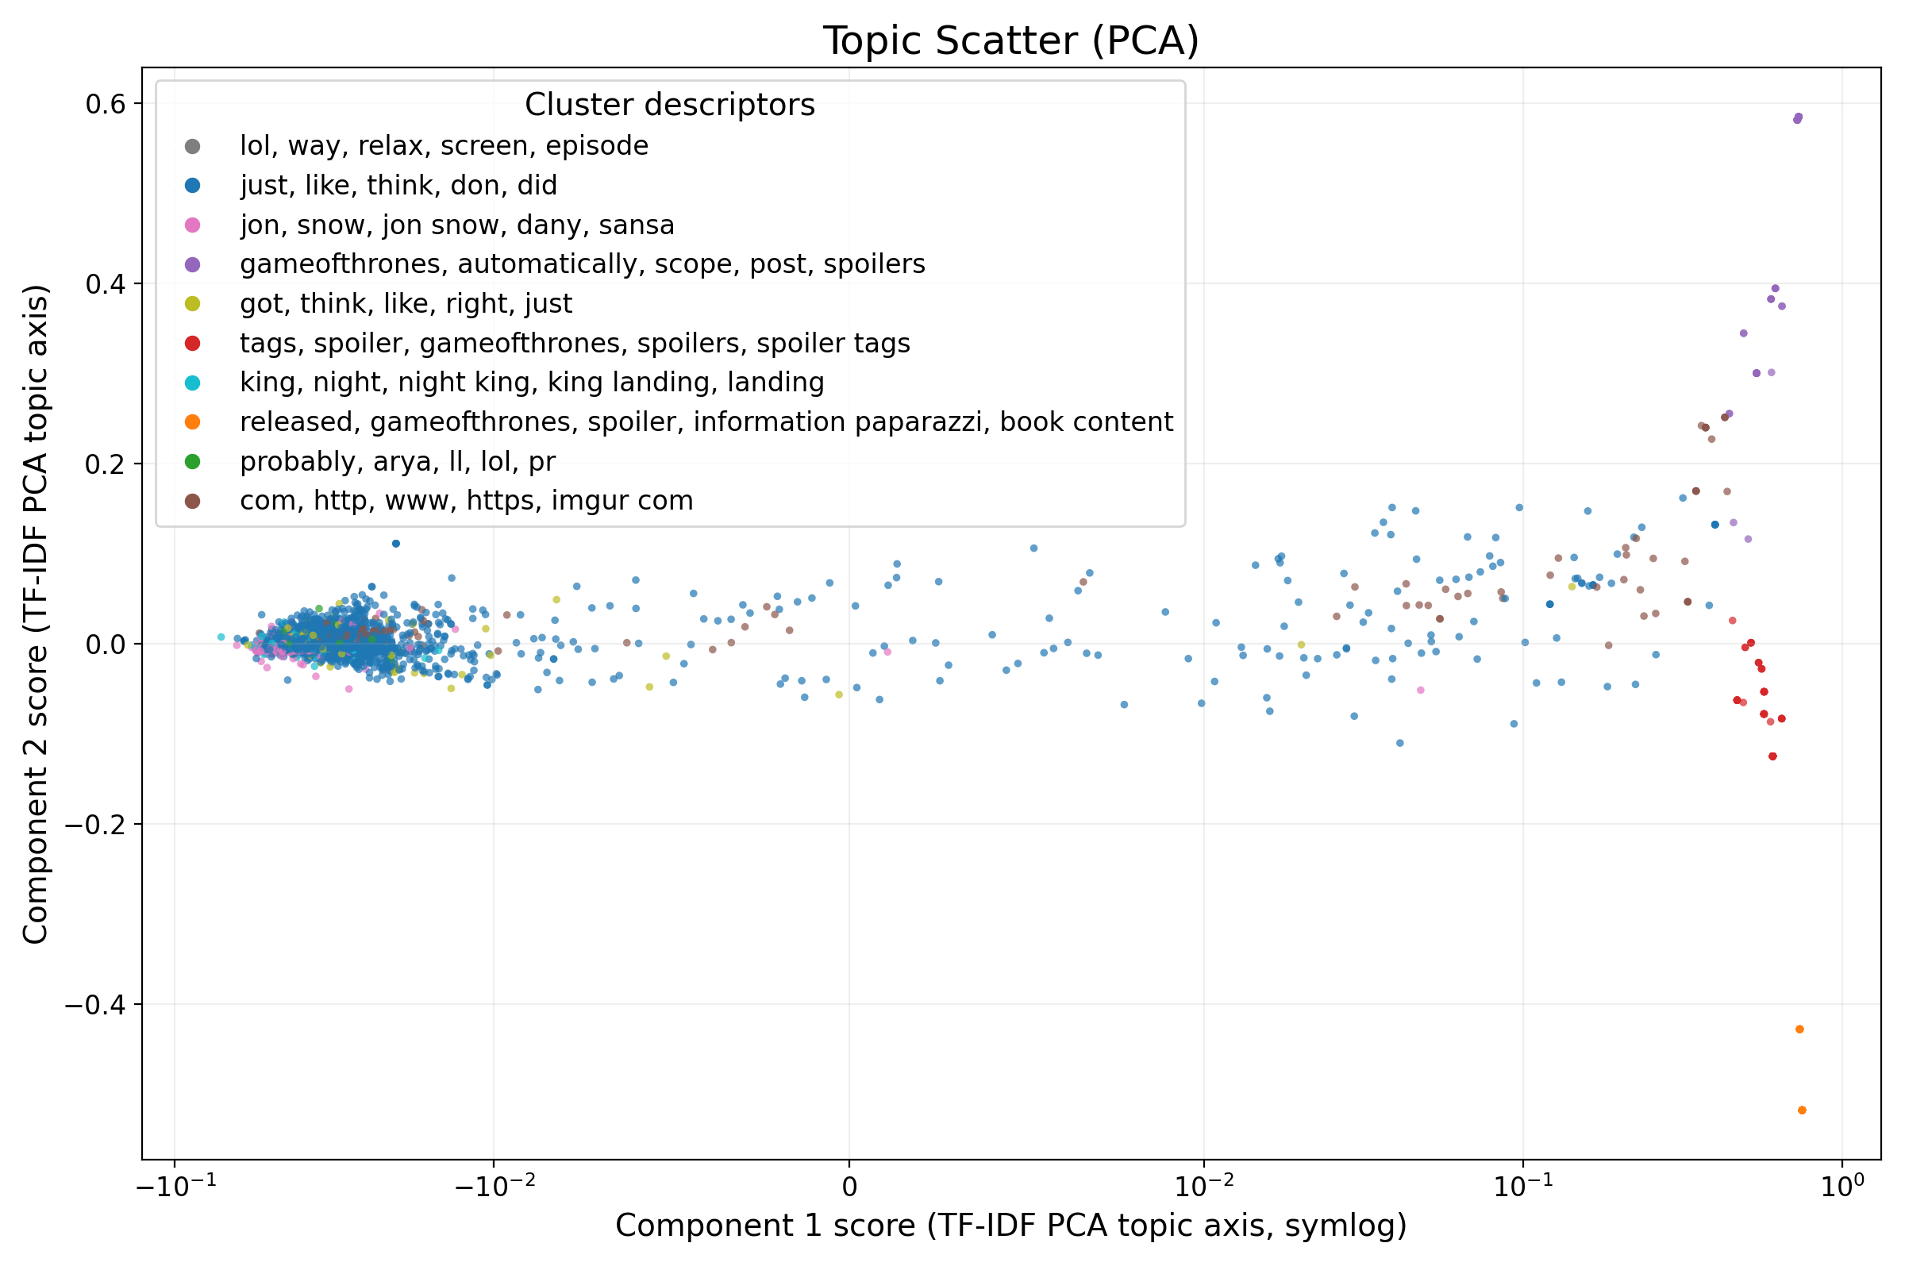
Topic (r/GoT)
Notes:
Hodně tematicky úzký subreddit=překryv clusterů
Oddělenější clustery obsahující spoilery (red, orange, purple)

Slide 10
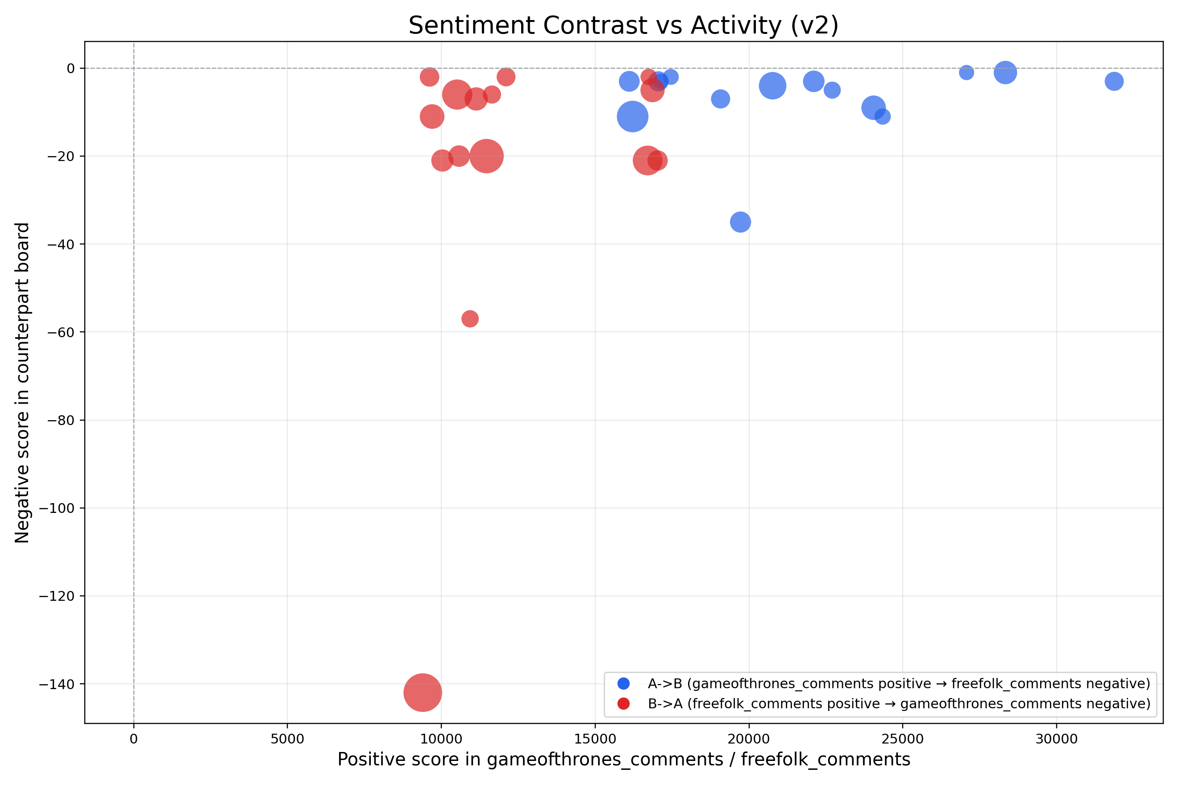
Sentiment contrast (r/GoT, r/FreeFolk)
Notes:
Users, size=activity = minimum comment count across both boards

Slide 11
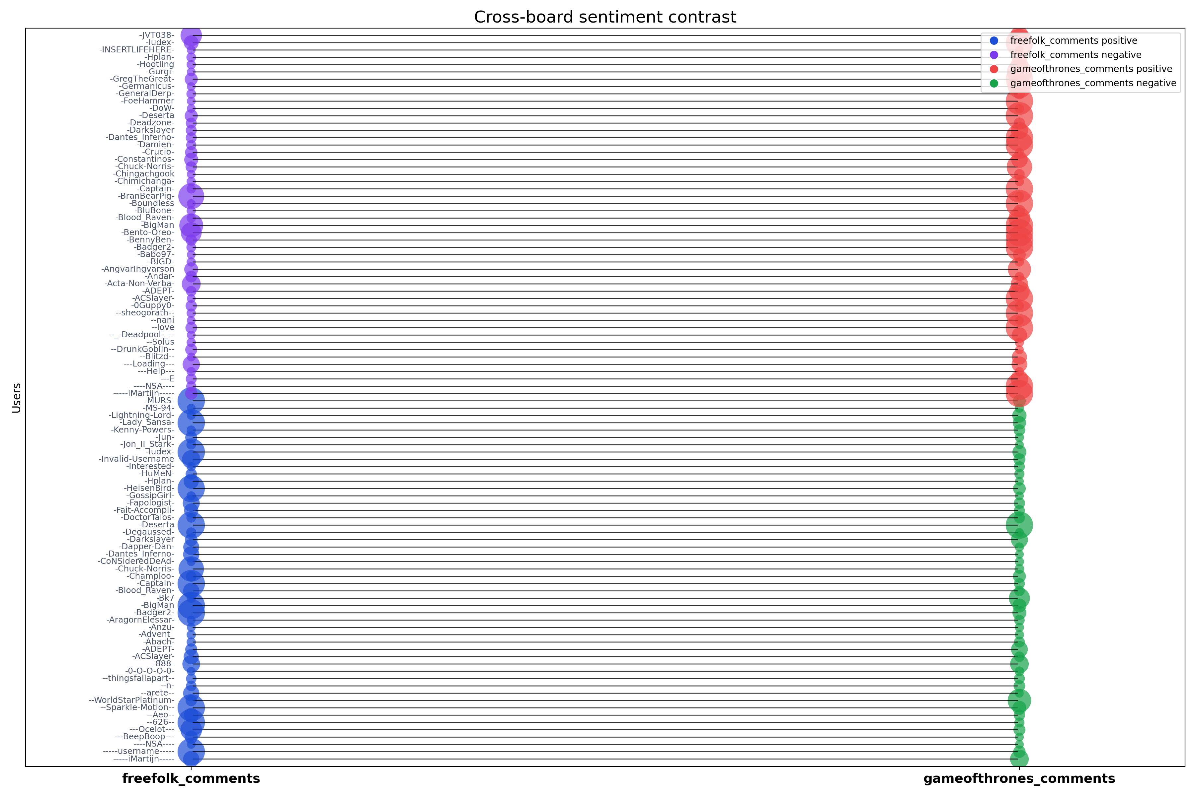
Inter-community conflict (r/GoT, r/FreeFolk)
Datta, S., & Adar, E. (2019). Extracting Inter-Community Conflicts in Reddit. Proceedings of the International AAAI Conference on Web and Social Media, 13(01), 146-157
Notes:
Size = comment count

Slide 12
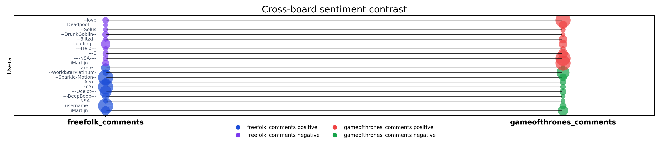
Inter-community conflict (r/GoT, r/FreeFolk)
Datta, S., & Adar, E. (2019). Extracting Inter-Community Conflicts in Reddit. Proceedings of the International AAAI Conference on Web and Social Media, 13(01), 146-157

Slide 13
Thank you for your attention

