Slide 2
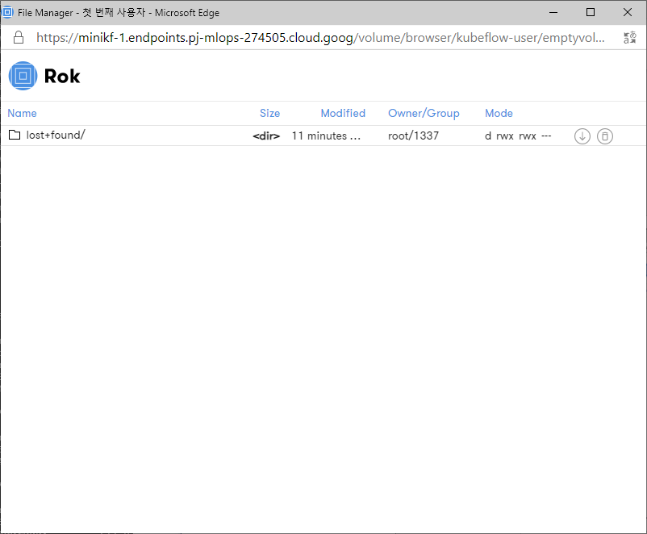
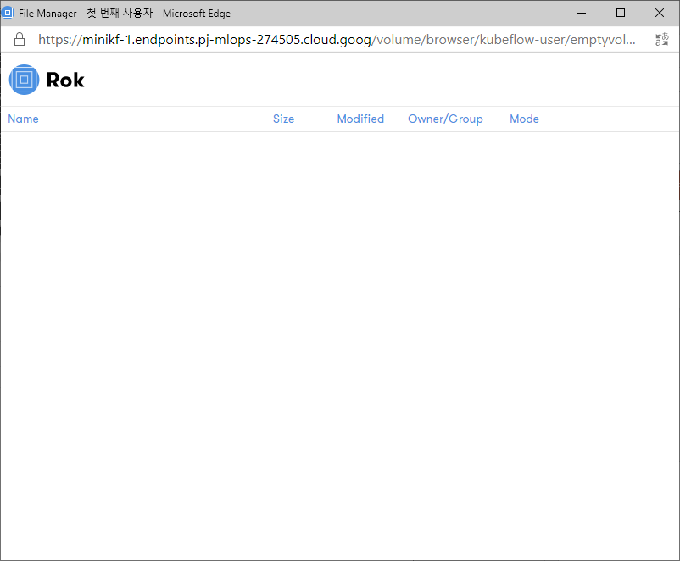
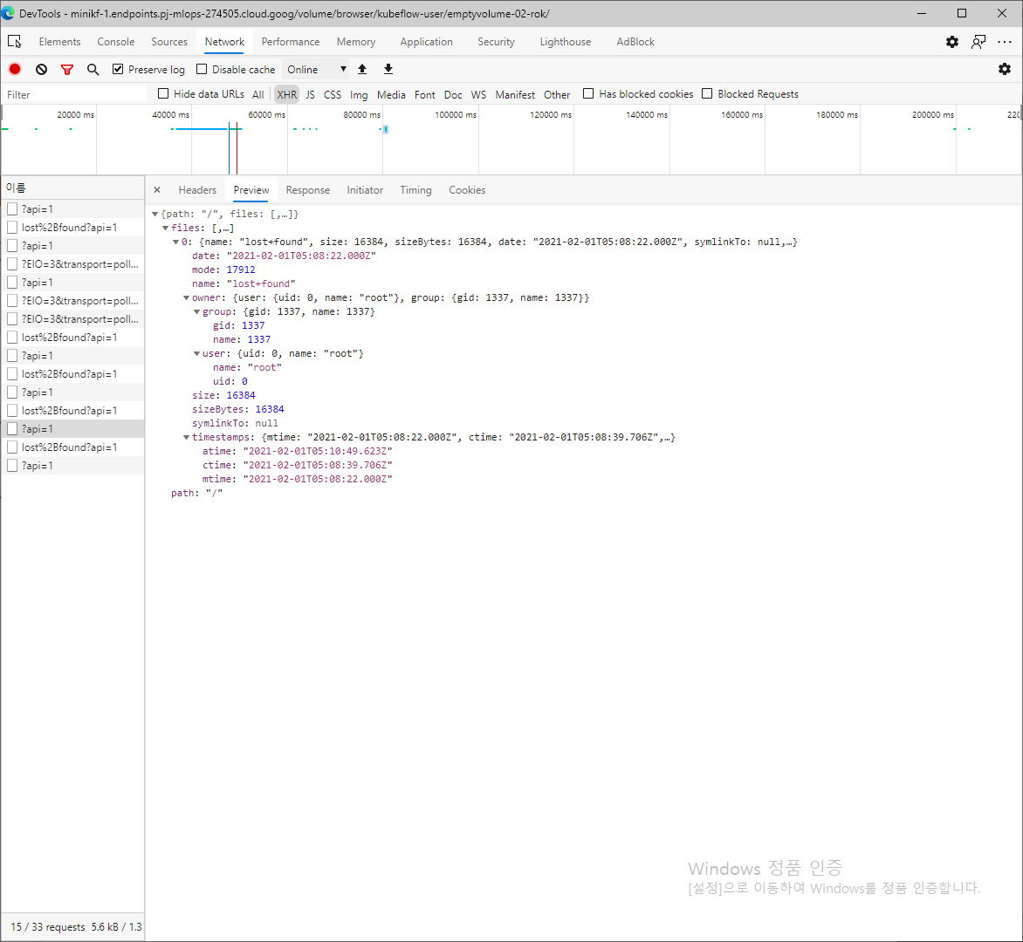
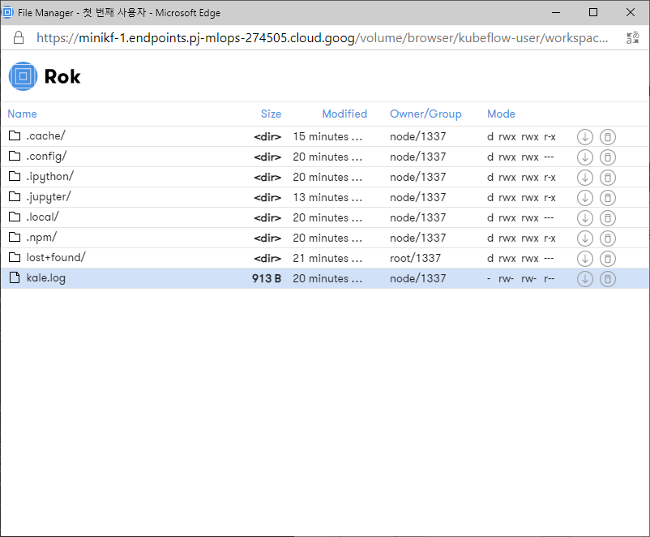
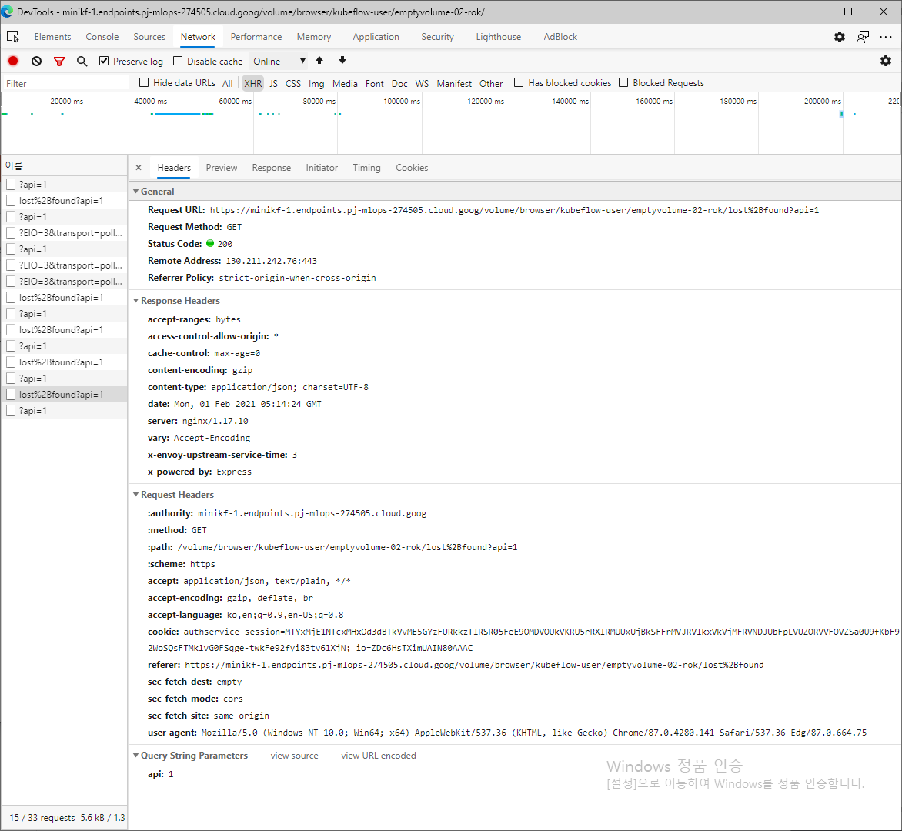

Slide 3
노트북 생성시 data volume 은 rok storage class 로 만들어지며 rok volume 만 재사용가능

Slide 4
jovyan@kevin-nb1-0:~/.config/configstore$ env
LC_ALL=en_US.UTF-8
JUPYTER_SERVER_ROOT=/home/jovyan
KEVIN_NB1_SERVICE_HOST=10.111.50.44
LANG=C.UTF-8
ROK_GW_URL=http://rok.rok.svc.cluster.local
KEVIN_NB1_SERVICE_PORT=80
KEVIN_NB1_PORT_80_TCP=tcp://10.111.50.44:80
HOSTNAME=kevin-nb1-0
OLDPWD=/home/jovyan/.config
PVC_VIEWER_EMPTYVOLUME_02_ROK_PORT_80_TCP_PROTO=tcp
NB_UID=1000
ROK_GW_PARAM_REGISTER_POD_NAMESPACE=kubeflow-user
PVC_VIEWER_EMPTYVOLUME_01_STD_SERVICE_HOST=10.104.190.245
PVC_VIEWER_EMPTYVOLUME_02_ROK_PORT=tcp://10.107.51.80:80
JUPYTER_SERVER_URL=http://0.0.0.0:8888/notebook/kubeflow-user/kevin-nb1/
PVC_VIEWER_EMPTYVOLUME_02_ROK_SERVICE_PORT_HTTP_PORT=80
PVC_VIEWER_EMPTYVOLUME_01_STD_SERVICE_PORT=80
ROK_GW_PARAM_REGISTER_DATASET_NAMESPACE=kubeflow-user
PVC_VIEWER_EMPTYVOLUME_01_STD_SERVICE_PORT_HTTP_PORT=80
PVC_VIEWER_EMPTYVOLUME_02_ROK_PORT_80_TCP_ADDR=10.107.51.80
PVC_VIEWER_EMPTYVOLUME_01_STD_PORT_80_TCP=tcp://10.104.190.245:80
KUBERNETES_PORT_443_TCP_PROTO=tcp
KUBERNETES_PORT_443_TCP_ADDR=10.96.0.1
container=docker
ROK_GW_PARAM_REGISTER_JUPYTER_NAMESPACE=kubeflow-user
KUBERNETES_PORT=tcp://10.96.0.1:443
KEVIN_NB1_SERVICE_PORT_HTTP_KEVIN_NB1=80
ROK_GW_ACCOUNT=kubeflow-user
KEVIN_NB1_PORT_80_TCP_PROTO=tcp
PWD=/home/jovyan/.config/configstore
LINES=59
PVC_VIEWER_EMPTYVOLUME_01_STD_PORT_80_TCP_ADDR=10.104.190.245
HOME=/home/jovyan
KEVIN_NB1_PORT=tcp://10.111.50.44:80
PVC_VIEWER_EMPTYVOLUME_02_ROK_SERVICE_PORT=80
KUBERNETES_SERVICE_PORT_HTTPS=443
DEBIAN_FRONTEND=noninteractive
KUBERNETES_PORT_443_TCP_PORT=443
PVC_VIEWER_EMPTYVOLUME_01_STD_PORT_80_TCP_PROTO=tcp
PVC_VIEWER_EMPTYVOLUME_02_ROK_PORT_80_TCP_PORT=80
PVC_VIEWER_EMPTYVOLUME_02_ROK_SERVICE_HOST=10.107.51.80
PVC_VIEWER_EMPTYVOLUME_02_ROK_PORT_80_TCP=tcp://10.107.51.80:80
KEVIN_NB1_PORT_80_TCP_ADDR=10.111.50.44
NB_USER=jovyan
ROK_GW_PARAM_REGISTER_KUBERNETES_NAMESPACE=kubeflow-user
ML_PIPELINE_SA_TOKEN_PATH=/var/run/secrets/ml-pipeline/token
KUBERNETES_PORT_443_TCP=tcp://10.96.0.1:443
COLUMNS=138
TERM=xterm
SHELL=/bin/bash
NB_PREFIX=/notebook/kubeflow-user/kevin-nb1
ROK_GW_PARAM_REGISTER_JUPYTER_LAB=kevin-nb1-0
PYXTERM_DIMENSIONS=80x25
KEVIN_NB1_PORT_80_TCP_PORT=80
ROK_GW_PARAM_REGISTER_POD_POD=kevin-nb1-0
SHLVL=1
LANGUAGE=en_US.UTF-8
PVC_VIEWER_EMPTYVOLUME_01_STD_PORT_80_TCP_PORT=80
KUBERNETES_SERVICE_PORT=443
PVC_VIEWER_EMPTYVOLUME_01_STD_PORT=tcp://10.104.190.245:80
PATH=/home/jovyan/.local/bin:/usr/local/sbin:/usr/local/bin:/usr/sbin:/usr/bin:/sbin:/bin
KUBERNETES_SERVICE_HOST=10.96.0.1
_=/usr/bin/env

Slide 5
jovyan@kevin-nb1-0:~/.config/configstore$ pip list
Package Version
----------------------------- ---------------------------
absl-py 0.10.0
adal 1.2.5
alabaster 0.7.12
aniso8601 8.0.0
argon2-cffi 20.1.0
astor 0.8.1
async-generator 1.10
attrs 20.3.0
autopep8 1.4.4
azure-common 1.1.26
azure-storage-blob 2.1.0
azure-storage-common 2.1.0
Babel 2.9.0
backcall 0.2.0
bleach 3.2.1
cachetools 4.1.1
certifi 2020.11.8
cffi 1.14.3
chardet 3.0.4
click 7.1.2
cloudpickle 1.6.0
configobj 5.0.6
configparser 5.0.1
crcmod 1.7
cryptography 3.2.1
debtcollector 2.2.0
decorator 4.4.2
deepdiff 3.3.0
defusedxml 0.6.0
Deprecated 1.2.10
dill 0.3.3
dnspython 2.0.0
docstring-parser 0.7.3
docutils 0.16
entrypoints 0.3
google-api-core 1.23.0
google-auth 1.23.0
google-cloud-core 1.4.3
google-cloud-storage 1.32.0
google-crc32c 1.0.0
google-resumable-media 1.1.0
googleapis-common-protos 1.52.0
graphviz 0.14.2
grpcio 1.33.2
idna 2.10
imagesize 1.2.0
importlib-metadata 2.0.0
importlib-resources 3.3.0
ipykernel 5.3.4
ipython 7.16.1
ipython-genutils 0.2.0
ipywidgets 7.5.1
iso8601 0.1.13
jedi 0.17.2
Jinja2 2.11.2
json5 0.9.5
jsonpickle 1.4.1
jsonschema 3.2.0
jupyter-client 6.1.7
jupyter-core 4.6.3
jupyterlab 2.2.9
jupyterlab-pygments 0.1.2
jupyterlab-server 1.2.0
keystoneauth1 4.2.1
kfp 1.0.0rc2
kfp-pipeline-spec 0.1.2
kfp-server-api 1.0.4
kfserving 0.4.1
kubeflow-kale 0.5.1
kubernetes 11.0.0
latexcodec 2.0.1
lockfile 0.12.2
MarkupSafe 1.1.1
minio 6.0.0
mistune 0.8.4
ml-metadata 0.24.0
monotonic 1.5
msgpack 1.0.0
nbclient 0.5.1
nbconvert 5.6.1
nbformat 4.4.0
nest-asyncio 1.4.3
netaddr 0.8.0
netifaces 0.10.9
networkx 2.5
notebook 6.1.5
numpy 1.19.4
oauthlib 3.1.0
os-service-types 1.7.0
oslo.config 8.3.2
oslo.i18n 5.0.1
oslo.serialization 4.0.1
oslo.utils 4.7.0
packaging 20.4
pandocfilters 1.4.3
parso 0.7.1
pbr 5.5.1
pexpect 4.8.0
pickleshare 0.7.5
pip 20.2.4
prettytable 1.0.1
progress 1.5
prometheus-client 0.8.0
prompt-toolkit 3.0.8
protobuf 3.13.0
psutil 5.7.3
ptyprocess 0.6.0
pyasn1 0.4.8
pyasn1-modules 0.2.8
pybtex 0.23.0
pycodestyle 2.6.0
pycparser 2.20
pyflakes 2.2.0
Pygments 2.7.2
PyJWT 1.7.1
pyparsing 2.4.7
Pyro4 4.80
pyrsistent 0.17.3
python-daemon 2.2.4
python-dateutil 2.8.1
python-etcd 0.4.5
python-keystoneclient 4.1.1
pythondialog 3.5.1
pytz 2020.4
pyvmomi 6.5.0.2017.5.post1
PyYAML 5.3.1
pyzmq 19.0.2
requests 2.25.0
requests-oauthlib 1.3.0
requests-toolbelt 0.9.1
rfc3986 1.4.0
rok-common 1.0rc0.post0+997.gefd49e9f4
rok-etcd-client 1.0rc0.post0+997.gefd49e9f4
rok-fort-client 1.0rc0.post0+997.gefd49e9f4
rok-gw-client 1.0rc0.post0+997.gefd49e9f4
rok-kubernetes 1.0rc0.post0+997.gefd49e9f4
rok-tasks 1.0rc0.post0+997.gefd49e9f4
rsa 4.6
Send2Trash 1.5.0
serpent 1.30.2
setuptools 50.3.2
simplejson 3.17.2
six 1.15.0
snowballstemmer 2.0.0
Sphinx 3.3.1
sphinxcontrib-applehelp 1.0.2
sphinxcontrib-devhelp 1.0.2
sphinxcontrib-htmlhelp 1.0.3
sphinxcontrib-jsmath 1.0.1
sphinxcontrib-qthelp 1.0.3
sphinxcontrib-serializinghtml 1.1.4
stevedore 3.2.2
strip-hints 0.1.9
table-logger 0.3.6
tabulate 0.8.7
termcolor 1.1.0
terminado 0.9.1
testpath 0.4.4
tornado 6.1
traitlets 4.3.3
tzlocal 2.1
udatetime 0.0.16
unicodecsv 0.14.1
urllib3 1.26.1
wcwidth 0.2.5
webencodings 0.5.1
websocket-client 0.57.0
wheel 0.30.0
widgetsnbextension 3.5.1
wrapt 1.12.1
zipp 3.4.0
WARNING: You are using pip version 20.2.4; however, version 21.0.1 is available.
You should consider upgrading via the '/usr/bin/python3 -m pip install --upgrade pip' command.
jovyan@kevin-nb1-0:~/.config/configstore$

Slide 6
jovyan@kevin-nb1-0:~/.config/configstore$ jupyter serverextension list
config dir: /usr/local/etc/jupyter
jupyterlab enabled
- Validating...
jupyterlab 2.2.9 OK
jovyan@kevin-nb1-0:~/.config/configstore$ jupyter server extension list
Traceback (most recent call last):
File "/usr/local/bin/jupyter", line 8, in <module>
sys.exit(main())
File "/usr/local/lib/python3.6/dist-packages/jupyter_core/command.py", line 247, in main
command = _jupyter_abspath(subcommand)
File "/usr/local/lib/python3.6/dist-packages/jupyter_core/command.py", line 134, in _jupyter_abspath
'Jupyter command `{}` not found.'.format(jupyter_subcommand)
Exception: Jupyter command `jupyter-server` not found.
jovyan@kevin-nb1-0:~/.config/configstore$
jovyan@kevin-nb1-0:~/.config/configstore$
jovyan@kevin-nb1-0:~/.config/configstore$ jupyter labextension list
JupyterLab v2.2.9
Known labextensions:
app dir: /usr/local/share/jupyter/lab
kubeflow-kale-labextension v0.5.1 enabled OK*
local extensions:
kubeflow-kale-labextension: /kale/labextension

Slide 7
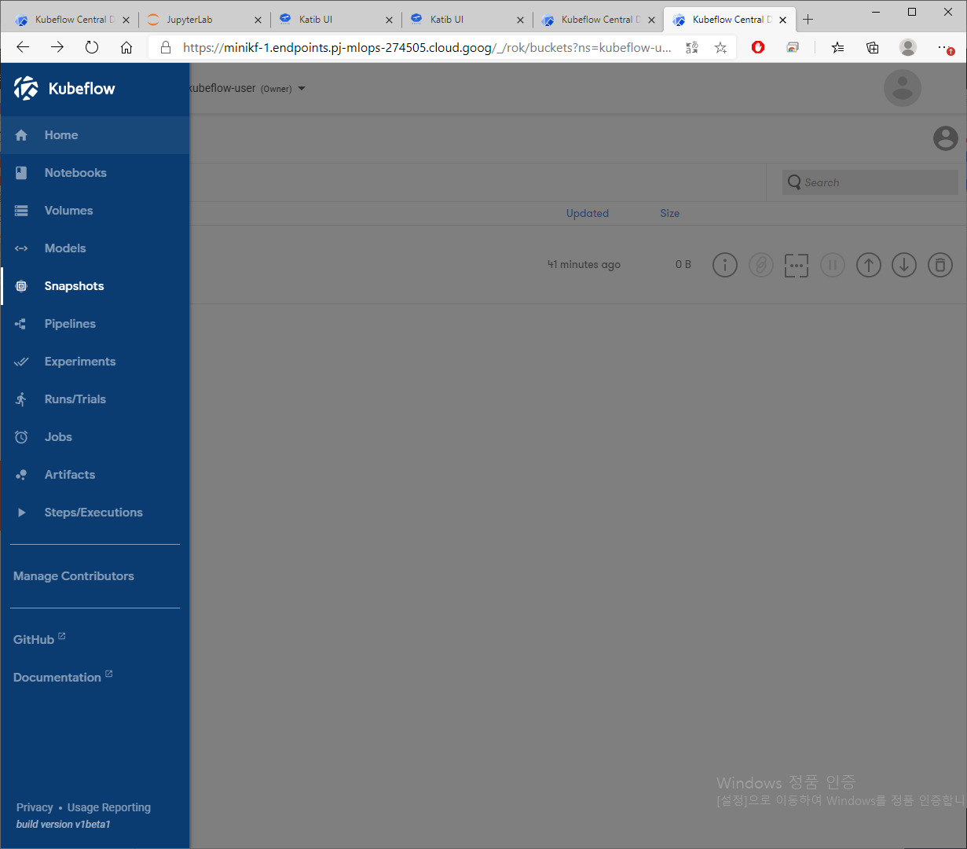

Slide 8
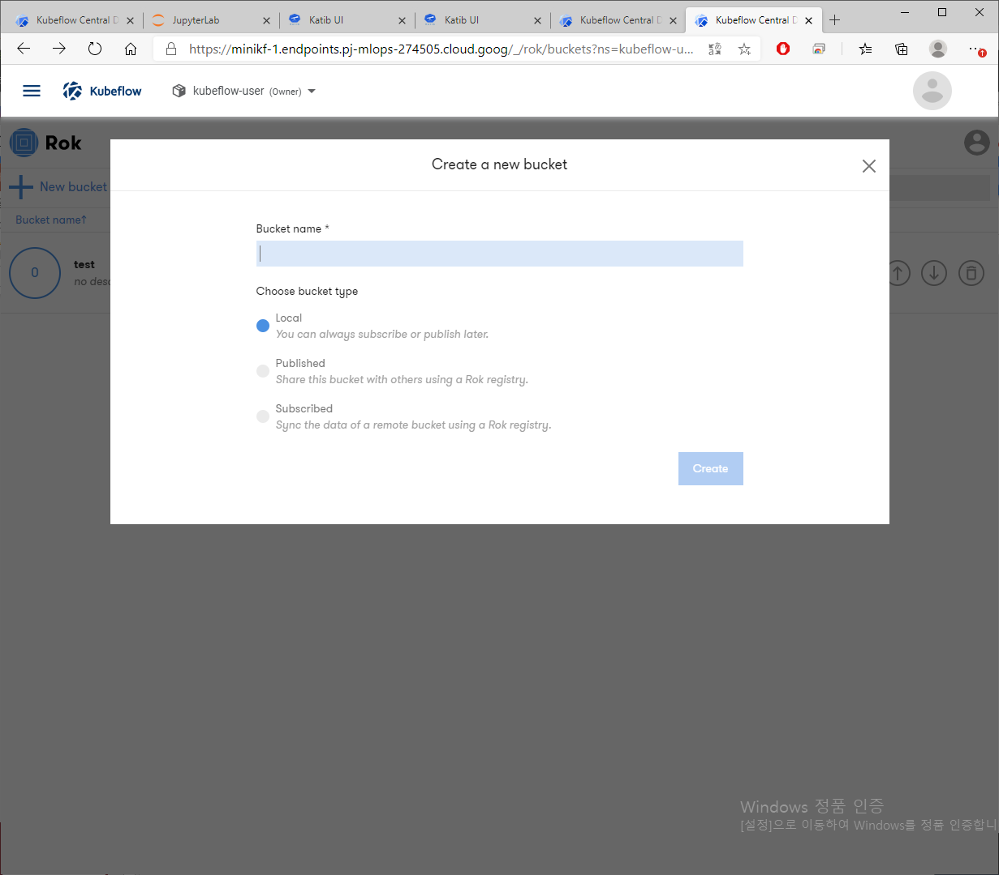

Slide 9
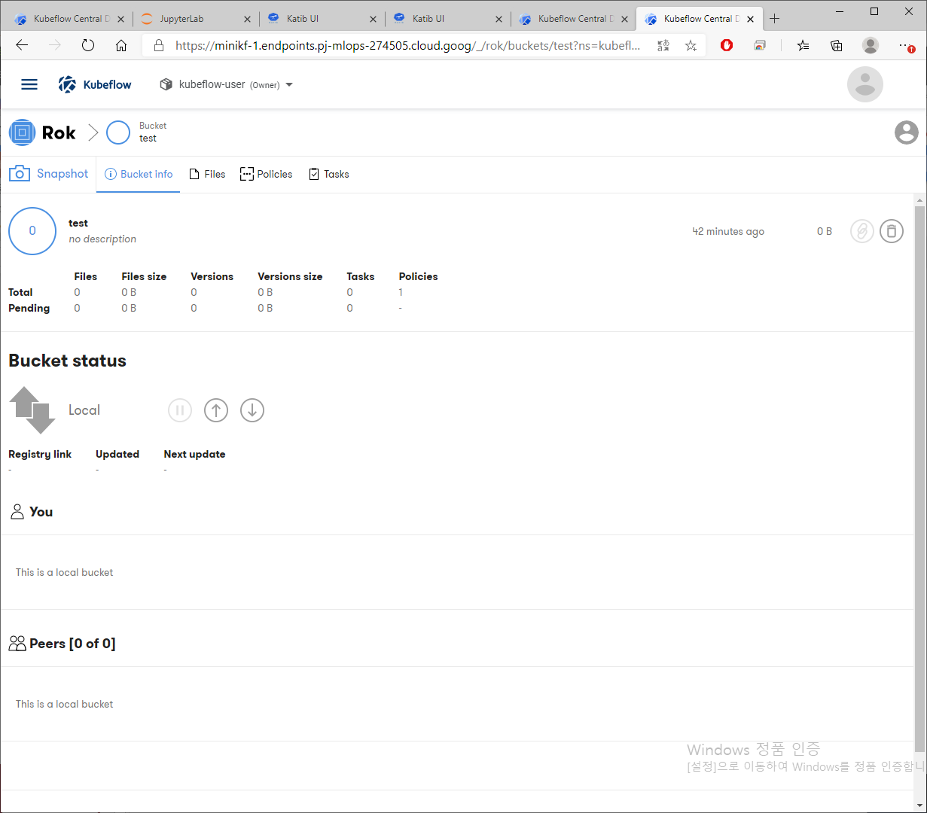

Slide 10
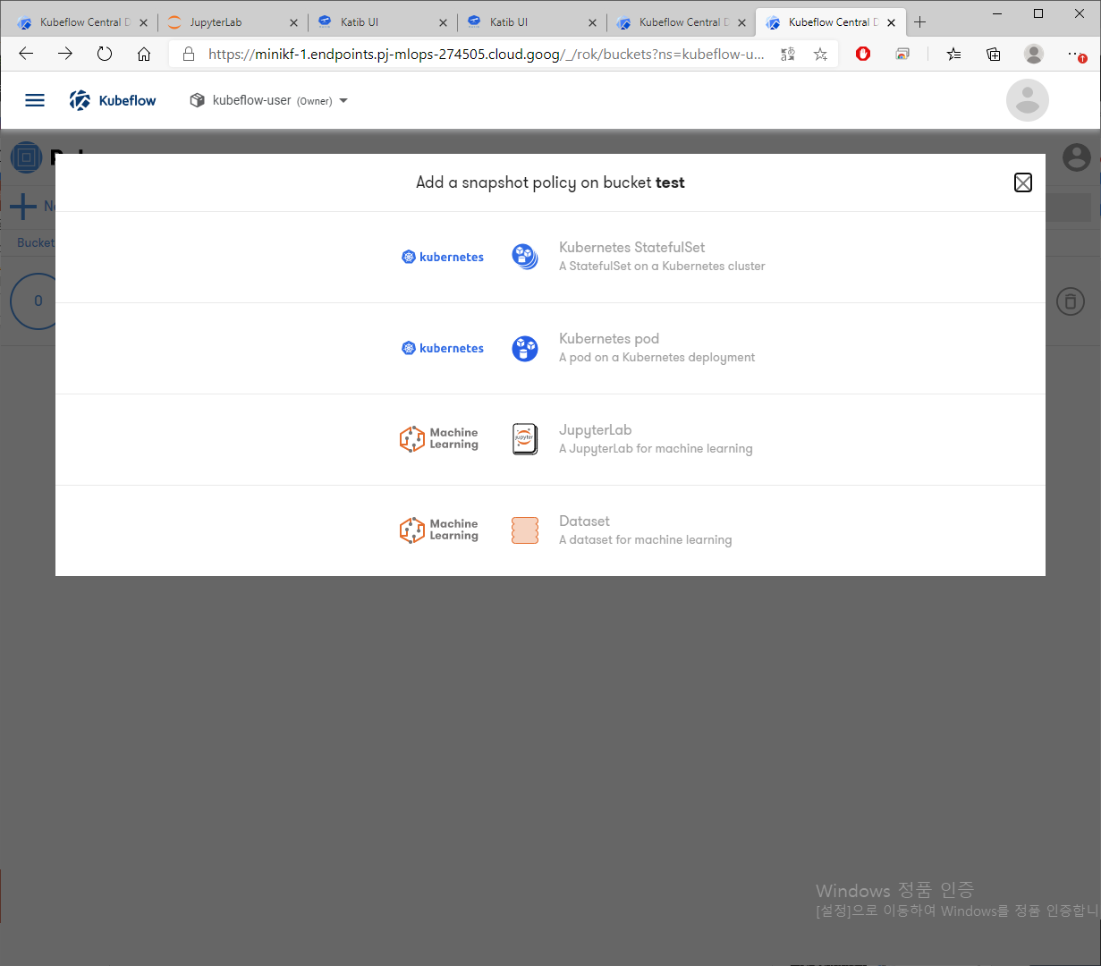

Slide 11
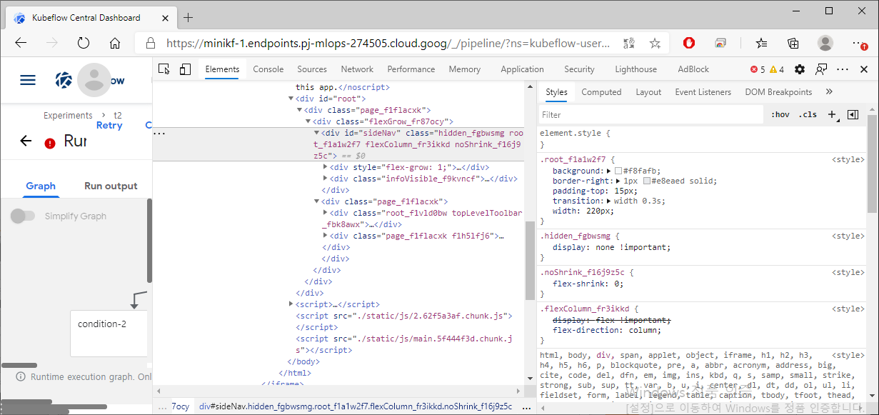
Hidden style (.hidden_fgbwsmg) 적용
id='sideNav'
pipelines/SideNav.tsx at c320a5d8fd1ecc1da2c1e54c95d6d2dc131cc346 · kubeflow/pipelines (github.com)

Slide 12
return c.createElement("div", {
id: "sideNav",
className: Object(K.classes)(Xc === Nc.KUBEFLOW ? il.hidden : "", il.root, Me.flexColumn, Me.noShrink, n && il.collapsedRoot)
}, c.createElement("div", {
style: {
flexGrow: 1
}
}, Xc === Nc.MARKETPLACE && c.createElement(c.Fragment, null, c.createElement("div", {
className: Object(K.classes)(il.indicator, !e.startsWith(Ul.START) && il.indicatorHidden)
}),
return c.createElement("div", {
id: "sideNav",
className: Object(K.classes)(el.root, Fe.flexColumn, Fe.noShrink, n && el.collapsedRoot)
}, c.createElement("div", {
style: {
flexGrow: 1
}
}, Gc === xc.MARKETPLACE && c.createElement(c.Fragment, null, c.createElement("div", {
className: Object(K.classes)(el.indicator, !e.startsWith(kl.START) && el.indicatorHidden)
}), c

