Slide 1
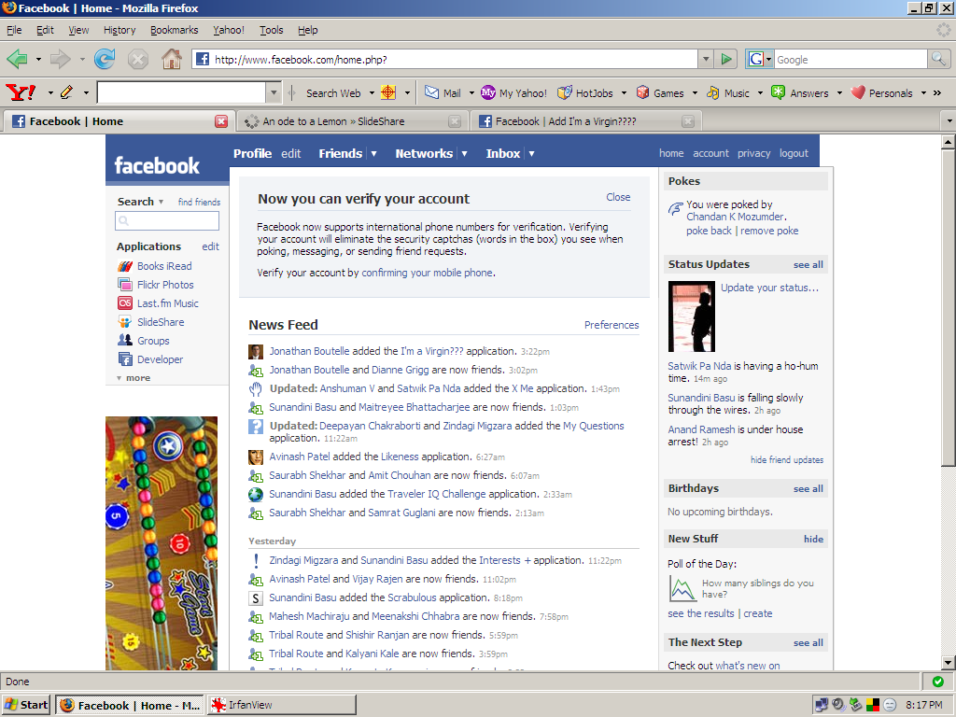
Any change here goes to kwippy.

Slide 2
kwippy
Let all your facebook status updates go to kwippy.
post
a new

Slide 3
v
kwippy
Let all your facebook status updates go to kwippy.
Submit
Cancel
also make this the status of
gtalk
Your past kwips
Yahoo friends’ kwips
Gtalk friends’ kwips

