Slide 1
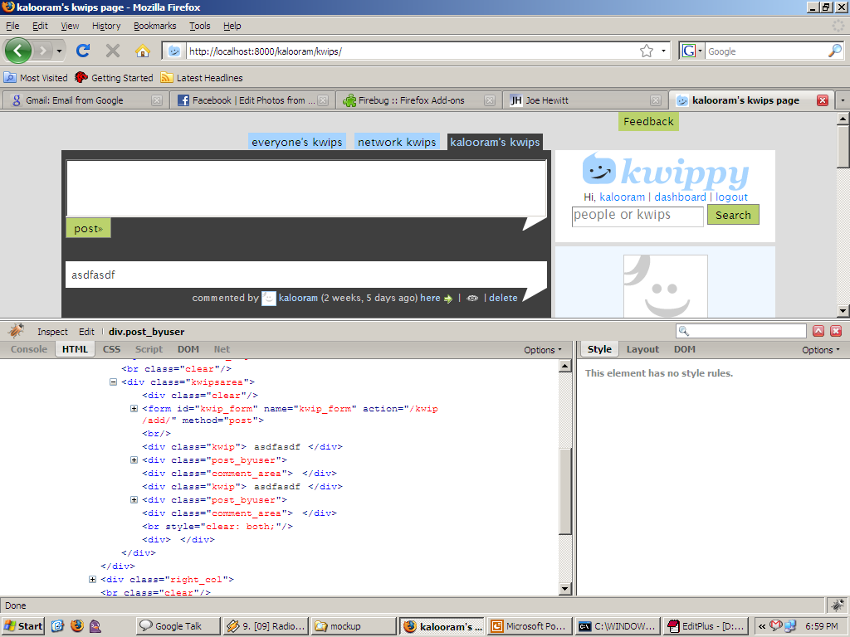
heading
Use the same header tags as the favorites
The order in which they appear is same as kwips, latest
One on top,

Slide 2
And the “num of comments” becomes a link in the user info

