Slide 1
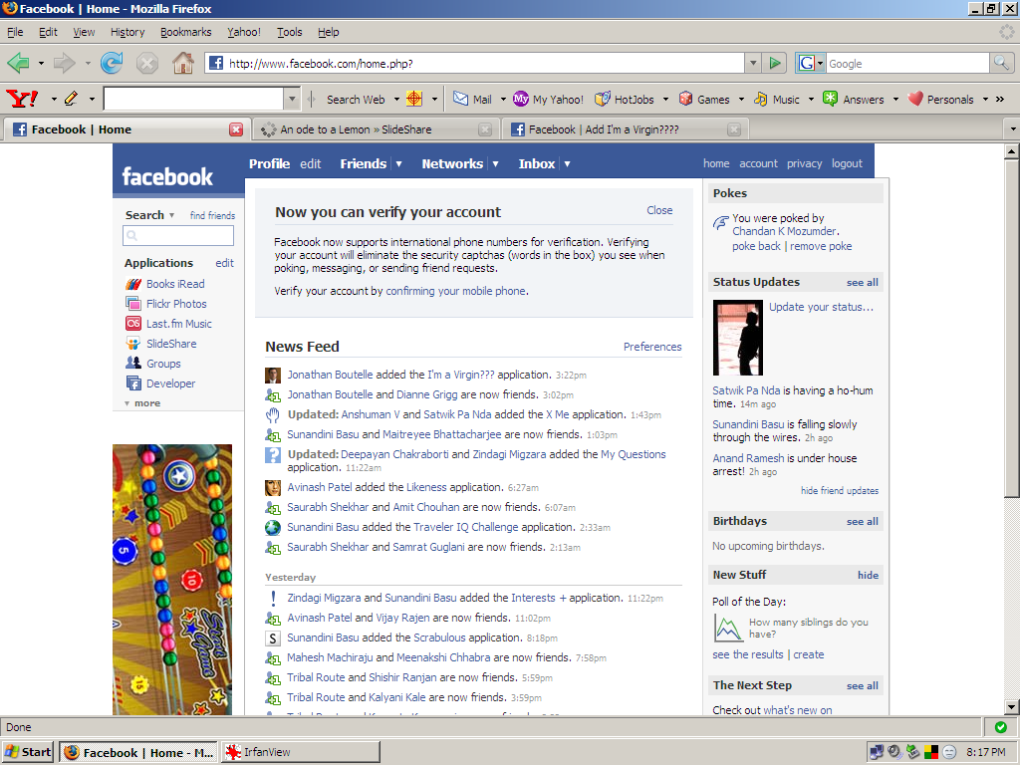
Any change here goes to kwippy.

Slide 2
App added
Add app
The usual allow this
And that.
app interface
Flash message
If you are a user of kwippy, you can also send the facebook status to kwippy. Go integrate>>
Kwippy username
Kwippy password

Slide 3
If not a user can store facebook statuses and maybe comment on them.

Slide 4
kwippy
Invite friends | Integrate with kwippy
A status is a quip is a kwip
Network’s kwips
Kaa’s kwips
Woman hath no fury like a fucking fuck.
Posted on (time) by kaa
Woman hath no fury like a fucking fuck.
Posted on (time) by kaa
Woman hath no fury like a fucking fuck.
Posted on (time) by kaa
<<older
Newer >>

