Slide 1
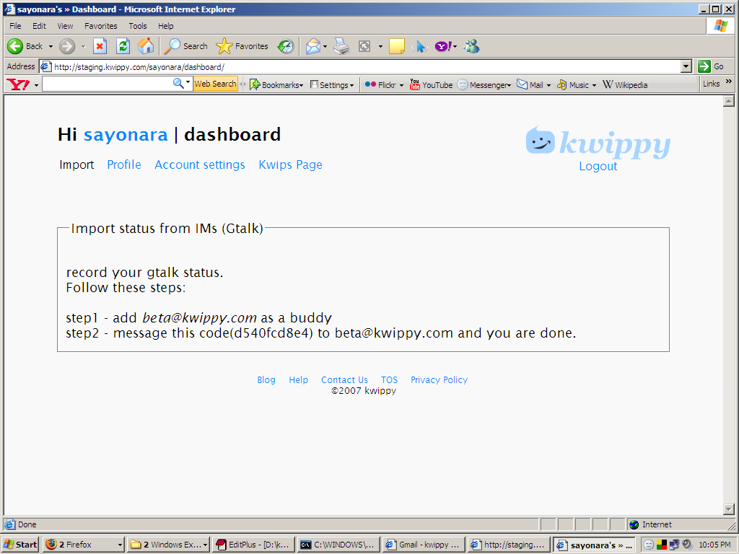
archive your Gtalk statuses, do it now or later. Skip>>
First time login (this is when
User activates)‏

Slide 2
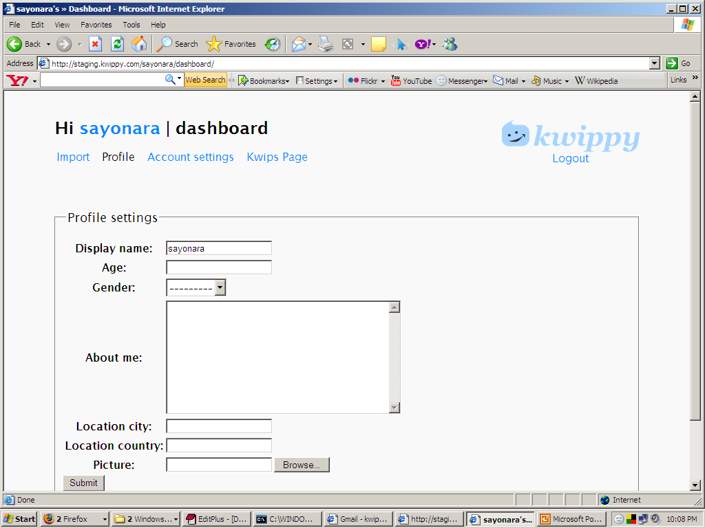
fill your personal details here, or skip>> and do it later
When skipped on this ..take to
Kwips page.
First time login (this is when
User activates)‏

Slide 3
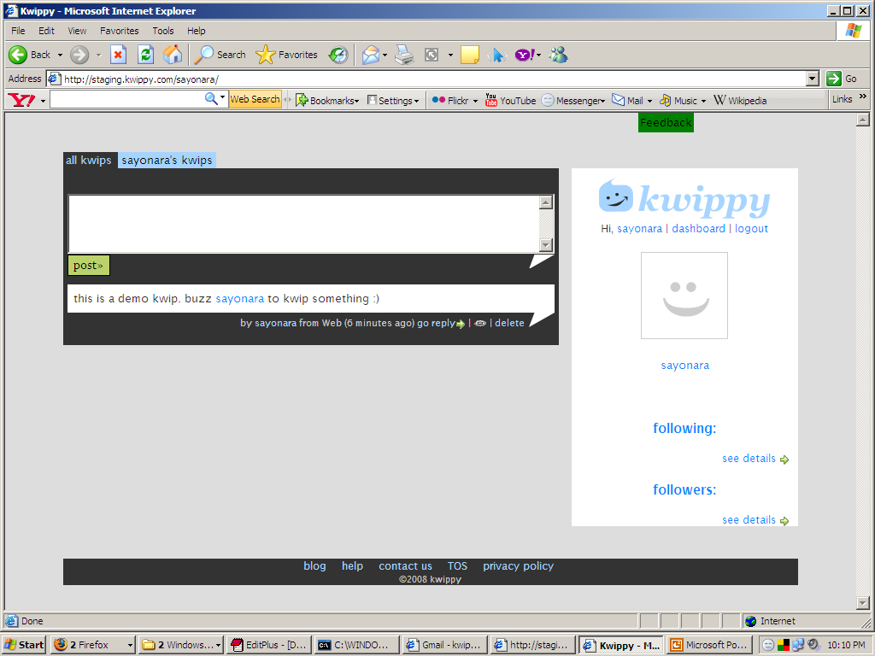
Link to dashboard/#import
why don’t you integrate your Gtalk statuses to this page, do it here x
Second type of flash
With close link.
Show this if not integrated to gtalk.
First time login

Slide 4
Show nothing if he has
Integrated.
First time login

Slide 5

Stop taking him to dashboard either when he has filled and
Submitted.
Or he has skipped.
If skipped only imort , don’t take to import
But take to profile settings.

Slide 6
s
Close button
you have comments here, here, here and here X
& Username1 , username2 have started following you
This flash should come two occasions
*on login
*can it occur anytime something happens. If this is
Difficult, do it everyday, or after every fixed amount of
Time.

Slide 7
Plz note – flash messages are for things which the user cannot see for himself. When he submits a kwips – he can see that the kwip has come . So no flash needed. Thumbrule – wherever we are using AJAX – don’t show flash. Same case with deleted.
forgot password
unlogged in user - form filled and submitted - go to login page - show in flash - the "reset password" link will be sent to "submitted emailid" shortly.
logged in user - same as above.
forms - anything saved - keep them in the same page - show in flash message - saved 'whatever setting'
/login if already logged in - take to users kwips page - show - already logged in as "username", to login as someone else plz first logout

Slide 8
Don't show these:
“your kwip has been deleted”
“your kwip has been saved”
THUMBRULE
where users can see the change made right there... no need for flash. only show it when the change is in some other place.
can we track which page a user sees. especially related to comment notification emails? if a user has clicked the link from his mail shouldnt get it on the flash message.

