Slide 1
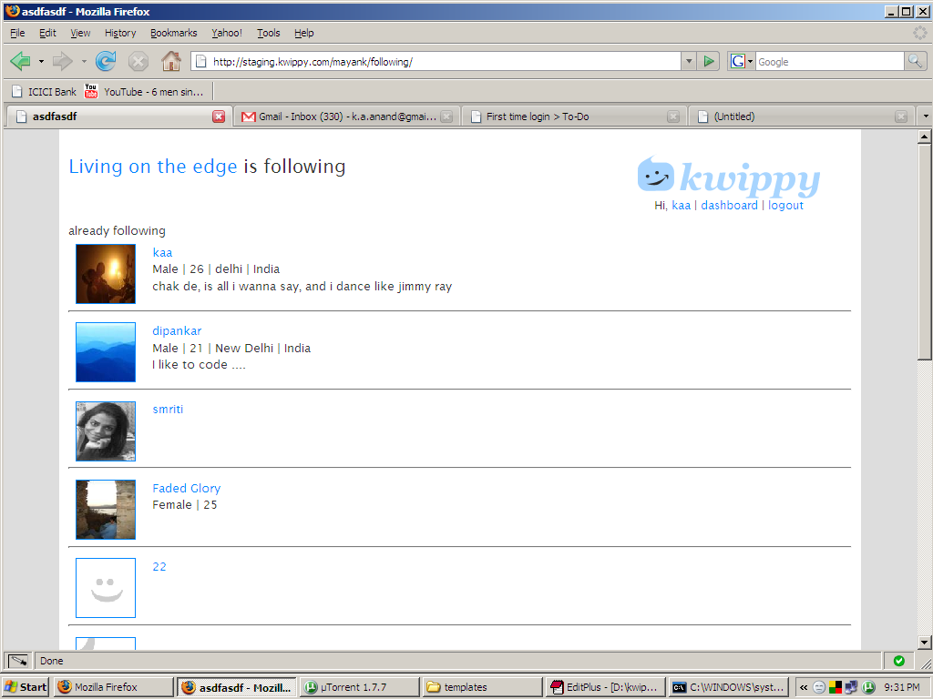
Not like this, see next slide

Slide 2
This is another
Users page.
Also the image from s3 is incorrect .
Plz note – never use the width and height inside the img tag. The images have been resized exactly the size they have to be shown
+follow
+follow
+ follow
My mistake I should have
Changed it in the mockup too.
Its easy to miscommunicate on a call.
| already following

