Slide 1
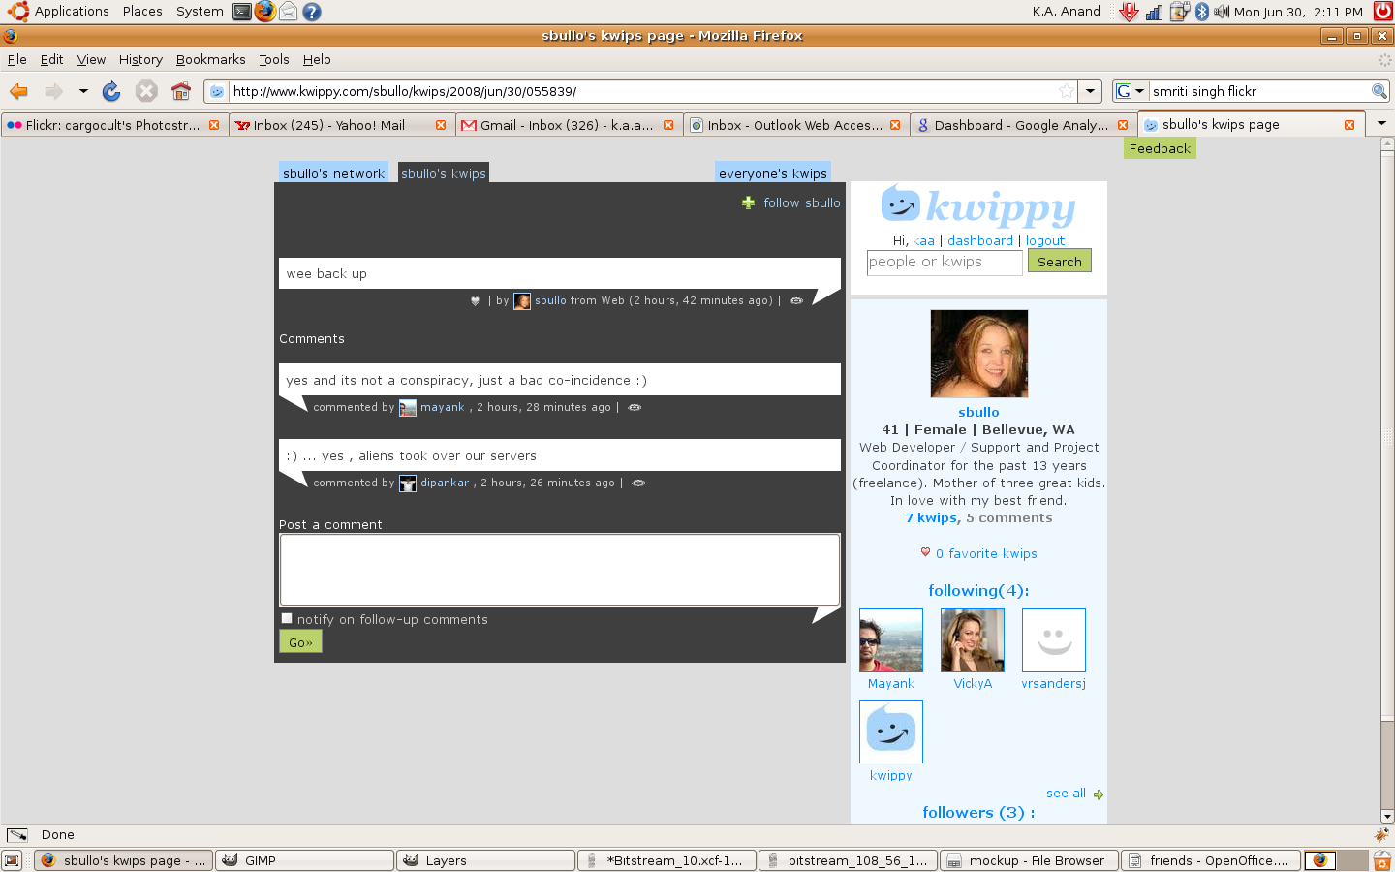
I visit this profile. I m not
following her nor her
friend.
Can add at two places – on the right
as well as while following
Add as friend
block sbullo

Slide 2
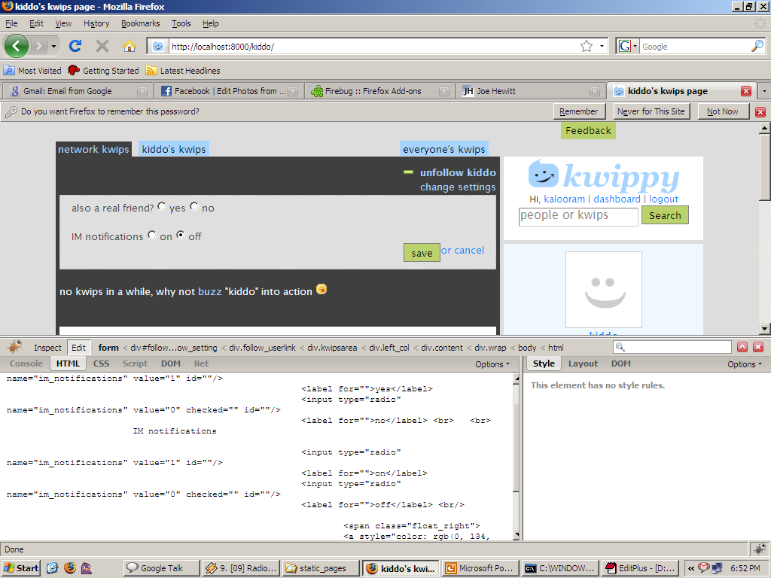
This box must appear just when the user clicks
Follow(which becomes unfollow rightaway).
With the friends feature this is even more imp.
Default === no

Slide 3
If i do yes and save. ===
clicking on the add as friend on
right

Slide 4
I visit this profile. I m not
following her nor her
friend.
Can add at two places – on the right
as well as while following
Add as friend
block sbullo
Add as friend
block sbullo
On clicking
add as friend
it changes to
“friend request
pending”

Slide 5
If the user denies friendship request
the add as friend again appears.
The person can again request friendship.
There is a block userlink on the right
which if clicked, that user will never see the
add as friend link on the right. Or follow. Can't interact anyway with the user who has blocked.

Slide 6
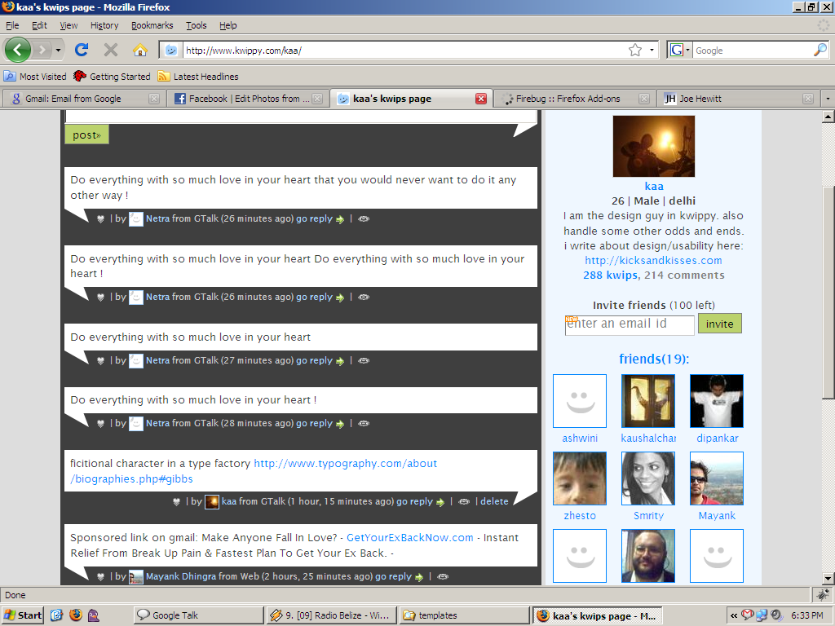

Slide 7
On a friend request the requestee gets a mail. And IM alert.

