Slide 1
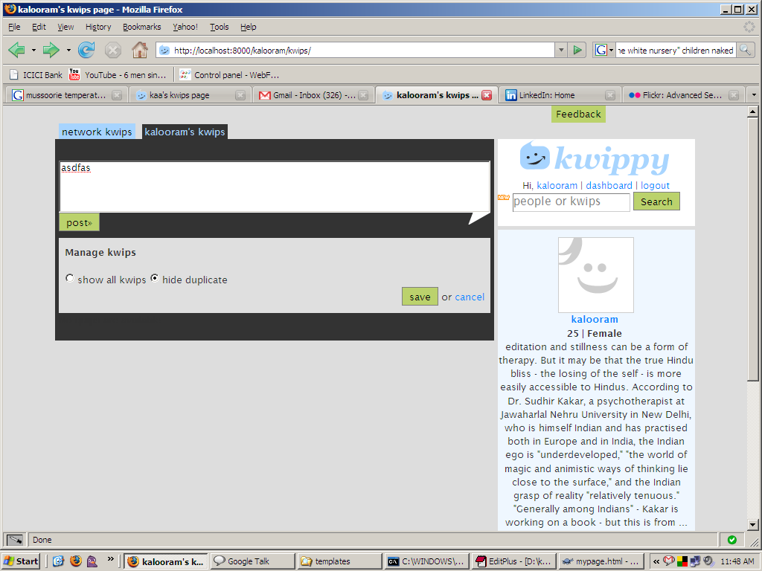
On login after feature release this comes on the user self page (for both tabs)
The same html goes inside the fieldset for the “kwips page setting” inside dashboard.
Rules for hiding:
1.hide everything but the latest of the duplicates.
2. Don’t hide kwips with comments.
3.Even hidden kwips show up on their URL.
4.If a user decides to hide , hide even for the network kwips.

