Slide 1
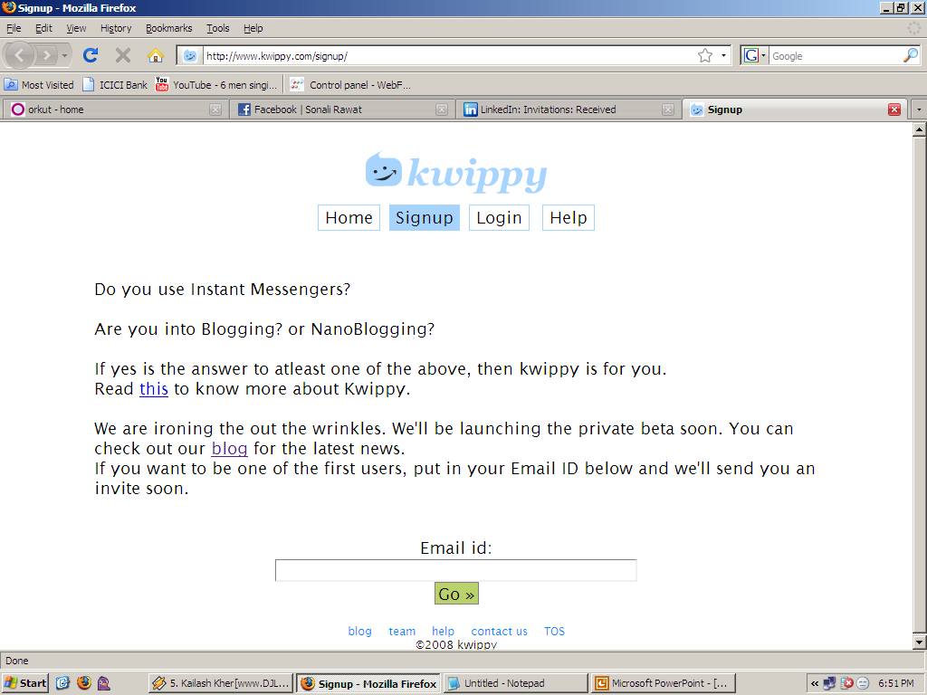
home
signup
Points for what ppl can do with kwippy
Asdfasdf asd
Asdf
Asdf
asdf
Graphic here:
Every adventure requires a first step. Trite, but true, even here.
Submit
This is a random kwip. For the time being
I have got a quote from cheshire cat
(alice in wonderland). Once we open the kwippy
page we can have our favs here.

