Slide 1
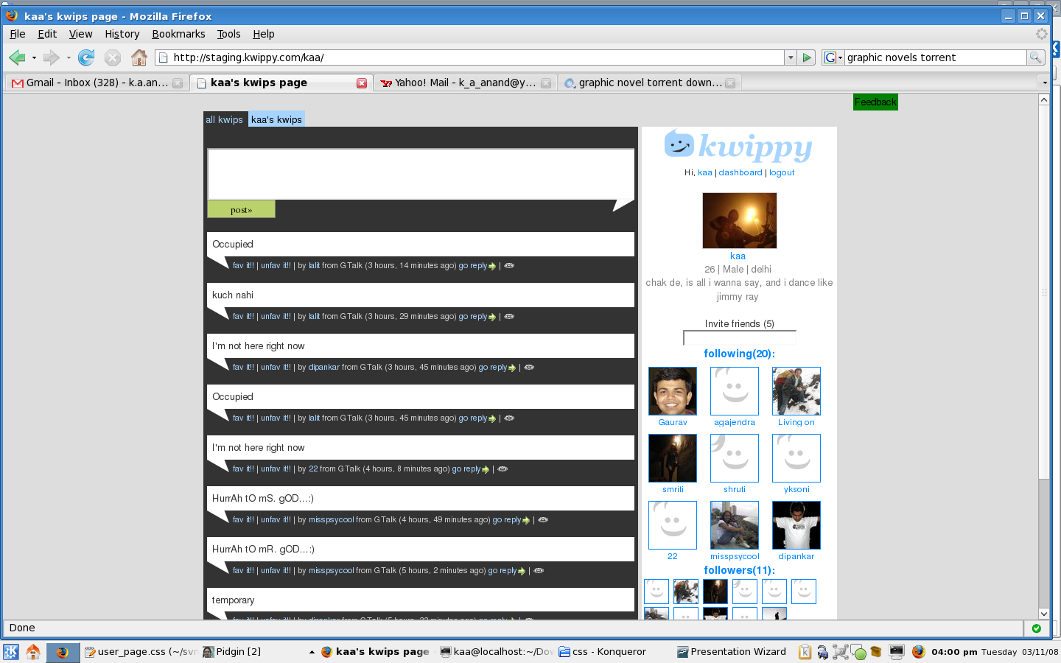
I'll change the css. See html mockups.
invite

Slide 2
The number besides the invites – number of invites left
cases1-
If the email id entered is already registered. The invite is not used. And in the oopar vala flash
message show this,
“email id entered” is already registered :), <link>here<link>
case2 -
if already invited, we can send the invite and show this in flash -
“invite has been sent to “id”, these ppl have also invited “id”, you may know them <displayname or username link1>, <displayname or username link2>
invite mail from friends
#I think in future we can even give a small textbox where users themselves can add a line.
#from has friends email id
#all invite senders (to that id) name
#on signup all those ppl should become auto followers
#friends of friends probability - “these might be your friends” - can also be taken from here

