Slide 1
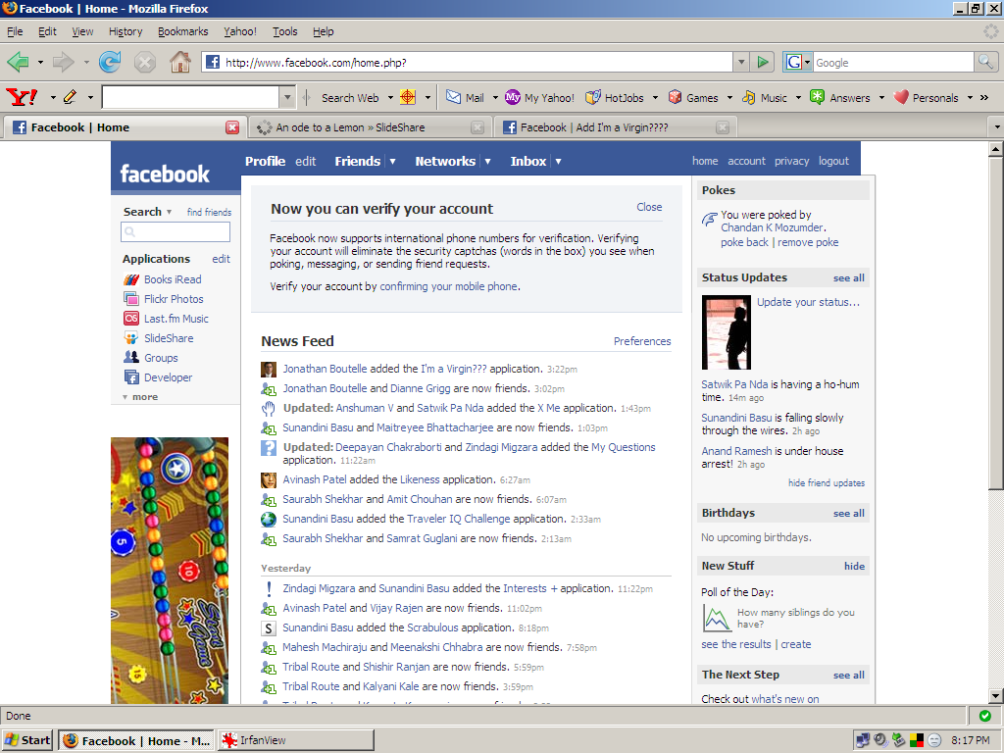
Any change here goes to kwippy.

Slide 2
kwippy
settings
Let all your facebook status updates go to kwippy.
post
a kwip
Woman hath no fury like a fucking fuck.
kaargocult
Chicken hath no gravy like a fucking duck.
Dipankar.sarkar | Reply
Chinchan hath no muck like a sucking chuck
Dhingra.mayank | Reply

Slide 3
v
Kwippy/settings
Let all your facebook status updates go to kwippy.
add kwippy@kwippy.com to your IM list to send your status messages to kwippy.

Slide 4
v
Kwippy/settings
Let all your facebook status updates go to kwippy.
add kwippy@kwippy.com to your IM list to send your status messages to kwippy.
For

Slide 5
v
Kwippy/settings
Let all your facebook status updates go to kwippy.
add kwippy@kwippy.com to your IM list to send your status messages to kwippy.

Slide 6
kwippy
On clicking here
Login
Signup
login
password
Blog
FAQs

Slide 7
kwippy
Settings |
Login
post
a kwip
Woman hath no fury like a fucking fuck.
kaargocult
Chicken hath no gravy like a fucking duck.
Dipankar.sarkar | Reply
Chinchan hath no muck like a sucking chuck
Dhingra.mayank | Reply

