Slide 1
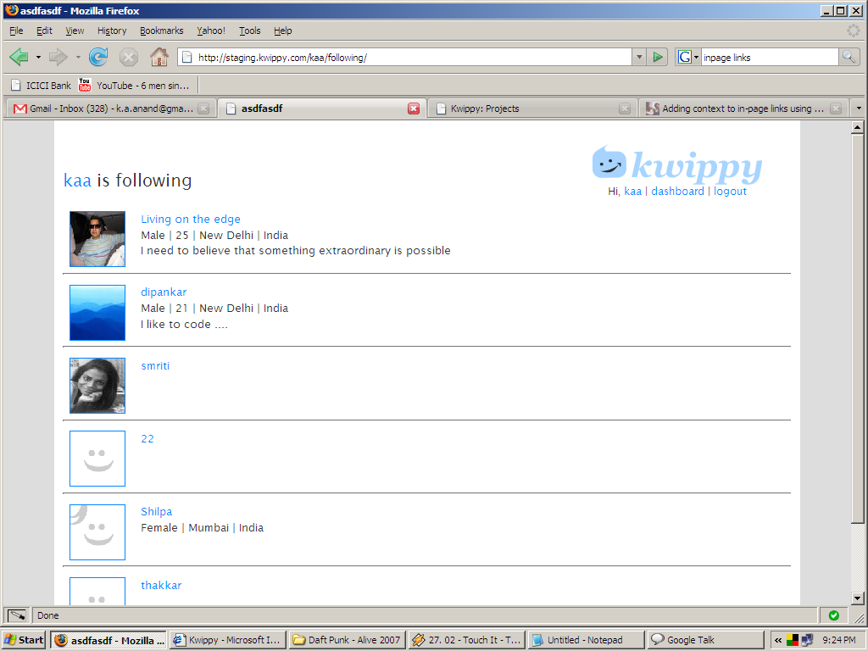
Number of results
delhi
search
search results - “12”
delhi
delhi
Highlight the search query

Slide 2
What stuff are you searching?
Emails? Profile info? Kwips/comments
Search the emails only if the entire email id is put k.a.anand@gmail.com should return results while k.a.anand should not. {we have to keep in mind the future find your friends and both should be similar, also the email id is currently private}
If it is a kwip – just add that part of the kwip (see next slide). After the profile info
The profile info and pic remains in all searches.

Slide 3
mahatma
search
12 results for “mahatma”
kwip: “….they fight you, then you win. Mahatma Gandhi …”
go to kwip>>
40 characters before the query
and 40 afterwards
Link to that kwip page

Slide 4
mahatma
search
12 results for “mahatma”
kwip: “….they fight you, then you win. Mahatma Gandhi …”
go to kwip>>
Link should always
Be to the specific kwip
page
If the query is in the kwip show the
Kwip owners photo and detail.
If it is in the comment show the commenter’s
Pic and details

Slide 5
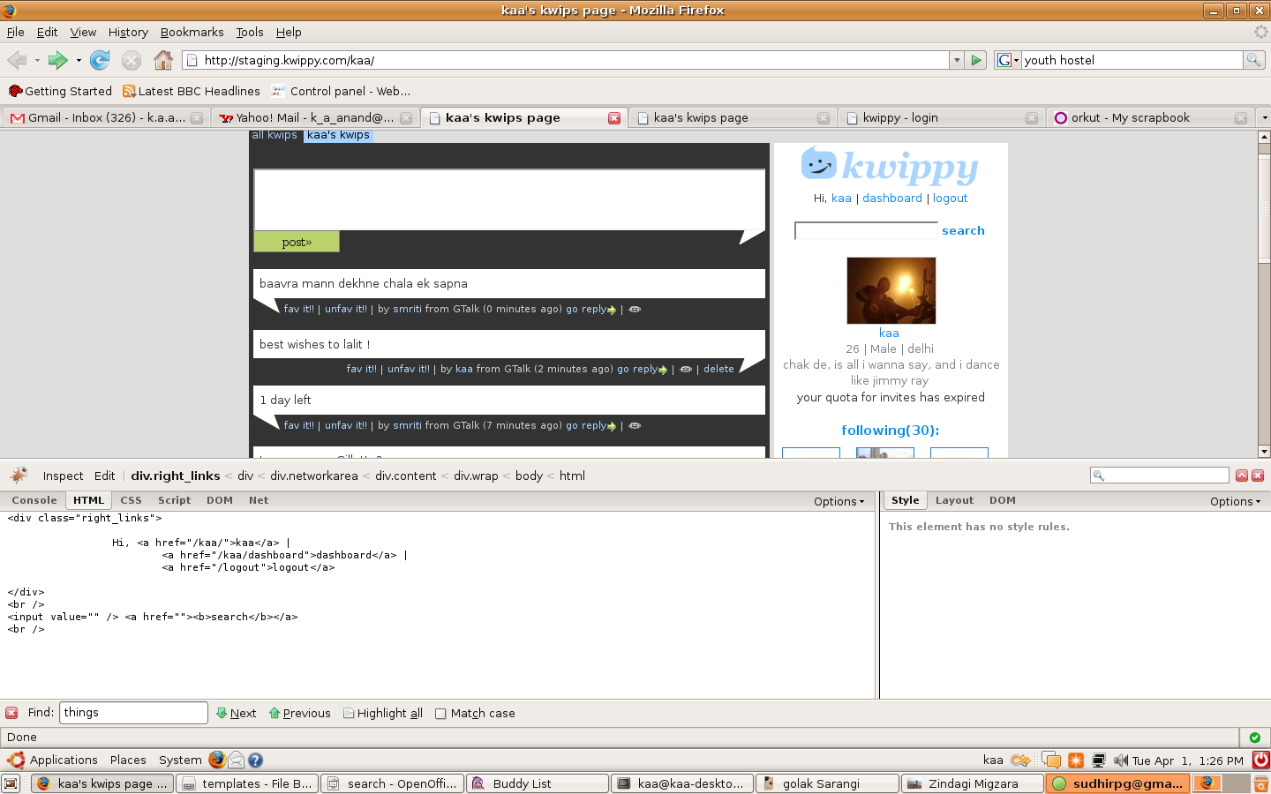
this is a button as well as a link
if clicked here will go to the
result page. and if something is filled and
then pressed it will show those results.
URL of search would be /search

Slide 6
Algo for search rank
morepriority>>less priority
username,email_id,display name>>locality,age,gender >> description>>kwips>>comments

