Slide 1
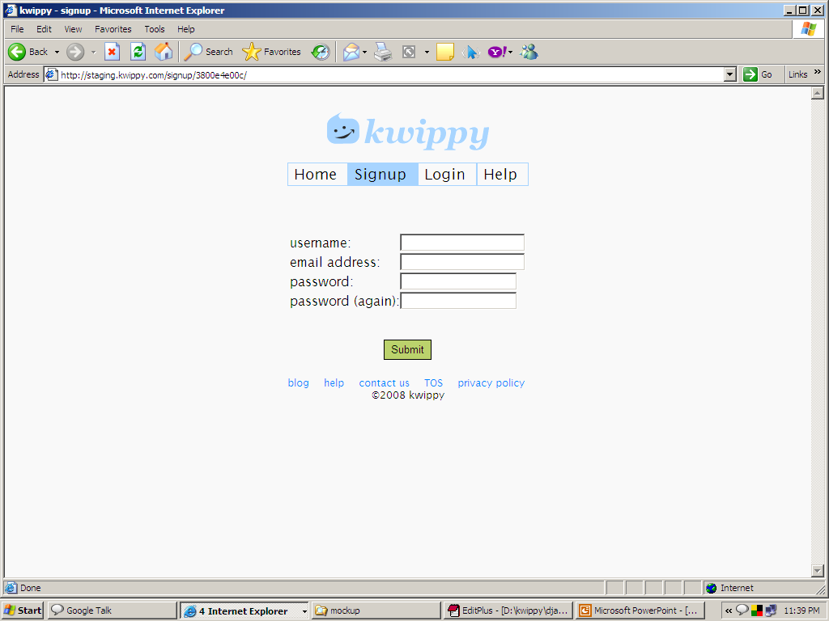
kwippy.com/
Everything in a separate div
And divs in between (these will be the divs where the hints or feedback will come, I’ll style them later)

Slide 2
Min 3 characters
“.”, other special characters not allowed (except hashes and underscores)
Min 5 characters
Check if it is a valid format.

Slide 3
Hint – tell what it is, other info – shud come when clicked inside textfield
Feedback – 3 types
Positive – when the deed is correctly done
Negative – incorrect – tell what so that user can correct
Both positive and negative should come –
When with mouse somewhere outside that textfield is clicked – or tab (that textfield looses focus

Slide 4
The three feedbacks for each field
Username – hint – “this will be in your url”
Positive – great username ☺
Negative – username not available, please try again
Password – hint – minimum 5 characters
Positive – negative – can we show strong weak thing.. If not leave it
Confirm Password – hint - to make sure ☺
Postive – great the passwords match ☺
Negative – you made a typing error (empty the text field also)☹
Email – you need to activate your account, so put in a real email id.
Postive – great
Negative – that’s an invalid id
Just see pownce’s signup page. That’s awesome

