Slide 1
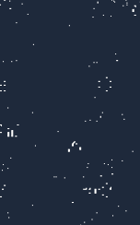

Kwirth
Kubernetes Observability & Management
Simple. Real-time. Open Source.
v0.5.40
Kubernetes Wirth
in honor of Niklaus Wirth
kwirthmagnify.dev · github.com/kwirthmagnify/kwirth

Slide 2
What for?
Observe & manage Kubernetes can be… complex, hard and expensive.
ELK Stack
DataDog / Dynatrace
Complex, priceful, heavy
Expensive. Very expensive
Prometheus + Grafana
kubectl logs
Powerful, but too much config and storage
Functional, but (very) limited
Lens
K9s
Just desktop experience, high resource consumption
Functional, but just console and very limited
What if you can find something simpler, that can be started with just a kubectl apply?

Slide 3
What is Kwirth?
An OSS observability and management tool for Kubernetes.
A single pod. No persistence. No PVs or PVCs.
Logs, metrics, alerts, events, AI, management… — in real time.
1 pod
9
0
OSS
for deploying it all
available channels
Storage needs
MIT License
kubectl apply -f https://...kwirth.yaml ← that’s all

Slide 4
Kwirth = Kubernetes + Wirth
Niklaus Wirth
Magnify & our logo
Creator of Pascal, Modula, Oberon
1984 Turing Award
Wirth's Law: “Software is getting slower more rapidly than hardware is becoming faster”
Passed away on January 1, 2024
The stylized “K” in the style of Roy Lichtenstein.
Just as he used Ben-Day dots to create art from comics, Kwirth takes the cluster’s “dots” (logs, metrics, events) and magnifies them into something clear and visual.
Magnify: the management channel + the desktop app.

Slide 5
Channels
Every feature is a channel — pluggable, independent, extensible.
Log
Metrics
Alert
Aggregated log streaming in real time
CPU, memory, I/O, bandwidth…
Log-based alerting
Trivy
Ops
Fileman
Cybersecurity 100%
Shell, restarts, cluster info
Containers’ filesystems access
Magnify
Pinocchio
Echo
Full Kubernetes management platform
Kubernetes extended with LLM / AI
Reference channel for channel devs

Slide 6
Architecture
BACKEND (Node.js / TypeScript)
FRONTEND (React / TypeScript)
Kwirth Core (WebSockets, seguridad)
Core Front App (auth, store, routing)
WS / HTTP
Back Channels (Log, Metrics, Alert…)
Front Channels (plug & play)
Providers
Kwirth Desktop (Electron)
Storage in etcd (secrets + configmaps)
Multi-cluster
Deploy: Kubernetes · Docker · Standalone (npm) · Desktop App (Electron)

Slide 7
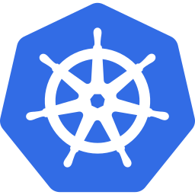







Tech Stack
Kubernetes
TypeScript
React
Node.js
Target platform
Front + Back
Frontend SPA
Backend runtime
React MUI
Docker
Helm
GitHub
Component library
Containerized
K8s packaging
Source & website
WebSockets for real-time data streaming · etcd as a storage (via Kubernetes secrets/configmaps)

Slide 8
How to deploy Kwirth?
Kubernetes
Docker
kubectl apply -f kwirth.yaml
docker run kwirthmagnify/kwirth
helm install kwirth kwirth/kwirth -n kwirth \
--create-namespace
It is the perfect solution if you want to run Kwirth out-of-cluster, using your own kubeconfig.
Kwirth inside-cluster with direct access to Kubernetes API.
Iron
Desktop (Electron)
npm i -g @kwirthmagnify/kwirth-external
Download from kwirthmagnify.dev
Deploy on top of your OS, next to client application (e.g., Backstage)
Windows & Linux. Like Lens/K9s, but with the power of Kwirth.

Slide 9
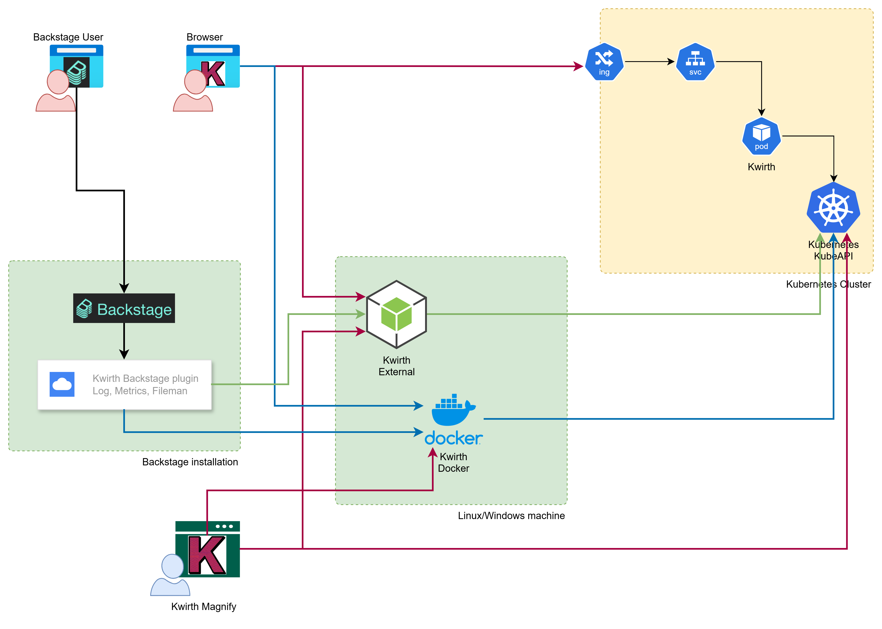
Kwirth family
Deployment
Same codebase, four different deployment options
Total interoperability & interchangeability
Front/back fully decoupled. 100% APIfied.

Slide 10
[ DEMO ]
Let’s see Kwirth in action 🚀
1. Real time log streaming
2. Artifact metrics & aggregation
3. More fun stuff with Fileman & Trivy
4. Magnify channel — cluster management
5. Pinocchio — ask your LLM about your cluster

Slide 11
Roadmap
✅ Ready
🔜 In the pipeline
✓ Helm chart deployment
→ Alerts based on metrics (thresholds)
✓ Real time aggregable metrics
→ Pinocchio (more AI)
✓ Event streaming
→ Session management, SSO, IdP, IAM
✓ WebSocket multi-instance
→ External notifiers
✓ 9 channels (observabilitu & management)
→ OTel provider, IaC support (ArgoCD, flux, kustomize…)
✓ Log ephemeral (alerting without storage)
→ Plugin system like Backstage or Grafana

Slide 12
What can you do?
Kwirth has been designed fer receiving everyone’s help, adding the value that comes from each one’s effort
Frontend
Backend
• New React MUI channels
• Implement more back-channels
• UX/UI improvements
• OpenShift support
• Desktop app (Electron, Tauri) and Mac
• WebSocket features
• Mobile version
• New providers
QA / Testers
Architecture
• E2E tests
• Design a plugin system
• Channel testing
• Performance & scaling
• Security coverage
• Multi-cluster strategy
• Trivy integration testing
• Channel spec evolution

Slide 13
How to join the project?
01
Clone the repo
github.com/kwirthmagnify/kwirth
Analyze the README and the docs on the website
02
Create your own environment
Node.js v22+, kubectl, Docker.
Follow the developing guide for building a new channel.
03
Select where to work
Open issues in GitHub if needed. Comment about everything you like and dislike, propose a new idea. All profile s are welcomed.
04
Pull Request
Fork & open a PR. We review it quickly,
Project is small and you’ll get direct feedback.

Slide 14
Why to join?
🚀 Real tech
🧠 Work deeply with K8s
🌍 OSS in your CV
TypeScript, React, Node.js, Kubernetes.
Everything you already know and use.
Working with Kwirth will lead you to learn a lot of Kubernetes.
This is an open project with real people.
It is more than a private side project.
🤝 Small community = great impact
⚡ Modern architecture
🎯 Real needs
Working in big projects gives you low visibility.
Here, your PR changes something real.
Plugin system, channels,
real-time streaming, AI. No legacy.
Kubernetes observability and management is a problem everyone needs to face.

Slide 15
Questions?
Documentation:
kwirthmagnify.dev
Source code:
github.com/kwirthmagnify/kwirth
Install:
kubectl apply -f ...kwirth.yaml
Join — Kwirth will be build by a strong community! 🙌

Slide 16
Kwirth
Simple observability for Kubernetes.
Built with ❤️ — and TypeScript.
kwirthmagnify.dev

