Slide 1
kwirth
Technical Overview
Kubernetes observability & operations
Architecture · Deployment · Integration · Security
Open source · Apache License 2.0 · github.com/kwirthmagnify/kwirth

Slide 2
OVERVIEW
What is Kwirth?
Kwirth replaces a full observability stack (Prometheus + Grafana + Loki + Alertmanager + …) with a single pod. Real-time logs, metrics, alerting, security scanning, BYO-LLM AI analysis and a complete Kubernetes manager — all in one pod.
One pod, zero deps
Real-time first
Multi-cluster native
Single container. State in Kubernetes — ConfigMaps, Secrets, a PVC or files. No external DB, queue or sidecar.
All data flows over WebSockets — no polling. Logs, metrics, alerts and AI answers arrive as they happen.
Connect many clusters from one instance, each with independent access control. Federated in the front end.
Extensible by design
Secure by default
Clean stack
Hot-reloadable plugins, providers, senders, themes, homepages, IdPs, logins and webhooks — no pod restart.
Fine-grained RBAC with per-plugin scopes, SSO via external IdPs, and permanent/volatile/bearer access keys.
TypeScript end-to-end. Node.js + Express back end, React + MUI front end, direct Kubernetes API access.
Listens on port 3883 · in-cluster or desktop (Kwirth Magnify) · started 2022

Slide 3
PART 1
Architecture

Slide 4
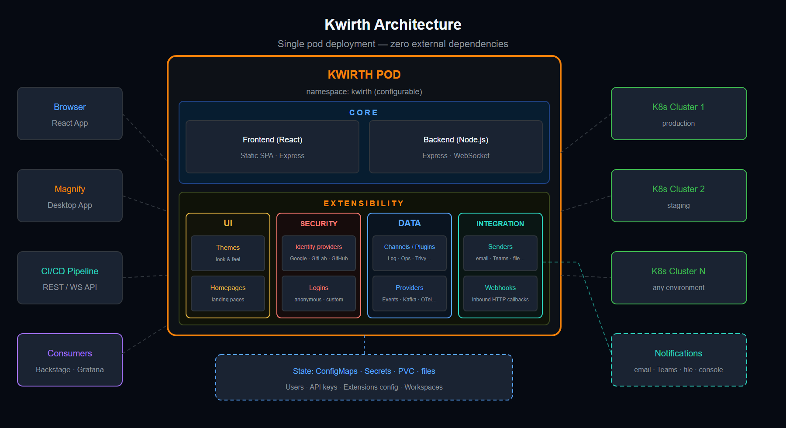
ARCHITECTURE
The single-pod topology

Slide 5
ARCHITECTURE
Inside the pod
Core — Frontend
Core — Backend
React + MUI single-page app, served as static assets by the Express server. Renders channels, dashboards and the extension managers. Talks to the back end over REST + WebSocket.
Node.js + Express. Exposes the REST API and the WebSocket server, hosts the channel/provider/sender subsystems, and reaches clusters directly through @kubernetes/client-node — no middleman.
State
Real-time transport
Persisted in Kubernetes-native stores: ConfigMaps, Secrets, a PVC, or plain files — users, API keys, extension config and workspaces. No external database or message queue.
A single multiplexed WebSocket carries every stream — logs, metrics, events, AI. Service instance ids let multiple instances of a service share the socket. No polling anywhere.

Slide 6
ARCHITECTURE
Extensibility — families & areas
Everything above the core is a hot-reloadable extension, installed / configured / enabled from the UI with no pod restart. Grouped in four runtime areas plus packaging.
UI
Security
Data
Integration
Themes — repaint the whole shell.
Homepages — swap the landing dashboard.
Identity providers — SSO connectors.
Logins — pluggable sign-in methods.
Plugins — the channels users work in.
Providers — feed data into channels.
Senders — outbound delivery.
Webhooks — inbound HTTP callbacks.
Packaging: Packs bundle many extensions in one .tgz · Documentation packages are docsify sites Kwirth serves itself.
Channels (13): Log · Metrics* · Alert · Ops · Fileman · Trivy · Magnify* · Topology · Pinocchio · Censor · mIRC · News · Echo (*built-in)
Providers: Events* · Metrics · Business (built-in) · Kafka · OpenTelemetry · Syslog · Trivy · Tick · Validating (installable)
Senders: console · file · email-smtp · email-resend · teams + pipelines: tee · regex · timed · ratelimit · composite

Slide 7
PART 2
Deployment

Slide 8
DEPLOYMENT
Five ways to run it
① Kubernetes — Helm (recommended)
② Kubernetes — manifests
helm repo add + helm install kwirth kwirth/kwirth -n kwirth --create-namespace. Tune with values.yaml.
kubectl apply -f …/test/kwirth.yaml for an express setup; edit the YAML to change defaults.
③ Docker
④ External — no Docker
docker run -p 3883:3883 with your kubeconfig mounted so Kwirth can reach the cluster.
npm i -g @kwirthmagnify/kwirth-external, then kwirth-external start --front --port …
⑤ Desktop — Kwirth Magnify
Native installer for Windows, macOS and Linux. A context selector picks the cluster: LOCAL (kubeconfig contexts) or REMOTE (through a Kwirth server). The source cluster appears as inDesktop.

Slide 9
DEPLOYMENT
Helm — install & configure
helm repo add kwirth \
https://github.com/kwirthmagnify/kwirth
helm install kwirth kwirth/kwirth \
-n kwirth --create-namespace \
-f values.yaml
Most useful Helm options
option | meaning
masterkey | signs the access keys issued to clients — change it
rootpath | path Kwirth is served under (default /kwirth)
image | full image ref (default …/kwirth:latest)
resources | pod CPU / memory (K8s format)
ingress.* | deploy an Ingress (nginx / agic, hostname)
nginx.tls | enable TLS + secret holding CRT + KEY
kwirth:
config:
channelMetrics: "true"
channelMagnify: "true"
rootpath: /kwirth
masterkey: <change-me>
image: kwirthmagnify/kwirth:0.5.287
Channels are plugins — install Log, Ops, Trivy, Fileman… from the plugin management UI, not via Helm flags.

Slide 10
DEPLOYMENT
Networking & operations
Port — Kwirth listens on 3883 inside the container; publish/map it as you like for Docker or external runs.
Sub-path — serve under a custom path by creating an Ingress and setting the ROOTPATH env var to the same path (e.g. /kwirth). That is the one thing Kwirth must know.
TLS — terminate at the Ingress (nginx.tls + a secret with CRT + KEY) or in front of the pod.
Namespace — fully selectable; the Helm chart creates it (kwirth by default).
Self-update — restart Kwirth from the UI; with the latest image tag this pulls and runs the newest version.
Resources — sensible defaults (limits cpu 1 / mem 2Gi, requests mem 256Mi); override per environment.
env:
- name: ROOTPATH
value: "/kwirth"
# → http://host/kwirth
Consumers
External tools — Backstage, Grafana, CI/CD — consume Kwirth through its REST / WebSocket API.

Slide 11
PART 3
Security

Slide 12
SECURITY
The authorization model
Every request is authorized against an access key that encodes exactly which cluster resources — namespaces, workloads, pods, containers — and which actions the holder may reach. Security works at three levels.
Administrator
User
API
The built-in admin account manages users, API keys and identity providers. Only the admin scope may perform security-related actions.
Created with a fine-grained set of resources and scopes. Scopes are declared dynamically by each plugin and served by the core — installing a channel can add new permissions.
Access keys let external apps and other Kwirth instances reach resources across clusters, carrying their own scopes, target resources and optional lease/expiry.
Fine-grained RBAC · per-plugin dynamic scopes · enforced in the back end — never trusting the client.

Slide 13
SECURITY
Authentication & Single Sign-On
Built-in user / password — always available for the bootstrap admin account.
Login extensions — pluggable sign-in methods (e.g. anonymous), each with its own config schema.
SSO via external Identity Providers — can be combined with the above.
Bundled connectors (installable)
Google
Gmail and Google Workspace accounts.
GitLab
GitLab.com and self-managed (on-prem).
GitHub
GitHub.com and GitHub Enterprise Server.
Connectors are extensions, so more providers — including third-party ones — can be added over time.
SSO flow — hardened
OIDC / OAuth2 connectors.
PKCE + state, back-channel token exchange — the browser never sees provider tokens.
Single-use login hand-off and anti open-redirect checks.
No auto-provisioning — the user must already exist and be bound to the IdP they use.

Slide 14
SECURITY
Access keys & inbound webhooks
permanent
volatile
bearer
Persisted in the cluster. Long-lived keys for other Kwirth instances and external integrations.
In-memory only. Disappear when the pod restarts — ideal for short-lived, session-scoped access.
Signed and handed to clients at login. Verified with the masterkey; can carry a lease / expiry.
masterkey — signs and verifies every issued access key. Change it from the default before production.
Inbound webhooks — endpoints where external systems POST events into Kwirth are protected by the same access-key model, so only authorized callers get through. Each config exposes a tokenized URL that can be rotated.

Slide 15
PART 4
Integration

Slide 16
INTEGRATION
Inbound, outbound & consumers
Kwirth plugs into your ecosystem in every direction — ingesting external data, receiving inbound calls, pushing notifications out, and exposing everything through its API.
Ingest — Providers
Inbound — Webhooks
Outbound — Senders
Consume — API
Feed external data into channels.
Built-in: Events, Metrics, Business.
Installable: Kafka, OpenTelemetry (OTLP/HTTP), Syslog, Trivy, Tick, Validating.
External systems POST events to a tokenized, rotatable URL. Kwirth parses the payload and routes it to a target channel or plugin.
Push alerts and notifications out: console, file, email (SMTP / Resend), Microsoft Teams. Pinocchio findings delivered via senders.
External tools pull from the REST / WebSocket API — Backstage, Grafana, CI/CD, other Kwirth instances — shared via API keys.
Every integration point authorizes against the same access-key model.

Slide 17
INTEGRATION
Routing pipelines & webhook flow
Sender pipelines — the dispatcher pattern
Inbound webhook flow
Routing senders intercept a message and decide the downstream target — and they chain freely.
external service --POST--> webhook URL (token)
--> parse --> target channel / plugin
tee — fan out to many senders at once.
regex — route or drop by rule; first match wins.
timed — gate by time-of-day / day-of-week (timezone-aware).
ratelimit — throttle to a max rate so alert storms cannot flood a destination.
composite — visual pipeline designer in the UI (no JSON editing).
Each webhook holds named configurations.
Every config exposes a unique URL carrying a secret token — rotatable.
The target is one of your installed channels / plugins.
Fields come from the webhook’s own config schema — typed, no guesswork.
Protected by the access-key model — only authorized callers get through.
regex -> timed -> tee -> email-smtp + file

Slide 18
In short
One pod. Real-time. Multi-cluster. Extensible. Secure.
Architecture — one container (React + Node/Express), direct Kubernetes API, real-time over WebSocket, state in ConfigMaps / Secrets / PVC / files.
Deployment — Helm, manifests, Docker, external Node package or native desktop; port 3883, ROOTPATH for sub-paths, self-update, channels as plugins.
Integration — ingest via providers (Kafka, OTLP, Syslog…), inbound webhooks, outbound senders with routing pipelines, and a REST / WebSocket API for Backstage, Grafana & CI/CD.
Security — three-level RBAC with per-plugin scopes, SSO via OIDC/OAuth2 (PKCE + back-channel), and permanent / volatile / bearer access keys enforced in the back end.
Documentation & source
github.com/kwirthmagnify/kwirth Apache License 2.0 BYO-LLM AI · single-pod observability

Slide 19
REFERENCE
Useful links
Documentation
Install
Source & community
Project website
http://kwirthmagnify.dev
Product guide (docsify)
served in-app at /docs
Releases & desktop installers
github.com/kwirthmagnify/kwirth/releases
Container image (Docker Hub)
kwirthmagnify/kwirth
Helm chart
…/kwirth/tree/master/deploy/helm
External CLI (npm)
@kwirthmagnify/kwirth-external
Repository
github.com/kwirthmagnify/kwirth
Issues
github.com/kwirthmagnify/kwirth/issues
Discussions
github.com/kwirthmagnify/kwirth/discussions
License — Apache 2.0
…/kwirth/blob/master/LICENSE

Slide 20
kwirth
Thank you
Kubernetes observability & operations — in a single pod.
github.com/kwirthmagnify/kwirth · Apache License 2.0

