Slide 1
Respiratory Monitoring Dashboard
Visualizing ICU Respiratory Data Using Power BI
Presented by: Ukwishaka Sandrine
Adventist University of Central Africa
Date: 3 August 2025

Slide 2
Problem Statement
Monitoring respiratory parameters is critical in ICU settings to ensure patients receive proper oxygenation and ventilation.
This project analyzes and visualizes respiratory data to support clinical decision-making.
Objective: Build an interactive Power BI dashboard to monitor key respiratory metrics such as FiO₂, LPM O₂, and ventilator rates.

Slide 3
Dataset Overview
Dataset: cleaned_respiratorycharting.csv
- Total Records: 176,089
- Columns:
• patientunitstayid – Unique patient stay ID
• respchartvaluelabel – Measurement type (FiO₂, LPM O₂, Vent Rate)
• respchartvalue – Recorded numeric value
• respchartoffset – Time offset from admission
- Data Type: Tabular (CSV)

Slide 4
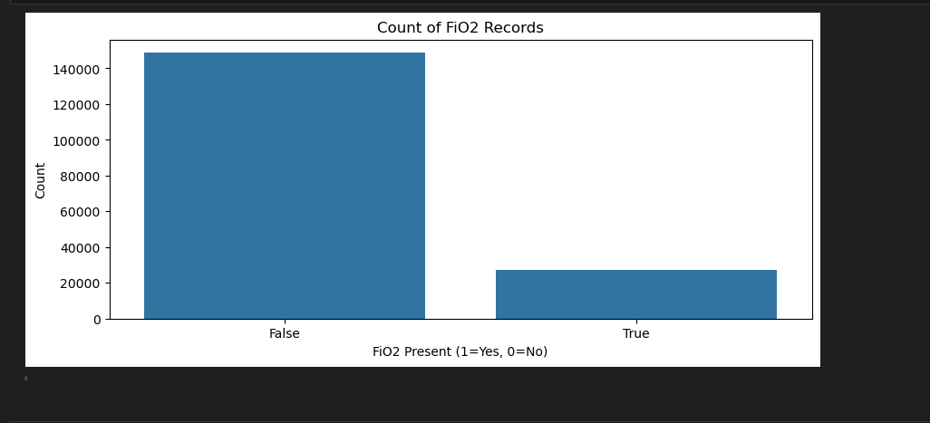
FIO2 RECORDS

Slide 5
Data Cleaning & Preparation
- Removed missing or duplicate rows (if any)
- Verified column data types
- Focused analysis on key fields
- No need for joining tables (single flat structure)
- Created DAX measures for average values

Slide 6
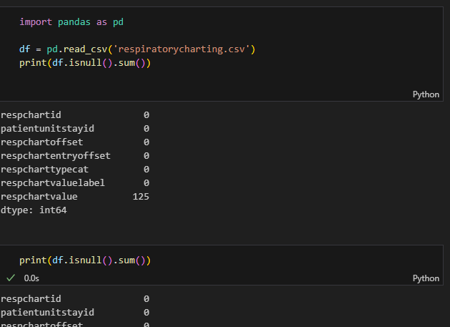
Data Cleaning & Preparation

Slide 7
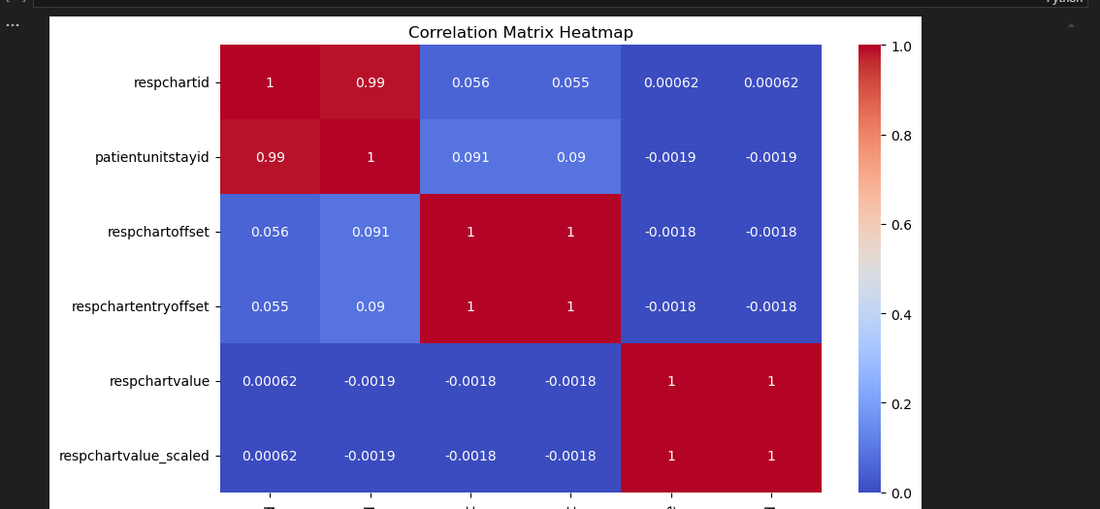
MATRIX HEATMAP

Slide 8
Power BI Dashboard Layout
The dashboard includes:
- Summary Cards: Total Patients, Avg FiO₂, Max Vent Rate
- Slicers: By respchartvaluelabel, patientunitstayid
- Line Chart: Trends over time by measurement
- Bar Chart: Average value by label
- Matrix: Patient vs. label averages
- Pie Chart: Distribution of reading types

Slide 9
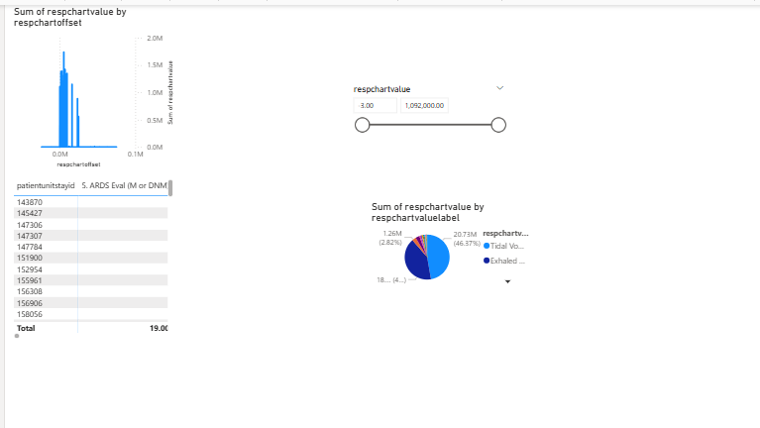
DASHBOARD

Slide 10
Dashboard Interactivity
- Users can filter by patient ID and chart label
- Drill-down enabled on time-based line chart
- Hover tooltips provide exact measurement values
- All visuals update based on slicer selection

Slide 11
Visual Results & Insights
- FiO₂ and LPM O₂ are the most frequently recorded values
- Average FiO₂ is approximately 45%
- Ventilator Rate peaks during early hours of patient admission
- High variation between patients indicates different respiratory needs

Slide 12
Conclusion
- The Power BI dashboard makes it easier to monitor and analyze respiratory data
- Useful for healthcare professionals in ICU environments
- Enables faster, more accurate decision-making
- Can be expanded with machine learning, patient alerts, or live data feeds

Slide 13
Thank You
Any Questions?
Ukwishaka Sandrine
Adventist University of Central Africa

