Slide 1

Data Structures
Priority Queues
&
Heaps
28-Nov-2019
By: Sehajpreet Singh

Slide 2
Introduction
Data Structures: Ways to store and organize data.
For different type of data we use different data structures. The choice of data structures may depend on the following factors:
What needs to be stored?
Cost of Operations
Memory Usage
Ease of Implementation(may not be a Primary Factor)
What would be the best Data Structure to Organize Hierarchical data? For example organizational hierarchy of some company?

Slide 3
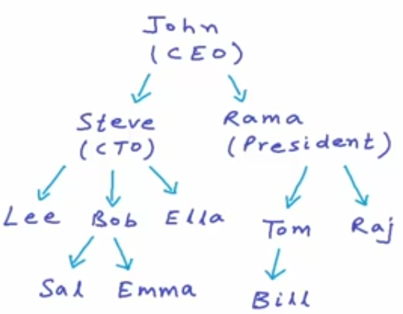

Trees
Tree is a non-linear data structure.
Each node may contain some data and link to other nodes.

Slide 4
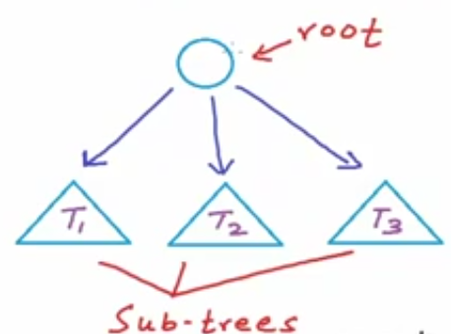
Tree is a Recursive Data Structure

Slide 5
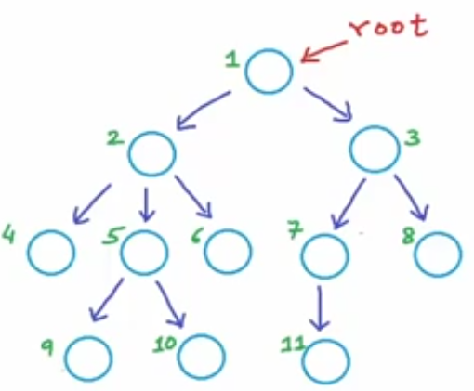
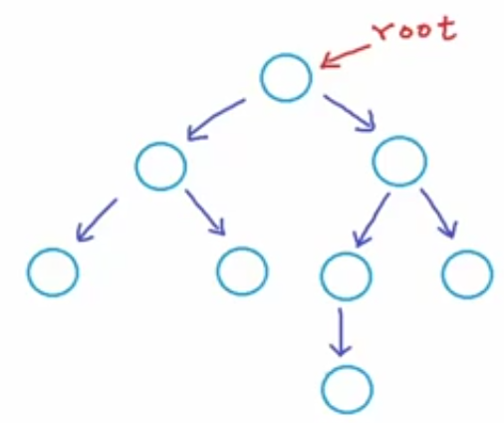
Binary Tree
A tree in which each node can have at max 2 children.

Slide 6
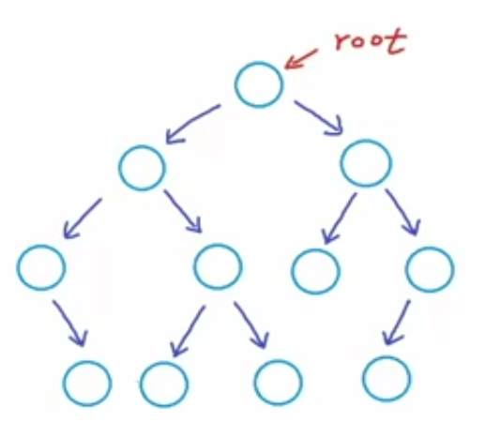
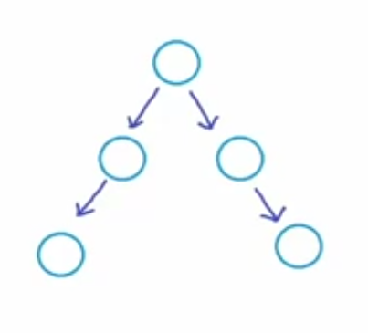
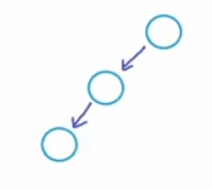
All of these are Binary Trees.

Slide 7
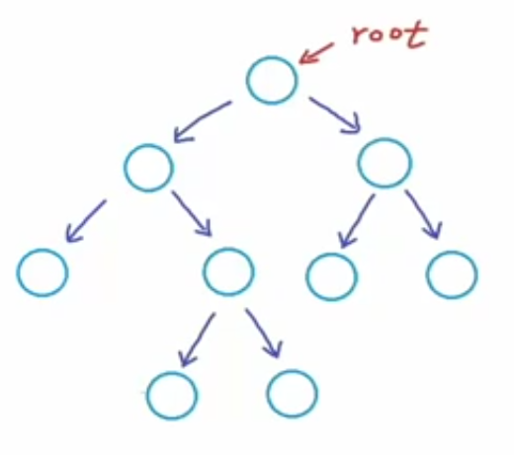
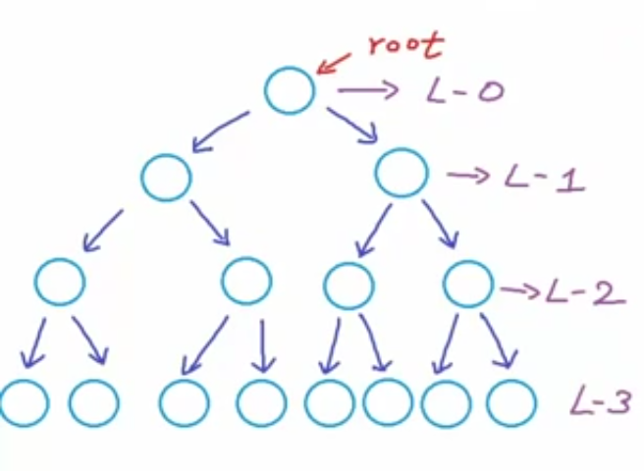
Types of Binary trees
Proper Binary Tree: Each node can have either 2 or no children.
Perfect Binary Tree: If all the levels are completely filled.

Slide 8
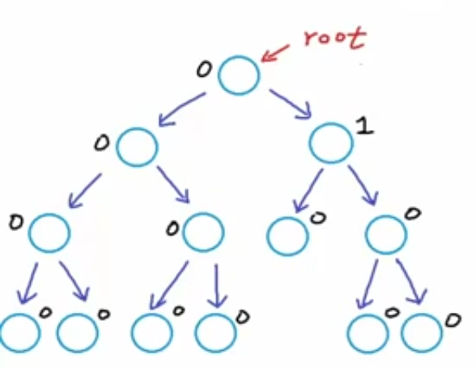
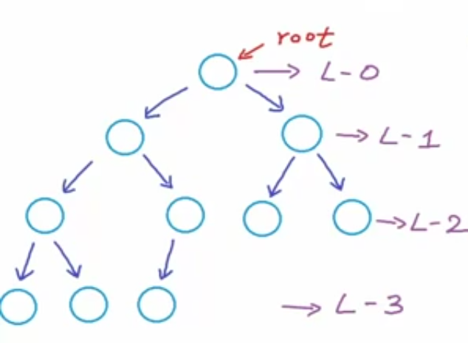
Types of Binary trees
Balanced Binary Tree: Difference between the height of left and right subtree for every node is not more than k (mostly k=1).
Complete Binary Tree: All levels, possibly except the last are completely filled and all nodes are as left as possible.

Slide 9
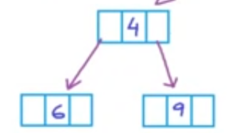
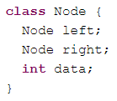
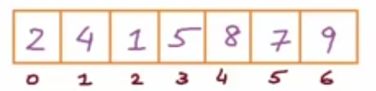
Implementation
We can implement Binary Trees using:
Dynamically created nodes
b) Arrays
For node at index i:
Left-child-index: 2i+1
Right-child-index: 2i+2
Parent: (i -1) / 2

Slide 10

Thinking
Something Obvious between Complete Binary Tree and its Array Implementation

Slide 11
Thinking
Something Obvious between Complete Binary Tree and its Array Implementation
There won’t be any Gaps in the Array Implementation of a Complete Binary Tree.

Slide 12
Heaps
A Heap is a special Tree-based data structure in which the tree is a complete binary tree. Generally, Heaps can be of two types:
Max-Heap: In a Max-Heap the key present at the root node must be greatest among the keys present at all of it’s children(descendants). The same property must be recursively true for all sub-trees in that Binary Tree.
Min-Heap: In a Min-Heap the key present at the root node must be minimum among the keys present at all of it’s children(descendants). The same property must be recursively true for all sub-trees in that Binary Tree.

Slide 13
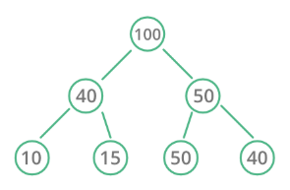
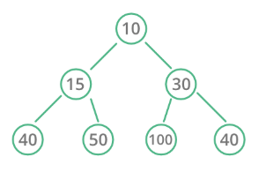
Types of Heaps
Max Heap
Min Heap

Slide 14
Insertion in Heaps
Given a Binary Heap and a new element to be added to this Heap. The task is to insert the new element to the Heap maintaining the properties of Heap.
Process of Insertion:
Insert the new element at the end of the Heap.
This newly inserted element may distort the properties of Heap for its parents. So, in order to keep the properties of Heap, heapify this newly inserted element following a bottom-up approach.

Slide 15
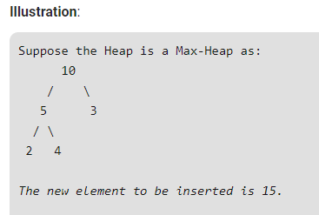
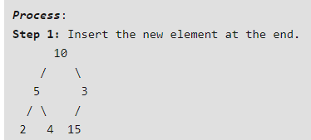
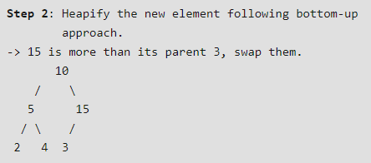
Insertion in Heaps

Slide 16
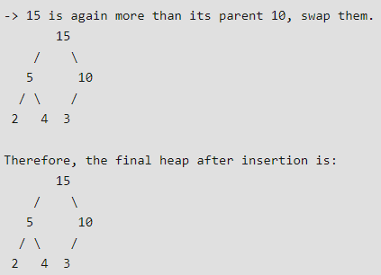
Insertion in Heaps

Slide 17
Deletion in Heaps
Since deleting an element at any intermediary position in the heap can be costly, so we can simply replace the element to be deleted by the last element and delete the last element of the Heap.
Replace the root or element to be deleted by the last element.
Delete the last element from the Heap.
Since, the last element is now placed at the position of the root node. So, it may not follow the heap property. Therefore, heapify the last node placed at the position of root.

Slide 18
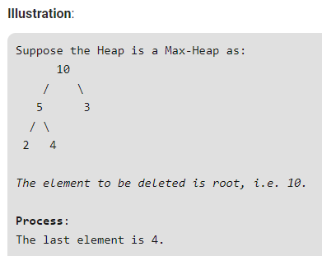
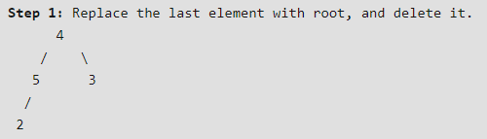
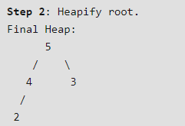
Deletion in Heaps

Slide 19
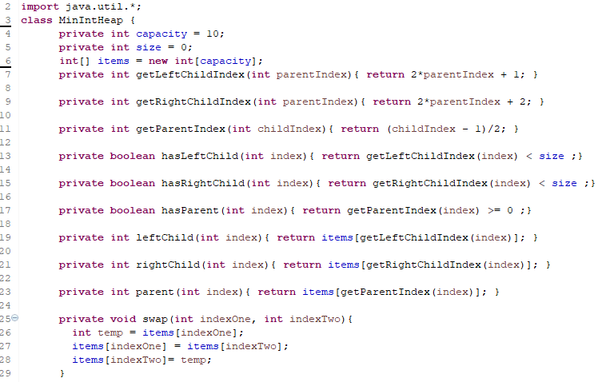
Array Implementation

Slide 20
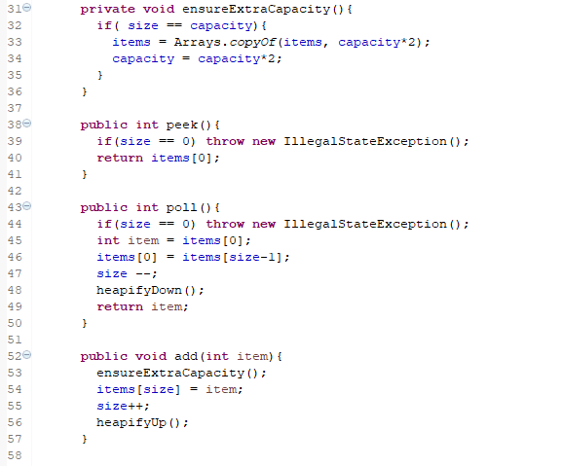
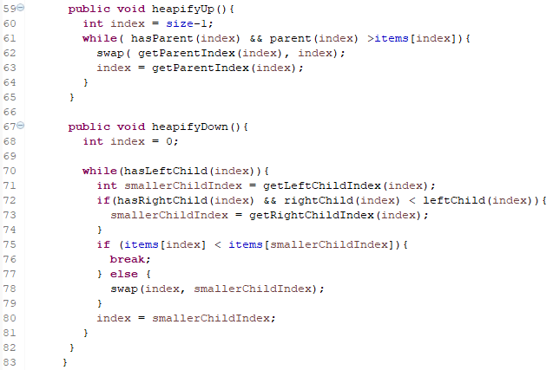
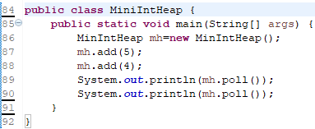
Array Implementation

