Slide 1

Data Structures
Priority Queues
&
Heaps
By: Sehajpreet Singh

Slide 2
What will you do in the following Scenario?
An emergency case arrives in a hospital
Essential system process asks for some resources during CPU Scheduling
Real life tasks which require some privileges compared to others

Slide 3
Priority Queue
Priority Queue is an extension of queue with following properties:
Every item has a priority associated with it.
An element with high priority is dequeued before an element with low priority.
If two elements have the same priority, they are served according to their order in the queue.
Entry and exit are not purely of the FIFO kind

Slide 4
Types of Priority Queue
Min – Priority Queue
Max – Priority Queue
8 | 6 | 3 | 10 | 5 | 1 | 4
8 | 6 | 3 | 10 | 5 | 1 | 4
Smaller Number
Higher Priority
(e.g. Ranks)
Larger Number
Higher Priority
(e.g. Marks)

Slide 5
Priority Queue ADT
Abstract Data Type only states what operations are to be performed but doesn’t say how these operations will be carried out.
It does not specify how data will be organized in memory and what algorithms will be used to carry out the operations.
Priority Queue ADT:
removeHighestPriority()
getHighestPriority()
add(T element)
isEmpty()
size()

Slide 6
Implementation of Priority Queue
Using In-Built Class “PriorityQueue”
Using Arrays
Using Heaps

Slide 7
Using In-Built Class
Priority Queue ADT:
removeHighestPriority()
getHighestPriority()
add(T element)
isEmpty()
size()
PriorityQueue Class:
poll()
peek()
add(T element)
isEmpty()
size()

Slide 8
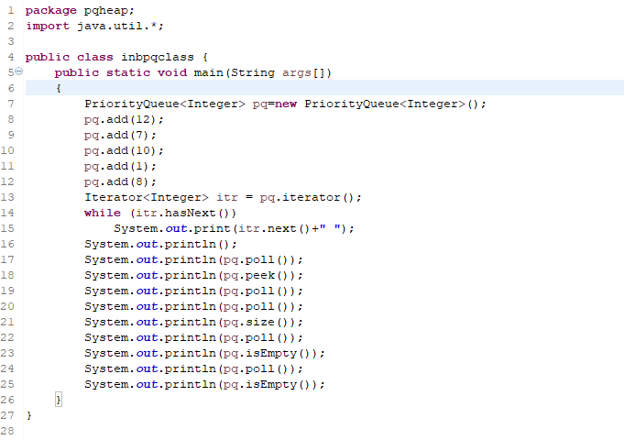
Using In-Built Class

Slide 9
Array Implementation
Two Scenarios:
Array Not Sorted
Array Sorted
8 | 6 | 3 | 10 | 5 | 1
1 | 3 | 5 | 6 | 8 | 10
Insertion – O(1)
Deletion – O(n)
Insertion – O(n)
Deletion – O(1)
e.g. Insert 9
e.g. Insert 9
8 | 6 | 3 | 10 | 5 | 1 | 9
1 | 3 | 5 | 6 | 8 | 9 | 10

Slide 10
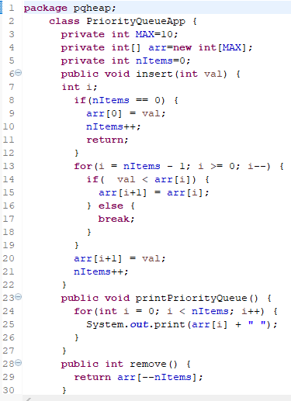
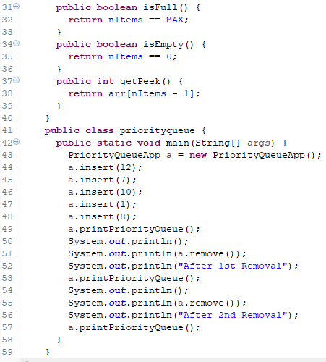
Array Implementation (Array Sorted)

Slide 11

Array Implementation (Array Not Sorted)

Slide 12
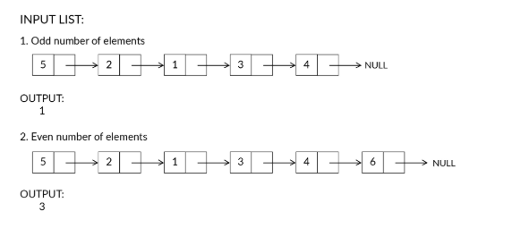
Interview Question
Given a singly linked list along with reference to the head of the list. Your task is to find the middle element of the given linked list.
Note: If there are even number of elements then there will be two middle elements and you need to print the second one as shown in the figure above.

Slide 13
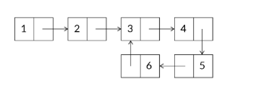

Interview Question – Home Work
Detect and Remove a Loop in a Singly Linked List.
If loop exists:
After Removal:

