Slide 1
Ground Truth Labeling
Date: 2018/08/24
Reporter: Yi-Lun Li

Slide 2
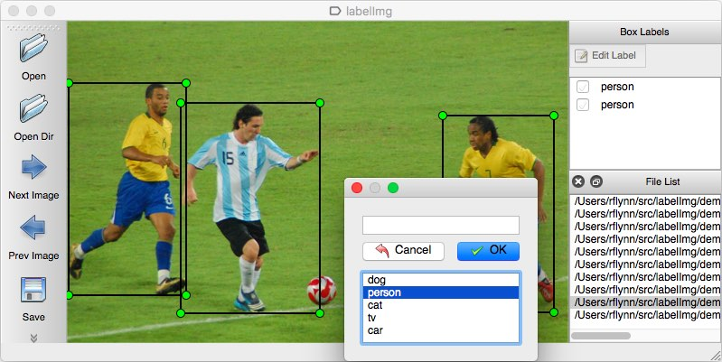
LabelImg
LabelImg
A graphical image annotation tool
Label object bounding boxes in images
Ref: https://github.com/tzutalin/labelImg

Slide 3
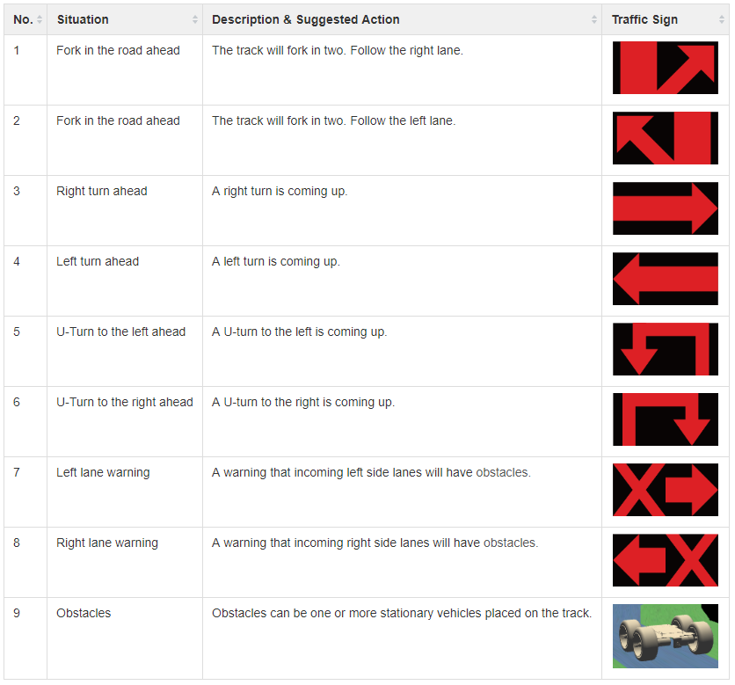
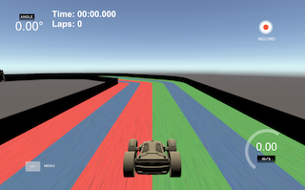
Self-driving car
ForkRight
ForkLeft
TurnRight
TurnLeft
UTurnLeft
UTurnRight
WarningLeft
WarningRight
Obstacle
Ref: https://github.com/tzutalin/labelImg

Slide 4
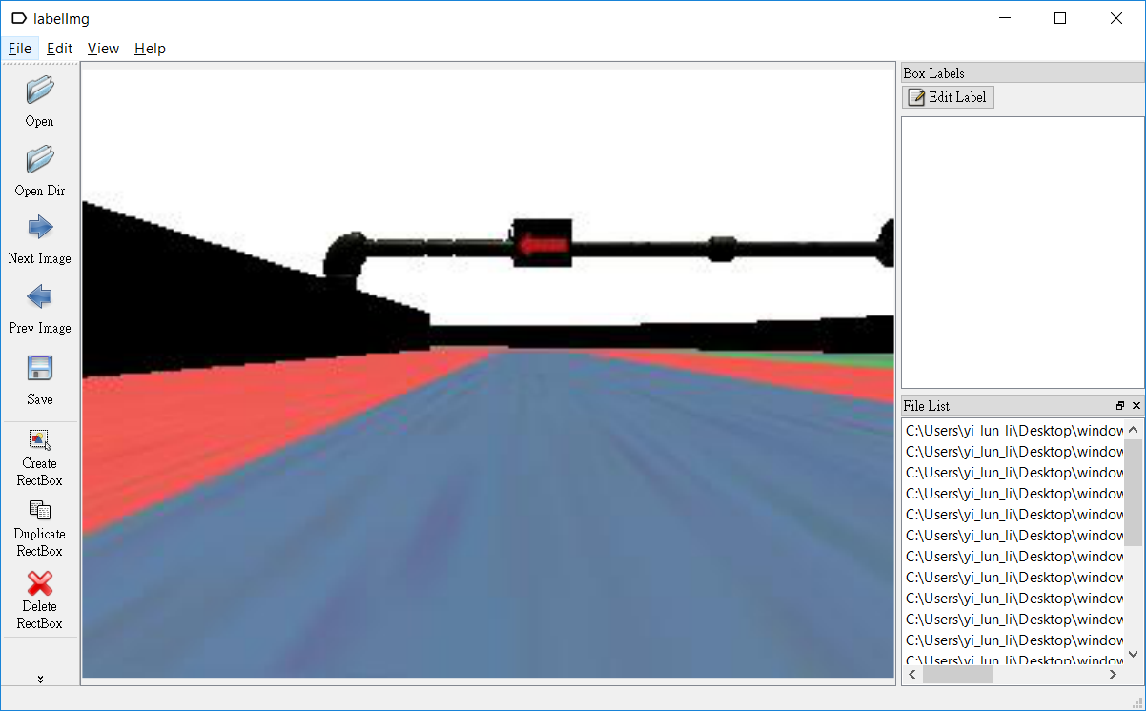
Example
1
2
Ref: https://github.com/tzutalin/labelImg

Slide 5
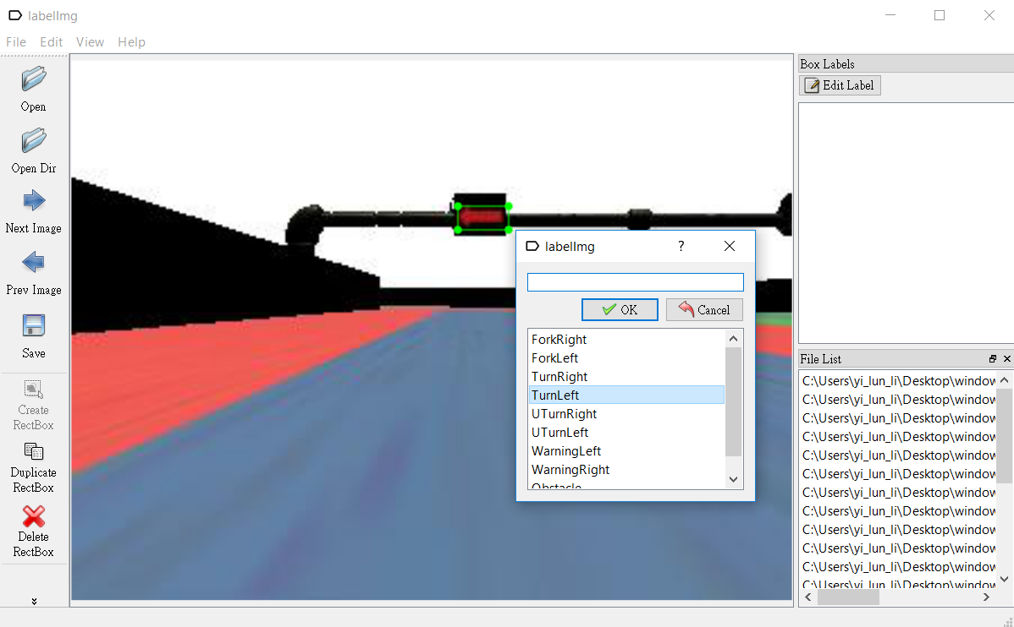
Example
3
Ref: https://github.com/tzutalin/labelImg

Slide 6

Example
4
5
Ref: https://github.com/tzutalin/labelImg

Slide 7
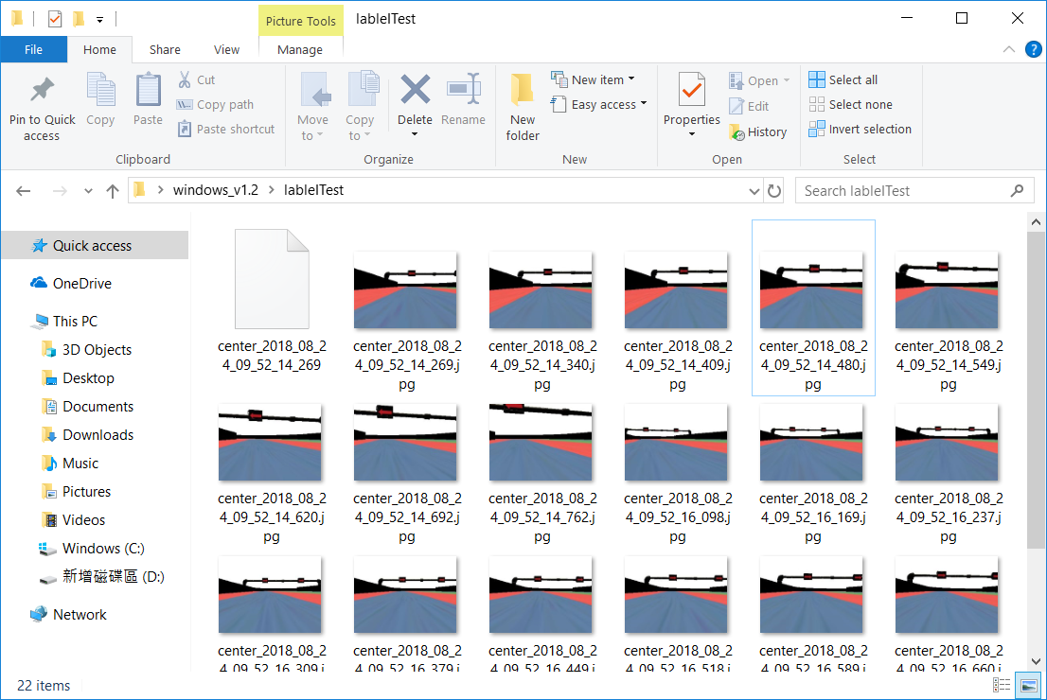
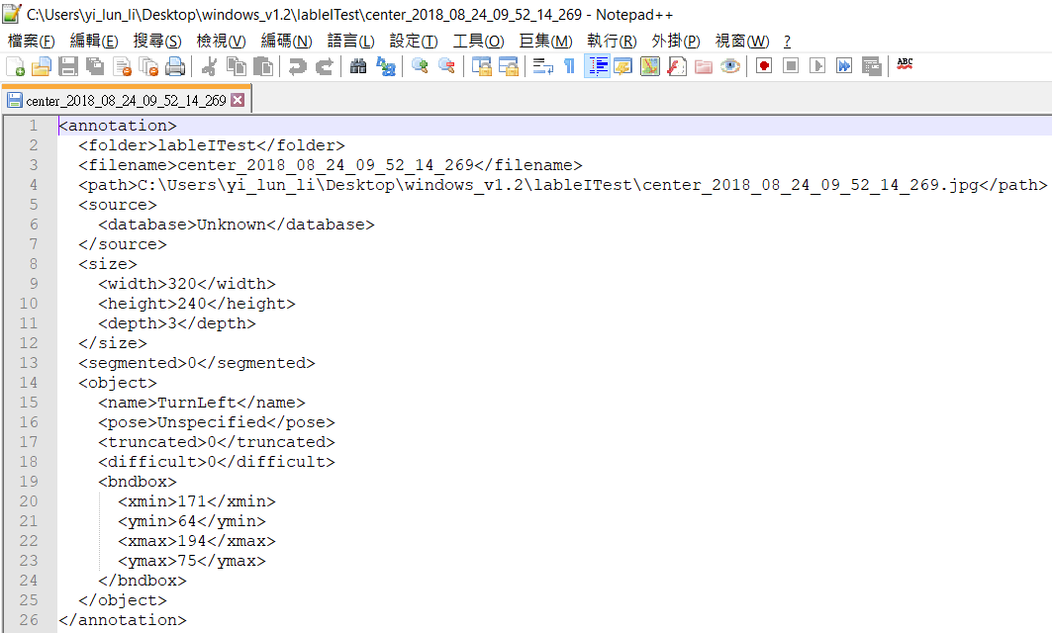
Example
6
7
Ref: https://github.com/tzutalin/labelImg

Slide 8
Example
Classification
ROI extraction from labeled data
Feature extraction + ML classifier
Inception, Mobilenet or lightened CNN
Detection
VOC format
Convert to darknet format (YOLO)

Slide 9
Thank you!

