Slide 1
AI Car Q team TOI
Date: 2018/09/06
Reporter: yi_lun_li

Slide 2
Outline
Dataset
Traffic sign labeled data
Driving logs
Optimized sample bot
Simple bumping detection
PID controller

Slide 3
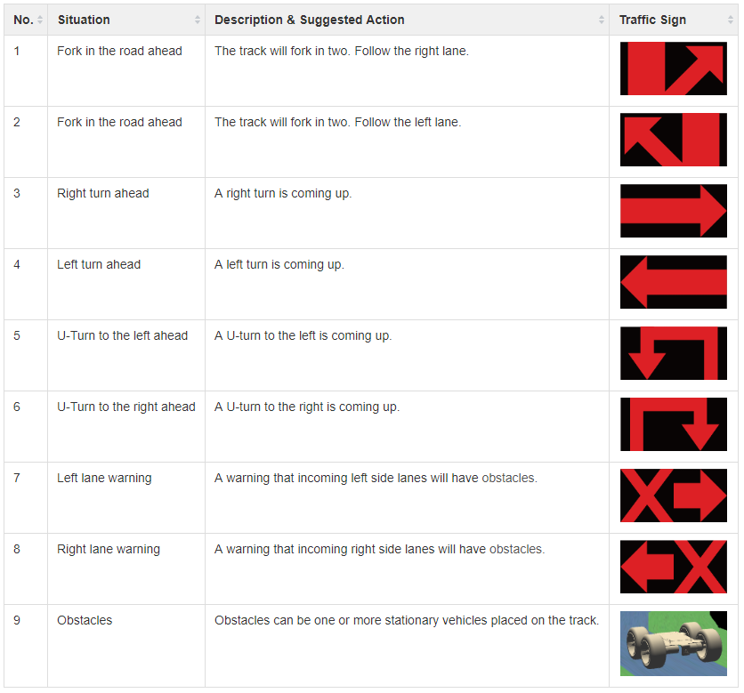
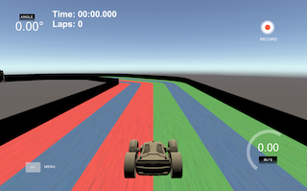
Self-driving car
ForkRight
ForkLeft
TurnRight
TurnLeft
UTurnLeft
UTurnRight
WarningLeft
WarningRight
Obstacle
Ref: https://github.com/tzutalin/labelImg

Slide 4
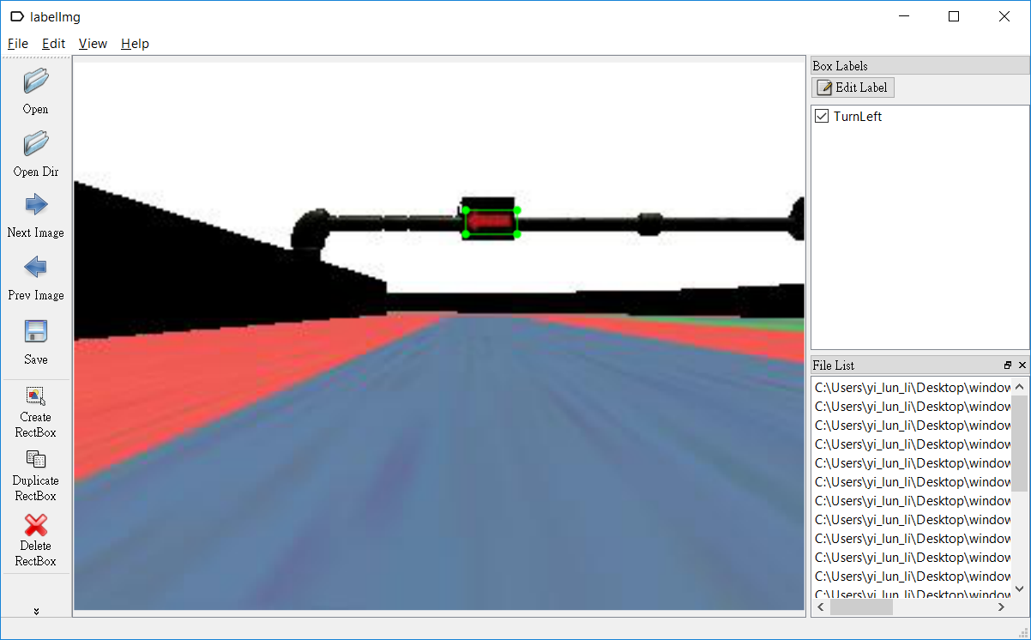
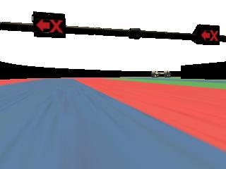
Traffic Sign Label
LabelImg
A graphical image annotation tool
Label object bounding boxes in images
Ref: https://github.com/tzutalin/labelImg

Slide 5
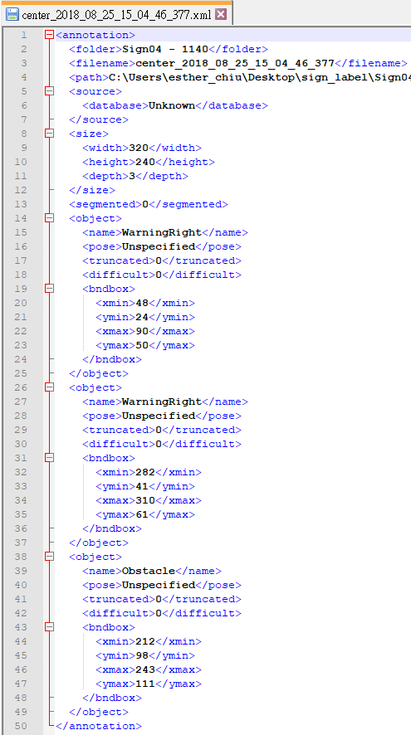
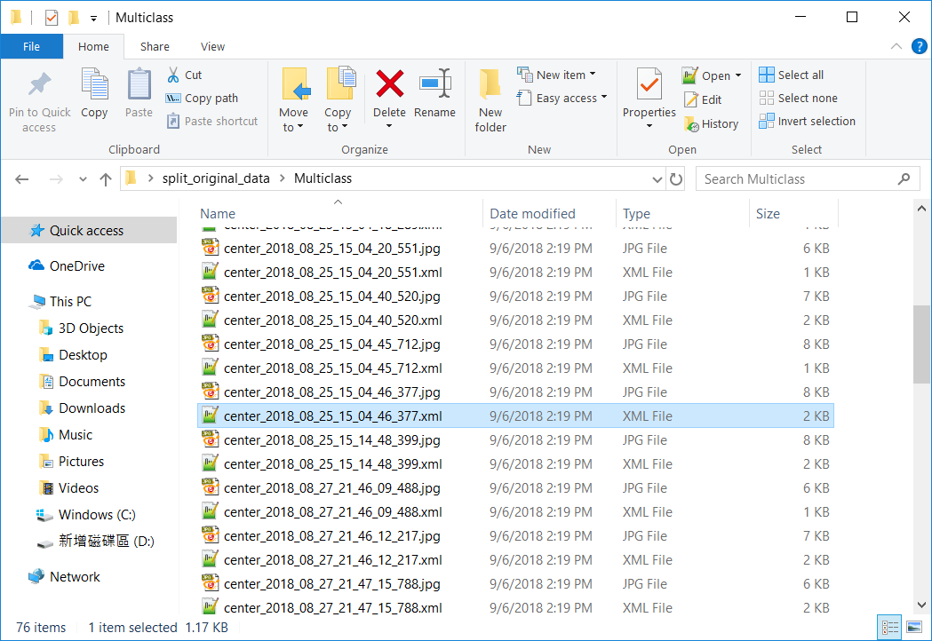
Traffic Sign Label

Slide 6
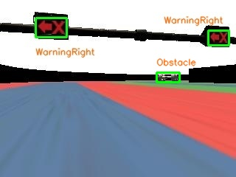
Traffic Sign Label
Dataset
9 classes (each~1000 images)

Slide 7
Outline
Dataset
Traffic sign labeled data
Driving logs
Optimized sample bot
Simple bumping detection
PID controller

Slide 8
Thank you!

