Slide 1

武器/密技傳授 Formula Trend Eddie S Hsieh (Consumer NBA team)

Slide 2
Outlines
The collaboration in TW sites
The resources

Slide 3
Collaboration in TW site
Development
Q team
TI6
mentors

Slide 4
Collaboration in TW site
Development
Delivery
Q team
TI6
mentors
TW site members

Slide 5
Collaboration in TW site
Development
Delivery
Feedback
Q team
TI6
mentors
TW site members

Slide 6
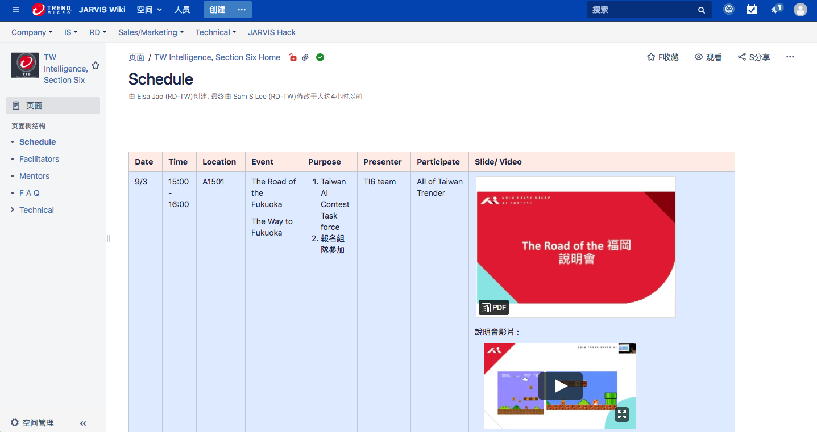
Official site
https://wiki.jarvis.trendmicro.com/display/TISS

Slide 7
Resources
Enhanced sample bot
Traffic sign detection library
Datasets
Traffic signs with labels
Driving records
Labeling tool

Slide 8
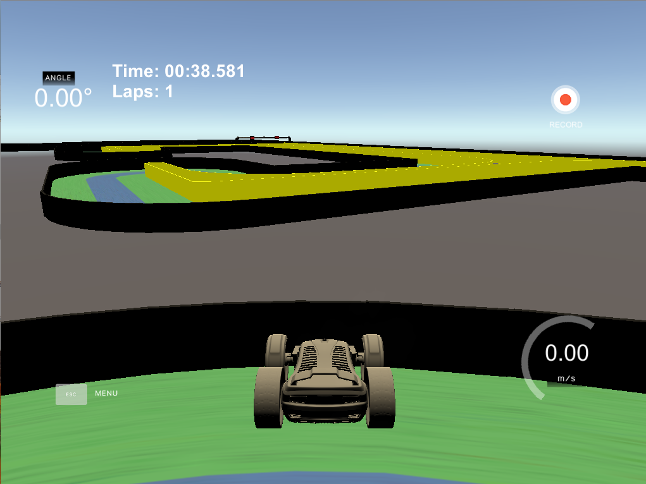
Enhanced bot
Wall detection
PID enhancement

Slide 9
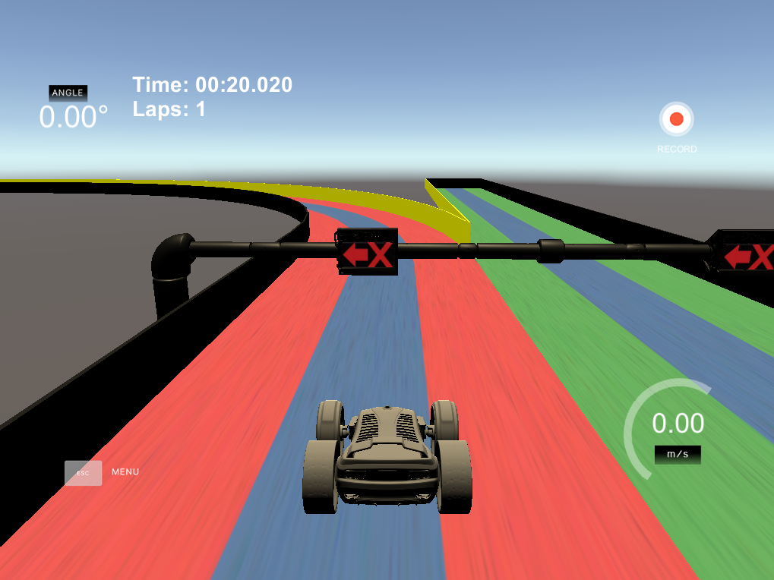
Traffic sign detection library

Slide 10
Environments
Python 3 (refactoring to Python 2)
Python libraries
Tensorflow
Keras
Protobuf
HDF5
OpenCV

Slide 11
Folder structure
Traffic sign detection
sample_bot_py3_sign_detect.zip
Model tiny_yolo_anchors.txt tiny_yolo_tf.h5 traffic_sign_classes.txt
yolo3 __init__.py model.py util.py
yoloSignDetection.py
sample_bot_py3.py

Slide 12
Usage
out_boxes: Array of bounding boxes
out_scores: Array of scores
out_classes: Array of classes which indicate the class name of the detected traffic sign
from yoloSignDetection import YOLOSignDetection
class AutoDrive(object):
def __init__(self, car, record_folder = None):
...
self._traffic_sign_detect = YOLOSignDetection()
def on_dashboard(self, src_img, last_steering_angle, speed, throttle, info):
...
out_boxes, out_scores, out_classes = self._traffic_sign_detect.detect_image(src_img)

Slide 13
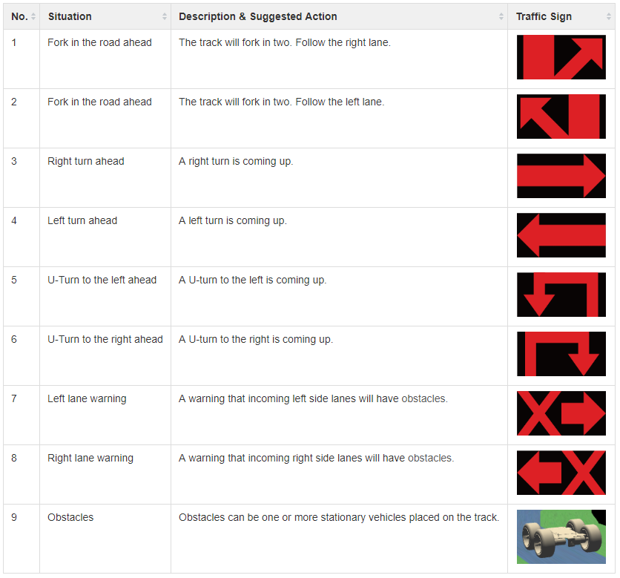
Datasets: traffic signs
ForkRight
trafficSignDataset.zip
ForkLeft
TurnRight
TurnLeft
UTurnLeft
UTurnRight
WarningLeft
WarningRight
Obstacle

Slide 14
Dataset: driving records
The driving records of 5 tracks

Slide 15
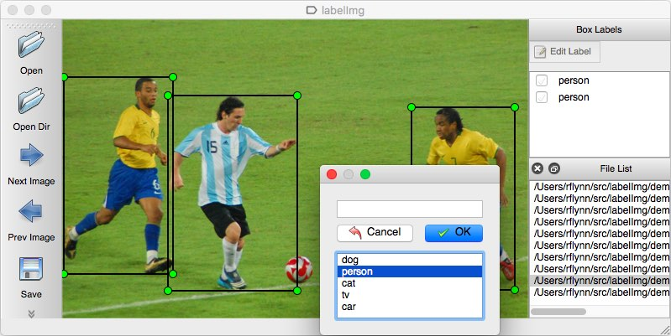
Labeling tool: LabelImg
LabelImg
A graphical image annotation tool
Label object bounding boxes in images
https://github.com/tzutalin/labelImg

Slide 16
Recap
Enhanced sample bot
Traffic sign detection library
Datasets
Traffic signs with labels
Driving records
Labeling tool

Slide 17
Contact your mentors, now !!!

Slide 18
Q&A
Thank you for listening

