Slide 1

武器 密技 Trend Hearts
三分鐘參賽懶人包
Kenny Huang (Foundation OfficeScan team)
Notes:
Explain Like I'm Five

Slide 2

Agenda
How to get the package
Types of bot
Verify docker image
Publish the image
Future release

Slide 3
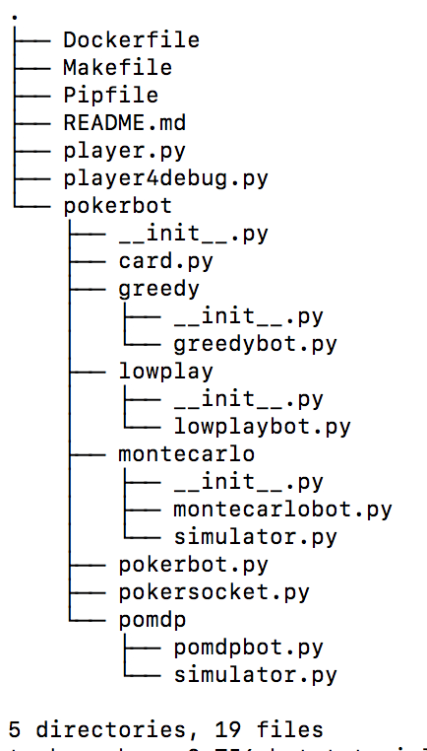
How to get the package
https://wiki.jarvis.trendmicro.com/display/TISS/Mentors
TI6_bot_0911.zip

Slide 4
Types of bot
LowPlayBot - global sample
GreedyBot - a rule based algorithm (dummybot like)
MonteCarloBot - MCTS based
POMDPBot - extend from MCTS, simulate greedy competitors then observation
Notes:
MCTS algorithm (--pick-card-timeout: default 1s)
self.maxTime = 0.5 (can be adjust)

Slide 5
Types of bot
Exchange three cards stage: rule-based
  QS, TC and non-score cards
Expose AH stage: random
Notes:
copy from sample_bot.py

Slide 6
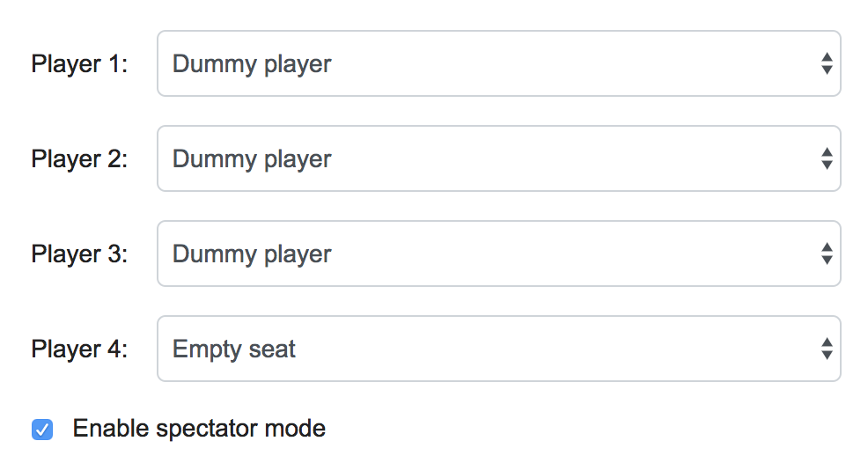
Verify docker image
make run IP=<IP of game server>
Find logs at “./log/hearts_logs.log”
Notes:
python player4debug.py kenny 4 9527 ws://tw-kennyhuang8.client.tw.trendnet.org:8080/
make run IP=10.1.152.117

Slide 7
Publish the image
make build TEAM=<TEAM_ID>
The script will ...
  build docker image
  tag with practice and rank
  prompt you to login with your AD account
  push the docker image to the game server
Please make sure docker is installed before execute command

Slide 8
Future release
Log parser
Local game simulator

Slide 9
Thank You !

