Slide 1
Group 1 Members
Circular Linked List
1. Mfashingabo Prince 20933
2. Nyiringabo Pacifique 21014
3. Kwizera Aime Elvis 21587
4. Higiro Emile 21686
5. Mugwaneza Marquise 21275
6.Umuhoza Chella 20928
7. Ndayizeye Aime 21703
8. Rukundo Kabare Benedictus 21801 9. Ndayishimiye Jean Luc 21006
10. Bitegitsimana Prince 21526
11. Gatsinzi Eric 21127
12. Ndayishimiye Edmond 21108
13. Dusabe Johnson 21125
14. Rukundo Gad 21760

Slide 2
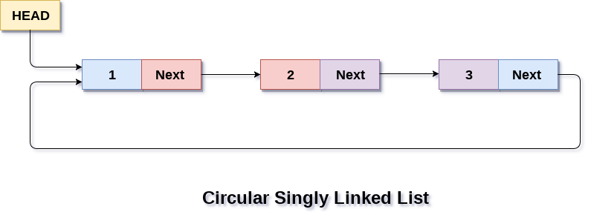
Circular Single Linked List
In a circular Singly linked list, the last node of the list contains a pointer to the first node of the list.We traverse a circular singly linked list until we reach the same node where we started. The circular singly liked list has no beginning and no ending. There is no null value present in the next part of any of the nodes.

Slide 3

Structure Representation of a Circular Single Linked List
The following Image demonstrates a structure representation of a circular single linked list.

Slide 4
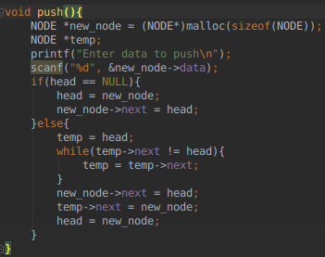
Pushing a value in a Circular Single Linked List

Slide 5
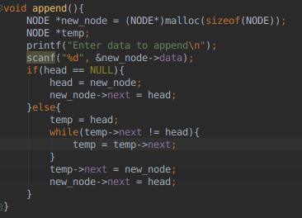
Appending a value in a Circular Single Linked List

Slide 6
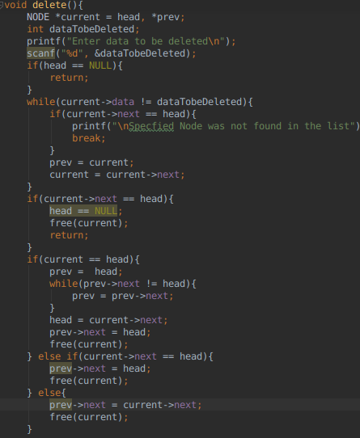
Deleting a value in a Circular Single Linked List

Slide 7
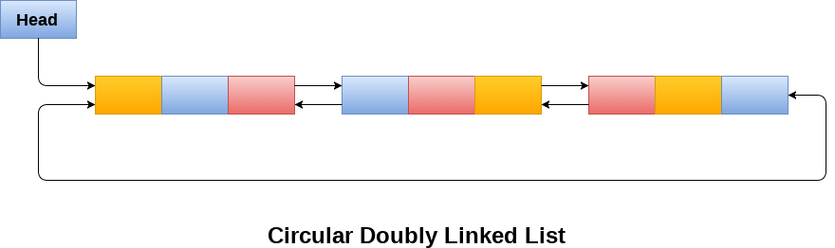
Circular Double Linked List
In a Circular double Linked List a node contains the pointer to both the previous and next nodes in the list.Furthermore, In a cirular double linked list their is no null value in any of the nodes since the last node will always point to the head/first node in the list and the head node also contains a link to the last node in it's previous pointer.

Slide 8

Structure Representation of Cirular Double Linked List
The following image demonstartes the structure representation of circular double linked list.

Slide 9
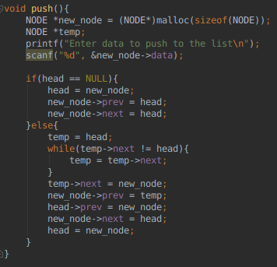
Pushing a node in a Circular Double Linked List

Slide 10
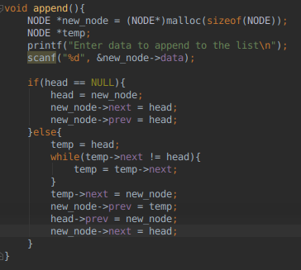
Appending a value to Circular Double Linked List

Slide 11
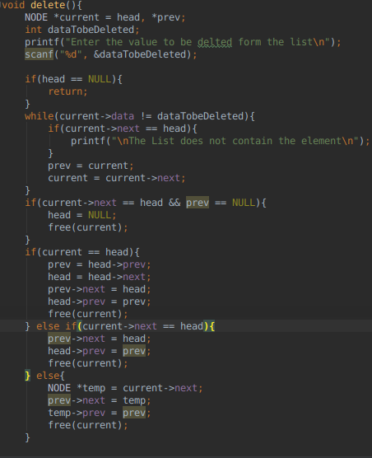
Deleting an element from a Circular Double Linked List

Slide 12
THANK YOU FOR YOUR ATTENTION

