Slide 1
CTC Introduction
January 28, 2026

Slide 2
Contents
Member Self-Introduction
Division Mobile&Service ,NTT docomo (NTT Group)
Contributions and Achievements
Customer interests and issues

Slide 3



Division Mobile&Service ,NTT docomo (NTT Group)
■What's NTT?
NTT stands for Nippon Telegraph and Telephone Corporation.
Originally, NTT was a state-owned enterprise,but it was privatized to enhance communication efficiency and respond to technological innovation.
■Main Roles and Businesses
NTT is a holding company, and its services are provided through its group companies
・NTT docomo
Mobile communications services (4G, 5G, etc.)
・NTT docomoBusiness
Corporate network services, cloud solutions, and data centers

Slide 4
Division Mobile&Service ,NTT docomo (NTT Group)
Our customer is NTT docomo. We will explain NTT docomo in detail.
■What's NTT docomo?
NTT docomo is one of Japan's largest mobile network operators.
It is Japan's largest mobile phone company in terms of subscribers.
■ Main Roles and Businesses
NTT docomo provides mobile phone and smartphone communication services.
Voice calls and data communication
4G (LTE) and 5G networks
Enterprise services such as mobile, IoT, and network solutions
■Characteristics Compared with Other Telecommunications Carriers
A leading major carrier that emphasizes nationwide coverage and communication quality
Provides broad coverage across the country, including mountainous and rural areas

Slide 5






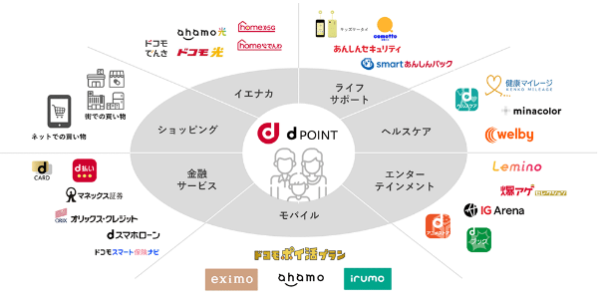
Contributions and Achievements
With long-term trust and experience, we support telecom and non-telecom areas.
Our Long-Term Contribution
We have mainly contributed to telecommunication infrastructure over many years.
We have introduced servers and wireless network equipment.
Infrastructure
Network
Digital Services
Support for non-telecom
NTT docomo aims to enter the “Smart Life” businesses in addition to its mobile network operators.
We are supporting not only telecommunication infrastructure but also “Smart Life” businesses.

Slide 6
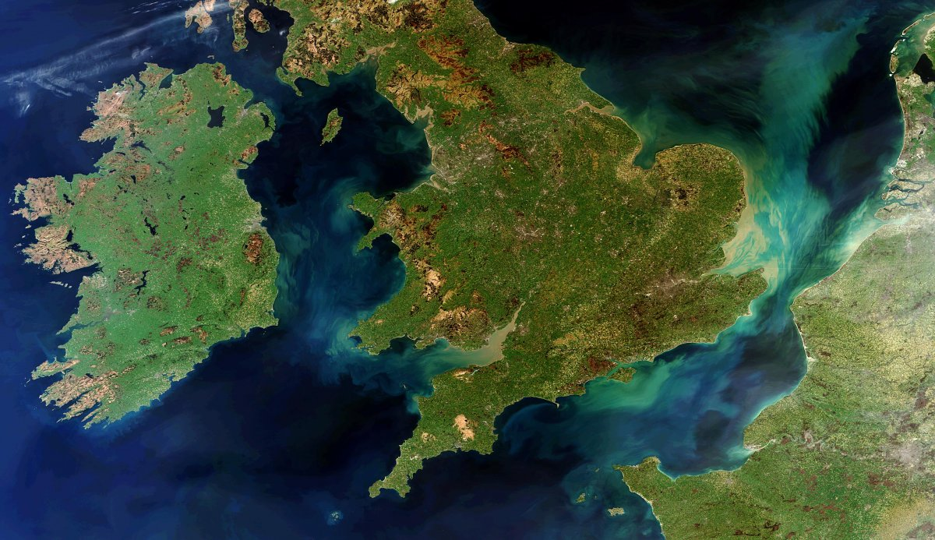


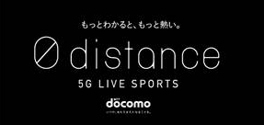


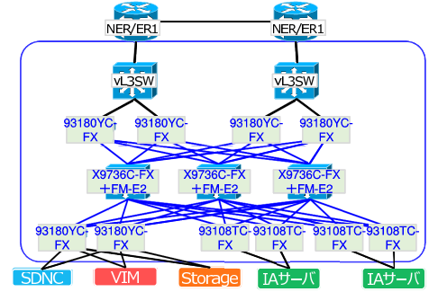


Contributions and Achievements
Case1
Virtualized Base Station System
Case2
IoT Camera Solution
IoT camera solution that enables real-time video monitoring and AI video analysis using camera-equipped lights
Disaster-resilient transmission network with automatic multi-route switching
リストレーション・パス
Category:Telecommunications
・Transmission
Category: IoT・AI
Case3
Virtualization Infrastructure Network
Case4
WiFi Event (Rugby World Cup)
Core network virtualization using Cisco ACI, supporting system development and validation
Wi-Fi service deployment for public viewing venues during the Rugby World Cup 2019
Category: Telecommunications
・SDN
Category: Network

Slide 7
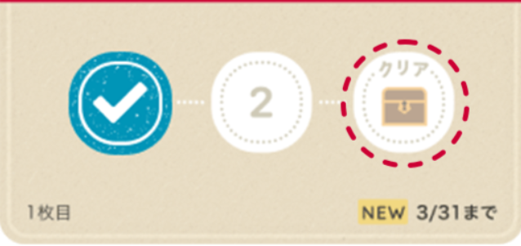
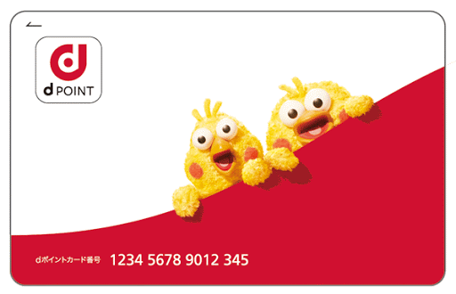

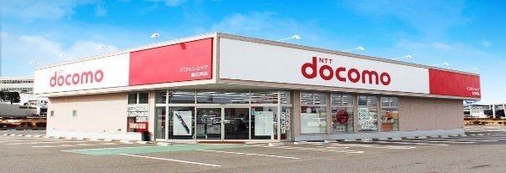
Contributions and Achievements
Case5
Mobile Payment Card Stamp Program
Case6
Point Reference Infrastructure
Point award system based on user actions and payment data
Point reference infrastructure designed to reduce billing system load
Category: Agile・Serverless
Category: Development
Case7
Bike Sharing Service
Case8
Retail Store Network Construction
Demand-based optimization system for docking station relocation
Network construction and maintenance support for 2,000 retail shop locations nationwide
Category: Development
Category: Technical Support

Slide 8
Customer interests and issues
Interests
・Leveraging generative AI across internal business operations.
Issues
・Implementation delays caused by concerns around data security and potential information leakage.
Inquiry for Quanta
・Could you propose any infrastructure‑level solutions or technical countermeasures to ensure high security for generative AI deployments?
Interests
・Transition from air cooling to liquid cooling systems.
・Understanding the impact of increasingly powerful CPUs on server cooling.
Issues
・Lack of clarity regarding the thermal limits of current air‑cooling systems.
・Uncertainty about the timing and conditions for migrating to liquid cooling.
Inquiry for Quanta
・When do you expect liquid cooling to become mainstream in the server market?
・As a manufacturer, what key considerations or best practices should we keep in mind when building liquid‑cooled server environments?
Generative AI
Liquid Cooling Servers

Slide 9
Customer interests and issues
Interests
・Driving social innovation through Smart Life services (e.g., d POINT) and contributing to a sustainable digital society.
・Building scalable and energy‑efficient infrastructure to support ongoing service expansion.
Issues
・Increasing need for infrastructure optimized for power efficiency and sustainability as service ecosystems grow.
Inquiry for Quanta
・What energy‑efficient server platforms or power‑optimized infrastructure solutions do you offer for large‑scale Smart Life services?
Sustainable "Smart Life" Growth

