Slide 1
CTC Introduction
0 00, 2025

Slide 2
Contents
Member Self-Introduction
Division No.2 / KDDI
Customer interests and issues
Contributions and Achievements

Slide 3
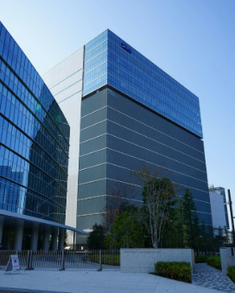
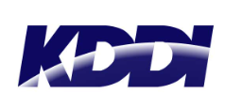
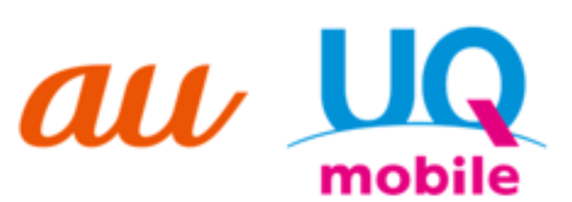

Division No.2 / KDDI group
KDDI is one of Japan’s three major telecommunications carriers.
It provides mobile phone services under the au brand, as well as data center and cloud services.
Established: 1984
Business Areas: Mobile communications, fixed-line communications, enterprise ICT solutions, IoT, cloud
Strengths: Domestic and international network infrastructure, enterprise services
Number of mobile subscribers: 70.3 million
This is KDDI’s data center located in the western part of Tokyo.
I often conduct testing here.
CTC’s dedicated team for KDDI is stationed on-site and provides 24/7 maintenance support.
xGN: A joint venture between KDDI and CTC.
It is a functional subsidiary that plans, designs, builds, and operates KDDI's mobile system (5GSA) using a new approach.
CTC employees are also assigned there and work on site.
Notes:
初めに第二本部のお客様であるKDDIについて紹介
KDDIは日本の三大キャリアの1つ
auブランドで携帯電話サービスを提供するとともに、データセンターやクラウドサービスも提供
設立は1984年
ビジネスエリアはモバイル通信、固定回線通信、企業向けICTソリューション、Iot,クラウドサービス
強みは国内外のネットワーク基盤と、企業向けのサービス
モバイル契約者数は7,030万
写真は多摩にあるデータセンター
ここでよく検証を行っている
KDDI専任 チームが常駐し、24時間365日の保守サポートを提供
次にxGNについて紹介
xGNはKDDIとCTCの合弁会社
KDDIのモバイルシステム（5GSA）を新しいアプローチで計画・設計・構築・運用する機能子会社
CTCの社員もそこに出向して働いてる
First, I would like to introduce KDDI, our customer from the Division NO.2.
KDDI is one of Japan’s three major telecommunications carriers.
It provides mobile phone services under the au brand, as well as data center and cloud services.
It was established in 1984.
Its business areas include mobile communications, fixed-line communications, enterprise ICT solutions, IoT, and cloud services.
Its strengths lie in its domestic and international network infrastructure and enterprise services.
The number of mobile subscribers is 70.3 million.
This photo shows KDDI's data center located in the western part of Tokyo.
I often conduct testing here.
CTC’s dedicated team for KDDI is stationed on-site and provides 24/7 maintenance support.
Next, I will introduce xGN.
xGN is a joint venture between KDDI and CTC.
It is a functional subsidiary that plans, designs, builds, and operates KDDI's mobile system (5GSA) using a new approach.
CTC employees are also assigned there and work on site.

Slide 4
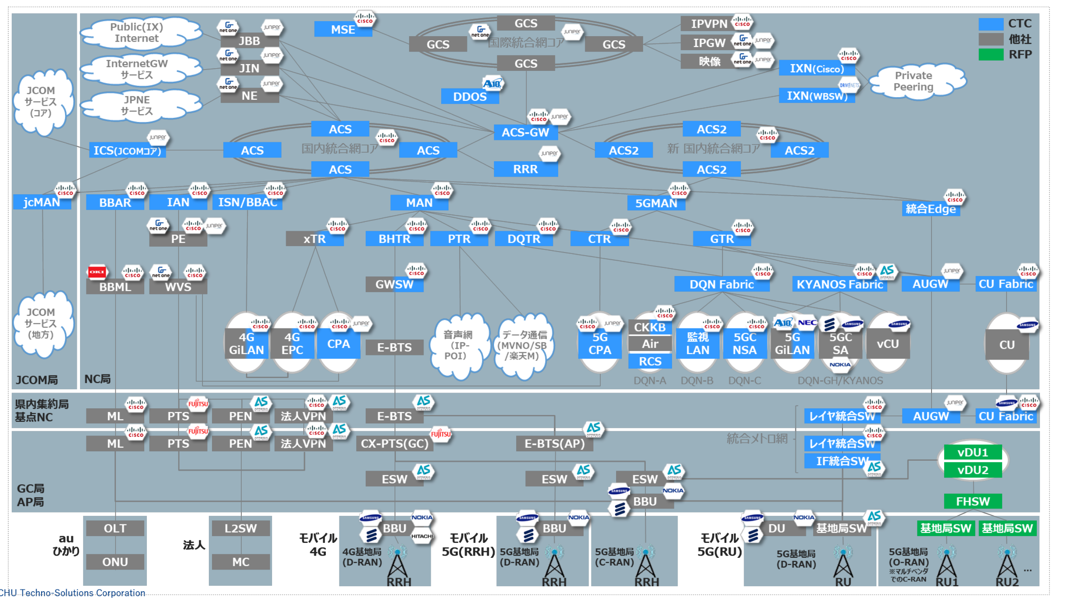
Division No.2 / KDDI group
Consumer segment
Telecom service (au,UQmobile)
Payment
Enterprise business segment
Network
Data center
Energy
Cloud
Device
WKONX
Finance
Commerce
The overall view of the network deployed by KDDI
KDDI’s business domains
CTC has been involved in the au service since its launch, with over 30 years of experience.
CTC plays a key role in the majority of KDDI’s network infrastructure.
CTC is also engaged in information systems such as authentication, contributing to a wide range of KDDI’s services.
Notes:
次にKDDIのサービスについて紹介
KDDIのビジネス領域
コンシューマセグメントでは、個人のお客さま通信サービス、決済、エネルギー、金融、コマースなどを提供しており、ビジネスセグメントでは法人のお客さま向けにデバイス、ネットワーク、クラウド、データセンターサービスなどを提供
CTCはauサービスが始まったときから30年以上かかわっている
また、右の画像がKDDIの展開するNWの全体像
この中の青い部分にCTCが携わっており、KDDIのネットワーク基盤において重要な役割を担ってる
他にも、認証などの情報システムもやっており、幅広くKDDIのサービスに関与
Next, I will introduce KDDI’s services.
These are KDDI’s business domains.
In the Consumer segment, KDDI provides individual customers with Telecom services, as well as payment, energy, finance, and commerce .
In the Enterprise Business segment, KDDI offers corporate customers network, cloud, data center , device and WKONX.
CTC has been involved in the au service since its launch, with over 30 years of experience.
This image shows the overall view of the network deployed by KDDI.
CTC is involved in the blue section of this.
CTC plays a key role in the majority of KDDI’s network infrastructure.
CTC is also engaged in information systems such as authentication, contributing to a wide range of KDDI’s services.

Slide 5
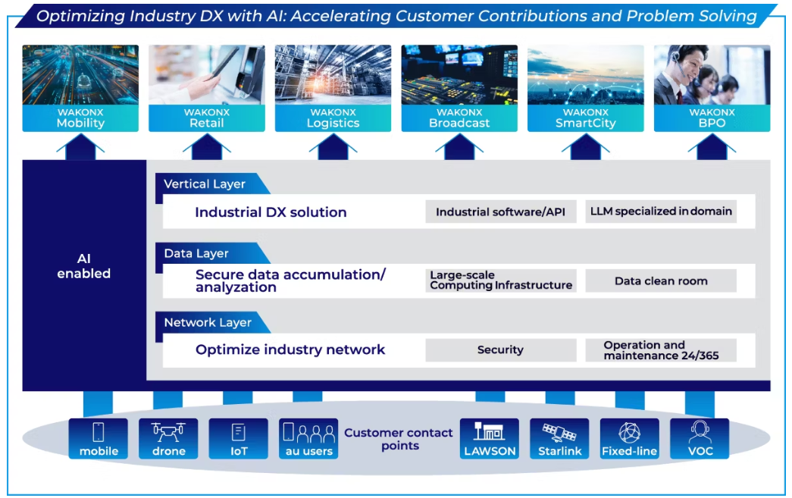
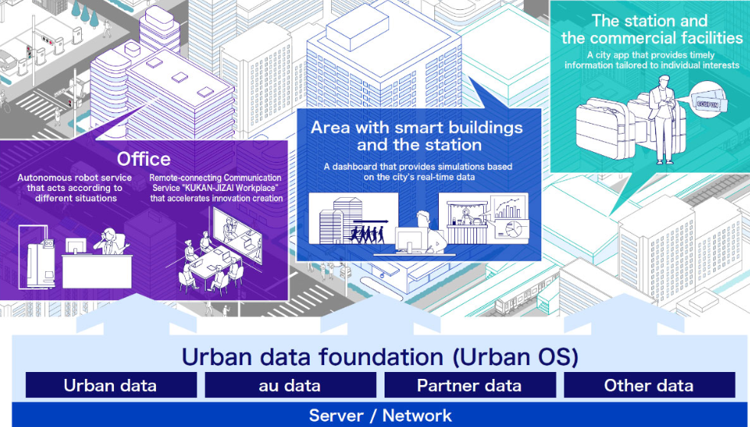
Customer interests and issues
Enterprise business
KDDI has recently begun focusing on Enterprise business.
They have launched a business platform called “WAKONX”
WAKONX provides a set of essential components for companies to advance DX transformation.
It is designed to support six key industries.
KDDI has started offering the WAKONX SmartCity solution from March 27, 2025.
<Concept of “WAKONX”>
<WAKONX SmartCity >
Notes:
お客様が現在注力している分野をご紹介します。
注力している分野は2つあり1つ目は法人サービスです。KDDIは最近法人サービスに注力し始め、WAKONXというビジネスプラットフォームを立ち上げました。
WAKONXは、企業がDX化するために必要な基本コンポーネントをKDDIが提供するというもので、主に6つの主要産業を支援するよう設計されています。
例として、2025年3月27日から 日本の高輪ゲートウェイシティ向けにWAKONX SmartCity ソリューションの提供を開始しています。
In addition to mobile
communication services,
KDDI has recently begun focusing on corporate services.
They have launched a business
platform called “WAKONX”
WAKONX provides a set of essential components for companies to advance DX transformation.
It is designed to support six key industries.
KDDI has started offering the WAKONX SmartCity solution from March 27, 2025.

Slide 6

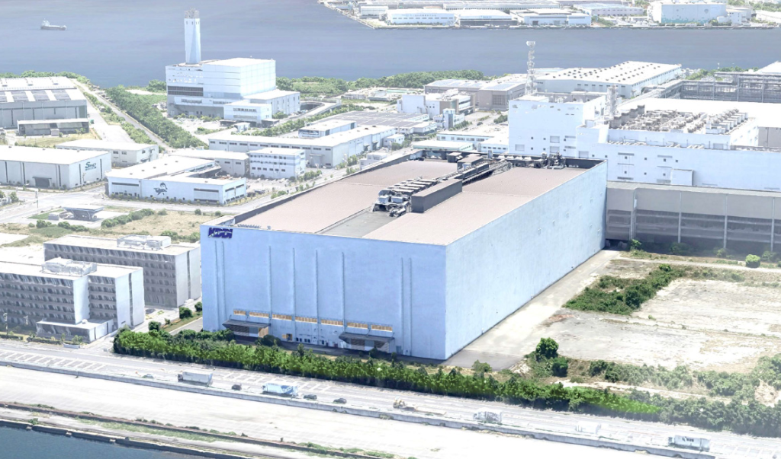
Customer interests and issues
AI
These days, KDDI are interested in the field of AI.
They are building their own AI data center in Osaka to use AI within their company.
NVIDIA GB200 NVL72 by HPE will be installed in this data center.
It is planned to support both liquid cooling and air cooling.
With the advancement of AI, they are particularly focusing on liquid cooling
because liquid cooling consumes less power than air cooling.
<AI Data center image>
<GB200 NVL72>
Notes:
KDDIが注力している分野二つ目はAIです。
現在社内でAIを活用するため、大阪に自社のAIデータセンターを建設しています。
このデータセンターには、HPE製の NVIDIA GB200 NVL72 が導入される予定で、データセンター内は液冷と空冷の両方に対応する計画です。
AIの高度化に伴い、液冷は空冷よりも消費電力を抑えられる理由で、KDDIは特に液冷に注目しています。
These days, KDDI are interested in the field of AI.
They are building their own AI data center in Osaka to use AI within their company.
NVIDIA GB200 NVL72 by HPE will be installed in this data center.
It is planned to support both liquid cooling and air cooling.
With the advancement of AI, they are particularly focusing on liquid cooling
because liquid cooling consumes less power than air cooling.

Slide 7
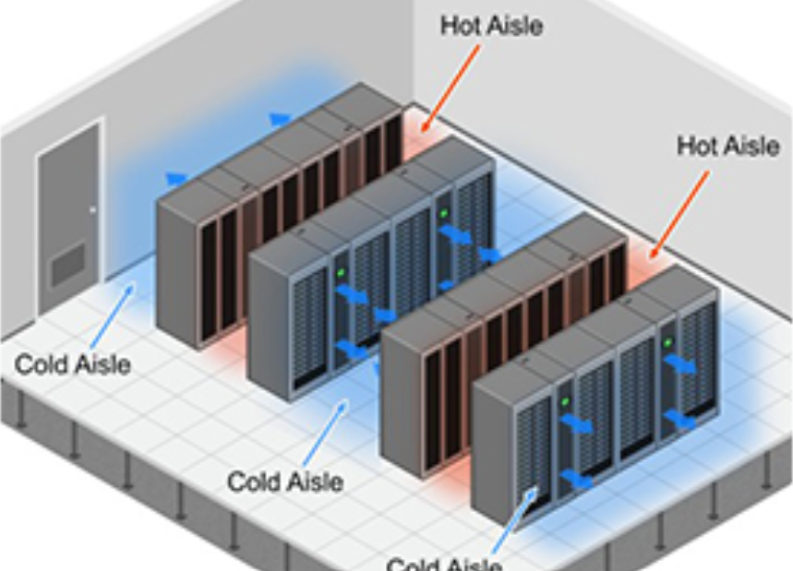
Customer interests and issues
AI
Growing customer demand for GPUs
GPU clusters consume significant power consumption
Traditional data centers are unsuitable to host GPUs
Next-generation AI data centers are needed
Research on liquid cooling systems
To implement AI, a cluster of GPU servers is essential.
Since liquid cooling can reduce power consumption compared to air cooling, it is ideal for GPU clusters.
Here we are now
<air cooling>
<liquid cooling>
CTC has a team that is officially qualified for construction work, and they can also handle liquid‑cooling installations.
Notes:
お客様のAIニーズに伴い、CTCとしてもAI分野を注力しています。
まずAIを実現するためにはGPUサーバが不可欠です。
GPUサーバの需要が増えるともちろんその分消費電力が増します。その結果従来のデータセンタの電力容量ではGPUサーバを動かすことができなくなっています。
このような動きがあったため、今は次世代AIデータセンターが求められています。このデータセンターとはＧＰＵサーバを動かすことをメインとし、冷却方法としては
消費電力が大きい空冷より水冷に注目しています。
なのでCTCは今水冷のシステムについて調査しておりナレッジをためようとしています。
さらにCTCには正式な資格を持った工事監理部がおり、水冷の工事も対応することができます。
Liquid cooling for GPU are now considered at KDDI.
CTC is currently researching liquid‑cooling systems and building internal knowledge.In addition, CTC has a Construction Management Department with official certifications, which enables us to handle liquid‑cooling installation work as well.
CTC are also focusing on the AI field in response to KDDI’s growing AI demands.
To implement AI, a cluster of GPU servers is essential.
As the demand for GPU servers increases, their power consumption naturally rises as well.
As a result, the power capacity of traditional data centers is no longer sufficient to run GPU servers.
Because of this trend, next‑generation AI data centers are now in demand.
These data centers are mainly built to run GPU servers, and for cooling, we are paying more attention to liquid cooling, which uses less power than air cooling.
Therefore, CTC is currently researching liquid‑cooling systems and building internal knowledge.In addition, CTC has a Construction Management Department with official certifications, which enables us to handle liquid‑cooling installation work as well.

Slide 8

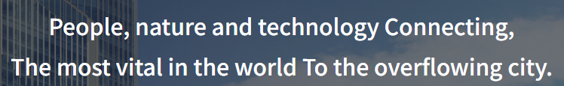
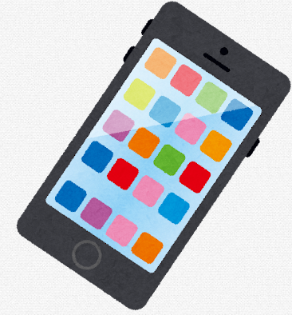

Contributions and Achievements
Takanawa Gateway City
Takanawa Gateway City is a smart city developed together by JR and KDDI.
JR is a large transportation company in Japan, operating major train networks all across the country.
This project aims to transform the areas around major stations in Tokyo
Feature “Integrated network”
Instead of constructing building facilities and ICT systems separately, consolidate them into an integrated network.
Advantage
build a high-value smart building that combines scalability, optimization and safety and security.
<Concept>
scalability
Optimization
Safety and security
Notes:
実績の説明
高輪ゲートウェイシティはJRとKDDIの共同で作られたスマートシティです。
JRは日本の鉄道会社で、日本最大の鉄道ネットワークを提供しています。
スマートシティの特徴は「統合ネットワーク」です。
統合ネットワークとは建物の設備とICTシステムを別々に構築するのではなく、統合されたネットワークとしてまとめて構築する。
そうすることにより、拡張性・最適化・安全性を兼ね備えたスマートシティを構築することができます。
Takanawa Gateway City is a smart city created together by JR and KDDI.
JR is Japan’s national railway company and operates the largest railway network in the country.
A key feature of this smart city is its integrated network.
integrated network means building facilities and ICT systems are not built separately. They are combined into one unified network.
By doing this, the city can keep scalability, optimization, and strong safety and security.

Slide 9
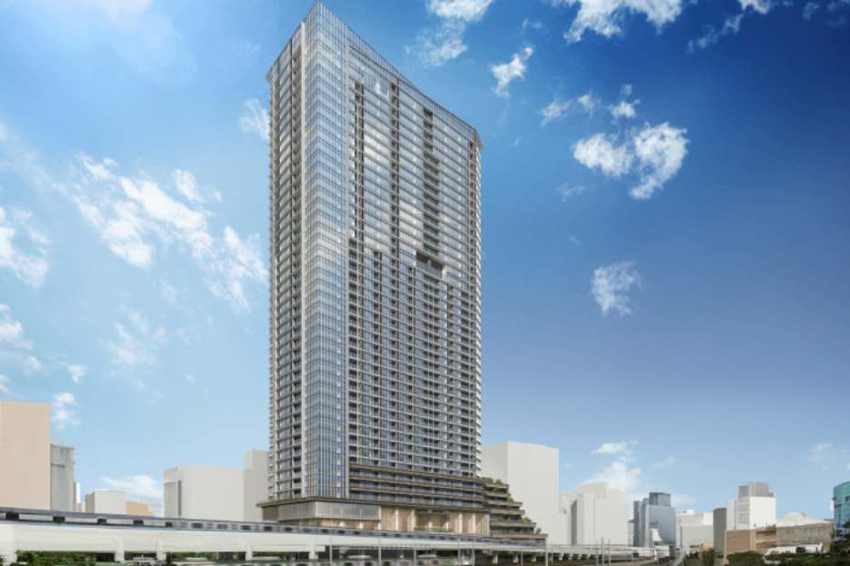
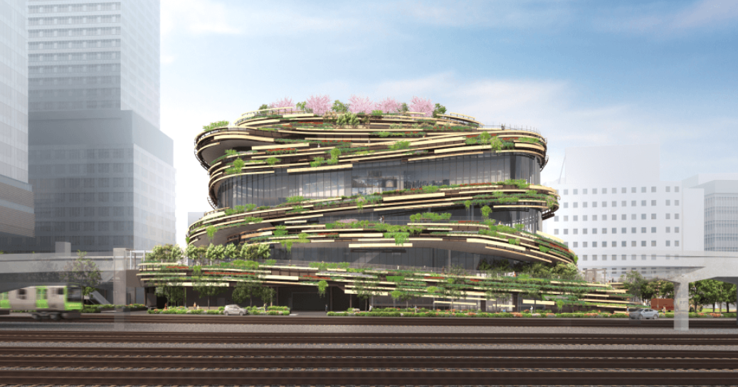
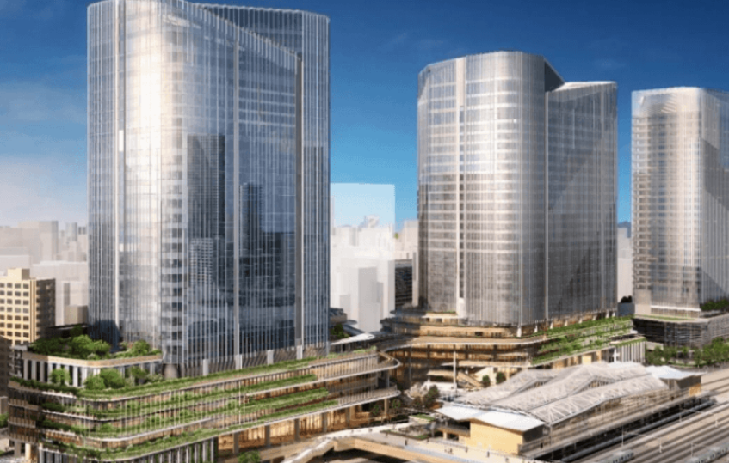
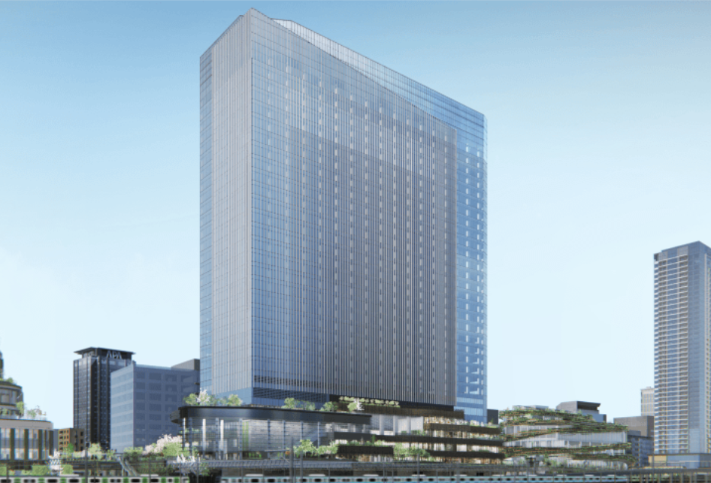

Contributions and Achievements
Takanawa Gateway City
Project Owner
ICT Specialist
Architect
Administrator
Block 1
Block 2
Block 3
Block 4
Collaboration
An integrated network supports all Blocks 1–4.
Access Control
KDDI Urban OS & Integrated Network Infrastructure Across Multiple Blocks
LAN
camera
phone
signage
Notes:
こちらの図のように、高輪ゲートウェイシティには1街区から4街区まで用途別に街区が分かれています。
こと4つの街区を統合ネットワークが支えています。
全ての建物をまたぐ統合プラットフォームとなるため、スマートシティ全体にネットワーク環境を展開します。
As you can see in this diagram, Takanawa Gateway City is divided into four blocks, each with a different purpose.
These four blocks are all supported by an integrated network.
By building a comprehensive integrated platform that spans all buildings, we enable seamless service collaboration between them.

Slide 10
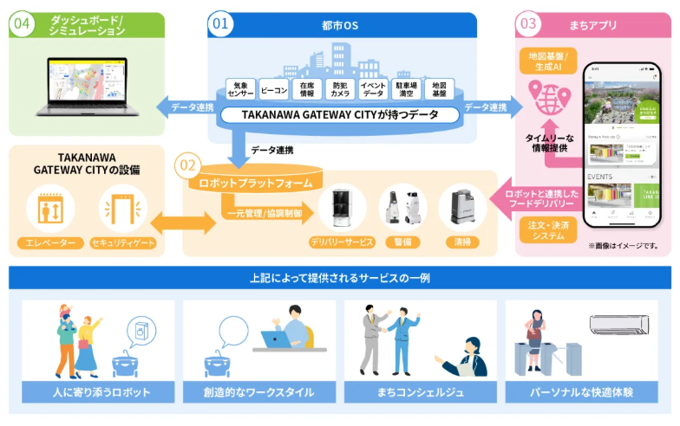
Contributions and Achievements
Dashboard / Simulation
Takanawa Gateway City
Urban OS
Town App
Location info / gen AI
By building a comprehensive integrated platform that spans all buildings, we enable seamless service collaboration between them.
Deploy a network environment across the entire city to serve diverse users, from operators to robots.
Weather sensor
Beacon
Stock senor
Security camera
Event data
Human flow
Railway data
Timely info delivery
TAKANAWA GATEWAY CITY Equipment
Robot Platform
Order&deliverysystem linked robots
mgmt /control
Elevators
Security gates
Delivery service
Patrol
Cleaning
Examples of services provided through the above system
Robots that support people in daily life
Creative work style
Town concierge
Comfortable personal experiences
Notes:
こちらは高輪ゲートウェイシティ全体の図となり、スマートシティにおいてどのようにデータが活用されているかを表しています。
①都市OS・統合ネットワーク
センサー、カメラ、ビル利用状況、イベント情報、まちの地図・移動データ などのデータを
統合して「街をどう動かすか」を判断します。
②ロボットプラットフォーム
街の中で動くロボットや設備へ、指示を出したり状態を把握したりする基盤です。
「都市OS」からのデータを使って最適に動きます。
③まちアプリ
住む人・働く人が使う スマホアプリ です。周辺の施設・イベント情報をリアルタイムに表示したり、ロボットと連携したデリバリー（注文・受取）をしたり、
街のニュースや混雑情報を確認することができます。街の情報を「住民・利用者に届ける窓口」のような存在です。
④ダッシュボード／シミュレーション
街の運営者（行政・管理者）が使うものです。まちの状態を可視化し、将来の動きをシミュレーションをします。イベントを開くと混み具合はどうなる？等。
これにより街全体の最適な運営をめざします。
これら①～④の仕組みを活用したサービスがこちらになります。
人に寄り添うロボット、快適なワークスタイルの提供、まちコンシェルジュ、照明の自動調整などが実現できます。
すなわち、スマートシティとは人・データ・設備・ロボットすべてが繋がっているまちとなります。
This diagram shows how data is used in the smart city “Takanawa Gateway City.”
① Urban OS
It collects many types of data: sensors, cameras, building usage, event info, maps, people movement, etc.
It uses this data to decide how the city should work.
② Robot Platform
This system gives instructions to robots and checks their status.
Robots work in the best way using data from the Urban OS.
③ Town App
This is a smartphone app for people who live or work in the city.
It shows real-time event info, facility info, delivery with robots, news, and crowd levels.
It delivers city information to users.
④ Dashboard / Simulation
This system is used by city managers.
It visualizes the current city situation and simulates future scenarios. For example, “How crowded will it get if we hold an event?” This helps make the entire city better.
In this way, smart city is a place where people, data, equipment, and robots are all connected.

Slide 11
Contributions and Achievements
Regarding Smartcity
Do you currently have any experience working on smart city projects? / or
Are there any customers or partners you have supported in the smart city domain?
Do you currently offer any IoT or sensor products designed for smart city use cases?
If not, do you have a product roadmap in this area?
Do you have servers designed for tough environments such as wide‑temperature, dust, humidity, etc
Regarding AI
What types of liquid cooling solutions do you currently support?
Could you share your product roadmap for liquid cooling, particularly immersion cooling, over the next 1–3 years?
Which GPU server model currently has the highest demand?
Notes:
スマートシティに関する質問
①スマートシティ関連のプロジェクトに取り組んだ経験はありますか？または、スマートシティ分野で支援したお客様やパートナーはいますか？
②スマートシティ向けのユースケースに対応した IoT やセンサー製品を、現在提供していますか？もし提供していない場合、この分野の製品ロードマップはありますか？
③厳しい環境に対応した耐環境サーバーはありますか？
AIに関する質問
①現在、御社のGPUサーバはどのタイプの液冷ソリューションに対応していますか？
②今後 1〜3 年における液冷、特に液浸の製品ロードマップを共有していただけますか？
③現在、最も需要が高い GPU サーバーモデルはどれでしょうか？
Regarding Smartcity
①Do you currently have any experience working on smart city projects? / or
Are there any customers or partners you have supported in the smart city domain?
②Do you currently offer any IoT or sensor products designed for smart city use cases?
If not, do you have a product roadmap in this area?
③Do you have servers designed for tough environments such as wide‑temperature, dust, humidity,,etc
Regarding AI
①What types of liquid cooling solutions do you currently support
②Could you share your product roadmap for liquid cooling, particularly immersion cooling, over the next 1–3 years?
③Which GPU server model currently has the highest demand?

