Slide 1

CTC Introduction Division No.1
28 January, 2026
Notes:
Hello, Quanta !
Thank you very much for inviting us today.
We would now like to introduce the business activities of Division No.1.
We hope this session helps you know more about our Enterprise.
（10ｓ）​

Slide 2

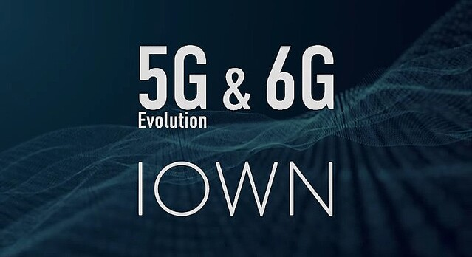
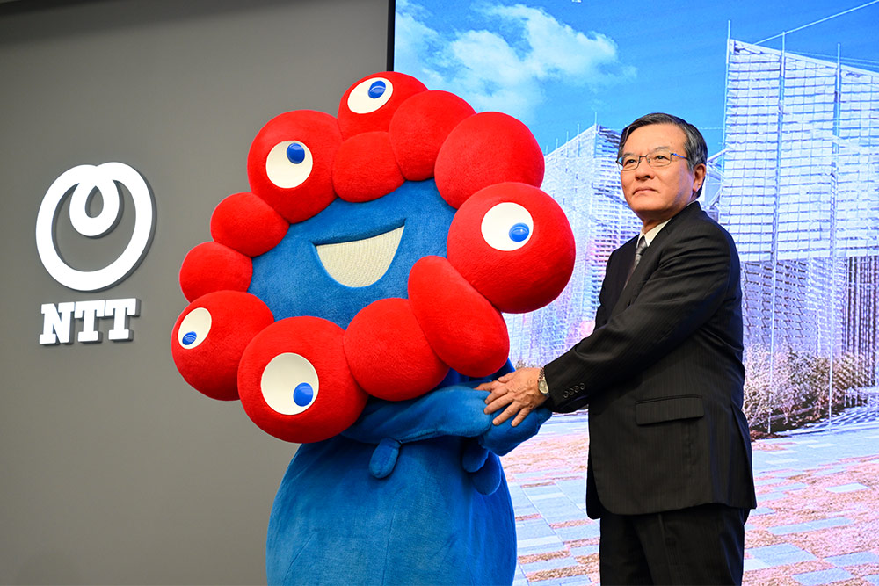
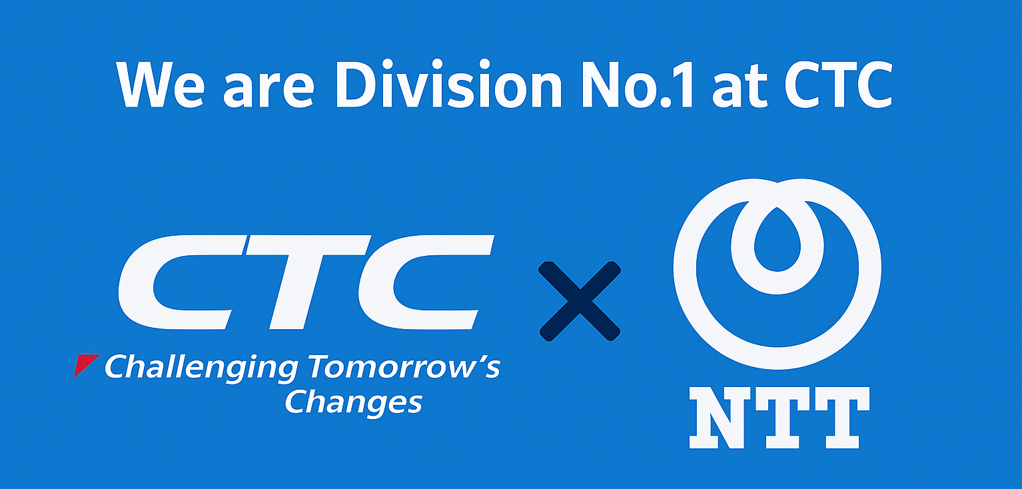
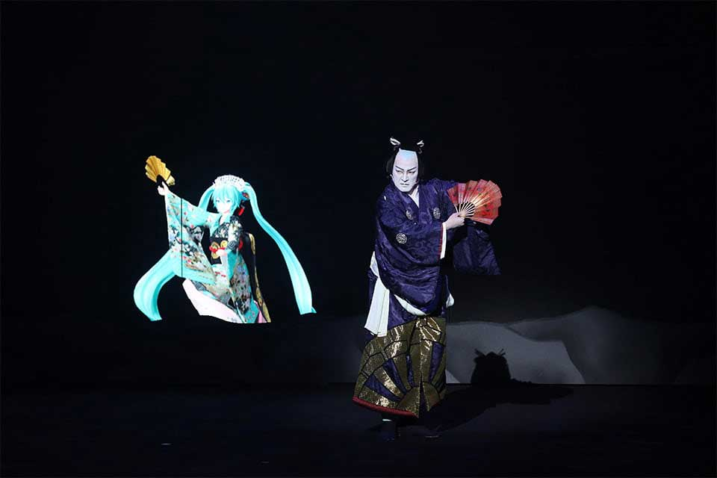
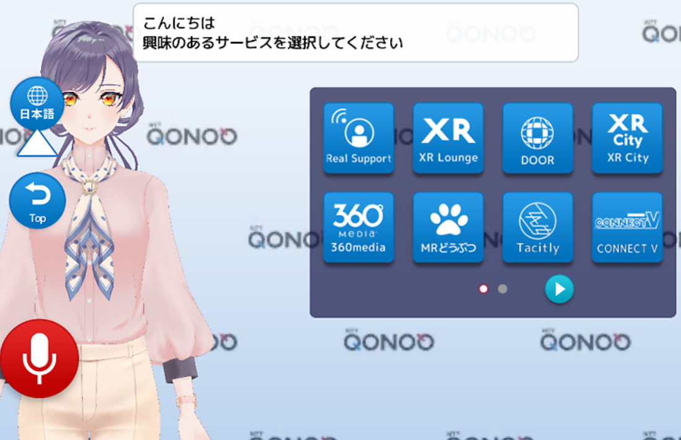
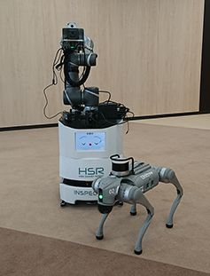

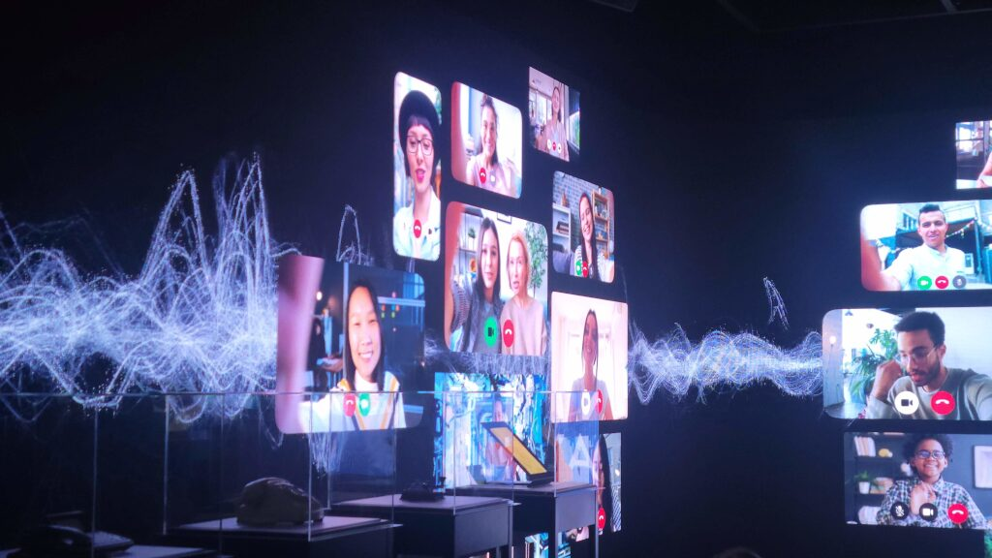
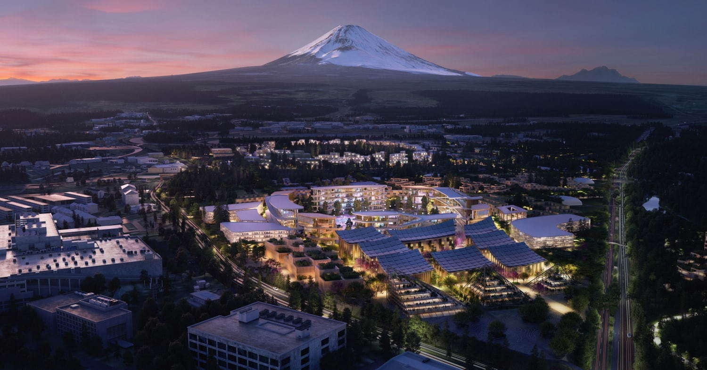
Hello Quanta👋Thank You for Welcoming !
Notes:
We have also built a long-standing and strategic partnership with NTT.
Our collaboration goes far beyond a simple cooperative relationship —
we work closely together in both technology and service development, and have successfully delivered numerous projects side by side.
By combining our strengths with NTT’s robust communication infrastructure and solutions,
we are able to provide more reliable services and create new value.
（３０s）

Slide 3
Contents
１，Member Self-Introduction
２，Division No.1 / NTT group Organization Introduction
３，CTC&NTT Contributions and Achievements
４，Customer interests and issues
Notes:
This is Today our contents.
Today, we will cover the following topics:
first of all​
１，Member Self-Introduction
and
２，Division No.1 and NTT group Organization Introduction
３，Contributions and Achievements
４，Customer Interests and Issues
Following
(10s)
１，Member Self-Introduction :1分×5人
２，Division No.1 / NTT group :2分（森村）
３，Contributions and Achievements :2分×2人（青木⇒程岡）
４，Customer interests and issues :2分×2人（石田⇒田頭）

Slide 4






NTT, Inc.
Largest Mobile Carrier in Japan
Offers comprehensive support for businesses, including mobile communications, devices, and operational services.
Provides technical solutions for businesses, including networks, cloud, cybersecurity, and IoT/AI.
Provide telecommunications infrastructure such as fixed-line and fiber-optic networks and offer corporate network and ICT services.
Provides IT solutions for businesses, including system development, cloud services, data analytics, and cybersecurity.
Notes:
Slide 1: Overview of NTT Group and Our Responsible Companies
First, I would like to explain the overall structure of the NTT Group
The NTT Group is one of the largest telecommunications and IT groups in Japan.
It provides a wide range of services, from mobile communications to fixed networks and IT solutions.
On the left side of this slide, you can see the major companies within the NTT Group.
At the top is NTT DOCOMO.
Docomoは国内の移動通信を
Next, They have NTT East and NTT West
At the bottom is NTT DATA.
As you can see, the NTT Group covers a very wide range of businesses, from telecommunications infrastructure to advanced IT services.

Slide 5



Division No.1 / NTT group
Service platform / Network infrastructure Business
CTC sell products, solutions and development that make up the services of NTT Group companies.
CTC
NTT
Services
Ex）
・Fiber-optic internet
・WAN line service
・Cloud / SaaS / IaaS
Internet
Services
Routers
L2, L3 Switches
Solutions etc…
Sell-through Business
As an SI partner, we deliver products and associated SI services to the enterprise businesses of NTT Group companies.
CTC
NTT
Enterprise
customers
Routers, Switches, RAN,
Servers, Storages,
Support Services etc…
Solutions
Notes:
Slide 2: Business Relationship between NTT Group and CTC
Next, I will explain how CTC and the NTT Group work together to create business.
On this slide, we show two main business models between CTC and NTT.
1. Service Platform Business
In this model, CTC provides products and system integration, or SI, to NTT Group companies.
From CTC on the left to NTT on the right, CTC provides network equipment, servers, cloud infrastructure, and integration services.
These products and SI support NTT’s services behind the scenes.
2. Sell-through Business
In this model, CTC works as an SI partner of NTT for enterprise customers.
First, CTC provides products and SI to NTT’s enterprise business.
Then, NTT delivers services to enterprise end users.
So, CTC is not just a vendor.
CTC works closely with NTT as a business partner to solve customers’ challenges.

Slide 6


Contributions and Achievements
NGN (Next Generation Network)
Telephone network implemented with data communication technology(Internet Protocol).
Internet
👉Overview
NGN networks are deployed in both East and West Japan, connected via IGE to trunk transmission routes.
CTC primarily provides equipment for L2 and L3 layers, with Cisco and Juniper as key vendors.
Priority Users
Content Provider
VNE
ISP
Other Operators’ Landline and Mobile Phones
PSTN
SSES
NTE
GWR
(IPoE)
GWR
(Fiber-optic
IP Phone)
GWR
(East-West Relay)
MG
IGS
Prefecture
unit
👉Point
CTC offers strong pricing advantages for common East-West procurement.
To minimize service impact from bugs, vendors are sometimes nested across East and West regions.
Long-standing support and collaboration between East and West have strengthened CTC’s position.
Inter-prefecture
transmission path
Inter-prefecture
transmission path
Aggregation
Relay Router
IC
Aggregation block unit
SIP
Aggregation block unit
Prefecture
unit
Inter-Prefecture Routes
ENUM
SBC,DNS
Intra-prefecture
transmission path
GC
Hosting building unit
Aggregation Router
NTT-WEST
Notes:
★Service Platform Businessとしての紹介
Then, I would like to introduce contributions and achievements for our customers.
First, let me talk about our work with NTT East and NTT West.
NGN means Next Generation Network. NGN follows Telco global standards.
In Japan, NTT East and NTT West built NGN as the foundation for fiber-optic internet.
It uses IP technology, the same as the Internet.
This image is the structure at NTT west-side. NTT East and NTT West networks are connected through IGE to trunk routes.
We provides many devices for Layer 2 and Layer 3, mainly from vendors such as Cisco and Juniper.
To reduce service risks, vendors are nested across both East and West regions.
We have supported these networks for many years, strengthening collaboration between East and West.
Today, this market remains a major source of CTC’s business and profit.
------------------------------------------------------
NGN（Next Generation Network）とは、インターネットと同じIP（Internet Protocol）を基盤とするデータ通信技術を用いて構築された公衆交換電話網（加入電話網）。
日本ではNTT東日本・NTT西日本がフレッツ・光ネクストのために構築・運用している新世代のネットワーク基盤を指すことが多い。
※NGN自体はITU-T Y2000番台で規格化された仕様であり必ずしもNTT東西独自の網を指すわけではありませんが、本項ではNTT東西におけるNGN網について説明。
国内東日本エリア、西日本エリアでそれぞれNGN網が構築されており、IGEを介して中継伝送路へ接続される仕組みになっている。
このうち、CTCは主にL2,L3範囲で多く機器提供を行っており、CiscoやJuniperなどが主要製品となっている。
東西共通物品を調達する場合はCTCとして価格の強みを出せるし、バグによるサービス影響を回避するため、東西で使用するベンダーを入れ子にしている場合があり、
その場合も東西連携において強みを出しながら長年支援を行い続け、現状CTCとしての利益の源泉となっている商圏である。

Slide 7
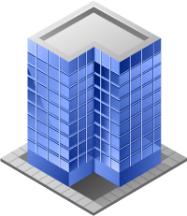
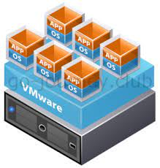



Contributions and Achievements
Virtual infrastructure renewal project(Sell-through Business)
👉Overview
Migrating virtual infrastructure due to end of life of hardware.
Worked with NTT docomo Business to migrate end-user systems(enterprise).
NTT roles: Overall project management and coordination with enterprise customers
CTC roles: Design, build, transition
DR Site
※vSphere
(Cloud)
Backup
Main Site
VMware
👉Point
Migrating servers using Veeam's replication function.
Backup to a main site and disaster recovery site.
Agentless backup of SQL Server and OS backup.
Storage is integrated into PureStorage Flash Array/X, an all-flash storage system.
Veeam
Migration by replication
API Integration
Snapshot
Notes:
Next introduction is virtual infrastructure renewal project.
This project was Migrating virtual infrastructure due to end of life of hardware.
CTC Worked with NTT docomo Business to migrate end-user systems.
NTT oversaw the entire project and communicated with enterprise customers.
CTC designed, built, and migrated the virtual infrastructure.
Migrated servers using Veeam's replication function.
This reduces the downtime of the virtual machine.
After migration,
Use Veeam to back up to a disaster recovery site.
Veeam is agentless and can back up the OS and SQL.

Slide 8
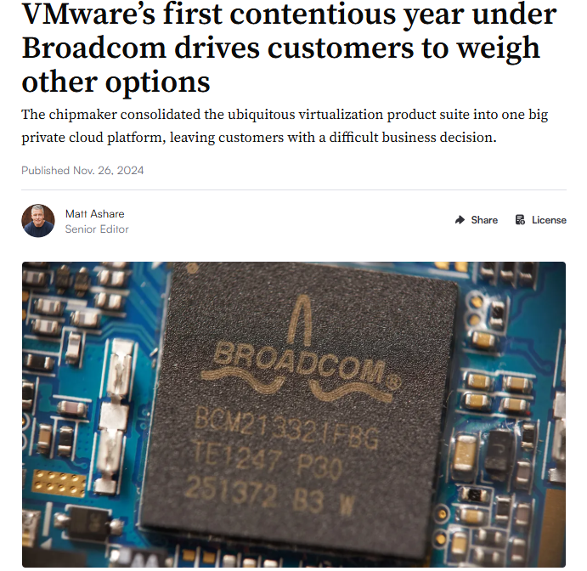
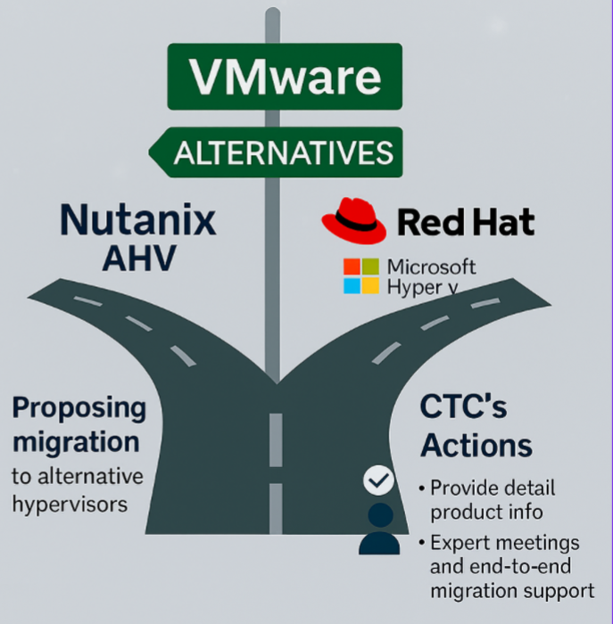

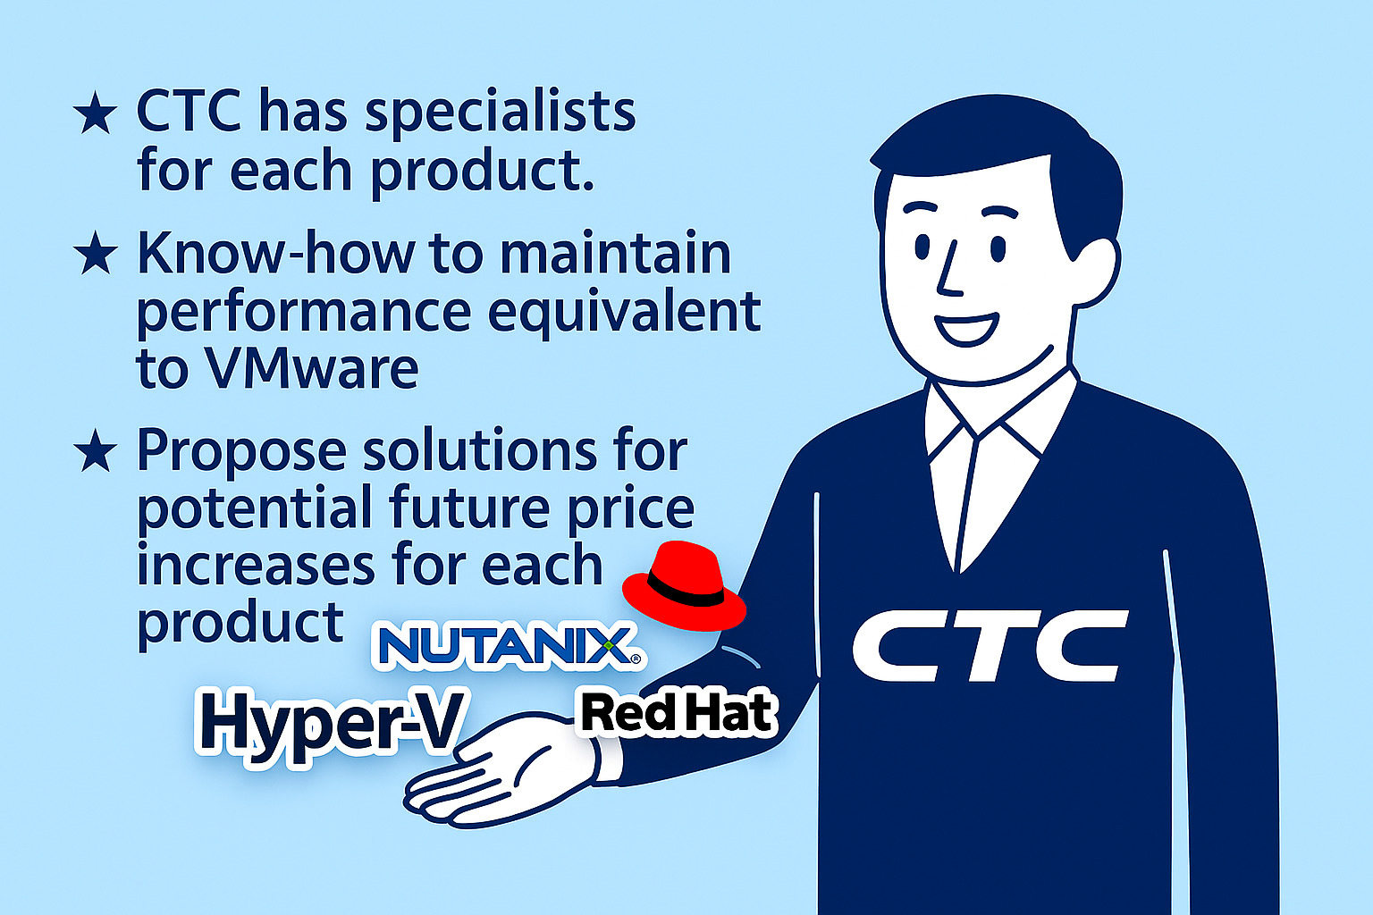


Customer interests and issues①
・Leading the Transition: What CTC can lead after VMware?
After VMware
★Reduce dependency on VMware
★Ensure long‑term platform stability
★lower virtualization costs
Main three
End User Request
VMware Cost Price Increase
＄＄＄
＄
Old VMware Pricing
New VMware Pricing
Notes:
In this section, we will introduce the customer's interests and issues.
Recentry,
Due to VMware’s price changes and licensing revisions, many customers are now considering alternative virtualization platforms.
Their three main concerns are reducing dependency on VMware, ensuring long‑term platform stability, and lowering overall virtualization costs.
CTC can compare multiple alternative hypervisors such as Nutanix AHV, Red Hat, and Hyper‑V
and propose the most suitable migration path for each customer.
With specialists for every product, we provide end‑to‑end support, including product information, performance validation, and full migration assistance.
In this way, CTC is well positioned to guide customers smoothly through the transition to new platforms beyond VMware.
（1.5 m）

Slide 9





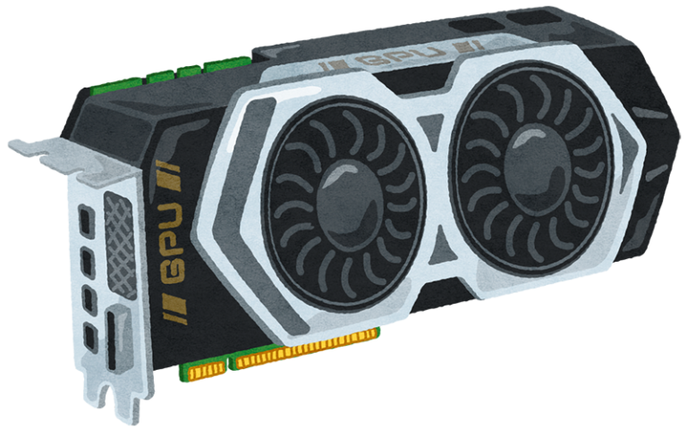




Customer interests and issues②
Driving AI Implementation with GPU Infrastructure
Redundancy strategies to avoid downtime during frequent retraining and model updates
High initial cost
???
Limited AI expertise on the customer side
Storage architecture for Large-Scale Training Data Delivery
Growing need for secure, on-premises
AI infrastructure
Notes:
As Customer interests and issues, we would like to discuss
How to effectively Implement AI with GPU Infrastructure
Our customers have a machine learning platform to support threat detection.
They aim to accelerate model training and inference on this platform and enable real-time processing.
We highlighted these five key challenges:
①High initial cost
Organizations face significant upfront investment
in GPU hardware and supporting infrastructure.
②Limited AI expertise on the customer side
Many of customers don't have enough in-house knowledge
to design and optimize AI workflows effectively.
③Storage Architecture for Large-Scale Training-Data-Delivery
Ensuring fast and reliable data-throughput is critical
for high-performance AI training.
④Redundancy strategies to avoid downtime during frequent-retraining and model-updates
Maintaining system availability while continuously updating models
is a major operational challenge.
⑤Growing need for secure, on-premises AI infrastructure
Cloud services don't always meet strict security and compliance requirements,
therefore, on-premises infrastructure can be another option.

Slide 10
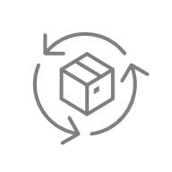
【Appendix】Customer interests and issues
What is CUVIC GPU Zero?
Customer’s business app
Customer’s business app
Tenant
AI agent
AI agent
Customer’s demarcation
CTC’s demarcation
Fully Managed Development Platform
for Building & Deploying Generative AI Agents
Monitoring & Operations Service
Configuration & Implementation Service
On-premise Environment Support
Pre-installed Language Models
*NVIDIA L40S
Development Platform
Dify
AI Model
LLM
OS
Red Hat Enterprise Linux
Infra
GPU Server*/Network | customer’s data center
Service
Monitoring
Fully Managed Service by CTC
Service Platform
Notes:
As a solution, CTC offers CUVIC GPU Zero.
This service provides GPU servers with OS, network devices, LLM as the AI model, and Dify as the development platform.
In addition to the infrastructure deployment, CTC also handles maintenance and operations.
With this environment, customers can easily develop AI applications on their own

Slide 11
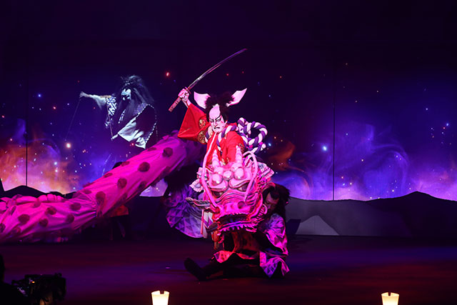
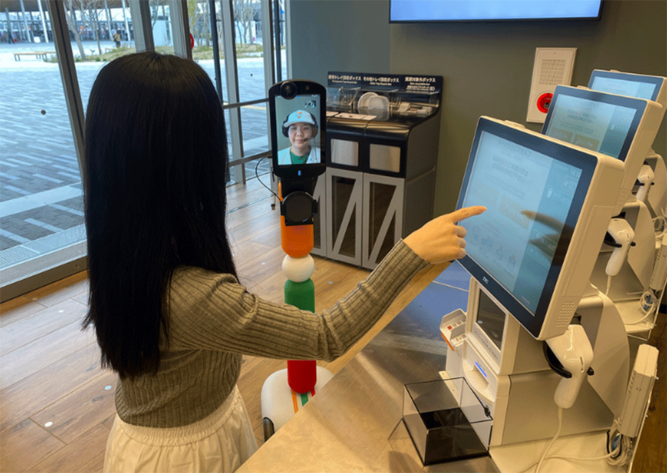
Inside the NTT Pavilion: Highlights of Their Expo 2025 Contributions
Expo 2025 × IOWN: Next‑Generation Experiences
Realtime collab: 官將首×歌舞伎
Ultra-high-capacity
Low latency
Immersive both in Taiwan and in Japan
Remote customer service
Take measures against workforce shortages
Optimization
Notes:
NTT group also played an important role at the Kansai Expo using IOWN’s ultra-high-capacity and low-latency network
I would like to introduce some of their contributions there
- For instance, they enabled an interactive real-time connection of the stage performances between ‘Guān Jiāng Shòu’ in Taiwan and ‘Kabuki’ in Osaka
- Besides, they launched a demonstration of IOWN-powered remote customer service at a Seven-Eleven store,
which is expected to take measures against workforce shortages and optimize store operations
NTT is planning to further accelerate the business expansion of IOWN in the coming years.

Slide 12
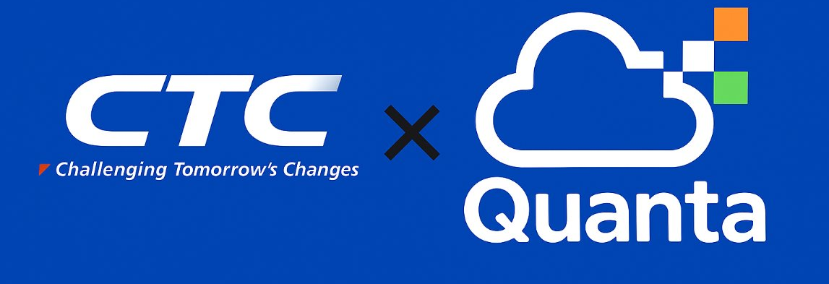
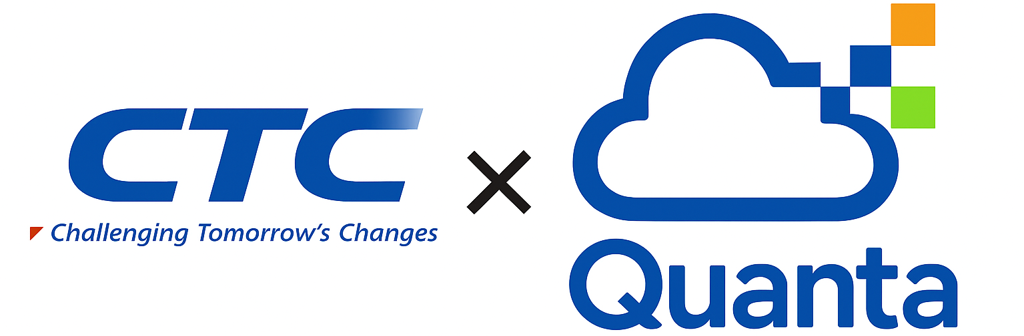
Thank you for your attention and support throughout this presentation！
Together, we create lasting value
Let’s have a great session and exchange ideas together!
Notes:
Thank you for having us today
We look forward to exchanging ideas with you all ☺

