Slide 1
Object Detection for Shopee Data
Kou Wen

Slide 2
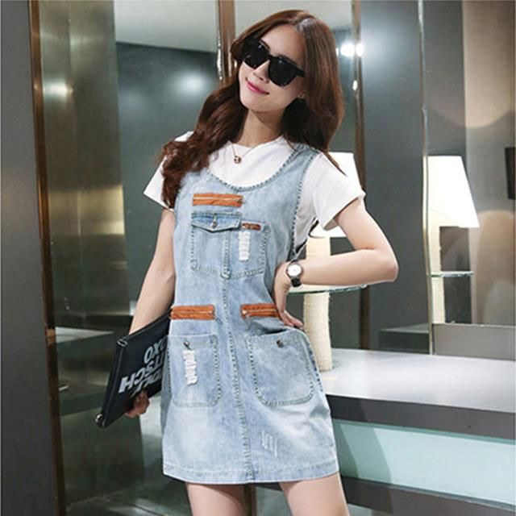
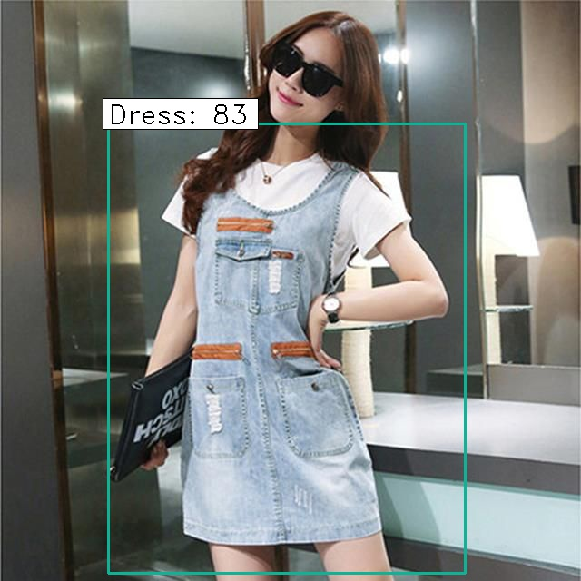
Problem Description
Given a shopee women’s apparel image, the designed system will draw bounding box of clothes and give tags of detected clothes.
Original Image
Result

Slide 3
Solution
Object Detection:
Typically it will be separated into two steps; the first step is to localize the object using bounding box; in the second step, the object in each bounding box will be classified into a category respectively.
feed the window size patch into image classifiction
resize image at multiple scales to solve object size variations

Slide 4
Outline
Object Detection
Implementation
Experiment results
Conclutions
Q&A

Slide 5
Object detection
HOG
Histogram of Oriented Gradient
SVM
Region CNN
Selective Search
CNN
SVM

Slide 6
Object detection
Spatial Pyramid Pooling Net
Input Images(arbitray size)
CNN
SPP layer
FC layer
Output
Fast R-CNN
featuremap of whole image
softmax for classification
Input Images(arbitray size)
CNN
featuremap of region of interest
FC layer
regression of bounding box
It is difficult for SPP net for fine-tune using the whole net architecture with SPP layer. Fast R-CNN later conquer the barrier. Both algorithms apply shared compution so they save a lot of time.

Slide 7
Object detection
Faster R-CNN
softmax for classification
Net architecture same with Fast R-CNN
input images
Region Propose Net
regression of bounding box
Computation the whole image using CNN
Solve the computational expensive part of selective search
Achieve similar accuracy of Fast R-CNN
Region Propose Net
Achor schemes
The current Faster R-CNN is one of the most advanced algorithm, so I choose this algorithm as my solution.

Slide 8
Implementation: source code
The source code is from https://github.com/yhenon/keras-frcnn.git . Now there is better version of https://github.com/fizyr/keras-retinanet.git . In this version, the original author improves the code quality for usability, extends the interface to read more different dataset and improves the speed.
My implementation is https://github.com/kwkwvenusgod/Shopee_ObjectDetection.git

Slide 9
Implementation: dataset
In this task, the dataset is obtained from deep fashion. I applied the Consumer-to-shop Clothes Retrieval Benchmark
For Consumer-to-shop dataset, it has 239557 data with annotated bounding box and contains 16 categories in the total. Moreover, it covers both photo in shop and also consumers’ selfies photo. So the diversity and the volume is desirable for training and cover the shopee dataset. The drawback is that the dataset does not contain sufficient women’s underwear. There is dataset named Objects segmentation in the fashion field which contains women’s underwear. But compare with the size with Deepfashion, the size is too small (400 images) in total; so I did not use it.

Slide 10
implementation: category in Dataset
{0: 'Polo_Shirt', 1: 'T_Shirt', 2: 'Summer_Wear', 3: 'Tank_Top', 4: 'Lace_Shirt', 5: 'Blouse', 6: 'Coat', 7: 'Chiffon', 8: 'Pants', 9: 'Skirt', 10: 'Leggings', 11: 'Jeans', 12: 'Dress', 13: 'Suspenders_Skirt', 14: 'Sleeveless_Dress', 15: 'Lace_Dress', 16: 'bg'}
‘bg’ is referred as background
Even the dataset only contains women’s apparel clothes; a subcategory can be selected from the whole set. From my point of view, it is worth examining the generalization performance of the algorithm. Since it may not be pre determined the gender of the cloth for.

Slide 11
Implementation: training facility
1 GeForce GTX 1080 GPU

Slide 12
Result
Training time: the total training number is about 180,000 images. One full epoch will take approximately 30-40 hours.
Test time: for each image the recognition time will take 300ms to 700ms based on the image size.

Slide 13
Results
Applied first 20000 samples for test. 15000 are training samples. 5000 are test samples
Train:
Test:
Classifier accuracy for bounding boxes from RPN: 0.7626
Loss RPN classifier: 0.0279
Loss RPN regression: 0.0599
Loss Detector classifier: 0.6196
Loss Detector regression: 0.08338
Classifier accuracy for bounding boxes from RPN: 0.7541
Loss RPN classifier: 0.0355
Loss RPN regression: 0.0618
Loss Detector classifier: 0.6523
Loss Detector regression: 0.0869

Slide 14
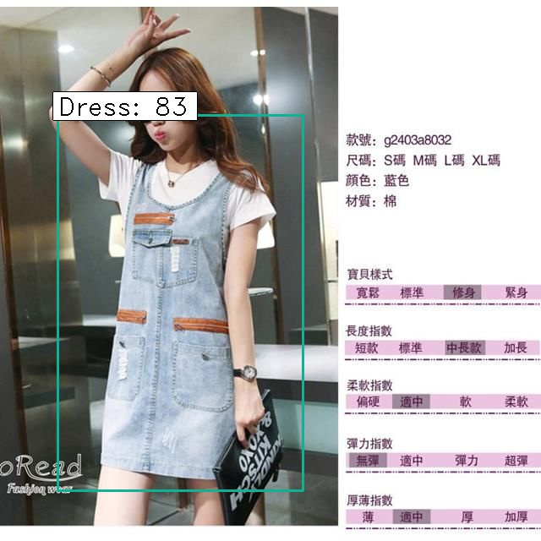
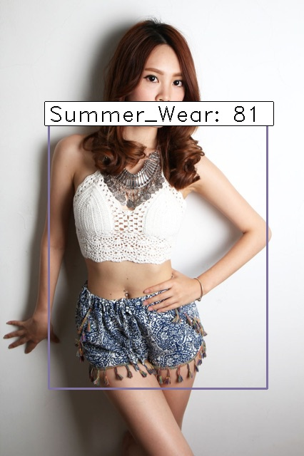
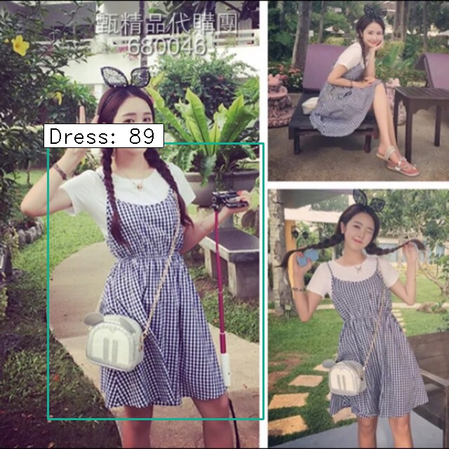
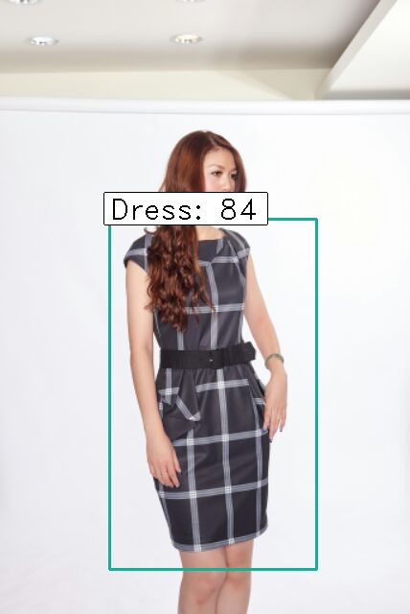
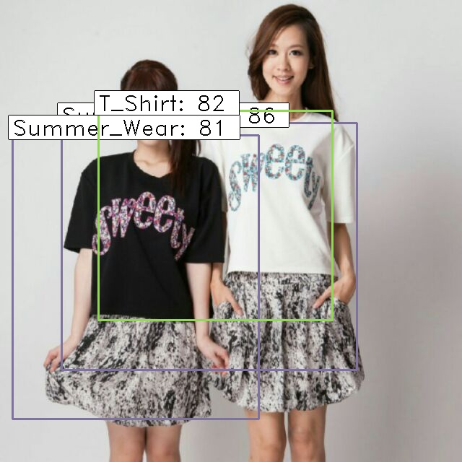
Results

Slide 15
Conclusion
Issues
The base deep network architecture is resnet50 which is really deep and complicated; It will exhaust a lot of resources, in general it will occupy about 6GB memory only for resnet50.
Since the dataset is too big and the training takes really long time
The implementation will handle image input with different size as Fast R-CNN and SPP-net, it is difficult to train on batch, since each input image size is different. Keras may not be able to handle input tensor with different sizes. (Correct me if it can!!) It is also one reason for the long time training
Since so far the training is not so complete, it is difficult to judge the final model. But some output from shopee data can give some straightforward and intuitive judgement on the trained model.
There is still a lot to improve. For example, from the business view the category of women apparel may not be so appropriate, the summer wear can be a little abstract. For top and bottoms, some clothes are categorized as summer wear, which would be over general in business scenario
From the current result, some sleeveless blouse will be recognized as top tank which is man’s cloth.

Slide 16
Q&A

Slide 17
Thanks

