Slide 1

Enabling ECN in Multi-Service Multi-Queue Data Centers
Wei Bai, Li Chen, Kai Chen, Haitao Wu (Microsoft)
SING Group @ Hong Kong University of Science and Technology
Notes:
Hello everyone, I am Wei Bai from Hong Kong University of Science and Technology. Today I am going to talk about our work, enabling ECN in multi-service multi-queue data centers. This is a joint work with Li Chen, Kai Chen from Hong Kong University of Science and Technology and Haitao Wu from Microsoft.

Slide 2




Background
Data Centers
Many services with diverse network requirements
Notes:
The context of this work is data center. As we know, today’s data centers host many services and applications with diverse network requirements. Some services desire high throughput. Some services desire low latency. Some services desire both high throughput and low latency.

Slide 3
Background
Data Centers
Many services with diverse network requirements
ECN-based Transports
ECN = Explicit Congestion Notification
Notes:
To satisfy such diverse network requirements, many people have leveraged ECN, explicit congestion notification, to design new transport mechanisms for data center networks.

Slide 4
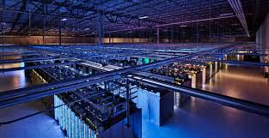
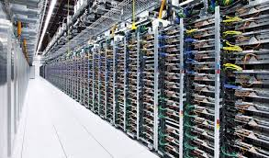
Background
Data Centers
Many services with diverse network requirements
ECN-based Transports
Achieve high throughput & low latency
Widely deployed: DCTCP, DCQCN, etc.
Notes:
With ECN, we can achieve high throughput even with little buffer occupancy. Due to their simplicity and effectiveness, many ECN-based transports, such as DCTCP and DCQCN, are being deployed in production data centers.

Slide 5
ECN-based Transports
Notes:
ECN-based transports actually consist of two parts.

Slide 6

ECN-based Transports
ECN-enabled end-hosts
React to ECN by adjusting sending rates
Notes:
The first part is ECN-enabled end-hosts. End-hosts reduce their sending rates when they see ECN marks.

Slide 7

ECN-based Transports
ECN-enabled end-hosts
React to ECN by adjusting sending rates
ECN-aware switches
Perform ECN marking based on Active Queue Management (AQM) policies
Notes:
The other part is ECN-aware switches. Switches need to perform ECN marking based on AQM policies to deliver congestion information.

Slide 8
ECN-based Transports
ECN-enabled end-hosts
React to ECN by adjusting sending rates
ECN-aware switches
Perform ECN marking based on Active Queue Management (AQM) policies
Our focus
Notes:
In this work, we focus on the ECN marking scheme on the switch.

Slide 9
ECN-aware Switches
Adopt RED to perform ECN marking
RED = Random Early Detection
Notes:
Today’s commodity switches typically adopt RED, random early detection, to perform ECN marking.

Slide 10
ECN-aware Switches
Adopt RED to perform ECN marking
Per-queue/port/service-pool ECN/RED
Track buffer occupancy of different egress entities
Notes:
More specially, there are several ECN/RED implementation on the switch, such as per-queue, per-port and per-service-pool ECN/RED. The key difference among these schemes is that they track buffer occupancy of different egress entities to make ECN marking decisions.

Slide 11
ECN-aware Switches
Adopt RED to perform ECN marking
Per-queue/port/service-pool ECN/RED
queue 1
port
queue 2
Notes:
In per-queue ECN marking, we track the buffer occupancy of each queue to make ECN marking decisions. Each queue has its own ECN marking threshold and performs ECN marking independently to other queues. An arrival packet gets ECN marked if the per-queue buffer occupancy is larger than per-queue ECN marking threshold.

Slide 12
ECN-aware Switches
Adopt RED to perform ECN marking
Per-queue/port/service-pool ECN/RED
queue 1
port
queue 2
Notes:
In per-port ECN marking, we track the total buffer occupancy of a switch port to make ECN marking decisions. Each port has its own ECN marking threshold. An arrival packet gets ECN marked if the per-port buffer occupancy is larger than the per-port ECN marking threshold.

Slide 13
ECN-aware Switches
Adopt RED to perform ECN marking
Per-queue/port/service-pool ECN/RED
shared buffer
queue 1
port
queue 2
queue 3
port
queue 4
Notes:
In per-service-pool ECN marking, we track the total buffer occupancy of a shared buffer region to make ECN marking decisions.

Slide 14
ECN-aware Switches
Adopt RED to perform ECN marking
Per-queue/port/service-pool ECN/RED
Leverage multiple queues to classify traffic
Isolate traffic from different services/applications
Notes:
As we have shown, commodity switches have provided multiple queues for each egress port. Current operation practice is to leverage multiple queues to isolate traffic from different services/applications.

Slide 15
ECN-aware Switches
Adopt RED to perform ECN marking
Per-queue/port/service-pool ECN/RED
Leverage multiple queues to classify traffic
Isolate traffic from different services/applications
Services running DCTCP
Services running TCP
Services running UDP
Notes:
For example, we can isolate traffic from different services based on their protocols.

Slide 16
ECN-aware Switches
Adopt RED to perform ECN marking
Per-queue/port/service-pool ECN/RED
Leverage multiple queues to classify traffic
Isolate traffic from different services/applications
Real-time services
Best-effort services
Background services
Notes:
We can also isolate services based on their importance.

Slide 17
ECN-aware Switches
Adopt RED to perform ECN marking
Per-queue/port/service-pool ECN/RED
Leverage multiple queues to classify traffic
Isolate traffic from different services/applications
Weighted max-min fair sharing among queues
Real-time services
Weight = 4
Best-effort services
Weight = 2
Background services
Weight = 1
Notes:
Among the queues, operators typically enforce weighted max-min fair sharing policy since they don’t want to persistently starve a whole service for long time. For example, we can assign a high weight to more important real-time services and a low weight to less important background services.

Slide 18
ECN-aware Switches
Adopt RED to perform ECN marking
Per-queue/port/service-pool ECN/RED
Leverage multiple queues to classify traffic
Isolate traffic from different services/applications
Weighted max-min fair sharing among queues
Perform ECN marking in multi-queue context
Notes:
In summary, in production data centers with multiple services, we need to perform ECN marking in multi-queue context. This is the problem we want to explore.

Slide 19
ECN marking with Single Queue
Notes:
To understand this problem, we start from the simplest scenario, ECN marking with single queue.

Slide 20
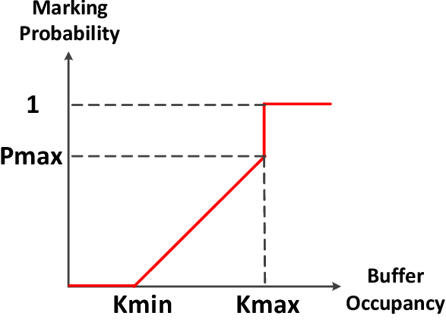
ECN marking with Single Queue
RED Algorithm
Notes:
This figure shows that how RED calculates marking probability based on buffer occupancy. It has at least three parameters: Kmin, Kmax and Pamx.

Slide 21
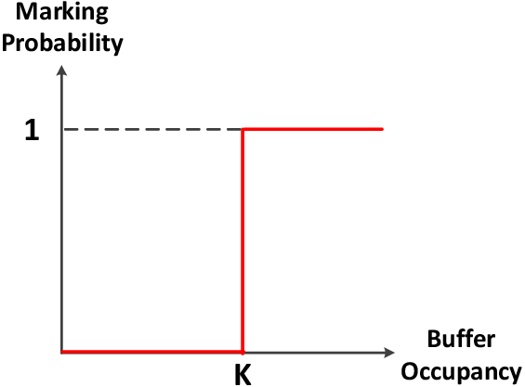
ECN marking with Single Queue
RED Algorithm
Practical Configuration
(e.g., DCTCP)
Notes:
In practice, operators typically set Kmin and Kmax to the same value. In this way, there is only one ECN marking threshold, K, that we need to configure. A packet gets marked if the buffer occupancy is larger than K.

Slide 22

ECN marking with Single Queue
To achieve 100% throughput
$$K≥C×RTT×λ$$
Notes:
To achieve 100% throughput for synchronized TCP flows, K should be no smaller than C times RTT times lambda.

Slide 23
ECN marking with Single Queue
To achieve 100% throughput
$$K≥C×RTT×λ$$
Determined by congestion control algorithms
Notes:
C times RTT is bandwidth delay product. Lambda is a fixed parameter determined by congestion control algorithms at end hosts. For example, lambda is 1 for regular ECN-enabled TCP which simply cuts window by half in the presence of ECN.

Slide 24
ECN marking with Single Queue
To achieve 100% throughput
$$K≥C×RTT×λ$$
Standard ECN marking threshold
Notes:
Here, we call C times RTT times lambda as the standard ECN marking threshold since it is the value we can use to fully utilize link capacity while delivering low latency.

Slide 25
ECN marking with Single Queue
To achieve 100% throughput
$$K≥C×RTT×λ$$
The standard threshold is relatively stable in DCN,
e.g., 65 packets for 10G network (DCTCP paper)
Notes:
In homogeneous data center networks, RTT is relatively stable. And C is given, lambda is given. So it is feasible for us to compute a static value as the standard ECN marking threshold. For example, in DCTCP paper, the authors recommend using 65 packets as the marking threshold for 10G network.

Slide 26
ECN marking with Multi-Queue (1)
Notes:
Now, we move to ECN marking in multi-queue context.

Slide 27

ECN marking with Multi-Queue (1)
Per-queue with the standard threshold
$K_{queue(i)}=C×RTT×λ$
standard threshold
Mark
Don’t mark
queue 1
queue 2
port
queue 3
Notes:
In multi-queue context, per-queue ECN making is widely employed by operators due to its good isolation among different queues. To fully utilize the link capacity in any condition, many operators configure the standard ECN marking threshold for each queue. In this way, any queue can independently fully utilize the link capacity regardless of traffic dynamics. To the best of our knowledge, this is current operation practice in industry.

Slide 28

ECN marking with Multi-Queue (1)
Per-queue with the standard threshold
$K_{queue(i)}=C×RTT×λ$
Increase packet latency
standard threshold
Mark
Don’t mark
queue 1
queue 2
port
queue 3
Notes:
However, such configuration will increase packet latency when many queues are concurrently active.

Slide 29
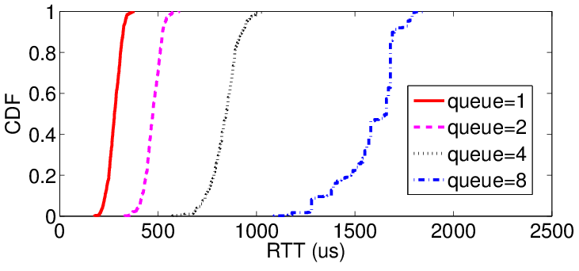
ECN marking with Multi-Queue (1)
Per-queue with the standard threshold
$K_{queue(i)}=C×RTT×λ$
Increase packet latency
Evenly classify 8 long-lived flows into a varying number of queues
Notes:
To confirm this, we even classify 8 long-lived flows into a varying number of queues. As we can see from this figure, more queues lead to worse latency.

Slide 30

ECN marking with Multi-Queue (2)
Per-queue with the minimum threshold
$K_{queue(i)}=C×RTT×λ×{w_{i}}/{\sum{w_{j}}}$
Normalized weight
minimum threshold
Mark
Don’t mark
queue 1
queue 2
port
queue 3
Notes:
Realizing above limitation, an alternative approach is to divide the standard ECN marking threshold into different queues based on queue weights. In this formula, Wi is the weight of queue i. So Wi over the sum of Wj is the normalized weight of queue i. Such configuration can achieve good latency even when all the queues are concurrently active.

Slide 31

ECN marking with Multi-Queue (2)
Per-queue with the minimum threshold
$K_{queue(i)}=C×RTT×λ×{w_{i}}/{\sum{w_{j}}}$
Degrade throughput
minimum threshold
Mark
Don’t mark
queue 1
queue 2
port
queue 3
Notes:
However, it will degrade throughput when very few queues are active simultaneously.

Slide 32
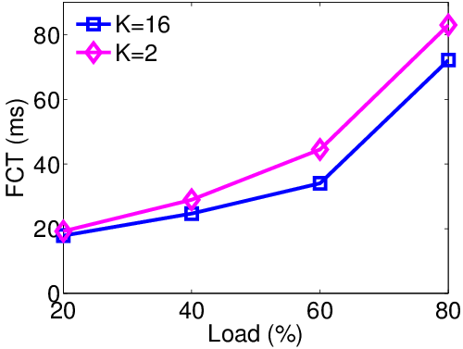
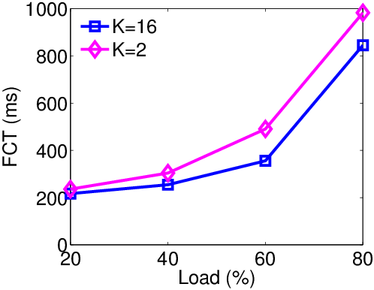
ECN marking with Multi-Queue (2)
Per-queue with the minimum threshold
$K_{queue(i)}=C×RTT×λ×{w_{i}}/{\sum{w_{j}}}$
Degrade throughput
Overall Average FCT
Average FCT (>10MB)
Notes:
To confirm this, we consider an extreme case where only one queue is active. As we can see from these figures, the threshold of 16 packets can achieve better performance compared to the threshold of 2 packets.

Slide 33

ECN marking with Multi-Queue (3)
Per-port
$K_{port}=C×RTT×λ$
standard threshold
Mark
Don’t mark
queue 1
queue 2
port
queue 3
Notes:
Unlike previous two per-queue-based approaches, we can use per-port ECN/RED to achieve both high throughput and low latency by setting the per-port marking threshold to the standard ECN marking threshold.

Slide 34

ECN marking with Multi-Queue (3)
Per-port
$K_{port}=C×RTT×λ$
Violate weighted fair sharing
standard threshold
Mark
Don’t mark
queue 1
queue 2
port
queue 3
Notes:
However, per-port ECN/RED cannot ensure isolation among different queues. Packets from one queue can get ECN marked due to the buffer occupancy of other queues. As a result, per-port ECN/RED can seriously violate the weighted fair sharing policy among queues. We believe this problem will be more serious if we use per-service-pool ECN/RED as queues from different ports can interfere with each other.

Slide 35
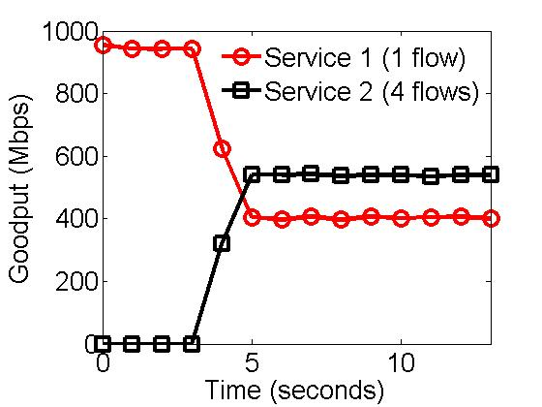
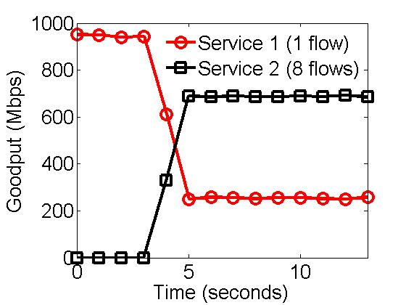
ECN marking with Multi-Queue (3)
Per-port
$K_{port}=C×RTT×λ$
Violate weighted fair sharing
Both services have a equal-weight dedicated queue on the switch
Notes:
To confirm this impairment, we classify traffic into two services. Both services have a equal-weight dedicated queue on the switch. According to scheduling policy, both services should always fairly share the link capacity. However, as we can see, with per-port ECN/RED, service 2 can get more bandwidth when we increase its number of flows.

Slide 36
Question
Can we design an ECN marking scheme with following properties:
Deliver low latency
Achieve high throughput
Preserve weighted fair sharing
Compatible with legacy ECN/RED implementation
Notes:
Here, we take one step back and ask a question, can we design an ECN marking scheme that achieve low latency and high throughput while strictly preserving weighted fair sharing policy? In addition, for hardware implementation friendliness, we also require the scheme should perform RED like enqueue ECN marking. More specially, our solution should compare buffer occupancy against a threshold at the enqueue side to make marking decisions.

Slide 37
Question
Can we design an ECN marking scheme with following properties:
Deliver low latency
Achieve high throughput
Preserve weighted fair sharing
Compatible with legacy ECN/RED implementation
Our answer: MQ-ECN
Notes:
Our answer is MQ-ECN

Slide 38
MQ-ECN’S DESIGN
Notes:
Now, let’s move to the design of MQ-ECN

Slide 39


Start from GPS Model
$N$ queues share the link with capacity $C$
Generalized Processor Sharing (GPS)
1
2
$$C$$
.
.
.
N
Notes:
We start from ideal GPS model. Consider we have N queues share the link with capacity C. The underlying scheduler is generalized processor sharing (GPS).

Slide 40



Start from GPS Model
$N$ queues share the link with capacity $C$
Input Rate
$$r_{1}$$
1
$$r_{2}$$
2
$$C$$
.
.
.
.
.
.
$$r_{N}$$
N
Notes:
The input rate of queue i is Ri.

Slide 41



Start from GPS Model
$N$ queues share the link with capacity $C$
Input Rate
Weight
$$r_{1}$$
$$w_{1}$$
1
$$r_{2}$$
$$w_{2}$$
2
$$C$$
.
.
.
.
.
.
.
.
.
$$r_{N}$$
$$w_{N}$$
N
Notes:
The weight of queue i is Wi.

Slide 42




Start from GPS Model
$N$ queues share the link with capacity $C$
$C=\sum_{i=1}^{N}{min⁡(r_{i}},w_{i}α)$
Weighted Fair Share Rate
Input Rate
Weight
Output Rate
$$r_{1}$$
$$w_{1}$$
1
$$min⁡(r_{1},w_{1}α)$$
$$r_{2}$$
$$w_{2}$$
2
$$min⁡(r_{2},w_{2}α)$$
$$C$$
.
.
.
.
.
.
.
.
.
.
.
.
$$r_{N}$$
$$w_{N}$$
N
$$min⁡(r_{N},w_{N}α)$$
Notes:
When the link is congested, according to weighted max-min fairness, we have the following equation. Alpha is unique solution for the equation. Wi times alpha is also called weighted fair share rate. The output rate of queue i is the minimum value between input rate Ri and weighted fair share rate Wi alpha.

Slide 43

Start from GPS Model
$N$ queues share the link with capacity $C$
$C=\sum_{i=1}^{N}{min⁡(r_{i}},w_{i}α)$
Use ECN to throttle queue i if $r_{i}>w_{i}α$
Input Rate
Weight
Output Rate
$$r_{1}$$
$$w_{1}$$
1
$$min⁡(r_{1},w_{1}α)$$
$$r_{2}$$
$$w_{2}$$
2
$$min⁡(r_{2},w_{2}α)$$
$$C$$
.
.
.
.
.
.
.
.
.
.
.
.
$$r_{N}$$
$$w_{N}$$
N
$$min⁡(r_{N},w_{N}α)$$
Notes:
When input rate Ri is larger than weighted fair share rate Wi alpha, queue i is congested. For such kind of queues, we should use ECN to throttle them.

Slide 44

Start from GPS Model
$N$ queues share the link with capacity $C$
$C=\sum_{i=1}^{N}{min⁡(r_{i}},w_{i}α)$
$K_{queue(i)}=w_{i}α×RTT×λ$
Input Rate
Weight
Output Rate
$$r_{1}$$
$$w_{1}$$
1
$$min⁡(r_{1},w_{1}α)$$
$$r_{2}$$
$$w_{2}$$
2
$$min⁡(r_{2},w_{2}α)$$
$$C$$
.
.
.
.
.
.
.
.
.
.
.
.
$$r_{N}$$
$$w_{N}$$
N
$$min⁡(r_{N},w_{N}α)$$
Notes:
To throttle queue i, we should set the marking threshold of queue i to Wi alpha times RTT times lambda. So the challenge is how can we derive Wi alpha in highly dynamic data center networks.

Slide 45
Start from GPS Model
$N$ queues share the link with capacity $C$
$C=\sum_{i=1}^{N}{min⁡(r_{i}},w_{i}α)$
$K_{queue(i)}=w_{i}α×RTT×λ$
bit-by-bit round robin
Input Rate
Weight
Output Rate
$$r_{1}$$
$$w_{1}$$
1
$$min⁡(r_{1},w_{1}α)$$
$$r_{2}$$
$$w_{2}$$
2
$$min⁡(r_{2},w_{2}α)$$
$$C$$
.
.
.
.
.
.
.
.
.
.
.
.
$$r_{N}$$
$$w_{N}$$
N
$$min⁡(r_{N},w_{N}α)$$
Notes:
We leverage the special properties of GPS scheduler to solve it. Note that GPS scheduler performs bit by bit round robin scheduling.

Slide 46

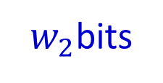

Start from GPS Model
$N$ queues share the link with capacity $C$
$C=\sum_{i=1}^{N}{min⁡(r_{i}},w_{i}α)$
$K_{queue(i)}=w_{i}α×RTT×λ$
bit-by-bit round robin
Input Rate
Quantum
Output Rate
$$r_{1}$$
$w_{1}$bits
1
$$min⁡(r_{1},w_{1}α)$$
$$r_{2}$$
$w_{2}$bits
2
$$min⁡(r_{2},w_{2}α)$$
$$C$$
.
.
.
.
.
.
.
.
.
.
.
.
$$r_{N}$$
$w_{N}$bits
N
$$min⁡(r_{N},w_{N}α)$$
Notes:
In each round, queue i can transmit Wi bits at most.

Slide 47




Start from GPS Model
$N$ queues share the link with capacity $C$
$C=\sum_{i=1}^{N}{min⁡(r_{i}},w_{i}α)$
$K_{queue(i)}=w_{i}α×RTT×λ$
Time of a round: $T_{round}$
Input Rate
Quantum
Output Rate
$$r_{1}$$
$${quantum}_{1}$$
1
$$min⁡(r_{1},w_{1}α)$$
$$r_{2}$$
$${quantum}_{2}$$
2
$$min⁡(r_{2},w_{2}α)$$
$$C$$
.
.
.
.
.
.
.
.
.
.
.
.
$$r_{N}$$
$${quantum}_{N}$$
N
$$min⁡(r_{N},w_{N}α)$$
Notes:
We use quantum i to denote Wi bits. The time of a round is denoted as T round, which can be measured directly. A congested queue is likely to use up its quantum in a round.

Slide 48

Start from GPS Model
$N$ queues share the link with capacity $C$
$C=\sum_{i=1}^{N}{min⁡(r_{i}},w_{i}α)$
$K_{queue(i)}={{quantum}_{i}}/{T_{round}}×RTT×λ$
Time of a round: $T_{round}$
Input Rate
Quantum
Output Rate
$$r_{1}$$
$${quantum}_{1}$$
1
$$min⁡(r_{1},w_{1}α)$$
$$r_{2}$$
$${quantum}_{2}$$
2
$$min⁡(r_{2},w_{2}α)$$
$$C$$
.
.
.
.
.
.
.
.
.
.
.
.
$$r_{N}$$
$${quantum}_{N}$$
N
$$min⁡(r_{N},w_{N}α)$$
Notes:
Therefore, we can use quantum i over T round to estimate weighted fair share rate.

Slide 49

MQ-ECN
$N$ queues share the link with capacity $C$
$C=\sum_{i=1}^{N}{min⁡(r_{i}},w_{i}α)$
$K_{queue(i)}={{quantum}_{i}}/{T_{round}}×RTT×λ$
Notes:
So the marking threshold of queue i can be given as quantum i over T round times RTT times lambda. This is how MQ-ECN calculates per-queue ECN marking thresholds.

Slide 50

MQ-ECN
$K_{queue(i)}={{quantum}_{i}}/{T_{round}}×RTT×λ$
Why does it work?
Notes:
So you may wonder why this works? Why this formula can achieve all of our design goals.

Slide 51


MQ-ECN
$K_{queue(i)}={{quantum}_{i}}/{T_{round}}×RTT×λ$
Deliver low latency
Achieve high throughput
$K_{queue(i)}$ adapts to traffic dynamics
Notes:
First of all, we find that, T round reflects traffic dynamics. When many queues are active, T round becomes very large. MQ-ECN reduces per-queue marking thresholds to achieve low latency. When few queues are active, T round is small. MQ-ECN increases per-queue thresholds to achieve high throughput.

Slide 52


MQ-ECN
$K_{queue(i)}={{quantum}_{i}}/{T_{round}}×RTT×λ$
Deliver low latency
Achieve high throughput
Preserve weighted fair sharing
$K_{queue(i)}$is in proportion to the weight
Notes:
Second, quantum i ensures that marking thresholds of different queues are in proportional to their weights. Therefore, MQ-ECN can strictly preserve weighted fair sharing policy.

Slide 53

MQ-ECN
$K_{queue(i)}={{quantum}_{i}}/{T_{round}}×RTT×λ$
Deliver low latency
Achieve high throughput
Preserve weighted fair sharing
Compatible with legacy ECN/RED implementation
Per-queue ECN/RED with dynamic thresholds
Notes:
Third, in this formula, quantum i, RTT and lambda are all given. T round is varying according to traffic dynamics. So, MQ-ECN is essentially a per-queue ECN/RED scheme with dynamic thresholds.

Slide 54
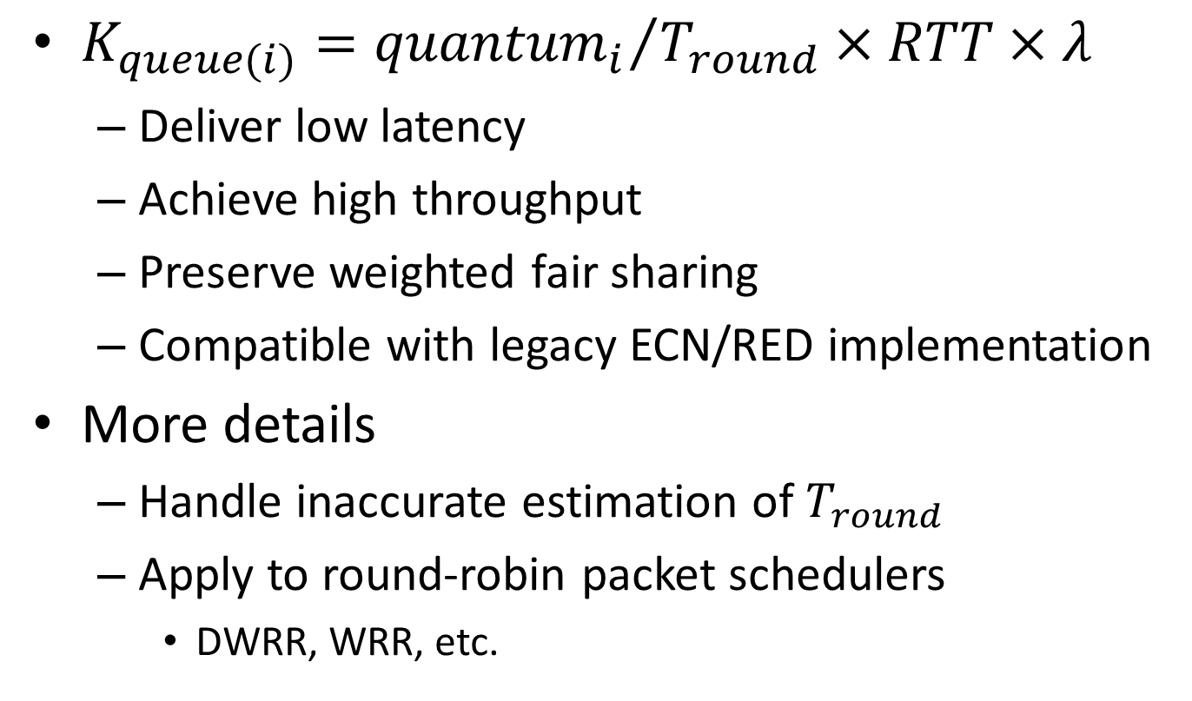
MQ-ECN
$K_{queue(i)}={{quantum}_{i}}/{T_{round}}×RTT×λ$
Deliver low latency
Achieve high throughput
Preserve weighted fair sharing
Compatible with legacy ECN/RED implementation
More details
Handle inaccurate estimation of $T_{round}$
Apply to round-robin packet schedulers
DWRR, WRR, etc.
Notes:
In the paper, we also discuss how to handle inaccurate estimation of T round and how to apply the formula to round-robin packet schedulers which are widely implemented in switching chips to approximate GPS. For these details, please refer to our paper.

Slide 55
Testbed Evaluation
MQ-ECN software prototype
Linux qdisc kernel module performing DWRR
Testbed setup
9 servers are connected to a server-emulated switch with 9 NICs
End-hosts use DCTCP as the transport protocol
Benchmark traffic
Web search (DCTCP paper)
More results in large-scale simulations
Notes:
We have implemented a MQ-ECN software prototype as a Linux qdisc kernel module. We build a testbed with 9 servers connected to a server-emulated software switch. At end-host, we use DCTCP as the transport protocol. We generate realistic traffic according to the web search workload in DCTCP paper. We also conduct large-scale simulations to complement our testbed experiments. Here, we just show testbed experiment results.

Slide 56
Static Flow Experiment
1 flow
Service 1
weight
1
1
Service 2
4 flows
Notes:
We start from a simple static flow experiment. In this experiment, service 1 has 1 flow while service 2 has 4 flows. Both services have a equal-weight queue on the switch.

Slide 57
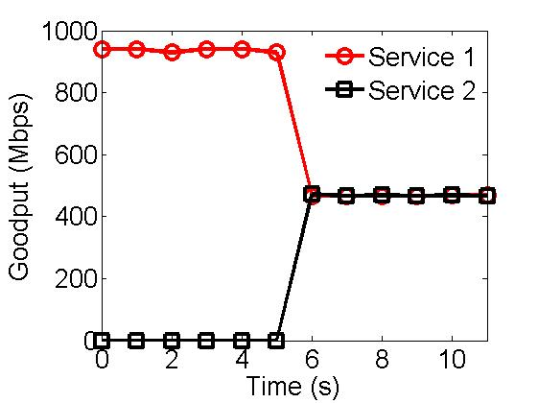
Static Flow Experiment
Notes:
This figure gives aggregate goodputs of two services achieved by MQ-ECN. In contrast to results achieved by per-port ECN/RED, both services fairly share the link capacity regardless of the number of flows.

Slide 58
Static Flow Experiment
MQ-ECN preserves weighted fair sharing
Notes:
This indicates that MQ-ECN can strictly preserve weighted fair sharing policy.

Slide 59
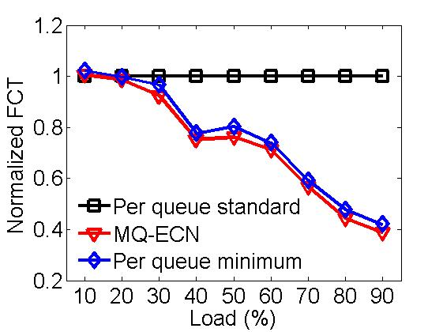
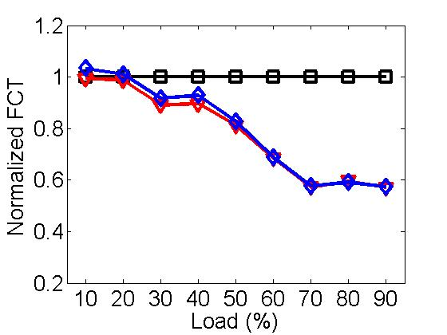
Realistic Traffic: Small Flows (<100KB)
Balanced traffic pattern
Unbalanced traffic pattern
Notes:
These figures show FCT results of small flows in realistic traffic workload. MQ-ECN achieves comparable performance as the minimum threshold while greatly outperforming the standard threshold. Compared to per-queue ECN/RED with the standard threshold, MQ-ECN can achieve up to 60% and 40% lower average FCT for small flows, respectively.

Slide 60
Realistic Traffic: Small Flows (<100KB)
Balanced traffic pattern
Unbalanced traffic pattern
MQ-ECN achieves low latency
Notes:
This indicates that MQ-ECN can achieve low latency.

Slide 61
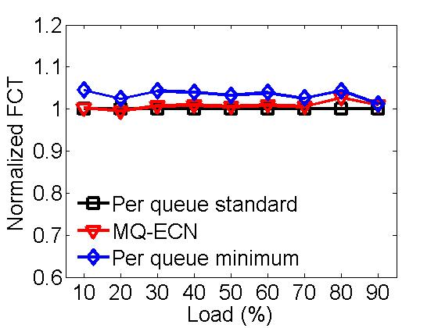
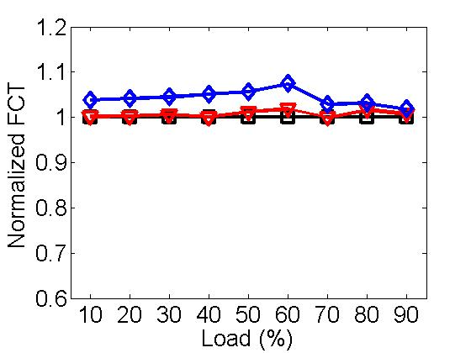
Realistic Traffic: Large Flows (>10MB)
Balanced traffic pattern
Unbalanced traffic pattern
Notes:
These figures gives the results of large flows. As we can see, MQ-ECN performs very similar as the standard threshold while obviously outperforming the minimum threshold.

Slide 62
Realistic Traffic: Large Flows (>10MB)
Balanced traffic pattern
Unbalanced traffic pattern
MQ-ECN achieves high throughput
Notes:
This indicates that MQ-ECN can achieve high throughput.

Slide 63
Conclusions
Identify performance impairments of existing ECN/RED schemes in multi-queue context
MQ-ECN: simple, yet effective
High throughput, low latency, weighted fair sharing
Currently, apply to round-robin packet schedulers
ECN marking scheme for arbitrary schedulers is an important ongoing effort
Code: http://sing.cse.ust.hk/projects/MQ-ECN
Notes:
In this work, we identify performance impairments of existing ECN/RED schemes in multi-queue context. Then we propose MQ-ECN, a simple yet effective ECN/RED scheme for round-robin packet schedulers. MQ-ECN can achieve high throughput and low latency while preserving weighted fair sharing policy. In the future, we expect to design a ECN marking scheme for arbitrary packet schedulers. The code and data is available in this website.

Slide 64
Thanks!

Slide 65
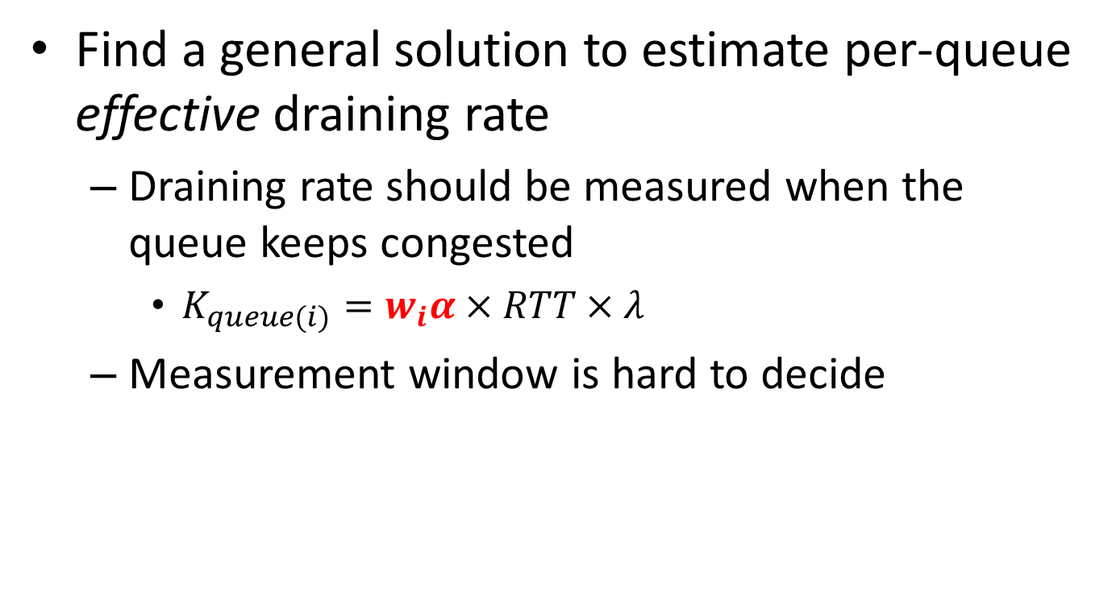
Support Arbitrary Packet Schedulers
Find a general solution to estimate per-queue effective draining rate
Draining rate should be measured when the queue keeps congested
$K_{queue(i)}=w_{i}α×RTT×λ$
Measurement window is hard to decide

