Slide 1

Information-Agnostic Flow Scheduling for Commodity Data Centers
Wei Bai
with Li Chen, Kai Chen, Dongsu Han, Chen Tian, Hao Wang
SING Group @ HKUST
SJTU, June 1st, 2015
Notes:
Hello everyone, I am Wei Bai from Hong Kong University of Science and Technology. Today, I am going to talk about our work: information-agnostic flow scheduling for commodity data centers. This is a joint work with Li Chen, Prof. Kai Chen and Hao Wang from SING group, Hong Kong University of Science and Technology, Prof. Dongsu Han from KAIST and Prof. Chen Tian from Nanjing University.

Slide 2
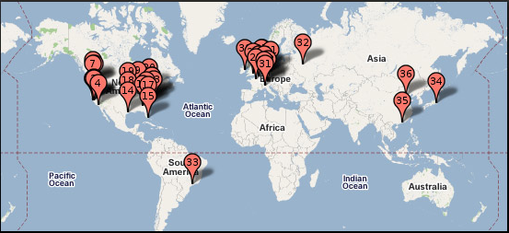

Data Centers

Slide 3
This talk is about the transport inside the data center

Slide 4


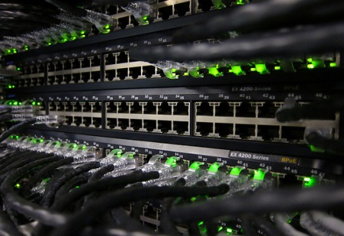

Data Center Networks
High bandwidth
Low latency
Commodity switches
Single administrative domain
Notes:
First of all, I want to introduce the background of this work. The context of this work is data center. As we all know, data centers are very important infrastructures for cloud computing. There are many applications running in data centers [click], such as Web search, high performance computing, database and cache. To serve a user request, these applications will generate a lot of short request and response messages across data center networks. These applications all desire [click] ultra low latency for these short messages. The reason is that the completion times of these short messages directly determine the user experience. [click] Therefore, to improve the application performance, one of the most important design goal for data center transport is to minimize flow completion times, especially for short flows. To address this challenge, [click] there are many flow scheduling proposals, [click]

Slide 5




Data Center Transport
Cloud applications
Desire low latency for short messages
Goal: Minimize flow completion time (FCT)
Many flow scheduling proposals…
Notes:
First of all, I want to introduce the background of this work. The context of this work is data center. As we all know, data centers are very important infrastructures for cloud computing. There are many applications running in data centers [click], such as Web search, high performance computing, database and cache. To serve a user request, these applications will generate a lot of short request and response messages across data center networks. These applications all desire [click] ultra low latency for these short messages. The reason is that the completion times of these short messages directly determine the user experience. [click] Therefore, to improve the application performance, one of the most important design goal for data center transport is to minimize flow completion times, especially for short flows. To address this challenge, [click] there are many flow scheduling proposals, [click]

Slide 6
The State-of-the-art Solutions
PDQ [SIGCOMM’12]
pFabric [SIGCOMM’13]
PASE [SIGCOMM’14]
…
All assume prior knowledge of flow size information to approximate ideal preemptive Shortest Job First (SJF) with customized network elements
Notes:
Such as PDQ, pFabric and PASE. These solutions can potentially provide very good, even near-optimal performance. However, we find that, [click] all of them assume prior knowledge of flow size information to approximate ideal preemptive shortest job first scheduling, which is the optimal scheduling policy to minimize average FCT over the single link. In addition to this, all of these solutions leverage customized network elements. For example, pFabric introduces non-trivial modifications to switch hardware and PASE requires an separate and complex control plane for arbitration. [click]

Slide 7
The State-of-the-art Solutions
PDQ [SIGCOMM’12]
pFabric [SIGCOMM’13]
PASE [SIGCOMM’14]
…
All assume prior knowledge of flow size information to approximate ideal preemptive Shortest Job First (SJF) with customized network elements
Not feasible for some applications
Notes:
We note that, the assumption of prior knowledge of flow size information does not hold for many cases. For many applications, such as database query and response, data is transferred as soon as it is generated without buffering. So we can not get flow size information beforehand. [click]

Slide 8
The State-of-the-art Solutions
PDQ [SIGCOMM’12]
pFabric [SIGCOMM’13]
PASE [SIGCOMM’14]
…
All assume prior knowledge of flow size information to approximate ideal preemptive Shortest Job First (SJF) with customized network elements
Hard to deploy in practice
Notes:
And the customized network elements make these solutions very hard to deploy in production data centers. So we take one step back [click]

Slide 9
Question
Without prior knowledge of flow size information, how to minimize FCT in commodity data centers?
Notes:
And ask an fundamental question: without prior knowledge of flow size information, how to minimize FCT in commodity data centers. [pause] Based on this question, we summarize the following three concrete design goals [click]

Slide 10
Design Goal 1
Without prior knowledge of flow size information, how to minimize FCT in commodity data centers?
Information-agnostic: not assume a priori knowledge of flow size information available from the applications
Notes:
The first design goal is information-agnostic. As I have mentioned, the assumption of flow size information available from applications does not for many cases. Therefore, we should not make such assumption. [click]

Slide 11
Design Goal 2
Without prior knowledge of flow size information, how to minimize FCT in commodity data centers?
FCT minimization: minimize average and tail FCTs of short flows & not adversely affect FCTs of large flows
Notes:
The second design goal is FCT minimization. Our solution should enforce a scheduling policy to minimize average and tail FCTs for short flows while not adversely affect FCTs of large flows. [click]

Slide 12
Design Goal 3
Without prior knowledge of flow size information, how to minimize FCT in commodity data centers?
Readily-deployable: work with existing commodity switches & be compatible with legacy network stacks
Notes:
The third design goal is readily-deployable. We should avoid introducing changes to any element in the data center networks. Our solution should fully utilize the functionalities provided by existing commodity switches and [pause] be compatible with legacy network stacks. Based on above analysis, [click]

Slide 13
Question
Without prior knowledge of flow size information, how to minimize FCT in commodity data centers?
Our answer: PIAS
Notes:
We give our answer to this question, that is PIAS. [click]

Slide 14
PIAS’S DESIGN
Notes:
Now, we talk about the design of PIAS [click]

Slide 15
Design Rationale
PIAS performs Multi-Level Feedback Queue (MLFQ) to emulate Shortest Job First
High
Priority 1
Priority 2
……
Low
Priority K
Notes:
The design rationale of PIAS is performing multi-level feedback queue to emulate shortest job first. So, what is multi-level feedback queues ? [pause]. I use this figure to show it. [click] As we can see, there are K priority queues. 1 is the highest priority while K is the lowest one. During a flow’s life time, its priority is gradually reduced. [click]

Slide 16
Design Rationale
PIAS performs Multi-Level Feedback Queue (MLFQ) to emulate Shortest Job First
Priority 1
Priority 2
……
Priority K
Notes:
For example, for this flow. The first packet is assigned to the priority 1. [click]. The second packet is demoted to priority 2. [click] For the third packet, its priority is further reduced. [click]. Eventually, if this flow is large enough, the last packet is assigned to the lowest priority. You can see that, the key idea of multi-level feedback queue is very simple and it does not require flow size information to do the scheduling. But why multi-level feedback queue can be used to minimize average FCT. [click]

Slide 17

Simple Example Illustrating PIAS
Congestion
Notes:
Here, I use a simple example to show this first and then I will explain the reason behind this. In this topology, the three servers are connected under the same switch. [click] The left two are senders while the right one is the receiver. So congestion happens in this egress port. [click]

Slide 18
Simple Example Illustrating PIAS
Flow 1 with 10 packets and flow 2 with 2 packets arrive
Priority 1
Priority 2
Priority 3
Priority 4
Notes:
We use a 4-level feedback queue as the scheduling policy of the switch. [click] Now, there are some flows. The flow 1 is a large flow and it has 10 packets. The flow 2 is a small flow with only 2 packets.

Slide 19
Simple Example Illustrating PIAS
Flow 1 and 2 transmit simultaneously
Priority 1
Priority 2
Priority 3
Priority 4
Notes:
The flow 1 and 2 transmit simultaneously. Because multi-level feedback queue does not assume flow size information, both of these flows are assigned to the highest priority. [click] So they fairly share the link capacity. [click]

Slide 20
Simple Example Illustrating PIAS
Flow 2 finishes while flow 1 is demoted to priority 2
Priority 1
Priority 2
Priority 3
Priority 4
Notes:
Flow 2 is finished in the highest priority queue while flow 1 is demoted to the second priority. [click]

Slide 21
Simple Example Illustrating PIAS
Flow 3 with 2 packets arrives
Priority 1
Priority 2
Priority 3
Priority 4
Notes:
Now, a new flow, say flow 3, arrives. Same as flow 2, it also has 2 packets.

Slide 22
Simple Example Illustrating PIAS
Flow 3 and 1 transmit simultaneously
Priority 1
Priority 2
Priority 3
Priority 4
Notes:
Now flow 3 and 1 transmit simultaneously. Note that, flow 3 is a new flow and it is assigned to the priority 1 but flow 1 has already been demoted to priority 2. [click]

Slide 23
Simple Example Illustrating PIAS
Flow 3 finishes while flow 1 is demoted to priority 3
Priority 1
Priority 2
Priority 3
Priority 4
Notes:
So flow 3 is prioritized over flow 1 and it is finished in priority 1. Flow 1 is further demoted to priority 3 after sending these two packets.

Slide 24
Simple Example Illustrating PIAS
Flow 4 with 2 packets arrives
Priority 1
Priority 2
Priority 3
Priority 4
Notes:
Now, flow 4 with 2 packets arrives. [click]

Slide 25
Simple Example Illustrating PIAS
Flow 4 and 1 transmit simultaneously
Priority 1
Priority 2
Priority 3
Priority 4
Notes:
Flow 4 and 1 transmit simultaneously. [click]

Slide 26
Simple Example Illustrating PIAS
Flow 4 finishes while flow 1 is demoted to priority 4
Priority 1
Priority 2
Priority 3
Priority 4
Notes:
Flow 4 is prioritized over flow 1 and it is finished in priority 1. Flow 1 is further demoted to priority 4.

Slide 27
Simple Example Illustrating PIAS
Eventually, flow 1 finishes in priority 4
Priority 1
With MLFQ, PIAS can emulate Shortest Job First without prior knowledge of flow size information
Priority 2
Priority 3
Priority 4
Notes:
Eventually, the last 4 packets from flow 1 are finished in priority 4. In this example, we find that, PIAS makes similar decisions as SJF except for the contention of flow 1 and flow 2 at the beginning.[click] The reason is that with PIAS, short flows are more likely to be finished in higher priority queues while large flows are more likely finished in lower priority queues. So short flows are prioritized over large flows in general.
So what is the reason behind this? We all know that, in data centers, flow size distribution is long-tailed. In this environment, the number of bytes sent is a good predictor for the bytes remaining to be sent in the future. With multi-level feedback queue, we prioritize flows with smaller bytes sent. In this way, shorter flows are likely to be finished in the higher priority queues while larger flows are likely to be finished in the lower priority queues. So, multi-level feedback queue can emulate shortest job first with prior knowledge of flow size information. [click]

Slide 28

How to implement?
Strict priority queueing on switches
Packet tagging as a shim layer at end hosts
$K$priorities:
$$P_{i} \left(1≤i≤K\right)$$
$K−1$ demotion thresholds: $α_{j }(1≤j≤K−1)$
The threshold to demote priority from $P_{j−1}$ to $P_{j}$is $α_{j−1 }$
Priority 1
Priority 2
……
Priority K
Notes:
However, multi-level feedback queue is not supported on commodity switches because it’s hard to track per-flow state on switches. To solve this problem, we decouple multi-level feedback queue. On the switch, we enable strict priority queueing [click]. At end hosts, we have a packet tagging module[click]. The logic of packet tagging module is quite simple. Assuming that they are K priorities and K-1 demotion thresholds correspondingly. Note that the P1 is the highest priority. The packet tagging module just maintains per-flow state and compare the bytes sent information with demotion thresholds. If a flow’s bytes sent value is exactly larger than Alpha[j-1], the following packet of this flow will be marked with Pj. For example, [click]

Slide 29
How to implement?
Strict priority queueing on switches
Packet tagging as a shim layer at end hosts
1
Priority 1
Priority 2
……
Priority K
Notes:
If the packet is marked with 1, it will go to the priority queue 1 on switches

Slide 30
How to implement?
Strict priority queueing on switches
Packet tagging as a shim layer at end hosts
Priority 1
Priority 2
……
Priority K

Slide 31
How to implement?
Strict priority queueing on switches
Packet tagging as a shim layer at end hosts
2
Priority 1
Priority 2
……
Priority K

Slide 32
Determine Thresholds
Thresholds depend on:
Flow size distribution
Traffic load
Solution:
Solve a FCT minimization problem to calculate demotion thresholds
Problem:
Traffic is highly dynamic
Traffic variations -> Mismatched thresholds
Notes:
A very interesting part of PIAS is demotion thresholds of multi-level feedback queue. These thresholds can directly affect the performance of PIAS. We build a very simple queueing theory model to analyze it and find that [click] ideal thresholds in theory depend on both flow size distribution and traffic load. By solving a FCT minimization problem, we can get demotion thresholds based on traffic information from entire data center. However, [click], traffic is highly dynamic in data centers. Traffic is always varying across time and space. In the same link, it may have different flow size distributions in different times. In the same time, different links may also have different flow size distributions. Because traffic is always varying, [click] so the mismatch between traffic and demotion thresholds is unavoidable. Even though we can periodically update our demotion thresholds based on the latest traffic information, it’s far from enough. How can we keep PIAS’s good performance in highly dynamic data center networks? [click]

Slide 33
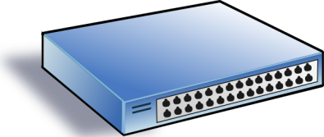
Impact of Mismatches
10MB
10MB
High
Low
20KB
Notes:
Before we come up with the solution, we should understand the impact of mismatches. I use a very simple example to show this [click]. In this network, there two types of flows: large flows with the size of 10MB and short flows with the size of 20KB. We have two priorities for multi-level feedback queue. So there is only one demotion threshold. [click]

Slide 34

Impact of Mismatches
When the threshold is perfect (20KB)
Notes:
If we want to achieve ideal completion time for short flows, the threshold should be 20KB. In such scenario, all the packets of short flows will be right finished in the high priority queue while almost all the packets of large flows are in the low priority queue. [click]

Slide 35
Impact of Mismatches
When the threshold is too small (10KB)
Increased latency for short flows
Notes:
However, when the threshold is too small, say 10KB, the last few packets of short flows will be prematurely put into the low priority queue. [click] These packets may experience very large queueing delay due to the impact of packets from large flows. [click]

Slide 36
Impact of Mismatches
When the threshold is too large (1MB)
Increased latency for short flows
Notes:
On the other hand, if we set a very large threshold, say 1MB, packets of large flows stay too long in the high priority queue, [click] This also greatly increases latency for short flows. Based on above observations, we find that, when mismatches happen, packets from short flows may coexist with packets from large flows in the same priority queue for long time and experience very large queueing delay. Note that the number of queues on switches is very limited, we cannot use more queues to further segregate these packets. A very intuitive solution is [click] using ECN to keep low buffer occupation, thus minimizing the impact of mismatches. [click]

Slide 37
Impact of Mismatches
When the threshold is too large (1MB)
Leverage ECN to keep low buffer occupation
Increased latency for short flows
Notes:
On the other hand, if we set a very large threshold, say 1MB, packets of large flows stay too long in the high priority queue, [click] This also greatly increases latency for short flows. Based on above observations, we find that, when mismatches happen, packets from short flows may coexist with packets from large flows in the same priority queue for long time and experience very large queueing delay. Note that the number of queues on switches is very limited, we cannot use more queues to further segregate these packets. A very intuitive solution is [click] using ECN to keep low buffer occupation, thus minimizing the impact of mismatches. [click]

Slide 38
Handle Mismatches
When the threshold is too small (10KB)
If we enable ECN
Notes:
When the threshold is too small, with ECN [click], the last few packets from short flows experience [click] much smaller latency in the low priority queue.

Slide 39
Handle Mismatches
When the threshold is too small (10KB)
ECN can keep low latency
Notes:
When the threshold is too small, with ECN [click], the last few packets from short flows experience [click] much smaller latency in the low priority queue.

Slide 40
Handle Mismatches
When the threshold is too large (1MB)
If we enable ECN
Notes:
When the threshold is too large, ECN[click][click] can also maintain low buffer occupation in the high priority queue. In summary, although the mismatches are unavoidable, but with ECN to keep low buffer occupation, we can greatly minimize the impact of mismatches.

Slide 41
Handle Mismatches
When the threshold is too large (1MB)
ECN can keep low latency
Notes:
When the threshold is too large, ECN[click][click] can also maintain low buffer occupation in the high priority queue. In summary, although the mismatches are unavoidable, but with ECN to keep low buffer occupation, we can greatly minimize the impact of mismatches.

Slide 42
PIAS in 1 Slide
PIAS packet tagging
Maintain flow states and mark packets with priority
PIAS switches
Enable strict priority queueing and ECN
PIAS rate control
Employ Data Center TCP to react to ECN
Notes:
Now, we summarize the design of PIAS in 1 slide. PIAS has 3 components. [click]. The first one is packet tagging module at end hosts. It tracks per-flow state and mark packets with priority. On switches [click], PIAS only enables strict priority queueing and ECN. Both of these two are basic functionalities of most commodity switches. To react to ECN, [click], PIAS leverage DCTCP as transport layer protocol. All of these three components are very easy to implement and configure in production data centers.

Slide 43

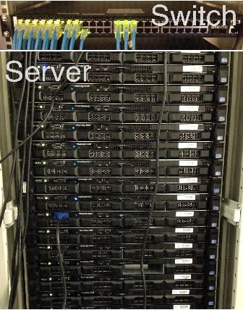
Testbed Experiments
PIAS prototype
http://sing.cse.ust.hk/projects/PIAS
Testbed Setup
A Gigabit Pronto-3295 switch
16 Dell servers
Benchmarks
Web search (DCTCP paper)
Data mining (VL2 paper)
Memcached
Notes:
Now, we come to the testbed experiments. We have already implemented a PIAS prototype. [click] It is open source. You c In our implementation, the packet tagging module works as a Linux kernel module, which can be installed and removed during the running time of the system. [click] We use 16 servers and 1 Gigabit switch for our evaluation. For the benchmarks [click], we use web search workload from DCTCP paper, data mining workload from VL2 paper as well as memcached application.

Slide 44
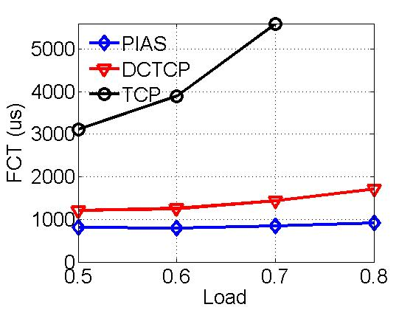
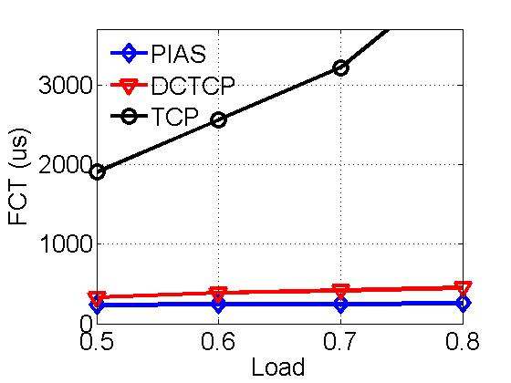
Small Flows (<100KB)
47%
45%
Web Search
Data Mining
Compared to DCTCP, PIAS reduces average FCT of small flows by up to 47% and 45%
Notes:
These two figures show the average completion times of small flows. Note that we don’t compare PIAS with other information-aware schemes because they can not be implemented in our testbed. Compared to DCTCP, PIAS reduces average FCT of small flows by up to [click] 47% in web search workload and [click] 45% in data mining workload. [click]. Even though DCTCP try to reduce buffer occupation to achieve low latency, it still needs moderate buffer occupation to fully utilize link capacity. But with PIAS, we can provide much fewer or even zero queueing delay for packets of short flows because they are finished in higher priority queues.

Slide 45
NS2 Simulation Setup
Topology
144-host leaf-spine fabric with 10G/40G links
Workloads
Web search (DCTCP paper)
Data mining (VL2 paper)
Schemes
Information-agnostic: PIAS, DCTCP and L2DCT
Information-aware: pFabric
Notes:
We also conduct extensive NS2 simulation in large-scale 10G/40G data centers. The set up of our simulation is very similar to pFabric paper. We compare PIAS to two information-agnostic schemes: DCTCP and L2DCT and 1 information-agnostic scheme: pFabric.

Slide 46
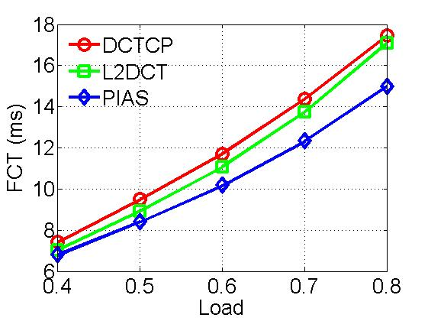
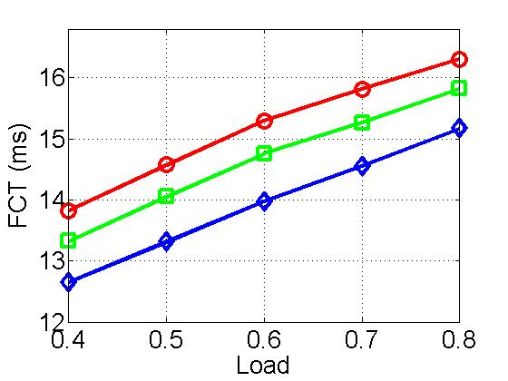
Overall Performance
Web Search
Data Mining
PIAS has an obvious advantage over DCTCP and L2DCT in both workloads.
Notes:
Now, let’s see the overall average flow completion times. We find that PIAS outperforms DCTCP and L2DCT. [click]. DCTCP is a fair sharing scheme. On the base of DCTCP, L2DCT adds the bytes sent information to ECN window adjustment function. But it is still host-based reactive rate control. Compare to them, PIAS enforces multi-level feedback queue scheduling by levering priority queues on switches. It’s more efficient.

Slide 47
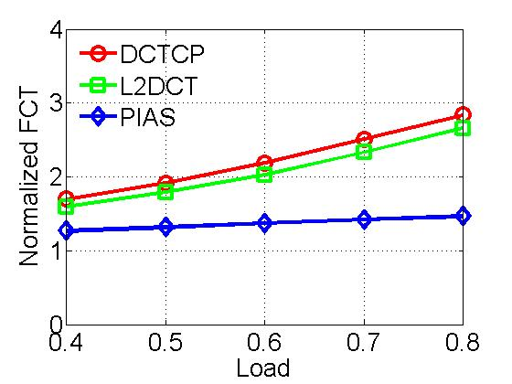
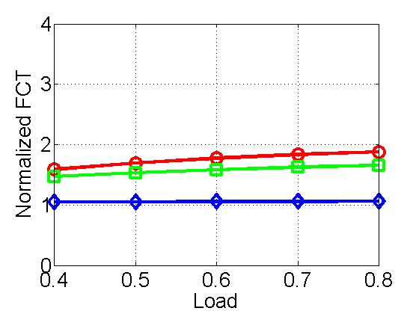
Small Flows (<100KB)
Web Search
Data Mining
40% - 50% improvement
Simulations confirm testbed experiment results
Notes:
The figure shows the completion times of small flows. We find that, compared to DCTCP and L2DCT,[click] PIAS can achieve 40%-50% lower FCT. [click] So this confirms our testbed experiment results.

Slide 48
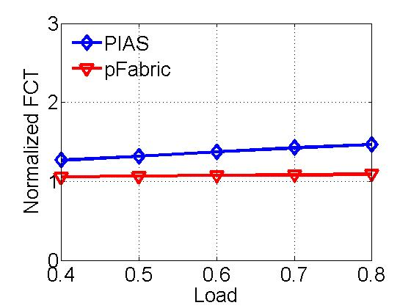
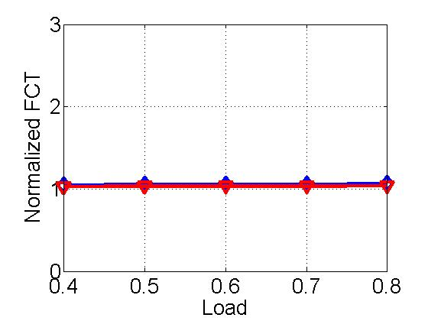
Comparison with pFabric
Web Search
Data Mining
PIAS only has 4.9% performance gap to pFabric for small flows in data mining workload
Notes:
We also compare PIAS against pFabric. Note that pFabric is a information-aware clean-slate design. It assumes prior knowledge of flow size information and introduces changes to switch hardware. For PIAS, we don’t make such assumptions and just use commodity switches. Compared to pFabric, PIAS achieves comparable performance in small flows, especially in data mining workload. [click] The performance gap here here is only 4.9%.

Slide 49
Conclusion
PIAS: practical and effective
Not assume flow information from applications
Enforce Multi-Level Feedback Queue scheduling
Use commodity switches & legacy network stacks
Information-agnostic
FCT minimization
Readily deployable
Notes:
Finally, we conclude our work. We think that PIAS is a practical and effective solution for data centers. First of all, it is information-agnostic without assuming that flow size information available from applications. Secondly, PIAS performs multi-level feedback queue to emulate shortest job fist, thus achieving FCT minimization. Thirdly, PIAS is readily deployable in commodity data centers. It just uses basic functionalities from commodity switches and is compatible with legacy network stacks.

Slide 50
Thanks!

Slide 51
Starvation
Measurement
5000 flows, 5.7 million MTU-sized packets
200 timeouts, 31 two consecutive timeouts
Solutions
Per-port ECN pushes back high priority flows when many low priority flow get starved
Treating a long-term starved flow as a new flow

Slide 52
Persistent Connections
Solution: periodically reset flow states based on more behaviors of traffic
When a flow idles for some time, we reset the bytes sent of this flow to 0.
Define a flow as packets demarcated by incoming packets with payload within a single connection

