Slide 1
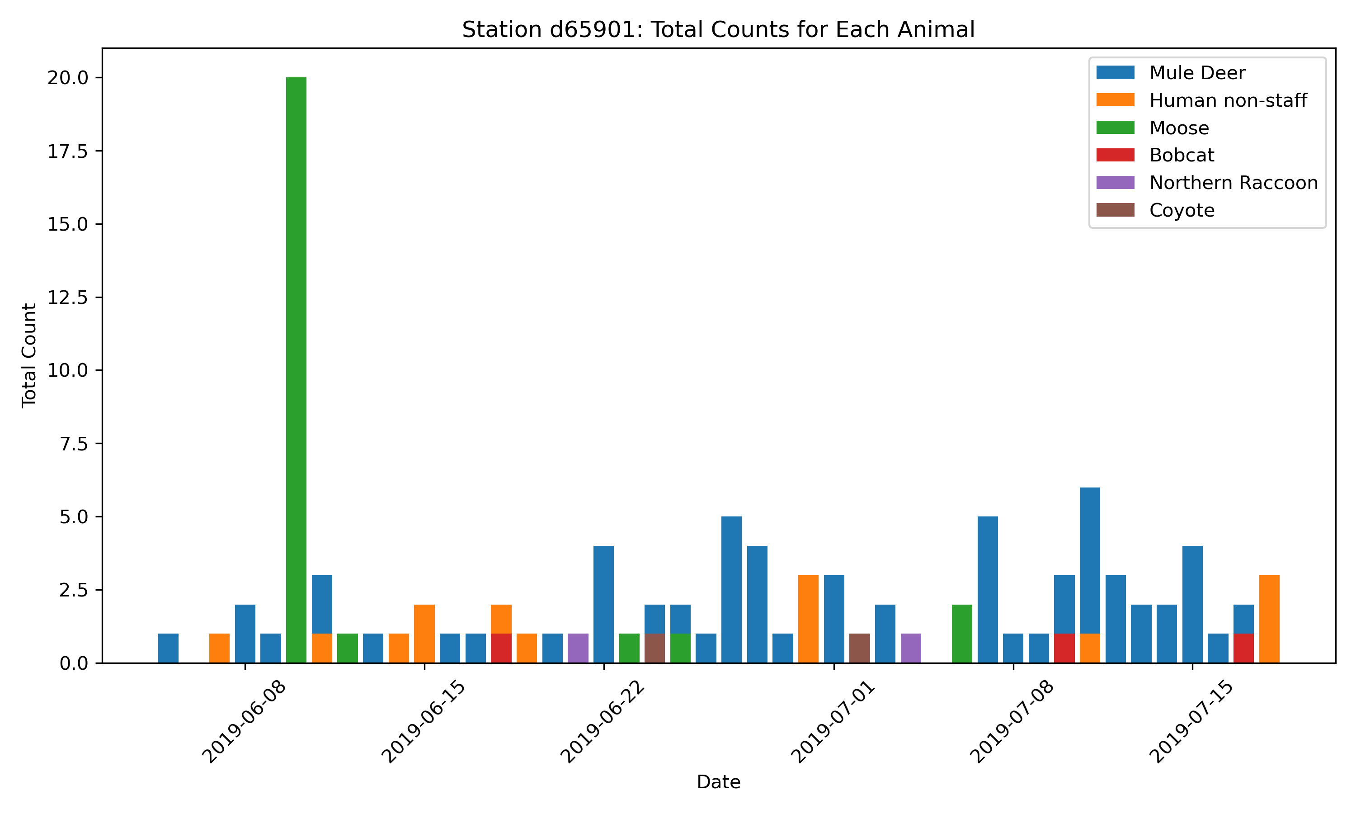
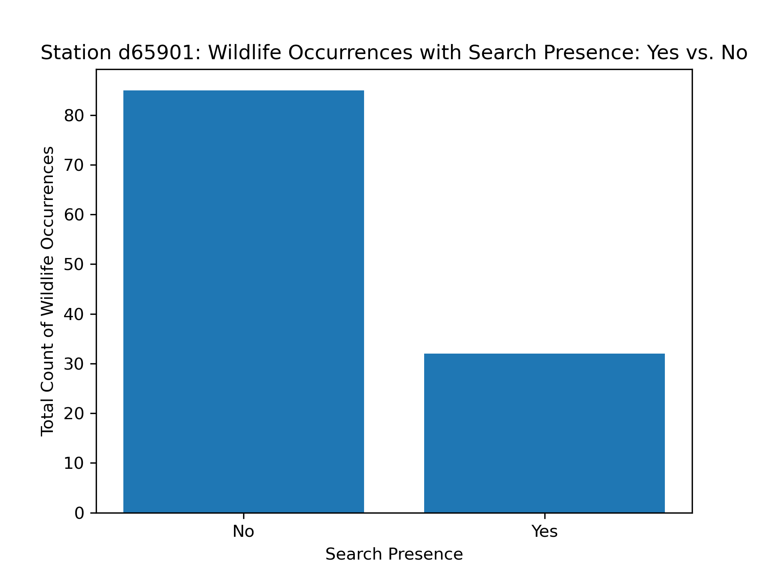
#Station d65901:P-Value: 0.5638934783239979, Null Hypothestis is there are fewer sightings of wildlife when humans are present.
#As p-Value is greater than 0.05 then the data failed to reject the Null Hypothesis
#p-value is large, it suggests that there is no significant difference, and we fail to reject the null hypothesis.
A 2 sample t-test was performed. Here is the P value result:
Station d65901:P-Value: 0.5638934783239979,
Null Hypothesis: there are fewer sightings of wildlife when humans are present.
As p-Value is greater than 0.05 then the data failed to reject the Null Hypothesis

Slide 2
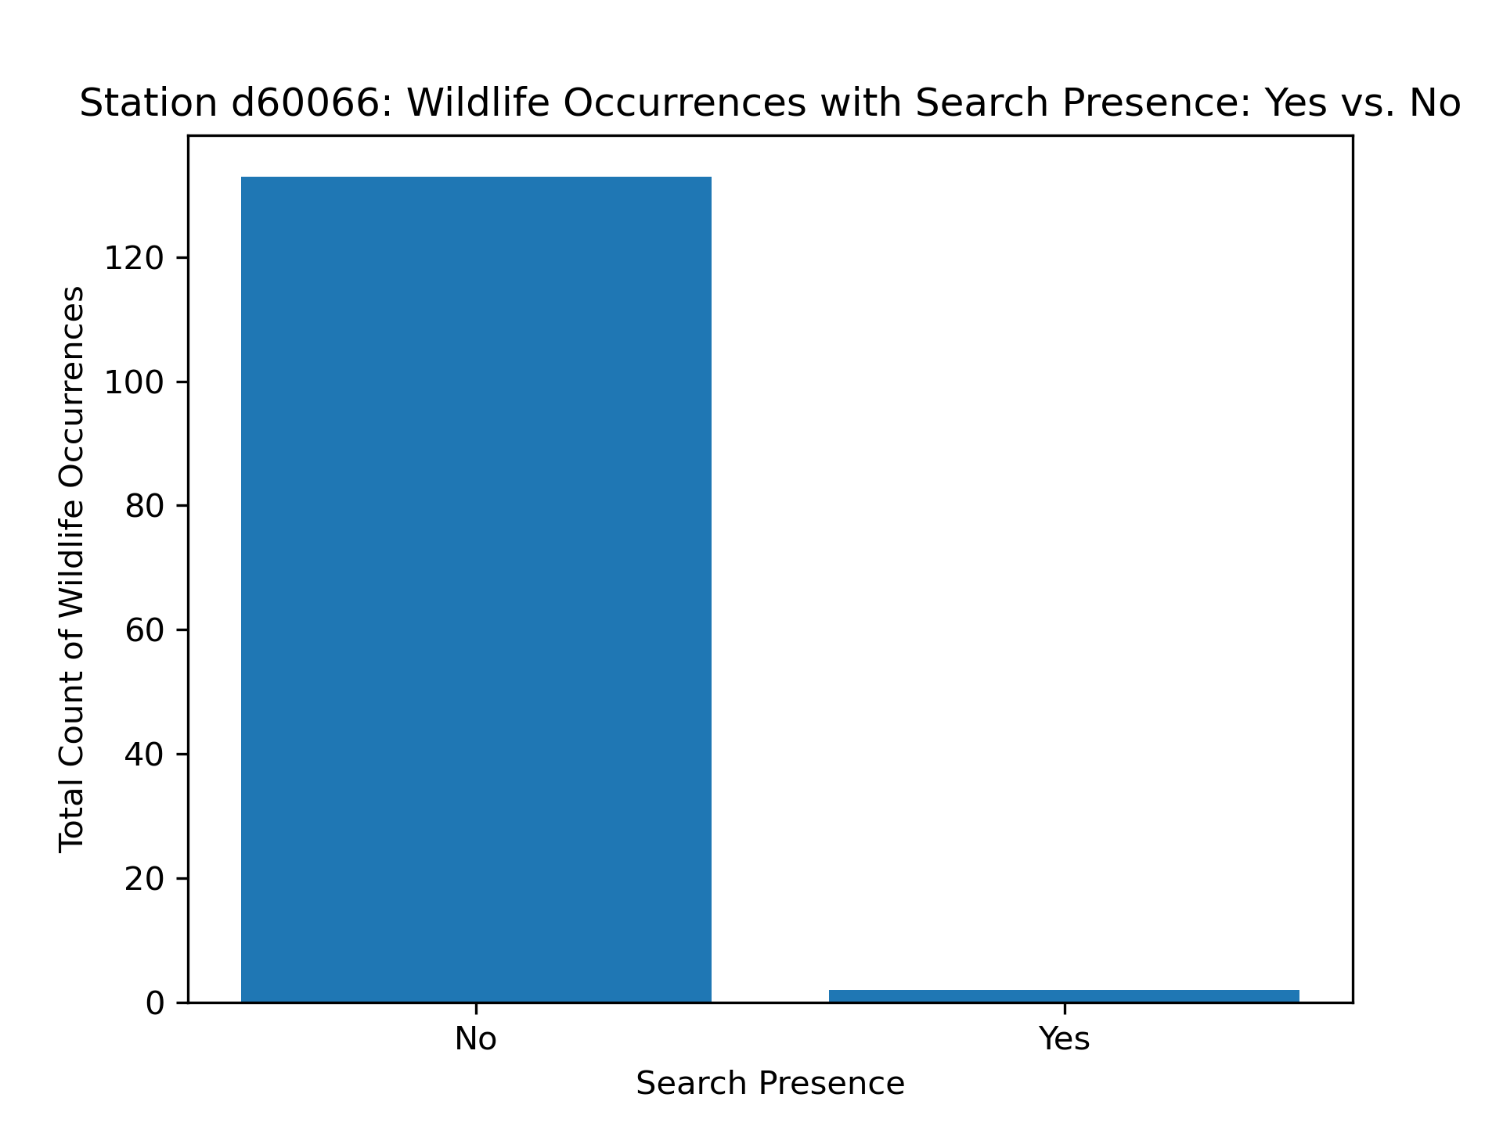
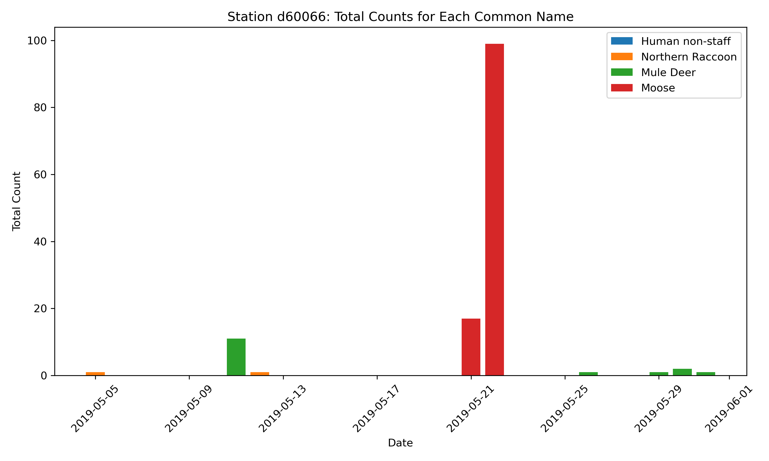
#Station d60066: P-Value: 0.5495702808838419
#Null Hypothesis: there are fewer sightings of wildlife when humans are present.
#As p-Value is greater than 0.05 then the data failed to reject the Null Hypothesis

Slide 3
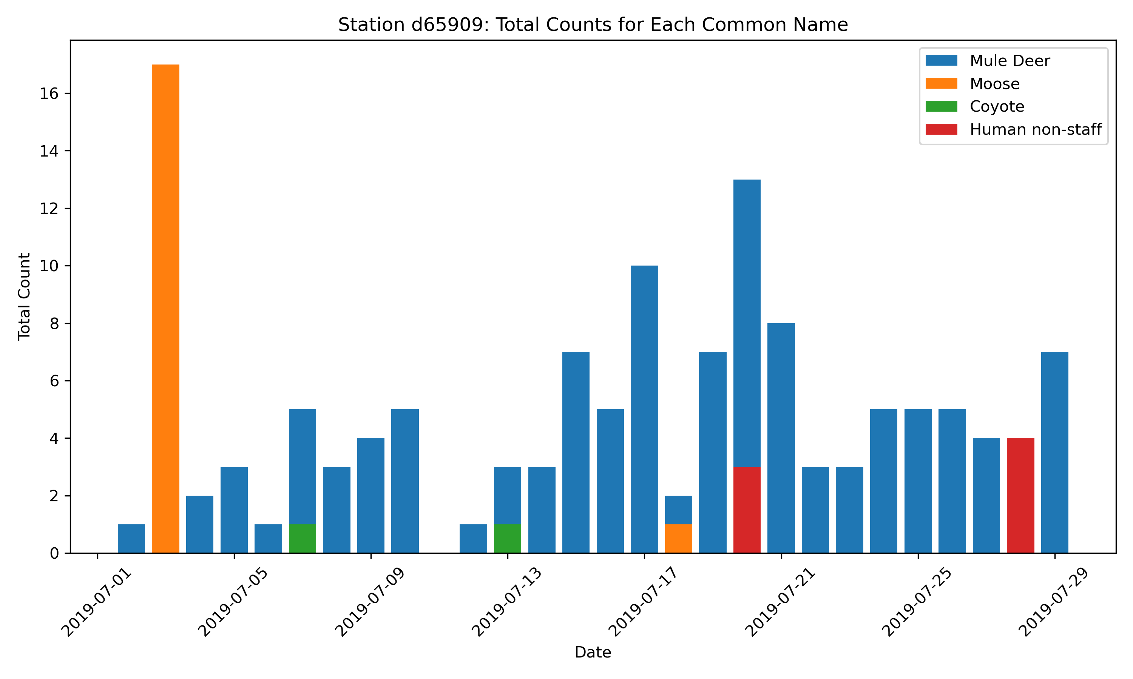
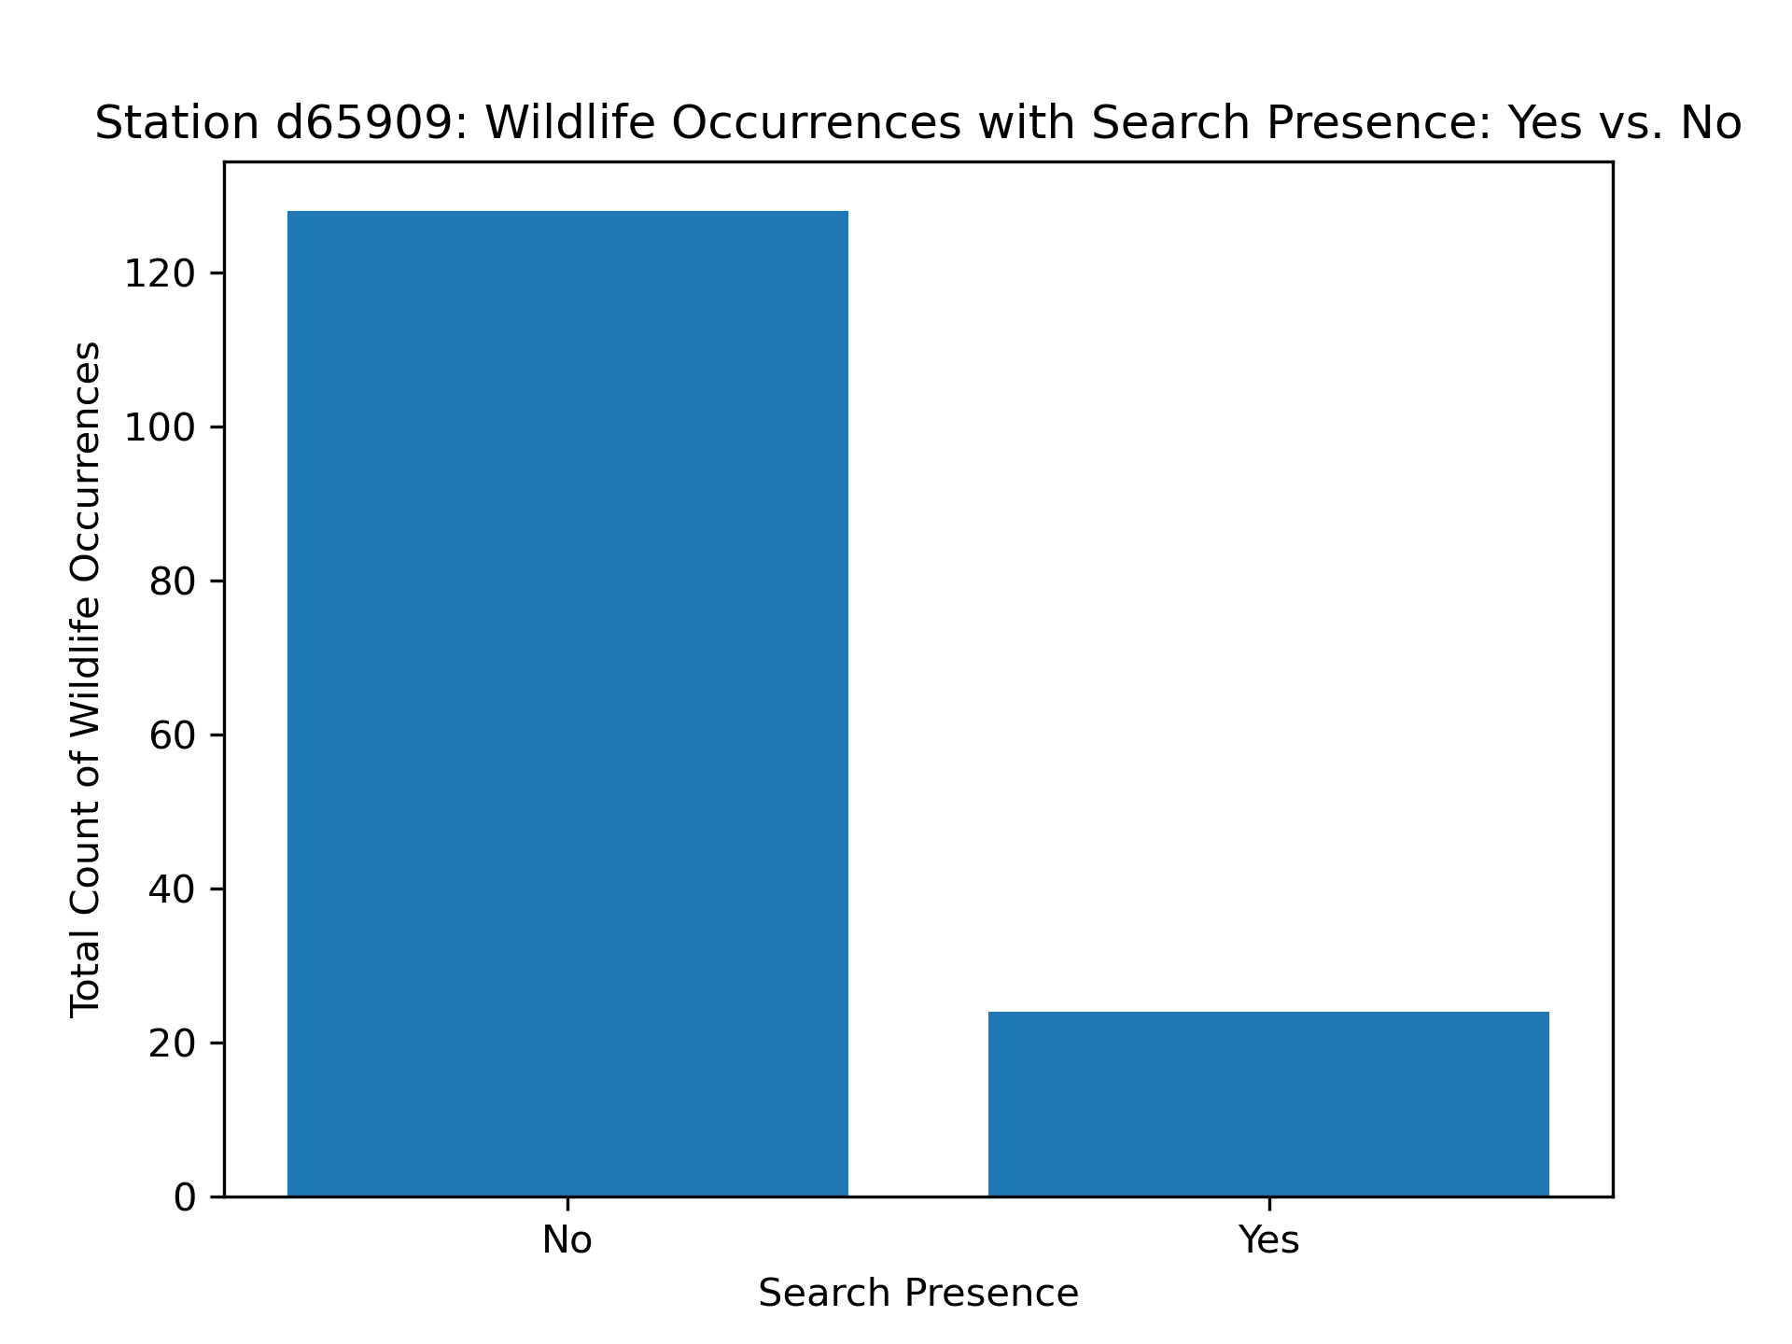
#Station d65909: P-Value: 0.8250596632724687
#Null Hypothestis is there are fewer sightings of wildlife when humans are present.
#As p-Value is greater than 0.05 then the data failed to reject the Null Hypothesis

Slide 4
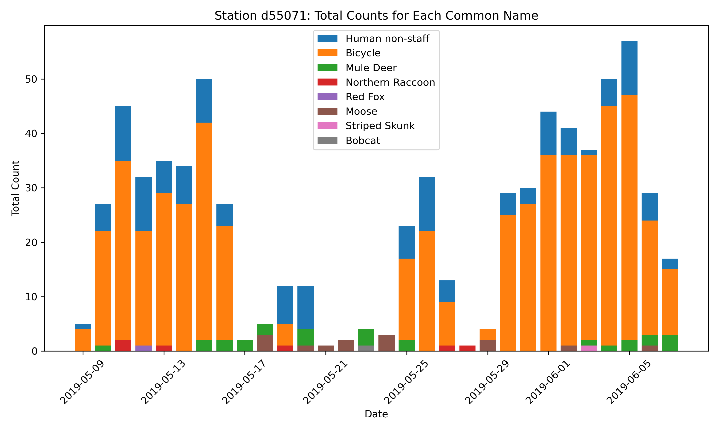
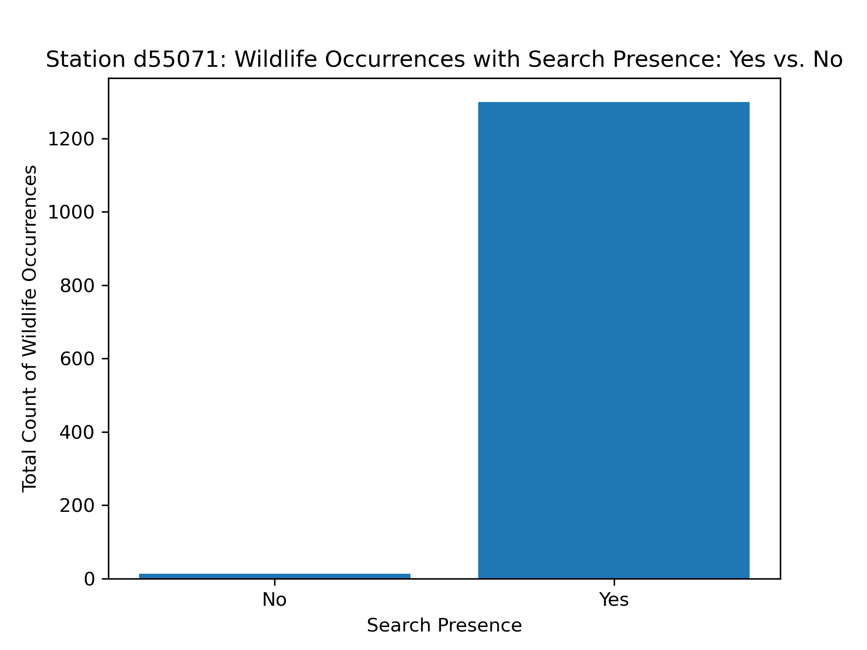
#Station d55071: P-Value: 0.016746640302199956
#Null Hypothestis is there are fewer sightings of wildlife when humans are present.
#As p-Value is less than 0.05 then this rejected the Null Hypothesis

