Slide 1


Segmentation and recognition of symbols for printed and handwritten music scores
Colloque de Master Recherche Informatique
Author
Kwon-Young Choi
Supervisors
Bertrand Coüasnon
Yann Ricquebourg
Notes:
Bonjour à tous,
Je m’appelle Kwon-Young Choi et je vais vous présenter mon travail bibliographique que j’ai réalisé pour mon stage.

Slide 2
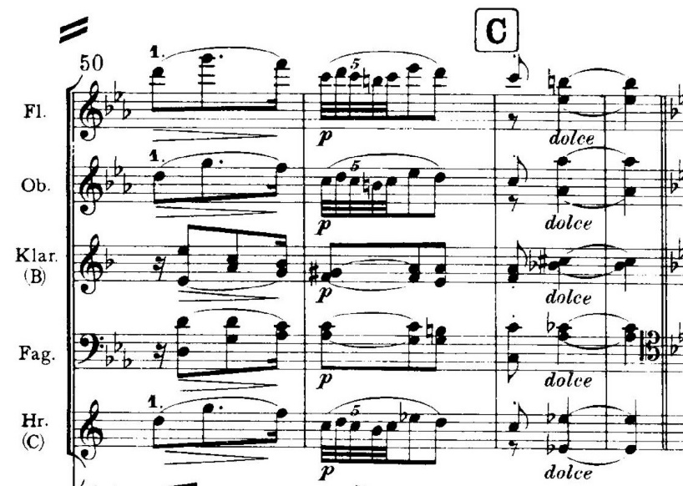
Music score definition
Written form of a music composition
Used to save and share music
Characteristics
Complex bidimensional organization
High density of symbols
High connectivity of symbols
Notes:
Musique est éphémère.
Complex bidimensional grammar:
- time flow in horizontal axis
- time synchronization in vertical axis
High density of symbols
- orchestral score
High connectivity of symbols
- staves lines

Slide 3
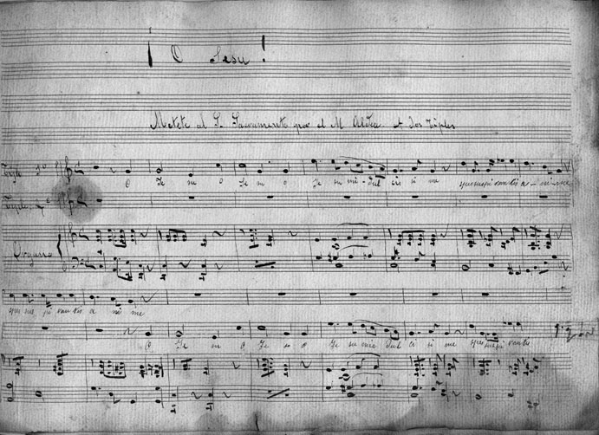
Music score definition
Written form of a music composition
Used to save and share music
Characteristics
Complex bidimensional organization
High density of symbols
High connectivity of symbols
Notes:
Complex bidimensional grammar:
- time flow in horizontal axis
- time synchronization in vertical axis
High density of symbols
- orchestral score
High connectivity of symbols
- staves lines

Slide 4
Optical Music Recognition
Use to transform an image of a score into a machine readable format
Steps of a classic ascending OMR system [Rebelo 2012] [Fornes 2014]
Pre-processing
Staves recognition and removal
Music symbols segmentation and recognition
Music notation reconstruction
Notes:
Pre-processing
- binarization
- skew correction
- noise removal
Staves recognition and removal
- recognition to determine the pitch of a note
- removal to ease the segmentation and recognition

Slide 5
Optical Music Recognition systems
Problem of bottom-up system like presented in [Rebelo 2009]
Context information is not used during segmentation and recognition
DMOS: « Description and MOdification of Segmentation » [Coüasnon 2001]
Use a grammar to describe the document organization
Grammar guide segmentation and recognition
Use the context during segmentation and recognition phase

Slide 6
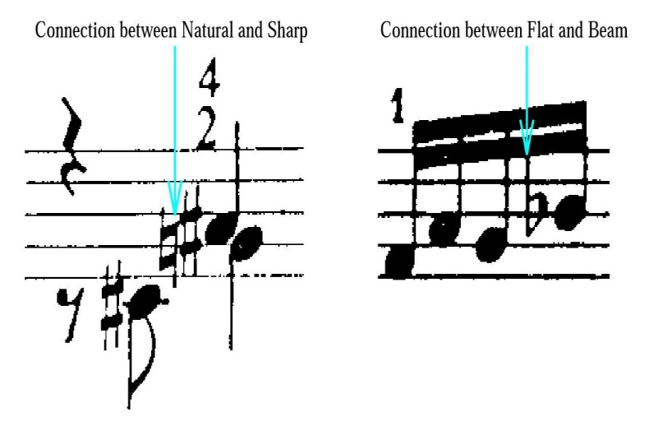
Segmentation and recognition of music symbols
Main problematics
Connected and overlapping symbols
Broken symbols because of the staff removal
Internship hypothesis
Merging segmentation and recognition will improve the recognition rate

Slide 7
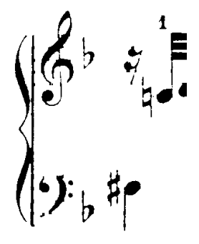
Segmentation and recognition of music symbols
Main problematics
Connected and overlapping symbols
Broken symbols because of the staff removal
Internship hypothesis
Merging segmentation and recognition will improve the recognition rate

Slide 8
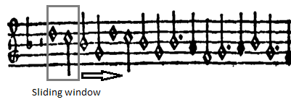
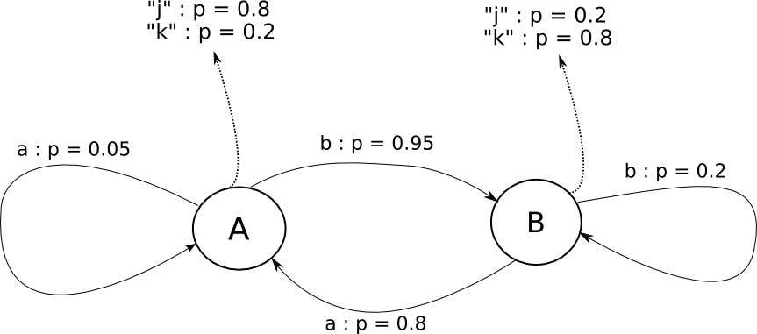
Merging segmentation and recognition in OMR
Hidden Markov Model (HMM) on old and very simple scores [Pugin 2006]
Features on a sliding window
HMM: discrete stochastic modelling:
Markov property
Problems
Simple and old score
Difficult to scale up
Limited use of context (HMM property)

Slide 9
Merging segmentation and recognition in text recognition
By using Recurrent Neural Network (RNN) [Graves 2009]
Long Short-Term Memory LSTM
Use of context with Multi-Dimensional RNN
Connectionist Temporal Classification layer
Training and evaluating the network with no explicite segmentation
State-of-the-art results
Problem: used only on classifying one dimensional sequence
Notes:
Text recognition:
- handwritten and printed

Slide 10
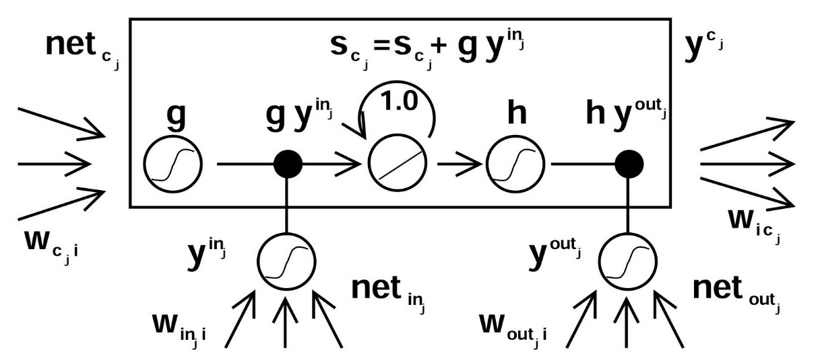
Merging segmentation and recognition in text recognition
Notes:
Text recognition:
- handwritten and printed

Slide 11
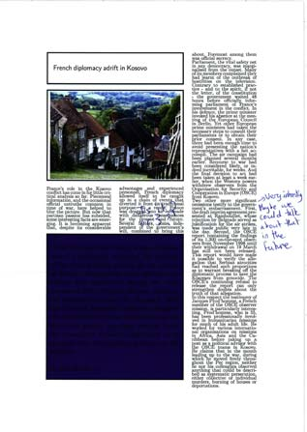
Resolving bidimensionality
Maurdor international contest: complex document recognition
Segmentation/recognition using previous RNN [Moysset 2014]
Input: block of text (bidimension)
Prior explicit segmentation of text lines
Similarly, use of DMOS to roughly segment the score
Contextual selection of the symbol recognizer input

Slide 12
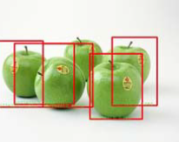
Object localization and identification
Another way to resolve bidimensionality:
Deep Convolutional Neural Network [Erhan 2014]
Supervised training: learn features
DNN generate bounding box with confidence score
Interests
multiple objects localization
With bounding boxes
However
Need annotated data for training
None available dataset with groundtruth on music scores
Notes:
Features = caractéristiques

Slide 13
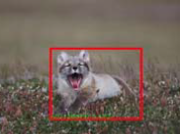
Object localization and identification
Another way to resolve bidimensionality:
Deep Convolutional Neural Network [Erhan 2014]
Supervised training: learn features
DNN generate bounding box with confidence score
Interests
multiple objects localization
With bounding boxes
However
Need annotated data for training
None available dataset with groundtruth on music scores

Slide 14
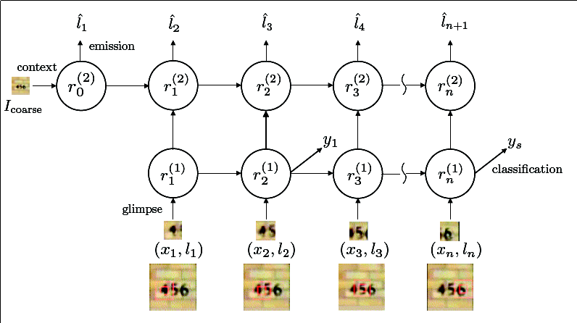
Visual attention model
Use multiple recurrent neural networks layers to localize an object in an image (Mnih 2014)
Use of glimpses to explore an image
RNN used to predict next glimpse location, to recognize digit
Pros : can localize an object in a two-dimensional space
Not tested on complicated data
Notes:
[Ba 2014] This training procedure can be used to train the model to both localize and recognize multiple objects purely from label sequences.

Slide 15
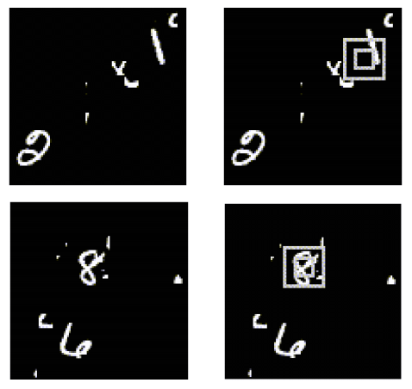
Visual attention model
Use multiple recurrent neural networks layers to localize an object in an image (Mnih 2014)
Use of glimpses to explore an image
RNN used to predict next glimpse location, to recognize digit
Pros : can localize an object in a two-dimensional space
Not tested on complicated data
Notes:
[Ba 2014] This training procedure can be used to train the model to both localize and recognize multiple objects purely from label sequences.

Slide 16
Conclusion
Problematic: joint segmentation and recognition of music symbol
MD LSTM RNN
use of context
only handle one-dimensional sequence
DCNN
multiple object recognition, produce bounding boxes
need annotated data for training
Visual attention model
can localize a symbol in an image, robust to noise
only tested on simple recognition tasks
Internship: study collaboration Neural Network/DMOS musical grammar
Rough segmentation with DMOS grammar
Fine segmentation and recognition with Neural Network

